Slide 1
EMPLOYEE SALARY PREDICTION USING MACHINE LEARNING and DEEP LEARNING ALGORITHMS
CAPSTONE PROJECT
Presented By:
Name:- Sai Geetanjali Tammina
College:- Lakireddy Balireddy College of Engineering
AICTE ID:-STU6797b40e02a051737995278
Department:- Information Technology

Slide 2
OUTLINE
Problem Statement
System Development Approach
Algorithm & Deployment
Result
Conclusion
Future Scope
References

Slide 3
Problem Statement
This project aims to predict whether an employee earns more than 50K per year based on personal and work-related details.It uses features like age, education, occupation, and working hours to train a classification model.The model is trained on the UCI Adult Income dataset using machine learning & deep learning algorithms.The goal is to assist organizations in making informed salary-related decisions.
An interactive web app is built using Streamlit for both single and bulk predictions.

Slide 4
System development Approach
1. System Requirements:-
Device Used: ASUS TUF Gaming F15 (Latest Gen)
Processor: Intel Core i5— suitable for ML model training and real-time prediction
RAM: 16GB DDR4 – ensures smooth multitasking, model training, and app execution
Storage: 512GB SSD – fast read/write for handling datasets and model files
GPU (Optional): NVIDIA GeForce GTX/RTX – helpful for large-scale ML or deep learning (not required here)
Operating System: Windows 11 (64-bit)
Python Version:3.12.9
Internet Browser: Google Chrome or MS Edge (to run and test Streamlit web app)
Library required to build the model:-
pandas – for data manipulation and analysis
numpy – for numerical operations
scikit-learn – for machine learning model building and evaluation
joblib – to save and load the trained model
streamlit – to build the interactive web application
matplotlib / seaborn – (optional) for data visualization during EDA

Slide 5
Algorithm & Deployment
1.Data Collection:-
Collected the Adult Income Dataset from the UCI Machine Learning Repository.
2.Data Preprocessing :-
Cleaned the data by handling missing values (e.g., replacing '?').
Converted categorical features to numeric using Label Encoding.
Selected relevant features for prediction.
Split data into training and testing sets.
3. Model Selection & Training:-
Chose the Random Forest Classifier for classification.
Trained the model on the preprocessed data.
Evaluated model accuracy using metrics like accuracy score and confusion matrix.
4. Model SavingSaved the trained model using joblib as best_model.pkl.
5. Web App Development:-
Built an interactive UI using Streamlit.
Added input forms for both single predictions and batch predictions (CSV upload).
Loaded the saved model and performed real-time predictions.
6. Deployment:-
The project is ready for deployment on platforms like:-
Streamlit Cloud (easy hosting)

Slide 6
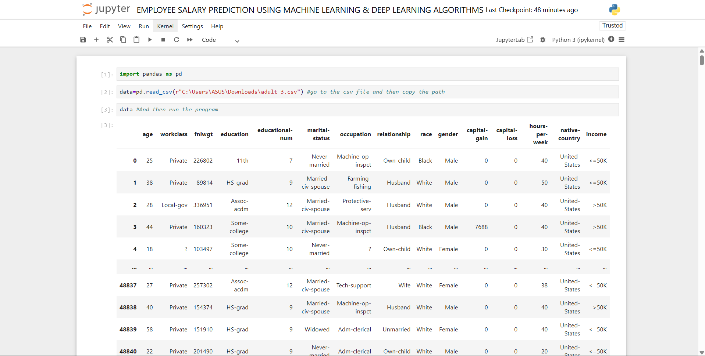
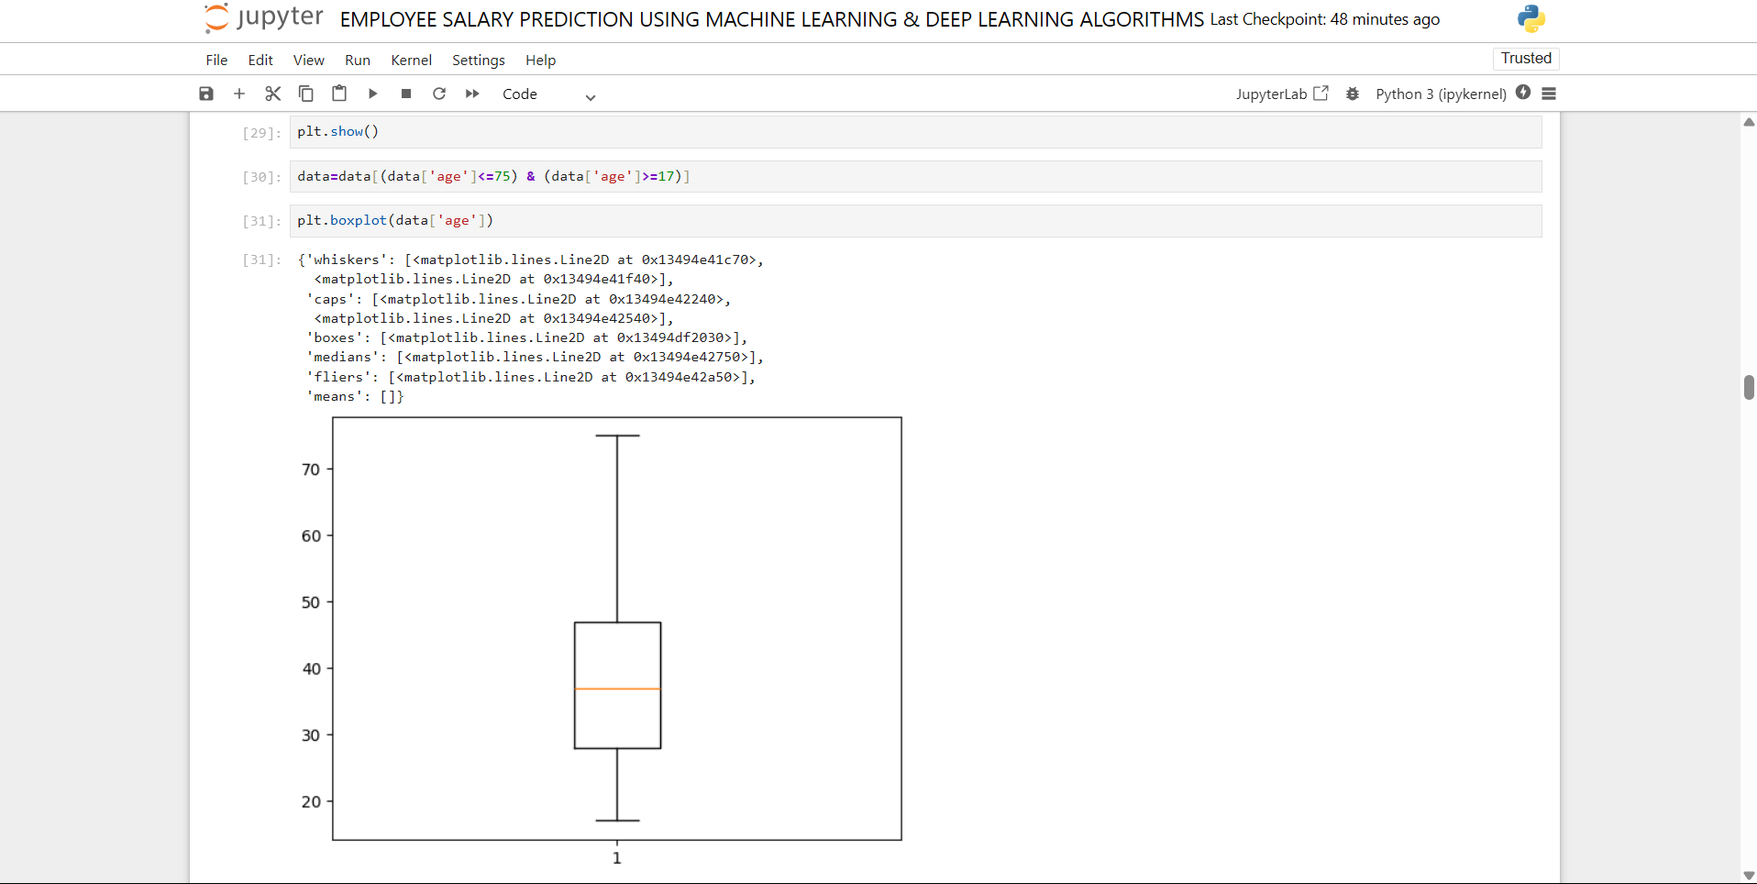
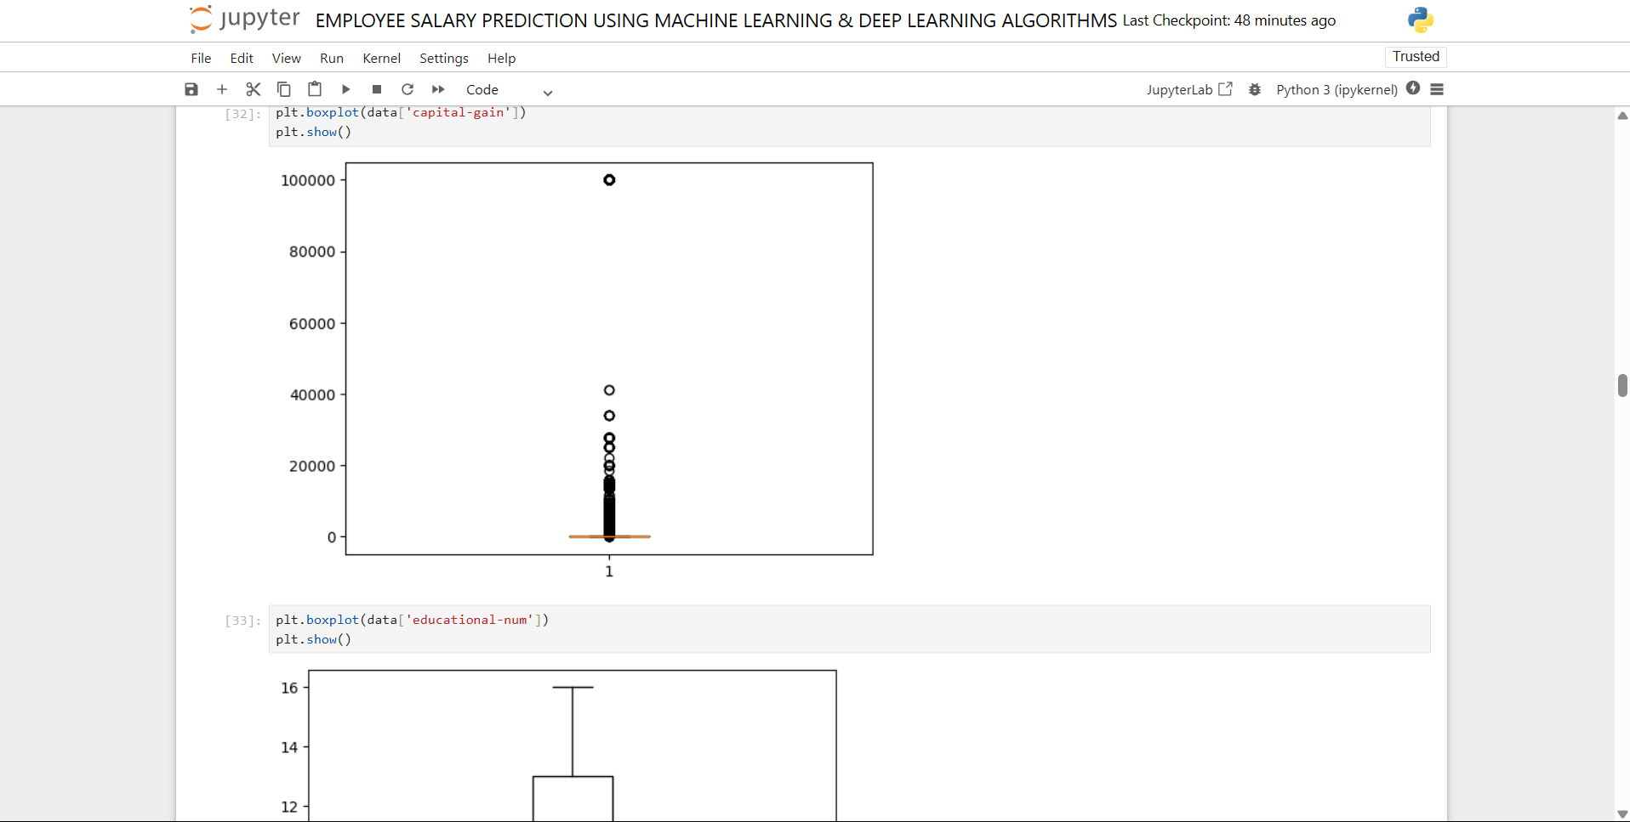
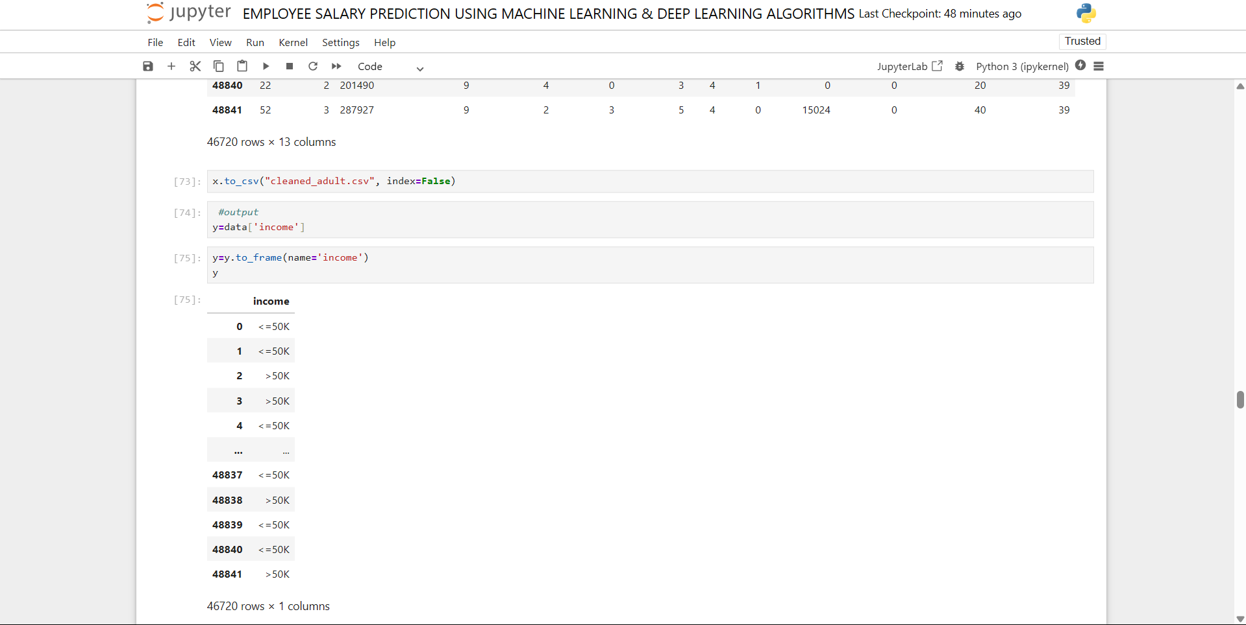
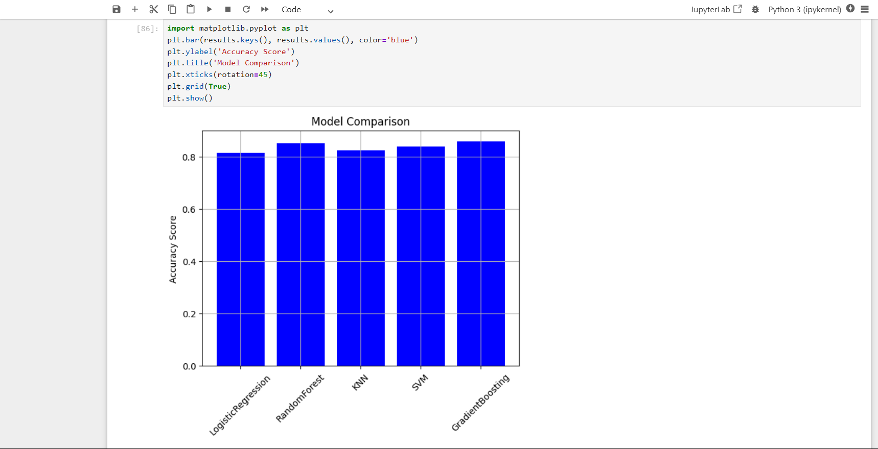
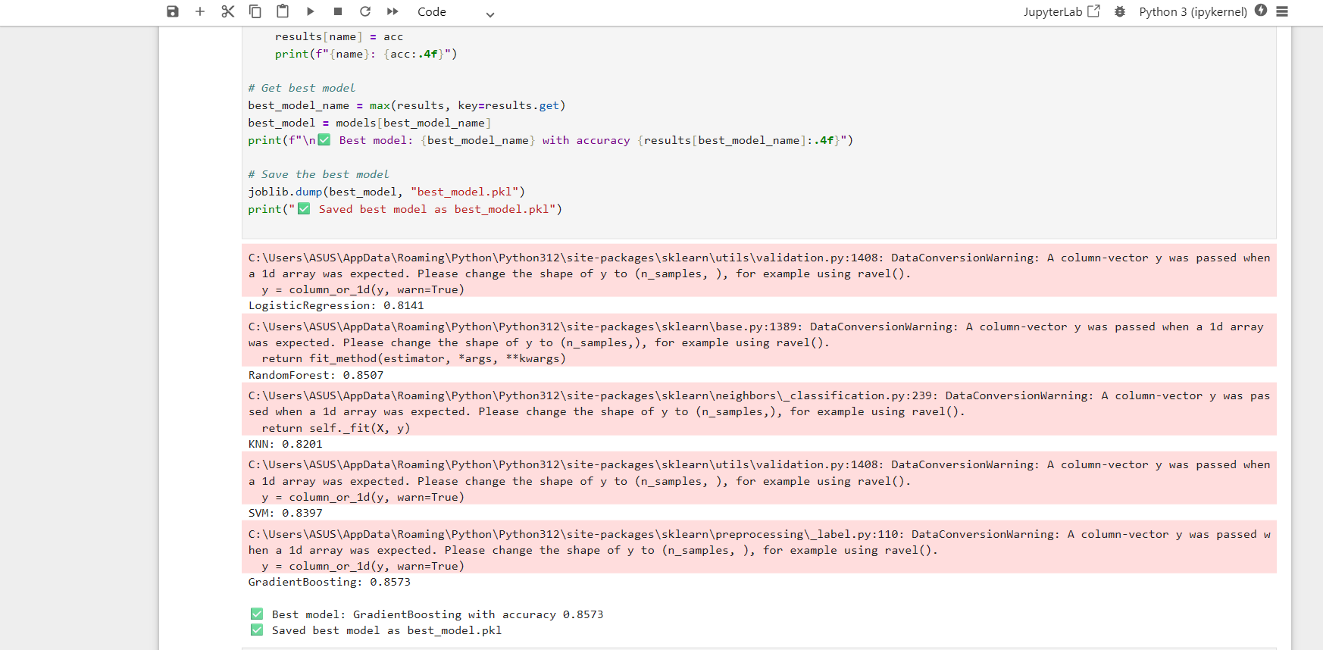
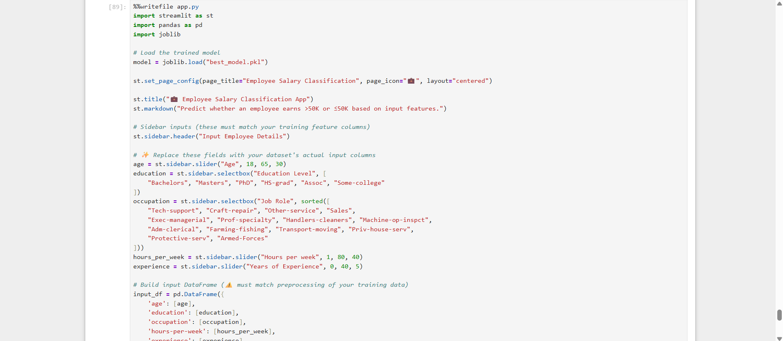
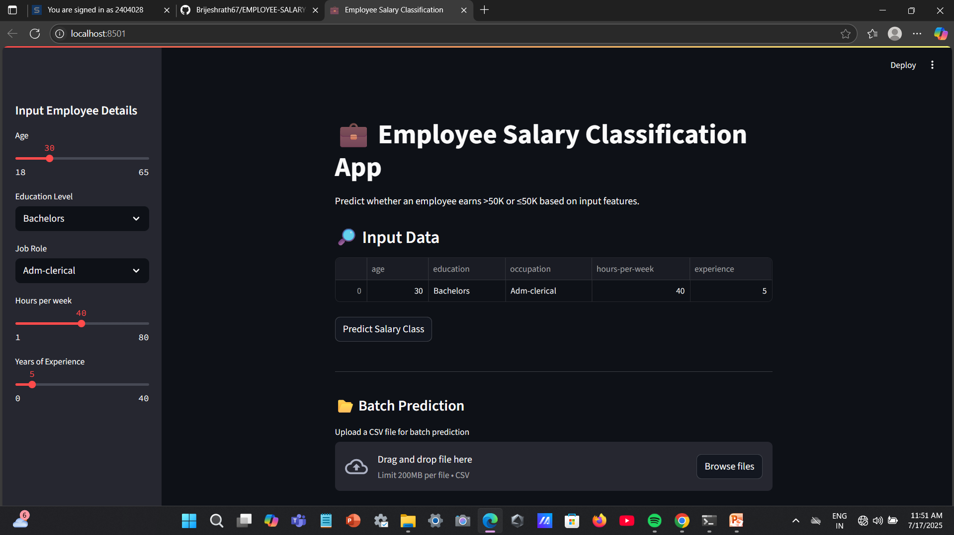
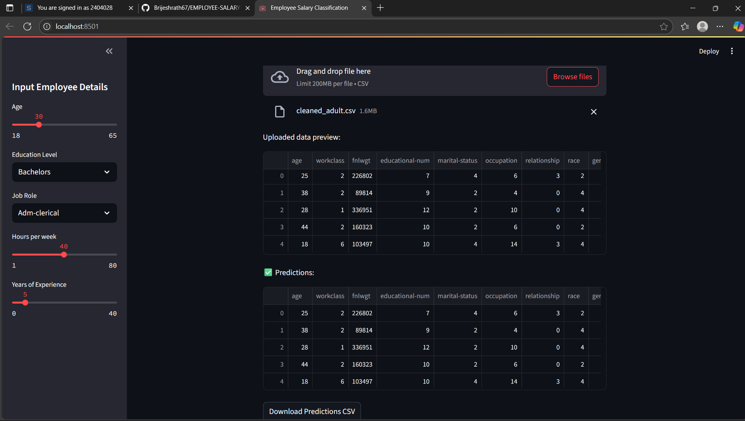
Result

Slide 7
Result
Attach your Github Link:-
https://github.com/Brijeshrath67/EMPLOYEE-SALARY-PREDICTION-USING-MACHINE-LEARNING-DEEP-LEARNING-ALGORITHMS.git
Also here is the clickable box where you redirected to my Github repo. 👇

Slide 8
Conclusion
The project effectively predicts whether an employee earns above or below 50K using a classification model trained on demographic and job-related features.
The model achieved satisfactory accuracy, demonstrating its capability in real-world salary prediction tasks.
During implementation, challenges included:-
-Handling missing data and categorical variables
-Ensuring dataset cleanliness and balancing
-Despite these, the system performed reliably after proper preprocessing and model tuning.
Future improvements may include:-
-Using ensemble models for better accuracy
-Expanding the dataset with more recent and diverse records
-Deploying a more interactive UI for end users

Slide 9
Future scope(Optional)
Model Enhancement:-
Integrate advanced machine learning models like Random Forest, XGBoost, or Neural Networks for higher prediction accuracy.
Live Data Integration: -
Include real-time job market data from APIs or live sources for dynamic and updated predictions.
Mobile-Friendly Interface:-
Extend the web app to mobile platforms for easier user access.
Explainable AI: -
Implement tools like SHAP or LIME to make the model’s decisions more transparent to users.
Salary Range Prediction:-
Expand the model to predict exact salary ranges instead of binary classification.

Slide 10
References
1. UCI Machine Learning Repository – Adult Income Dataset
https://archive.ics.uci.edu/ml/datasets/adult
2. Scikit-learn Documentation – Classification Algorithms
https://scikit-learn.org/stable/user_guide.html
3. Streamlit Official Documentation – Web App Development
(https://docs.streamlit.io/)
4. Kaggle Community – Discussions & Notebooks on Salary Prediction
(https://www.kaggle.com/)
5. Python Libraries:
-Pandas for data preprocessing
-Seaborn & Matplotlib for visualization
-Joblib for model saving and loading
👉The following resources were instrumental in the development of this project.
👉They provided the dataset, tools, and conceptual guidance necessary to build and deploy the salary prediction model effectively.

Slide 11
THANK YOU

