Slide 1

PO Insights
Purchase Order Intelligence
for Invoice Processing
Automating extraction, interpretation & validation of contractual terms
from SAP purchase orders using Gen AI + Human Validation

Slide 2
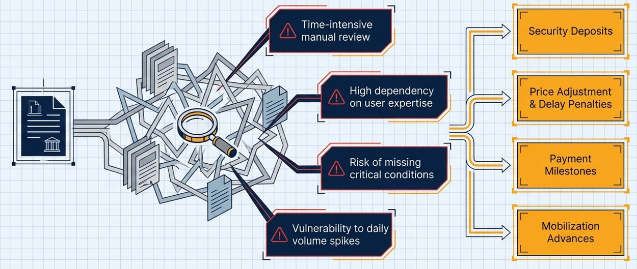
THE CHALLENGE
3,000–5,000 POs / Day (Gross)
Repeated review of same PO by different teams

Slide 3




SOLUTION OVERVIEW
PO Insights automates the entire lifecycle — from SAP data extraction to validated insights delivered to bill processors every morning.
Succes Metric: Reduce the turn around time (TAT) of bill processing cycle at VIM
01
SAP Data Extraction
02
OCR & Text Processing
Automated extraction of PO attachments, header texts & supporting metadata from SAP
Scanned PDFs and image-based documents are converted to searchable text via OCR pipeline
03
GenAI Based Interpretation
04
Human Validation Workflow
GenAI identifies and summarises contractual clauses: security deposits, penalties, advances, payment terms
Dual-level reviewer workflow (Initial → Final Validator) ensures governance before insights reach processors

Slide 4
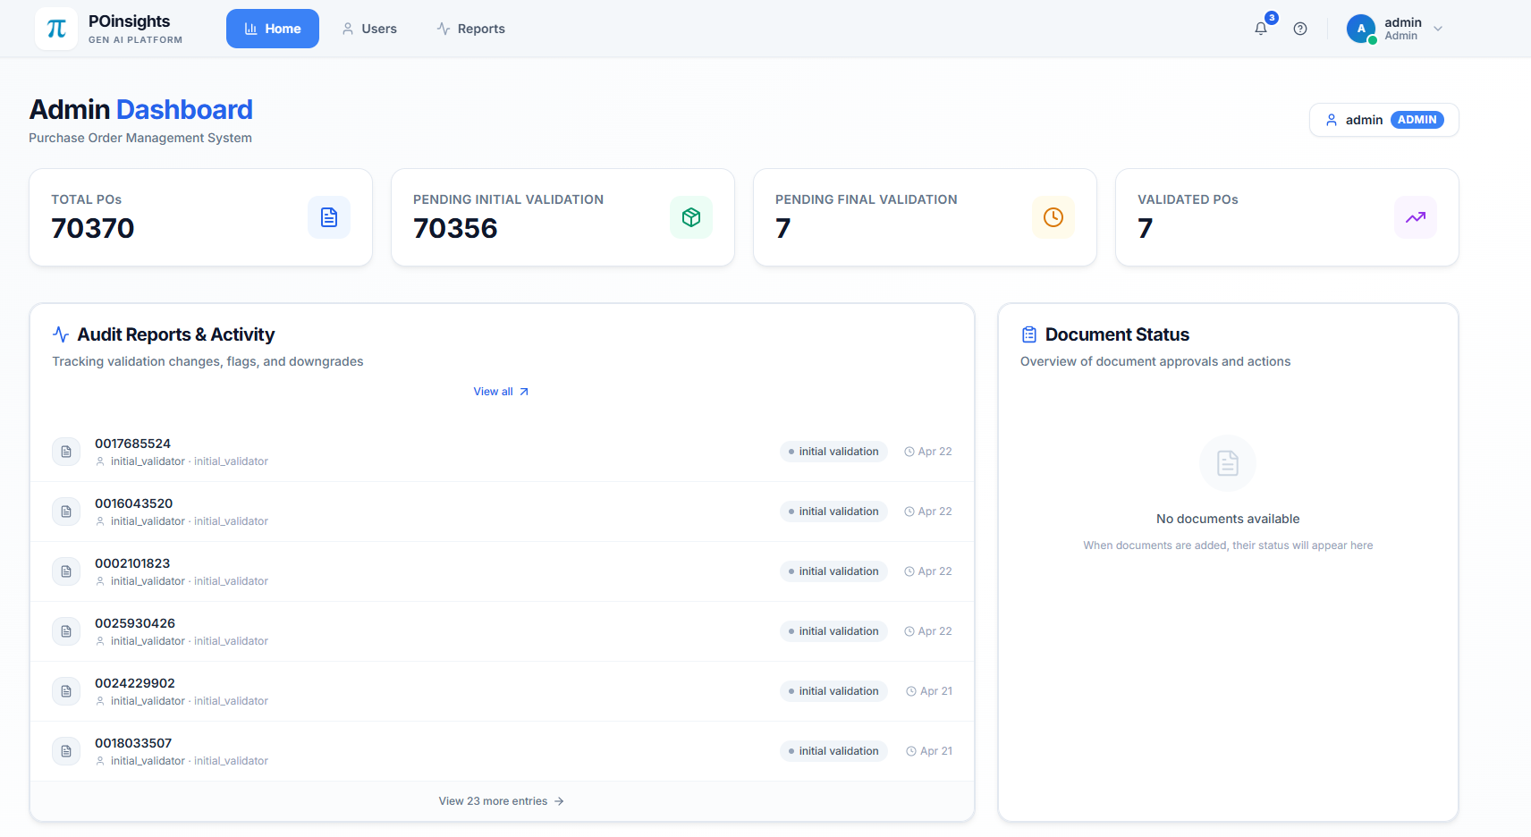
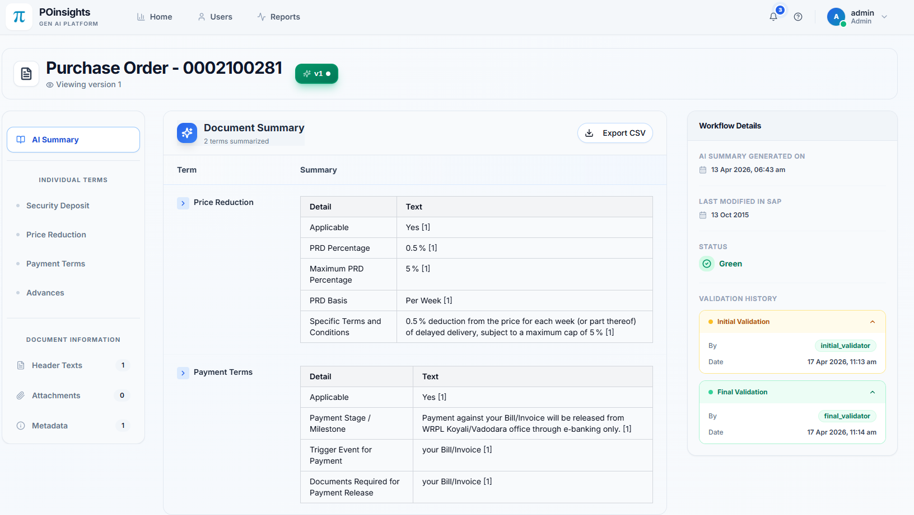
CURRENT STATUS
Currently 70,000+ POs summary available in the portal.
Seamless login with ESS credentials, roles will be attached by admin user.
Basic citation referring relevant document
Additional metadata of purchase order (PO type, Material, Company Code, last updated etc.)

Slide 5
HOW IT WORKS
End-to-end automated pipeline — running nightly, insights ready by 8:00 AM
12:10 AM
Job Scheduled
SAP
Extraction
OCR
Pipeline
Gen AI
Analysis
Database
Storage
8:00 AM
Portal Ready
▶
▶
▶
▶
▶
Scheduled trigger
PO texts & attachments
Scanned → Searchable
Clause identification
Results persisted
Insights published
Intelligent Incremental Processing
✔ Selection of DPs having role AP processor ✔ Skips already-processed, unchanged POs ✔ Adds new or updated POs
Human in the loop: Maker-Checker Validation
Insights generated overnight are reviewed by Initial and Final Validators before being published to the portal. Bill processors access pre-validated, ready-to-use PO summaries every morning.

Slide 6
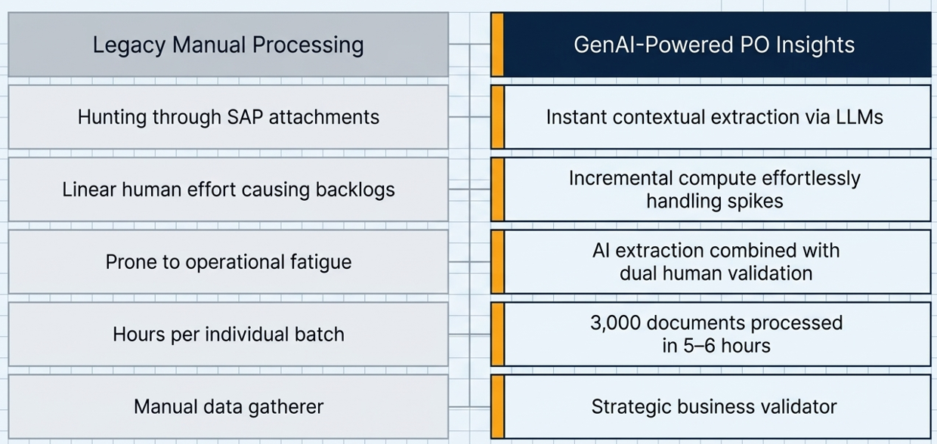
THE PROCESSING PARADIGM SHIFT

Slide 7
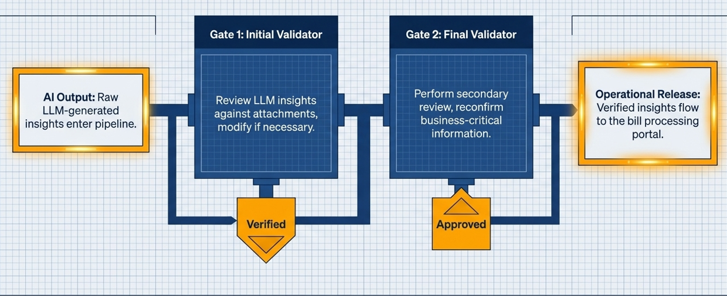



VALIDATION WORKFLOW
A structured two-level human review process ensures every AI-generated insight is verified before operational use.
Original and updated versions are maintained and can be reviewed.
AI Processing
Initial Validator
Final Validator
Bill Pocessor
Human-in-the-Loop: AI handles extraction; humans handle governance — building confidence and trust across the organisation.

Slide 8




KEY BENEFITS
Operational Efficiency
Improved Accuracy
Governance & Compliance
Significant reduction in manual document review effort. Faster invoice validation and bill processing across the VIM Center.
AI-assisted identification of critical clauses reduces the probability of missed security deposits, penalties, or advance conditions.
Dual-level human validation ensures all insights are verified before use — building trust and meeting audit requirements.
Scalability
Better UX for Processors
Automated incremental pipeline handles thousands of documents overnight and is designed to scale with future volume growth.
Bill processors receive summarized, validated insights directly — eliminating dependency on manual interpretation of lengthy attachments.

Slide 9
WAY FORWARD
From manual document hunting to AI-assisted intelligence
01
Include outline agreement attachments for processing
02
Enable precise citations for each AI generated output
03
Summarize purchase order purpose for each PO
04
Improve the AI output based on user feedback
05
Add AI agent to directly post documents in SAP

