Slide 1
Operating system

Slide 2
Different types of OS:
A mobile operating system is an operating system that helps to run other application software on mobile devices. It is the same kind of software as the famous computer operating systems like Linux and Windows, but now they are light and simple to some extent.
The operating system found on smartphones include Symbian OS, iPhone OS, RIM's BlackBerry, windows Mobile, Palm WebOS, Android, and Maemo.
Android, WebOS, and Maemo are all derived from Linux. The iPhone OS originated from BSD and NeXTSTEP, which are related to Unix.
It combines the beauty of computer and hand use devices. It typically contains a cellular built-in modem and SIM tray for telephony and internet connections. If you buy a mobile, the manufacturer company chooses the OS for that specific device.

Slide 3
Popular platforms of the Mobile OS:
Android OS: The Android operating system is the most popular OS today. It is a mobile OS based on the Linux Kernel and open-source software. The android operating system was developed by Google. The first Android device was launched in 2008.
Bada (Samsung Electronics): Bada is a Samsung mobile operating system that was launched in 2010. The Samsung wave was the first mobile to use the bada operating system. The bada operating system offers many mobile features, such as 3-D graphics, application installation, and multipoint-touch.
BlackBerry OS: The BlackBerry OS is a mobile operating system developed by Research In Motion (RIM). This operating system was designed specifically for BlackBerry handheld devices. This operating system is beneficial for the corporate users because it provides synchronization with Microsoft Exchange, Novell GroupWise email, Lotus Domino, and other business software when used with the BlackBerry Enterprise Server.
iPhone OS / iOS: The iOS was developed by the Apple inc for the use on its device. The iOS operating system is the most popular operating system today. It is a very secure operating system. The iOS operating system is not available for any other mobiles.
Symbian OS: Symbian operating system is a mobile operating system that provides a high-level of integration with communication. The Symbian operating system is based on the java language. It combines middleware of wireless communications and personal information management (PIM) functionality. The Symbian operating system was developed by Symbian Ltd in 1998 for the use of mobile phones. Nokia was the first company to release Symbian OS on its mobile phone at that time.
Windows Mobile OS: The window mobile OS is a mobile operating system that was developed by Microsoft. It was designed for the pocket PCs and smart mobiles.
Harmony OS: The harmony operating system is the latest mobile operating system that was developed by Huawei for the use of its devices. It is designed primarily for IoT devices.
Palm OS: The palm operating system is a mobile operating system that was developed by Palm Ltd for use on personal digital assistants (PADs). It was introduced in 1996. Palm OS is also known as the Garnet OS.
WebOS (Palm/HP): The WebOS is a mobile operating system that was developed by Palm. It based on the Linux Kernel. The HP uses this operating system in its mobile and touchpads.

Slide 4
Android Architecture
Android architecture contains different number of components to support any android device needs. Android software contains an open-source Linux Kernel having collection of number of C/C++ libraries which are exposed through an application framework services.
Among all the components Linux Kernel provides main functionality of operating system functions to smartphones and Dalvik Virtual Machine (DVM) provide platform for running an android application.
The main components of android architecture are following:-
Applications
Application Framework
Android Runtime
Platform Libraries
Linux Kernel

Slide 5
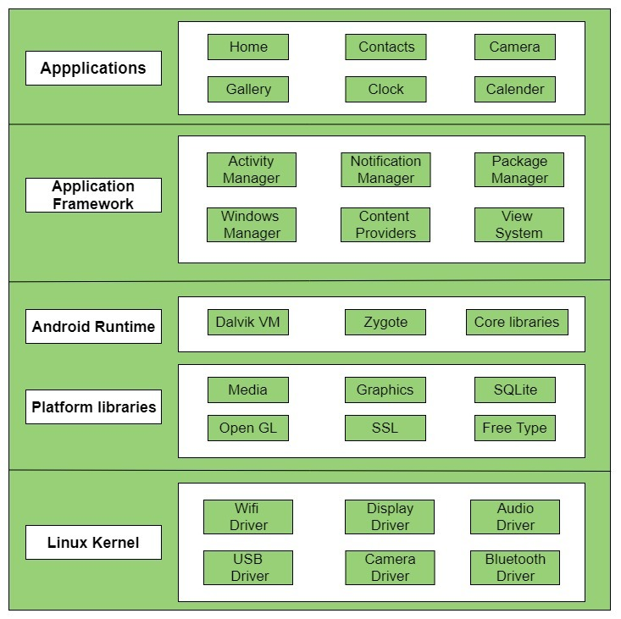
Android architecture with several main components and their sub components :–

Slide 6
Applications & Application framework
Applications is the top layer of android architecture. The pre-installed applications like home, contacts, camera, gallery etc and third party applications downloaded from the play store like chat applications, games etc. will be installed on this layer only. It runs within the Android run time with the help of the classes and services provided by the application framework.
&
Application Framework provides several important classes which are used to create an Android application. It provides a generic abstraction for hardware access and also helps in managing the user interface with application resources. Generally, it provides the services with the help of which we can create a particular class and make that class helpful for the Applications creation.
It includes different types of services activity manager, notification manager, view system, package manager etc. which are helpful for the development of our application according to the prerequisite.

Slide 7
Application runtime
Android Runtime environment is one of the most important part of Android. It contains components like core libraries and the Dalvik virtual machine(DVM). Mainly, it provides the base for the application framework and powers our application with the help of the core libraries.
Like Java Virtual Machine (JVM), Dalvik Virtual Machine (DVM) is a register-based virtual machine and specially designed and optimized for android to ensure that a device can run multiple instances efficiently. It depends on the layer Linux kernel for threading and low-level memory management. The core libraries enable us to implement android applications using the standard JAVA or Kotlin programming languages.

Slide 8
Platform libraries
The Platform Libraries includes various C/C++ core libraries and Java based libraries such as Media, Graphics, Surface Manager, OpenGL etc. to provide a support for android development.
Media library provides support to play and record an audio and video formats.
Surface manager responsible for managing access to the display subsystem.
SGL and OpenGL both cross-language, cross-platform application program interface (API) are used for 2D and 3D computer graphics.
SQLite provides database support and FreeType provides font support.
Web-Kit This open source web browser engine provides all the functionality to display web content and to simplify page loading.
SSL (Secure Sockets Layer) is security technology to establish an encrypted link between a web server and a web browser.

Slide 9
Linux Kernel
Linux Kernel is heart of the android architecture. It manages all the available drivers such as display drivers, camera drivers, Bluetooth drivers, audio drivers, memory drivers, etc. which are required during the runtime.
The Linux Kernel will provide an abstraction layer between the device hardware and the other components of android architecture. It is responsible for management of memory, power, devices etc.
The features of Linux kernel are:
Security: The Linux kernel handles the security between the application and the system.
Memory Management: It efficiently handles the memory management thereby providing the freedom to develop our apps.
Process Management: It manages the process well, allocates resources to processes whenever they need them.
Network Stack: It effectively handles the network communication.
Driver Model: It ensures that the application works properly on the device and hardware manufacturers responsible for building their drivers into the Linux build.

Slide 10
Architecture of IOS
The architecture of IOS is a layered architecture. At the uppermost level, iOS works as an intermediary between the underlying hardware and the apps you make. Apps do not communicate with the underlying hardware directly.
Apps talk with the hardware through a collection of well-defined system interfaces. These interfaces make it simple to write apps that constantly work on devices having various hardware abilities.
Lower layers give the basic services which all application relies on and the higher level layer gives sophisticated graphics and interface-related services. Apple provides most of its system interfaces in special packages called frameworks. A framework is a directory that holds a dynamic shared library that is .files, related resources like as header files, images, and helper apps required to support that library. Every layer has a set of Framework that the developer uses to construct the applications.

Slide 11
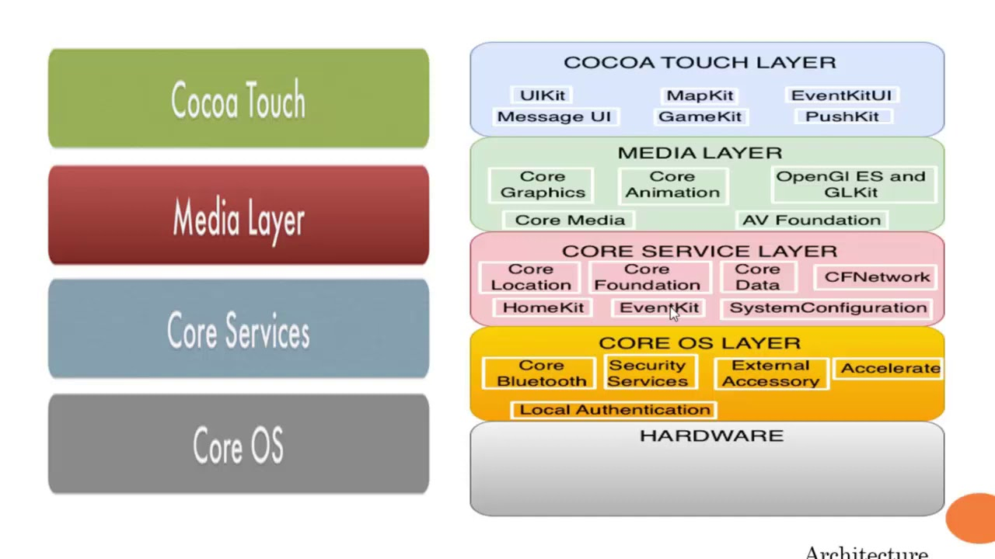
Architecture of IOS

Slide 12
1. Core OS Layer: The Core OS layer holds the low-level features that most other technologies are built upon
Core Bluetooth Framework.
Accelerate Framework.
External Accessory Framework.
Security Services framework.
Local Authentication framework.
64-Bit support from IOS7 supports the 64-bit app development and enables the application to run faster.
2. Core Services Layer Some of the Important Frameworks available in the core services layers are detailed:
Address book framework – Gives programmatic access to a contacts database of user.
Cloud Kit framework – Gives a medium for moving data between your app and iCloud.
Core data Framework – Technology for managing the data model of a Model View Controller app.
Core Foundation framework – Interfaces that give fundamental data management and service features for iOS apps.
Core Motion Framework – Access all motion-based data available on a device. Using this core motion framework Accelerometer based information can be accessed.
Foundation Framework – Objective C covers too many of the features found in the Core Foundation framework
Healthkit framework – New framework for handling health-related information of the user.

Slide 13
HomeKit framework – A new framework for talking with and controlling connected devices in a user’s home.
Social framework – Simple interface for accessing the user’s social media accounts.
Store Kit framework – Gives support for the buying of content and services from inside your iOS apps, a feature is known as In-App Purchase.
3. Media Layer: Graphics, Audio, and Video technology is enabled using the Media Layer. Graphics Framework:
UI Kit Graphics – It describes high-level support for designing images and is also used for animating the content of your views.
Core Graphics framework – It is the native drawing engine for iOS apps and gives support for custom 2D vector and image-based rendering.
Core Animation – It is an initial technology that optimizes the animation experience of your apps.
Core Images – gives advanced support for controlling video and motionless images in a non-destructive way
OpenGl ES and GL Kit – manages advanced 2D and 3D rendering by hardware-accelerated interfaces
Metal – It permits very high performance for your sophisticated graphics rendering and computation works. It offers very low overhead access to the A7 GPU.

Slide 14
Audio Framework
Media Player Framework – It is a high-level framework that gives simple use to a user’s iTunes library and support for playing playlists.
AV Foundation – It is an Objective C interface for handling the recording and playback of audio and video.
OpenAL – is an industry-standard technology for providing audio

Slide 15
Video Framework
AV Kit – framework gives a collection of easy-to-use interfaces for presenting video.
AV Foundation – gives advanced video playback and recording capability.
Core Media – framework describes the low-level interfaces and data types for operating media.

Slide 16
Cocoa Touch Layer
EventKit framework – gives view controllers for showing the standard system interfaces for seeing and altering calendar-related events
GameKit Framework – implements support for Game Center which allows users share their game-related information online
iAd Framework – allows you to deliver banner-based advertisements from your app.
MapKit Framework – gives a scrollable map that you can include in your user interface of the app.
PushKitFramework – provides registration support for VoIP apps.
Twitter Framework – supports a UI for generating tweets and support for creating URLs to access the Twitter service.
UIKit Framework – gives a vital infrastructure for applying graphical, event-driven apps in iOS.
Some of the Important functions of UI Kit framework:-Multitasking support, – Basic app management and infrastructure. – User interface management – Support for Touch and Motion event. – Cut, copy and paste support, and many more.

Slide 17
THE END

