Slide 1

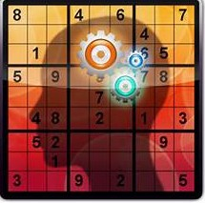
SMARTGRID PUZZLE SOLVER
DSCI-6612: Intro to Artificial Intelligence
Submitted by:
V E NK A T A SA I MOHA N
PR A NI T HA

Slide 2

Project Objectives
Create an AI algorithm that can generate unique and solvable Sudoku puzzles
Develop an AI algorithm capable of efficiently solving Sudoku puzzles of varying difficulty levels

Slide 3
Tools and Approach
Tools :
Python : For implementing the backtracking algorithm.
NumPy : Efficient manipulation of arrays for constraint propagation.
Pandas : Handling and analyzing possibilities and constraints.
Approach:
Representation of Sudoku Board:
Choosing a Cell
Exploring Possibilities
Backtracking on Failure
Repetition until Completion
Efficiency Measures

Slide 4


Deliverables
Python Module with Backtracking and Optimized Backtracking algorithm
Github Repository along with documentation and code Youtube link which demonstrates our project

Slide 5
Evaluation Methodologies
Generate a Result to check the efficiency of algorithms.
Verify if Solutions adhere to Sudoku rules. Measure the time taken taken to solve puzzles.
Ensure each generated puzzle is unique and has a single solution.

Slide 6
THANK YOU

