Slide 1
Ansible

Slide 2
Ansible
Ansible is a modern configuration management tool that doesn’t require the use of an agent software on remote nodes. Instead, it uses only SSH and Python to communicate and execute commands on managed servers.
Ansible does not need to have an agent installed in the host mechine
So we can scale it up to any number of mechines

Slide 3
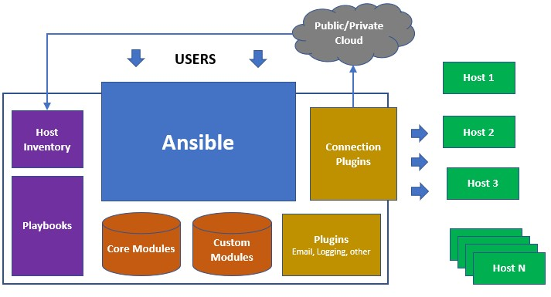
Ansible

Slide 4
Install ansible on ubuntu
sudo apt update
sudo apt install software-properties-common
sudo add-apt-repository --yes --update ppa:ansible/ansible
sudo apt install ansible

Slide 5
Setting inventory
node1 ansible_host=localhost ansible_pass=1234
# Web Servers
web_node1 ansible_host=web01.xyz.com ansible_connection=winrm ansible_user=administrator ansible_password=Win$Pass
web_node2 ansible_host=web02.xyz.com ansible_connection=winrm ansible_user=administrator ansible_password=Win$Pass
web_node3 ansible_host=web03.xyz.com ansible_connection=winrm ansible_user=administrator ansible_password=Win$Pass
# DB Servers
sql_db1 ansible_host=sql01.xyz.com ansible_connection=ssh ansible_user=root ansible_ssh_pass=Lin$Pass
sql_db2 ansible_host=sql02.xyz.com ansible_connection=ssh ansible_user=root ansible_ssh_pass=Lin$Pass

Slide 6
Grouping the hosts
# Groups
[db_nodes]
sql_db1
sql_db2
[boston_nodes]
sql_db1
web_node1
[dallas_nodes]
sql_db2
web_node2
web_node3
[us_nodes:children]
boston_nodes
dallas_nodes

Slide 7
Ansible Playbooks
An Ansible® Playbook is a blueprint of automation tasks—which are complex IT actions executed with limited or no human involvement.
Ansible Playbooks are executed on a set, group, or classification of hosts, which together make up an Ansible inventory.

Slide 8
Ansible run single command
ansible all -m ping

Slide 9
Playbook.yaml
- name: install
hosts: all
tasks:
name: installnginx
apt:
name: nginx

Slide 10
Ansible Modules
Modules (also referred to as “task plugins” or “library plugins”) are discrete units of code that can be used from the command line or in a playbook task.
Ansible executes each module, usually on the remote managed node, and collects return values. In Ansible 2.10 and later, most modules are hosted in collections.
Ex:-
ansible webservers -m service -a "name=httpd state=started"
ansible webservers -m ping
ansible webservers -m command -a "/sbin/reboot -t now"

