Slide 1
Kubernetes(k8s)

Slide 2
What is Kubernetes.
Kubernetes, also known as K8s, is an open-source system for automating deployment, scaling, and management of containerized applications.
It groups containers that make up an application into logical units for easy management and discovery.

Slide 3
Run K8s Anywhere
Kubernetes is open source giving you the freedom to take advantage of on-premises, hybrid, or public cloud infrastructure, letting you effortlessly move workloads to where it matters to you.

Slide 4
Kubernetes Features
Self-healing
Service discovery and load balancing
Secret and configuration management
Batch execution
Horizontal scaling
Automated rollouts and rollbacks
Automatic bin packing
IPv4/IPv6 dual-stack

Slide 5
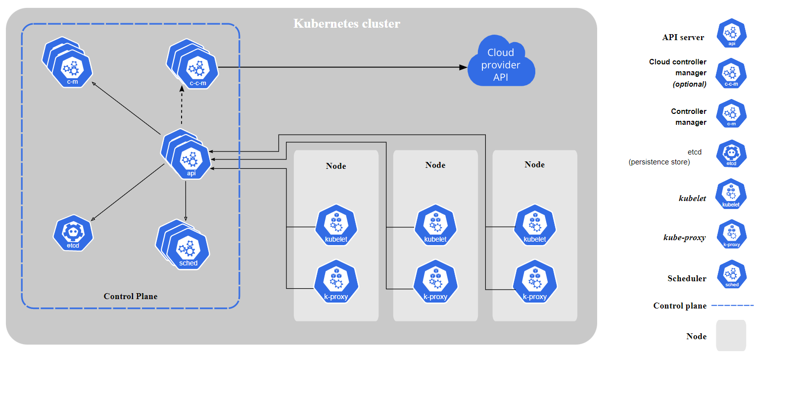
Kubernetes cluster

Slide 6
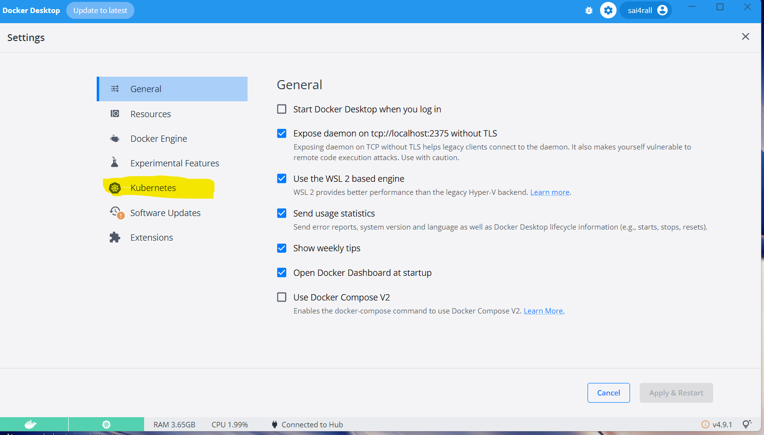
Installation
Kubernetes can be enabled with docker desktop

Slide 7
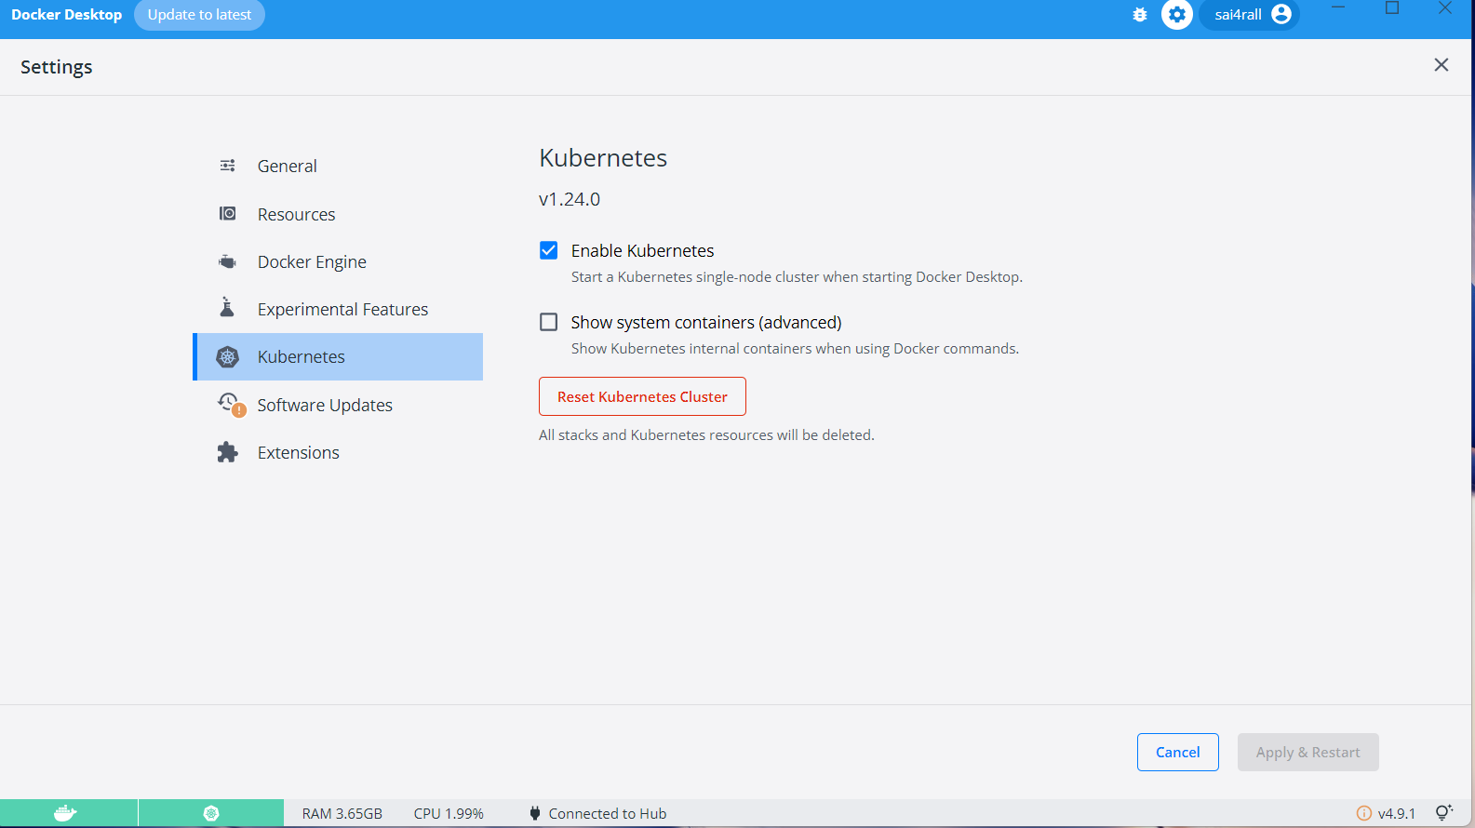
Enable Kubernetes

Slide 8
Play with k8s
https://labs.play-with-k8s.com/
kubeadm init --apiserver-advertise-address $(hostname -i) --pod-network-cidr 10.5.0.0/16
kubectl apply –f https://raw.githubusercontent.com/cloudnativelabs/kube-router/master/daemonset/kubeadm-kuberouter.yaml

Slide 9
What we learn
Pods
Deployments
Stateful sets
Service
ingress
Jobs
Config maps
Secrets
Pvcs
HPA

Slide 10
Join to k8s controller
kubeadm token create --print-join-command
kubeadm join 192.168.0.23:6443 --token oszhbv.g1qb9asfk6kft57b --discovery-token-ca-cert-hash sha256:cb91dac1791201b45130f18c56896
Kubectl get nodes

Slide 11
commands
Kubectl cluster-info
Kubectl get nodes
kubeadm init --apiserver-advertise-address $(hostname -i) --pod-network-cidr ipadddress
kubeadm token create --print-join-command
kubeadm join 192.168.0.23:6443 --token oszhbv.g1qb9asfk6kft57b --discovery-token-ca-cert-hash sha256:cb91dac1791201b45130f18c56896

Slide 12
pods
Pods are the smallest deployable units of computing that you can create and manage in Kubernetes.
A Pod (as in a pod of whales or pea pod) is a group of one or more containers, with shared storage and network resources, and a specification for how to run the containers

Slide 13
Creating pod
kubectl run superapp --image=superapp:1
kubectl run nginx --image=nginx

Slide 14
Pod yaml
apiVersion: batch/v1
kind: Job
metadata:
name: hello
spec:
template:
# This is the pod template
spec:
containers:
- name: hello
image: busybox:1.28
command: ['sh', '-c', 'echo "Hello, Kubernetes!" && sleep 3600']
restartPolicy: OnFailure
# The pod template ends here

Slide 15
Replicaset
Replicaset is a wraper above the pod
Replicaset allows us to maintain number of replicas of a given pod
We use labels to identify a pod
If a pod goes down then replicaset will create new pod

Slide 16
Replicaset.yaml
apiVersion: apps/v1
kind: ReplicaSet
metadata:
name: frontend
labels:
app: guestbook
tier: frontend
spec:
# modify replicas according to your case
replicas: 3
selector:
matchLabels:
tier: frontend
template:
metadata:
labels:
tier: frontend
spec:
containers:
- name: php-redis
image: gcr.io/google_samples/gb-frontend:v3

Slide 17
Deployment
Deployment is a wrapper above the replica set
As we know replicaset restores the pod, deployment restores the replicaset
We can use deployment for rolling updates
Deployment is also identify replicaset using labels

Slide 18
Deployment creation
Kubectl create –f deployment.yaml
Kubectl apply –f deployment.yaml

Slide 19
Deployment.yaml
apiVersion: v1
kind: Deployment
metadata:
name: nginx
spec:
replicas: 2
containers:
- name: nginx
image: nginx:1.14.2
ports:
- containerPort: 80

Slide 20
configmap
A ConfigMap is an API object used to store non-confidential data in key-value pairs. Pods can consume ConfigMaps as environment variables, command-line arguments, or as configuration files in a volume.

Slide 21
Configmap.yaml
apiVersion: v1
kind: ConfigMap
metadata:
name: game-demo
data:
# property-like keys; each key maps to a simple value
player_initial_lives: "3"
ui_properties_file_name: "user-interface.properties"
# file-like keys
game.properties: |
enemy.types=aliens,monsters
player.maximum-lives=5
user-interface.properties: |
color.good=purple
color.bad=yellow
allow.textmode=true

Slide 22
secrets
A Secret is an object that contains a small amount of sensitive data such as a password, a token, or a key.
Such information might otherwise be put in a Pod specification or in a container image.
Using a Secret means that you don't need to include confidential data in your application code.

Slide 23
Secret.yaml
apiVersion: v1
data:
username: YWRtaW4=
password: MWYyZDFlMmU2N2Rm
kind: Secret
metadata:
annotations:
kubectl.kubernetes.io/last-applied-configuration: { ... }
creationTimestamp: 2020-01-22T18:41:56Z
name: mysecret
namespace: default
resourceVersion: "164619"
uid: cfee02d6-c137-11e5-8d73-42010af00002
type: Opaque

Slide 24
Whats next
Service
Statefulset
Volumes
namespace

Slide 25
service
An abstract way to expose an application running on a set of Pods as a network service.
With Kubernetes you don't need to modify your application to use an unfamiliar service discovery mechanism.
Kubernetes gives Pods their own IP addresses and a single DNS name for a set of Pods, and can load-balance across them.

Slide 26
Service.yaml
apiVersion: v1
kind: Service
metadata:
name: my-service
spec:
Typw: Nodeport
selector:
app.kubernetes.io/name: MyApp
ports:
- protocol: TCP
port: 80
targetPort: 9376

