Slide 1
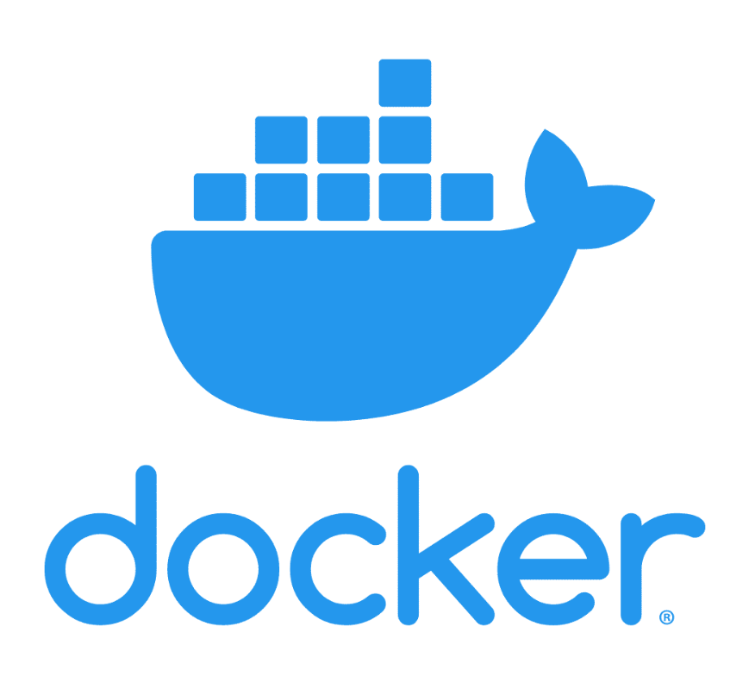

Slide 2
Docker Volumes
Volumes are the preferred mechanism for persisting data generated by and used by Docker containers.
While bind mounts are dependent on the directory structure and OS of the host machine, volumes are completely managed by Docker.
Volumes have several advantages over bind mounts:

Slide 3
Creation of volumes
Docker volumes
Docker volumes create <name>
Docker volumes create news-vol

Slide 4
Mounting a volume to container
Docker run –v volume:mount <image
Example:-
docker run -v news:/var/testvol/ -t newfile:2

Slide 5
Docker tag
The Docker tag helps maintain the build version to push the image to the Docker Hub.
The Docker Hub allows us to group images together based on name and tag.
Multiple Docker tags can point to a particular image. Basically, As in Git, Docker tags are similar to a specific commit. Docker tags are just an alias for an image ID.

Slide 6
Docker tag syntax
Docker tag <image_id> <repo_url>:<Tag_name>
Docker tag <Source_tag>:<Destination_Tag>
Docker build –t <reponame>:<Tag_Name> .
Docker images

Slide 7
Docker registry
A registry stores a collection of repositories.
As a registry can have many repositories and a repository can have many different versions of the same image which are individually versioned with tags.
Ex:- https://hub.docker.com/

Slide 8
Docker login & Docker push
Register in https://hub.docker.com
Get Access token
Docker login –u <username>
Docker tag <image> reponame:tag
Ex:-docker push sai4rall/superweb:2

Slide 9
Installing custom docker registry
Docker-compose up –d
Docker-compose down

Slide 10
Docker compose
Docker compose is used for multi container application
Multi container application are project with more than one containerized microservices , combinedly the serve a common purpose

Slide 11
How to write docker compose
We need to create a docker-compose.yaml file
Yaml (YAML stands for yet another markup language)
We use : (colon to separate key value)
We use space or tab to define an sub level
We use – to define an array

Slide 12
Yaml Examle
foo: bar
pleh: help
stuff:
foo: bar
bar: foo

Slide 13
Example docker-compose
Version: 3.8
Services:
servicea:
Buld:/app1/
Ports:
- 3000:3000
Envirnmeny:
-xyz:xyz
Serviceb:
Build: /app2
3001:3001
Servicec:
image: xyz/app3:
Ports:
27017:27017

Slide 14
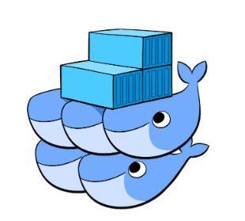
Docker swarm

Slide 15
Docker swarm
Docker swarm is technique to create a cluster of docker engines
Services deployed in any node can be accessed on other nodes in the same cluster

Slide 16
Features of docker swarm
High availability of services
Auto load-balancing
Decentralized access
Easy to scale-up deployments
Rolling updates

Slide 17
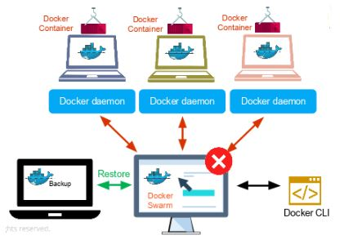
Docker swarm- How it works

Slide 18
Docker swarm components
Service
Task
Manager node
Task

Slide 19
Docker swarm setup
Docker swarm init –advertise-addr <ipaddress>
Docker join <token><manager_rip>
Docker info (on manager)
Docker node ls
Docker node leave –force
Docker node leave

Slide 20
Docker service
Docker service is used to deploy images on docker swarm
We can scale services on cluster
docker service create --name redis redis:3.0.6

