Slide 1
Kubernetes

Slide 2
Namespace
Creating namespace:
kubectl create namespace dev
Switching namespace
kubectl config set-context --current --namespace=dev

Slide 3
Namespace.yaml
apiVersion: v1
kind: Namespace
metadata:
name: <insert-namespace-name-here>

Slide 4
job
apiVersion: batch/v1
kind: Job
metadata:
name: pi
spec:
template:
spec:
containers:
- name: pi
image: perl:5.34.0
command: ["perl", "-Mbignum=bpi", "-wle", "print bpi(2000)"]
restartPolicy: Never
backoffLimit: 4

Slide 5
Cron job
apiVersion: batch/v1
kind: CronJob
metadata:
name: hello
spec:
schedule: "*/5 * * * *"
jobTemplate:
spec:
template:
spec:
containers:
- name: hello
image: busybox:1.28
imagePullPolicy: IfNotPresent
command:
- /bin/sh
- -c
- date; echo Hello from the Kubernetes cluster
restartPolicy: OnFailure

Slide 6
Sts(statefulset)
StatefulSet is the workload API object used to manage stateful applications.
Manages the deployment and scaling of a set of Pods, and provides guarantees about the ordering and uniqueness of these Pods.

Slide 7
Service
kubectl apply -f sta-example.yml
kubectl run -i --tty --image busybox:1.28 dns-test --restart=Never --rm

Slide 8
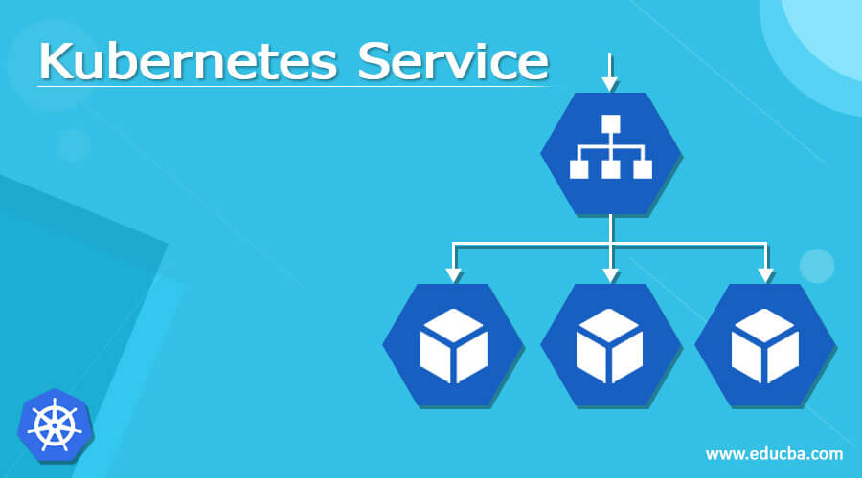
service

Slide 9
Service- cluster ip
apiVersion: v1
kind: Service
metadata:
name: mysql
labels:
app: mysql
spec:
ports:
- port: 3306
clusterIP: None
selector:
app: mysql

Slide 10
Service- nodeport
apiVersion: v1
kind: Service
metadata:
name: mysql
labels:
app: mysql
spec:
ports:
- port: 3306
clusterIP: None
selector:
app: mysql

Slide 11
Enabling Kubernetes dashboard
kubectl apply -f https://raw.githubusercontent.com/kubernetes/dashboard/v2.6.1/aio/deploy/recommended.yaml
kubectl proxy
http://localhost:8001/api/v1/namespaces/kubernetes-dashboard/services/https:kubernetes-dashboard:/proxy/.
https://kubernetes.io/docs/tasks/access-application-cluster/web-ui-dashboard/

Slide 12
Creating Service account
kubectl apply -f serviceaccount.yml
kubectl apply -f rolebinding.yml
kubectl -n kubernetes-dashboard create
thttps://github.com/kubernetes/dashboard/blob/master/docs/user/access-control/creating-sample-user.mdoken admin-user

