Slide 1
A Case study on Mobile Device Usage and Public Well-Being

Slide 2
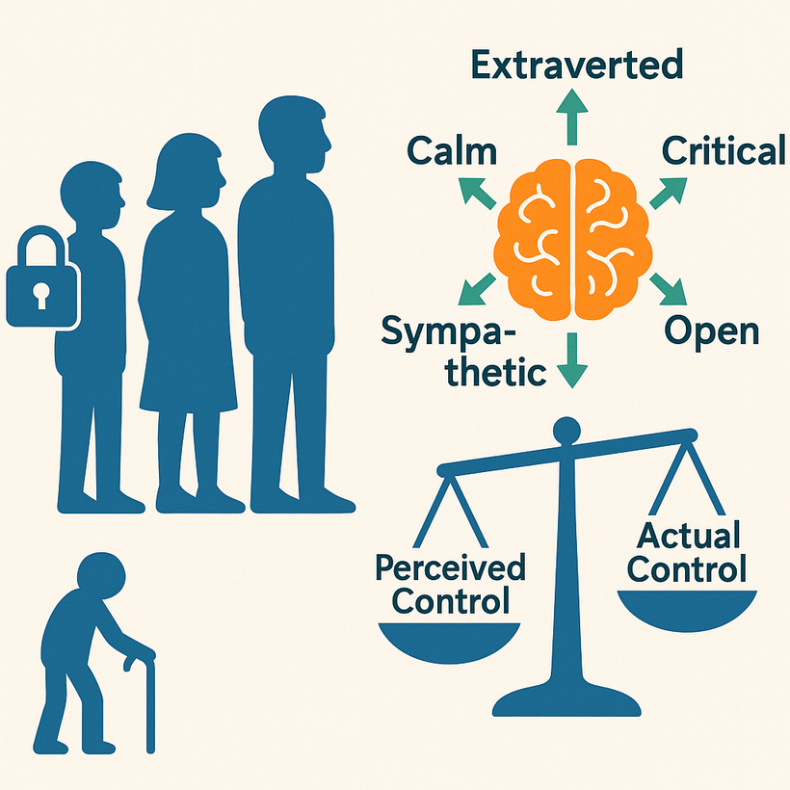
Introduction
Mobile apps are widely used for communication, entertainment, education, and daily tasks.
While convenient, they raise concerns about how personal data is collected, shared, and understood.
This case study focuses on users' sense of control over their personal data in mobile environments.
It introduces the concept of the Control Gap—the difference between what users believe about their data rights and what they’ve actually consented to.
Data science methods were used to analyze trends across age groups, personality types, and app usage behaviors.
The goal was to better understand how mobile technology impacts users’ well-being and perceptions of data control.

Slide 3
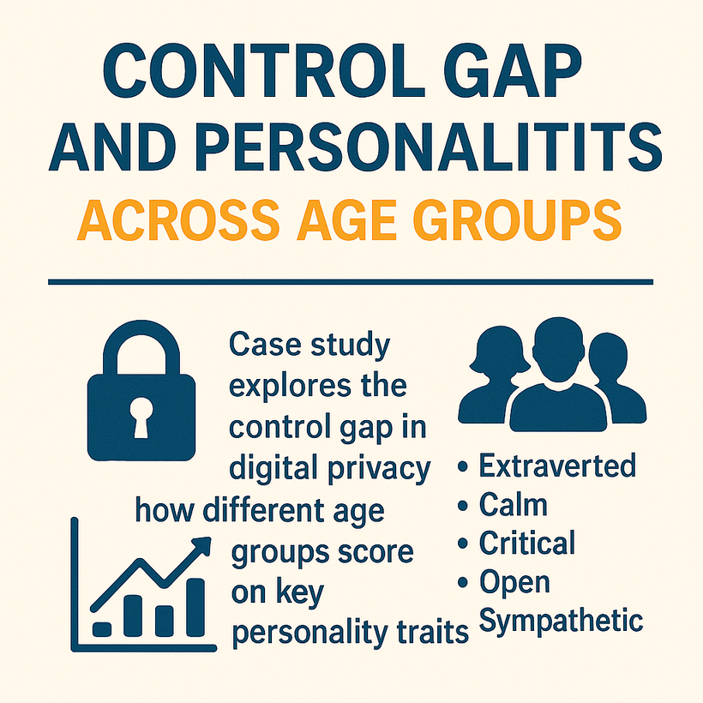
Problem Description
Mobile app users will experience a gap between perceived control over personal data (Ownership Belief) and actual control (Data Control Level) they possess, resulting in a quantifiable control gap.
The control gap between users can differ depending on their app-use habits and personality levels such as anxiety, openness, or conscientiousness.
Low awareness of which users possess the greatest control gap prevents platforms from implementing user-specific privacy features or enhancing consent clarity.
With such users identified through machine learning and clustering techniques, it is then possible to develop user-specific interventions that are respectful of user autonomy and maximize digital well-being.

Slide 4
Data Science Application Involved
The study utilizes data that reflects mobile use behavior, personality traits, as well as demographic data.
Exploratory Data Analysis (EDA) was conducted to comprehend the relationship between screen time, behavior, and how users perceive things.
Random Forest and other supervised machine learning models were used to predict the users who may potentially perceive that they lack control over their personal information.
These results are designed to make the app more comprehensible and improve the way the consent is given.

Slide 5
Ethical Concerns and Their Impact
Ethics: Users often give consent without understanding its implications. Mobile apps employ persuasive tactics that may exploit user vulnerabilities, particularly among youth.
Privacy: Re-identification risks remain high even when data is anonymized. Users report confusion over data ownership and lack tools to manage it.
Social Justice: Youth and low-income users are more exposed to data exploitation and often lack access to digital wellness resources. These disparities raise equity concerns in digital spaces.

Slide 6
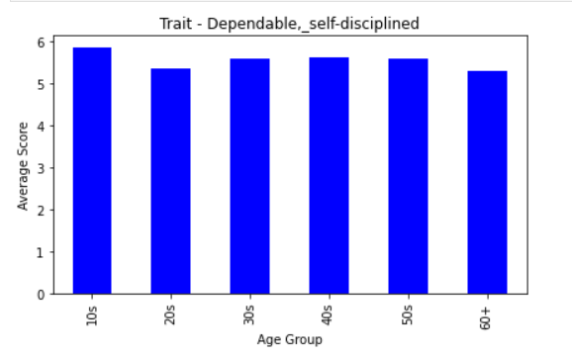
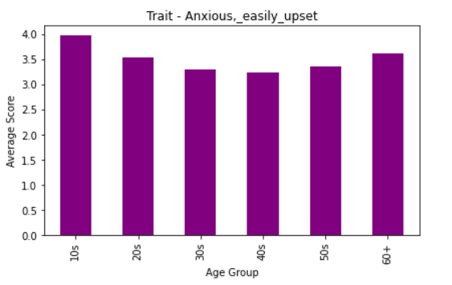
Personality Traits by Age Group
Teenagers (10s) are the most self-disciplined among all age groups, which is a bit surprising.
People in their 20s and 60s seem to be a little less dependable than others.
Teens also feel the most anxious and upset compared to other age groups.
Anxiety goes down from the 10s to the 40s, but it slightly increases again after 50

Slide 7
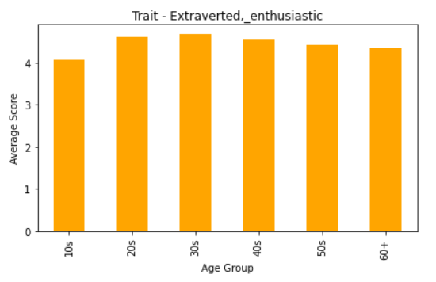
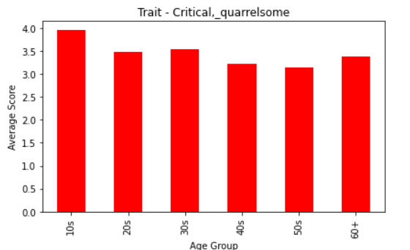
Personality Traits by Age Group
People in their 20s and 30s are the most outgoing and enthusiastic.
As people get older, they become a little less extraverted, especially after 40.
Teenagers seem to be the most critical and like to argue more than other age groups.
Older people are less quarrelsome and tend to be calmer with age.

Slide 8
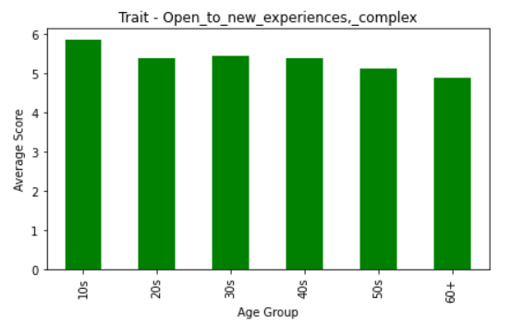
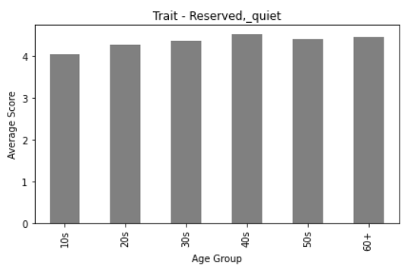
Personality Traits by Age Group
People in their 40s are the quietest and most reserved out of all age groups.
Younger people, especially teens, are less quiet compared to older age groups.
Teens are the most open to new ideas and like exploring different things.
As people age, they become less open to new experiences, with the lowest openness seen in those over 60.

Slide 9
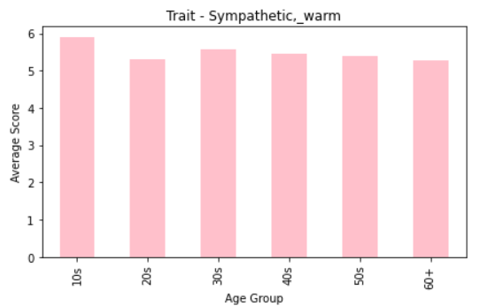
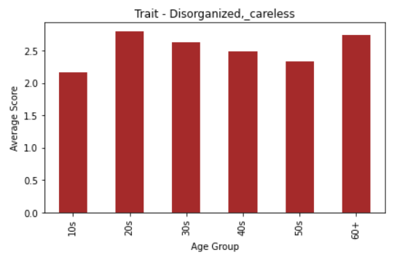
Personality Traits by Age Group
Teenagers (10s) are the most sympathetic and warm compared to other age groups.
People in their 20s and 60s show slightly lower warmth than those in their 30s and 40s.
People in their 20s are the most disorganized and careless based on the scores.
Teenagers seem more careful and organized than older adults, especially those over 60.

Slide 10
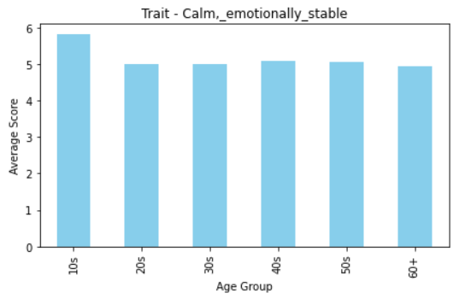
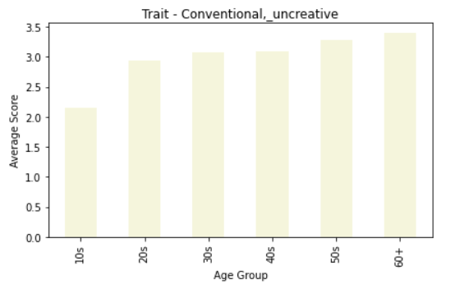
Personality Traits by Age Group
Teenagers (10s) are the calmest and most emotionally stable compared to all other age groups.
Emotional stability drops after the teen years and stays around the same from 20s to 60+.
Young people (10s) are the least conventional and seem more open to new ideas.
As age increases, people tend to become more conventional and less creative, especially those over 60.

Slide 11
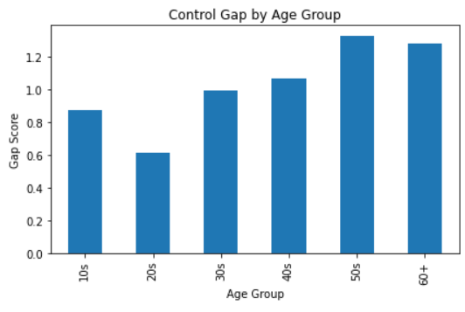
Distribution Of Control Gap
Control gap is the difference between how much control people think they should have over their personal data and how much control they actually feel they have. A higher gap means people feel less in control than they’d like to be.
People in their 20s feel the most in control, showing the lowest control gap score.
The control gap starts increasing in the 30s and keeps rising with age.
People in their 50s feel the biggest control gap—they want more control than they currently feel they have.
Teenagers (10s) are somewhere in the middle—not the most in control, but not the worst either.

Slide 12
Evaluation of Current Practices
Current mobile app practices prioritize data collection over user understanding or control.
Privacy settings are often hidden, unclear, or set to opt-out by default.
Consent screens commonly use complex legal language that is difficult for the average user to understand.
Ethical principles like transparency, data governance, and user empowerment are inconsistently applied.
These issues contribute to ongoing trust problems between users and app developers.

Slide 13
Existing Solutions
Most apps today offer basic privacy controls, but these settings are usually the same for everyone. They don’t take into account how different users might feel about their data or how much control they actually want.
Companies like Apple and Google provide tools like Screen Time or Digital Wellbeing, which help track app usage. However, they don't really help users understand or manage their data control based on their behavior or personality.
Consent pop-ups are common, but they’re often one-time messages that users quickly dismiss. These don’t adapt based on how confused or overwhelmed the user might feel.

Slide 14
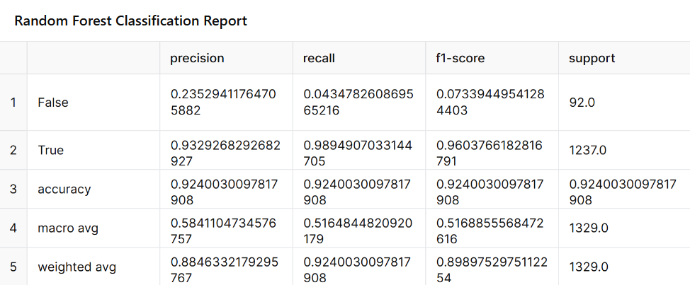
Proposed Solutions
Predict Users with Low Data Control
Use machine learning models (like Random Forest) to identify users who are likely to feel out of control this can help apps improve guidance or show clearer consent messages.

Slide 15
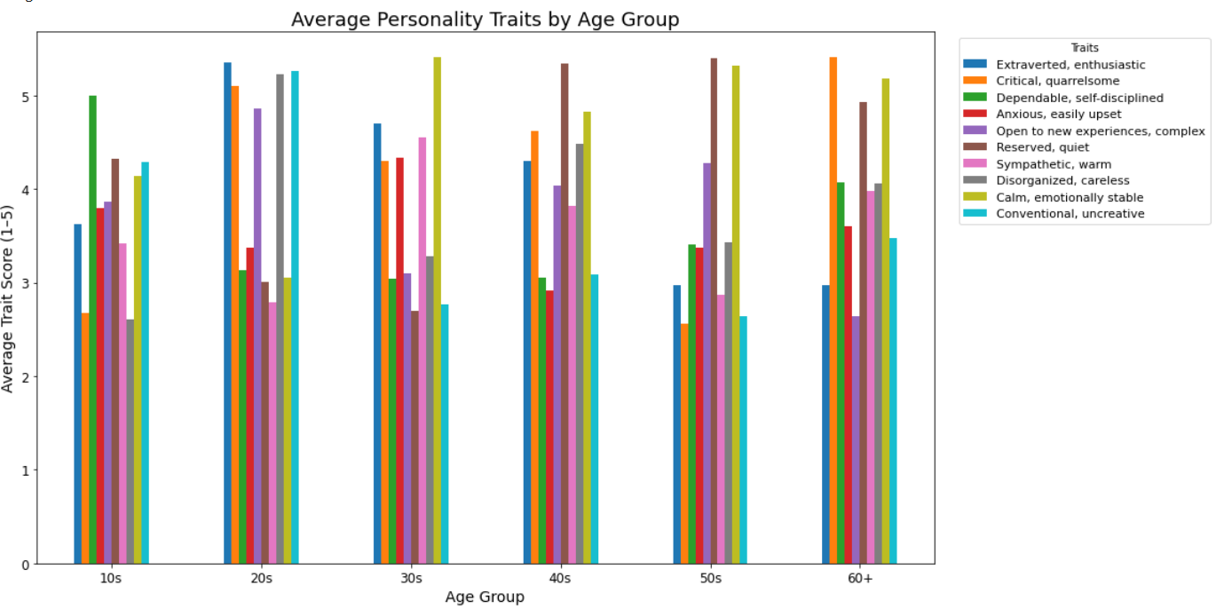
Proposed Solutions
Group Users by Behavior and Personality
Apply techniques to group users based on their age and traits. This helps find patterns like “users with high confusion,” so interventions can be more personalized.

