Slide 1
Prioritizing Workforce Retraining
for Occupations Exposed to Automation
Sai Krishna Reddy M.
MSDS692_S40_Data Science Practicum
Regis University

Slide 2
Workforce boards need to determine where workforce training will make the biggest difference given limited workforce training dollars.
Many occupations could see changes to routine tasks due to automation.
There is a lack of resources to train workers for these shifts on the part of workforce boards.
No consideration is given to varying employment demand and workforce size in exposure scores.
Task exposure, employment size, job outlook and annual openings should all be taken into account in funding decisions.
This project will make comparisons of these factors to identify an occupation for a targeted training pilot.

Slide 3
WORKFORCE BOARDS SHOULD PRIORITIZE RETRAINING FOR LARGE CLERICAL OCCUPATIONS, STARTING WITH BOOKKEEPING.
Limited training budgets should first reach occupations where many workers face changing job requirements.
Large clerical occupations share routine information tasks that technology can increasingly perform.
Bookkeeping combines substantial task exposure with a workforce of about 1.53 million people.
Its projected decline increases the need to prepare workers before their current duties change further.
Beginning with one large occupation gives the board a practical and measurable starting point.
WHY BOOKKEEPING FIRST
1.53M
−5.6%
workers
projected change
144,100
annual openings

Slide 4
AUTOMATION IS CHANGING ROUTINE INFORMATION-PROCESSING WORK ACROSS CLERICAL OCCUPATIONS.
Automation often changes individual duties before it changes the total number of jobs.
Software can now handle more data entry, transaction matching and routine report preparation.
Clerical workers are therefore spending less time producing records and more time checking their accuracy.
WORK THAT GAINS IMPORTANCE
Exception handling, interpretation and communication become more important as routine work decreases.
Retraining should help workers move toward these changing responsibilities.

Slide 5
LIMITED TRAINING FUNDS REQUIRE A CLEAR METHOD FOR SELECTING OCCUPATIONS.
Occupations with similar exposure scores can create very different workforce needs.
The board should establish its decision criteria before reviewing which occupations rank highest.
Each occupation should be compared on task exposure, workforce size, job outlook and annual openings.
DECISION STANDARD
Using the same measures for every occupation reduces the influence of assumptions or current headlines.
The process should be repeated as occupational tasks and labor-market conditions change.

Slide 6
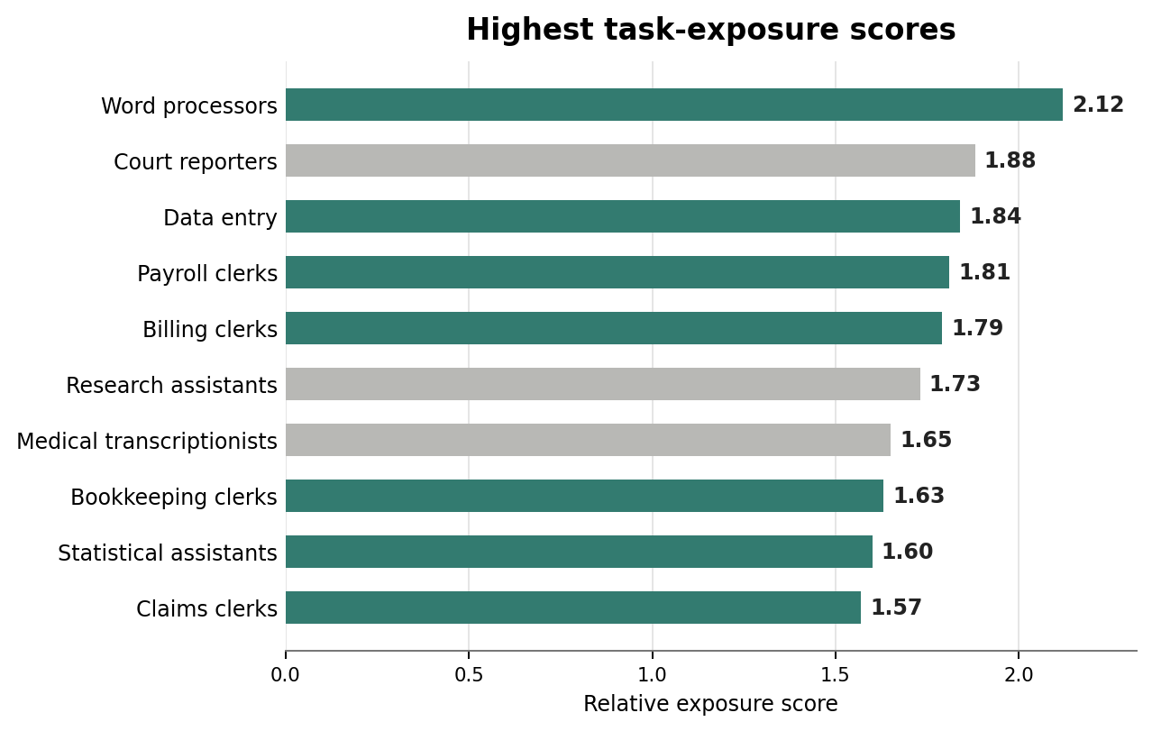
CLERICAL OCCUPATIONS APPEAR FREQUENTLY AMONG THE JOBS WITH THE HIGHEST TASK EXPOSURE.
Seven of the ten highest exposure scores belong to clerical or administrative occupations.
This concentration shows a pattern across an occupational group rather than one isolated job.
The highest-ranked roles depend heavily on repeated processing, documentation and computer-based work.
Bookkeeping ranks below several small occupations, but it affects far more workers.
The concentration supports a clerical training strategy with bookkeeping as the first case.

Slide 7
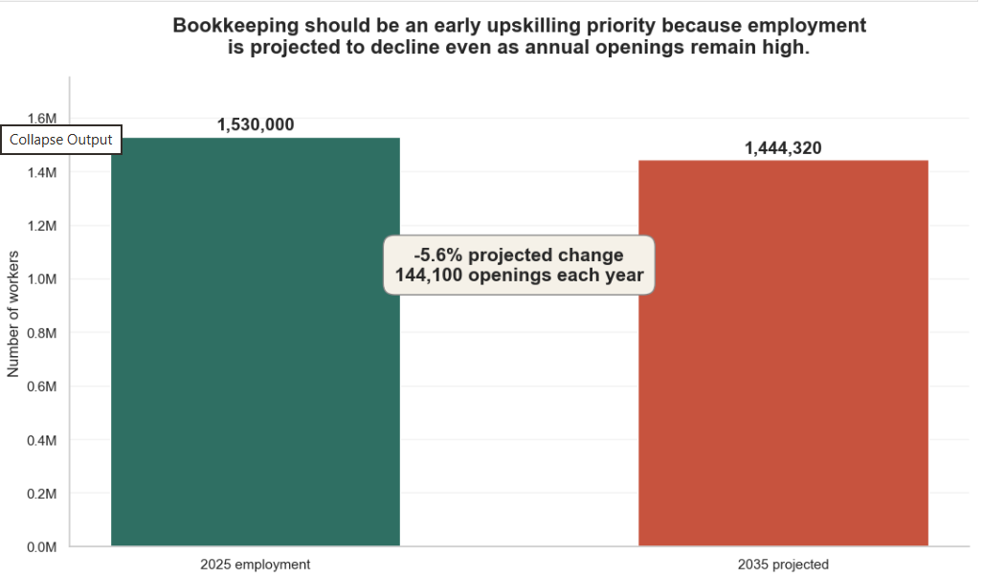
BOOKKEEPING REMAINS A MAJOR WORKFORCE CONCERN DESPITE ITS PROJECTED EMPLOYMENT DECLINE.
A projected decline means fewer total positions, but it does not mean the occupation will disappear.
Bookkeeping starts with about 1.53 million workers and remains above 1.44 million in the projection.
The 5.6 percent decline signals that current workers may face increasing pressure to update their skills.
Approximately 144,100 annual openings show continuing replacement demand within the occupation.
The combination of decline, openings and workforce size makes bookkeeping a continuing workforce issue.

Slide 8
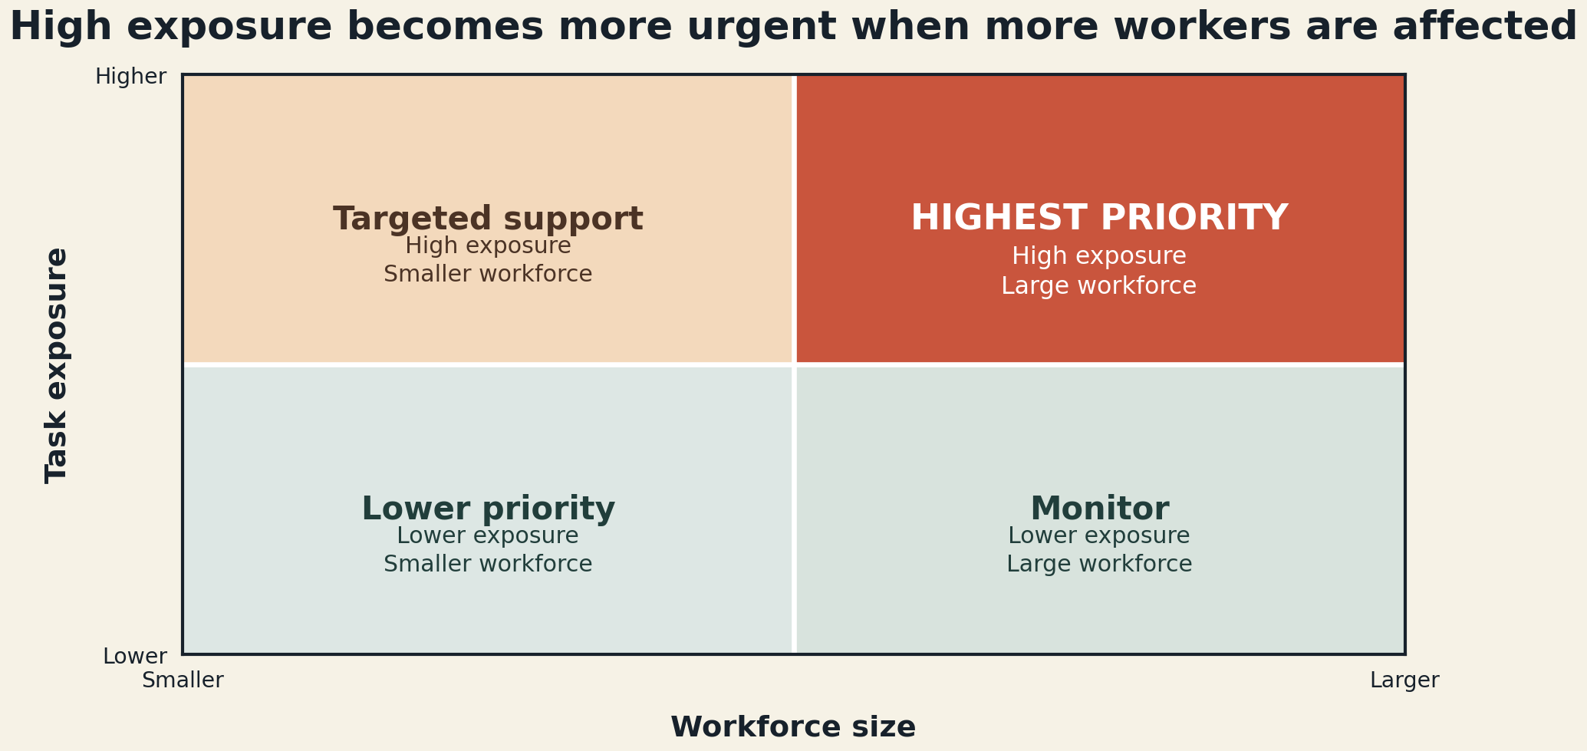
TRAINING PRIORITY SHOULD REFLECT TASK EXPOSURE AND THE NUMBER OF WORKERS AFFECTED.
Task exposure indicates how strongly an occupation may experience changes in daily work.
Workforce size indicates how many people could benefit from a training investment.
High exposure and a large workforce create a stronger public need than exposure alone.
High-exposure occupations with few workers may still need support, but through smaller programs.
Combining both measures prevents a small occupation from receiving priority only because its score is high.

Slide 9
JOB OUTLOOK AND ANNUAL OPENINGS HELP SEPARATE URGENT PRIORITIES FROM HIGH EXPOSURE ALONE.
Job outlook shows whether total employment is expected to increase or decrease.
Annual openings show how often employers may still need workers despite that overall direction.
High exposure with declining employment creates urgency for workers already in the occupation.
WHAT CHANGES THE PRIORITY
High exposure with many openings also creates a need to prepare people entering the occupation.
These measures help the board distinguish immediate retraining needs from exposure that only requires monitoring.

Slide 10
THIS ANALYSIS MEASURES TASK EXPOSURE, BUT IT CANNOT PREDICT LAYOFFS OR PROVE JOB DISPLACEMENT.
The exposure score describes occupational tasks, not an employer's decision to adopt a specific technology.
The data contains no record of layoffs, displacement events or individual employment outcomes.
Employment projections reflect economic and demographic changes in addition to automation.
National occupational averages can hide differences between industries and local labor markets.
The findings should guide investigation and pilot design rather than predict who will lose a job.
WHAT THE ANALYSIS CAN SUPPORT
Identify occupations with more routine work
Compare employment size and projected change
Estimate where training may be most useful
The pilot must test whether training improves outcomes.

Slide 11
A BOOKKEEPING PILOT CAN TEST WHETHER TARGETED TRAINING IMPROVES WORKER OUTCOMES.
The pilot should begin with a clearly defined group of bookkeeping workers or job seekers.
The board should record each participant's employment and wage position before training starts.
Training should address digital tools, error investigation and work that requires judgment.
Employment, retention and wage outcomes should be reviewed after three and six months.
A comparison group can show whether participants improved beyond normal labor-market changes.
1
2
3
4
SELECT
TRAIN
MEASURE
DECIDE
Choose a defined group
Build skills for changing tasks
Check work and wage outcomes
Expand only if results improve
Compare participant results with a similar group before expanding the program.

Slide 12
WORKFORCE BOARDS SHOULD BEGIN WITH BOOKKEEPING AND EXPAND TRAINING ONLY WHEN THE PILOT PRODUCES RESULTS.
Start with a small bookkeeping cohort so the board can manage cost and evaluate delivery closely.
Set the outcome targets before training begins, including employment, retention and wage measures.
Continue the program only when participants show meaningful improvement against the comparison group.
Revise or stop the training if the pilot does not produce better worker outcomes.
Use successful results to design services for related clerical occupations with similar task exposure.
BEGIN WITH
BOOKKEEPING
PILOT
MEASURE
EXPAND
The analysis identifies where to begin.
The pilot determines whether the investment works.

Slide 13
THANK YOU
Any questions?

