Slide 1
Crime Records Analysis and Visualization System
A Data-Driven Approach to Crime Pattern Analysis (2020–Present)
Presented by: Saieswar. A

Slide 2
Project Overview
- Analyze and visualize crime data using Python, MySQL, NumPy, and Pandas
- Extract actionable insights from crime trends (2020–Present)

Slide 3
Objectives
- Identify common crime types in specific areas
- Detect temporal patterns (e.g., night-time crimes)
- Locate crime hotspots
- Analyze weapon use and arrest correlation
- Study seasonal crime trends

Slide 4
Tools & Technologies
- Python: Data processing & analysis
- MySQL: Data storage & querying
- NumPy: Numerical computations
- Pandas: Data manipulation

Slide 5
Dataset Overview
- Crime Data from 2020 to Present
- Fields: Crime Type, Location, Time, Date, Weapon, Arrest, etc.
- Cleaned and structured for consistency

Slide 6
Temporal Patterns – Night-Time Crimes
- Majority of crimes occur between 10 PM and 2 AM
- Suggested increase in night patrol units
- Bar and time-series plots used for analysis

Slide 7
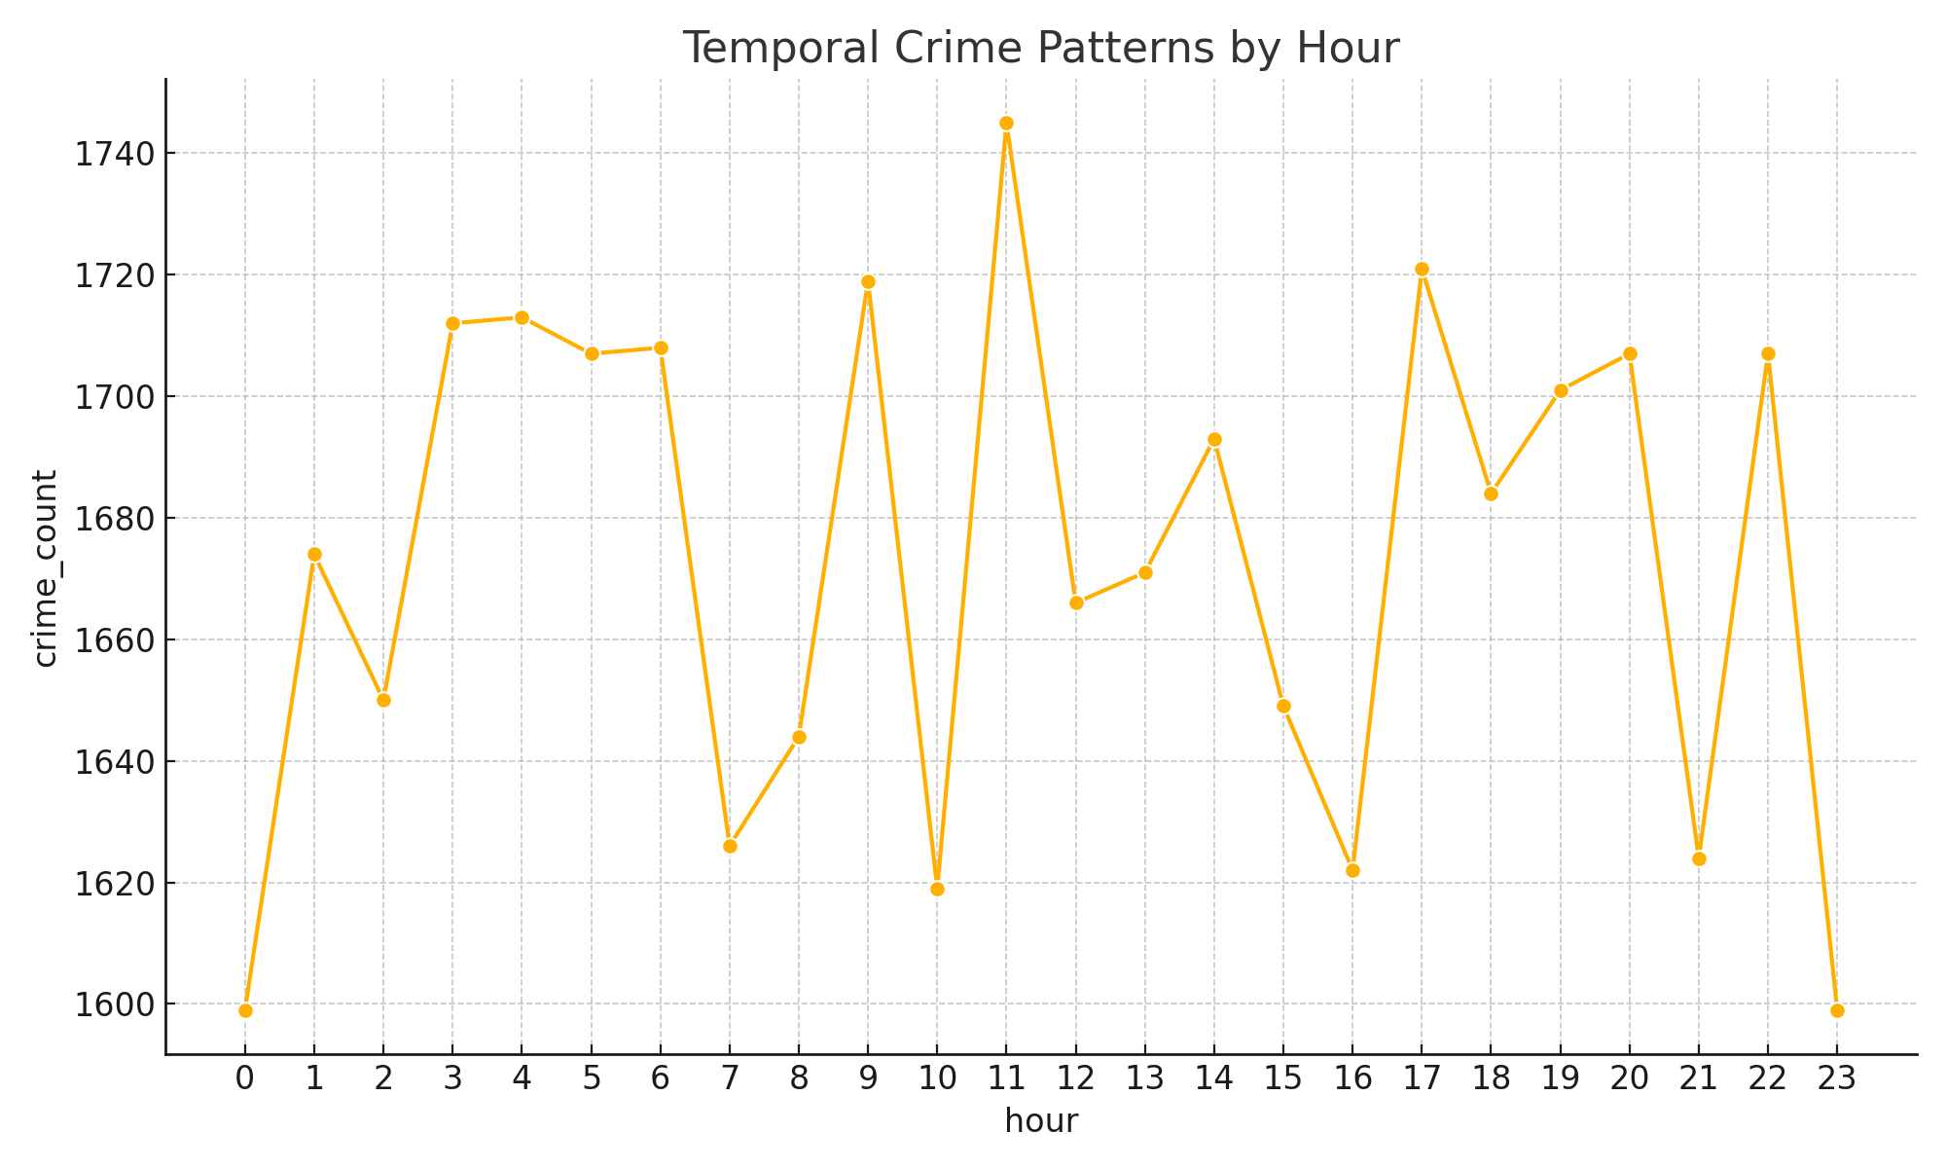
Temporal Patterns in Crime

Slide 8
Crime Hotspots
- Heatmaps show crime-dense areas across districts
- Helps law enforcement focus on high-risk zones
- Based on latitude-longitude clustering

Slide 9
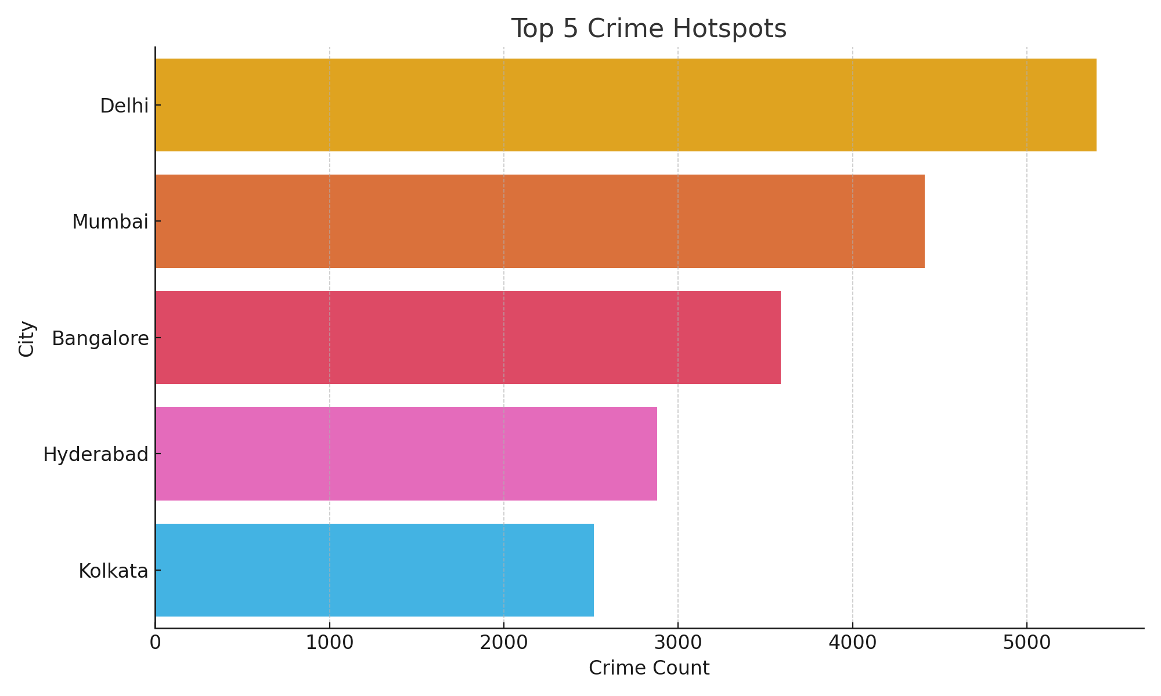
Crime Hotspots

Slide 10
Weapon Usage vs Arrest Rate
- Firearm-related crimes have highest arrest rate
- Correlation plots generated with NumPy & Pandas
- Supports focused interventions

Slide 11
Seasonal Crime Variations
- Summer months see spike in property crimes
- Rainy season has fewer outdoor crimes
- Trends visualized using multi-year line plots

Slide 12
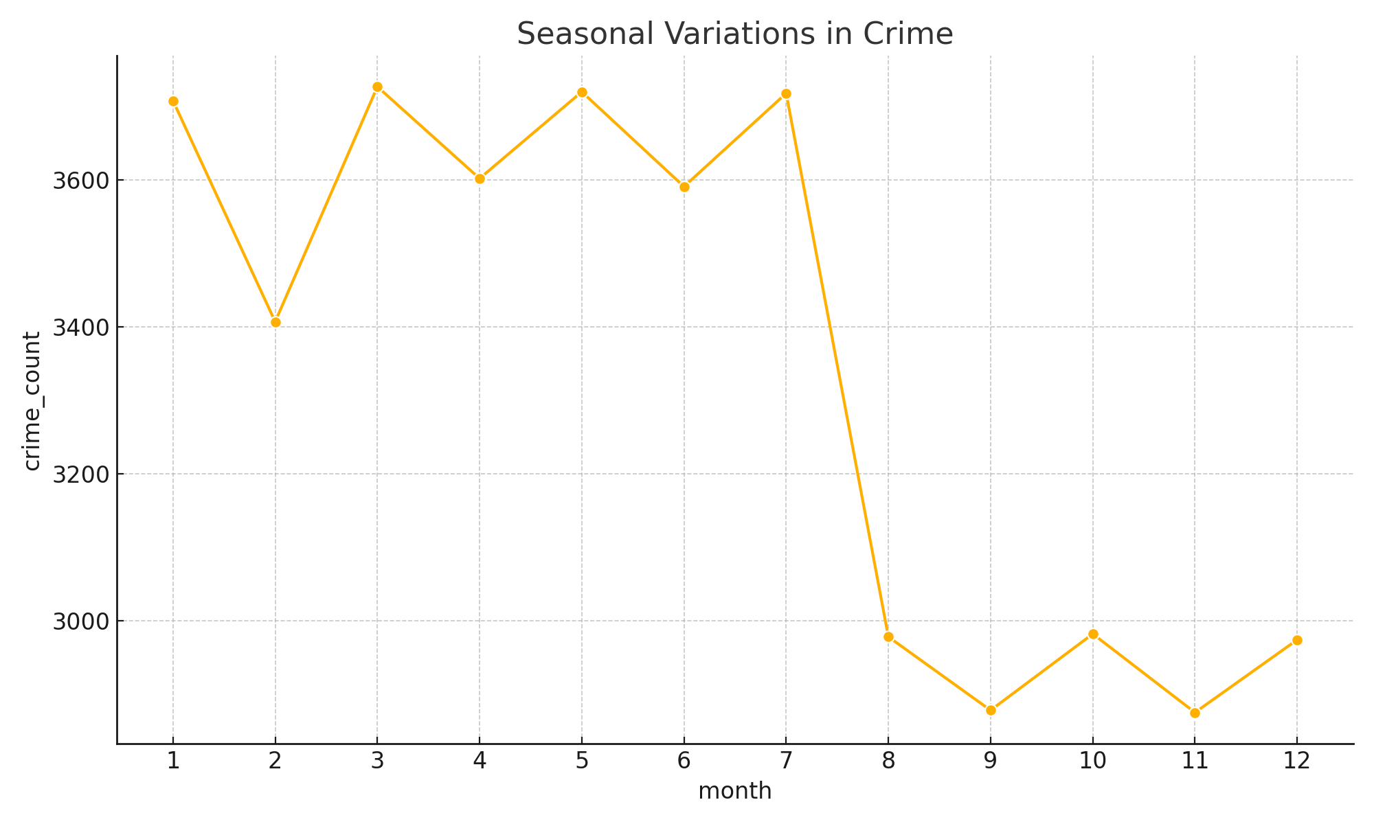
Seasonal Crime Variations

Slide 13
Conclusion
- Data-backed analysis reveals key crime trends
- Future work: Real-time dashboards, prediction models
- Strong foundation for data-informed policing

Slide 14
Thank You

