Slide 1
Failed Banking Transaction Analysis
Using PySpark, Cloud SQL, Dataproc, and BigQuery
Name : SAIESWAR A

Slide 2
Project Overview
Objective: Analyze failed banking transactions to uncover patterns and insights.
Tools: PySpark, Google Cloud Storage, Dataproc, Cloud SQL (MySQL), BigQuery

Slide 3
Data Pipeline Architecture
1. Upload raw CSV to Google Cloud Storage
2. Process using PySpark on Dataproc
3. Cleaned data written to GCS
4. Upload to Cloud SQL
5. Analyze in BigQuery

Slide 4
Cloud Setup
Dataproc Cluster: For distributed Spark processing
Cloud SQL: MySQL used to store cleaned data
IAM Roles & Service Accounts: Controlled access
Storage buckets, security, and connectivity

Slide 5
Data Cleaning with PySpark
Dropped null values
Filtered successful vs failed transactions
Converted timestamps
Generated cleaned CSV (failed_txns.csv)

Slide 6
Cloud SQL Integration
Created 'failed_transactions' table
Inserted cleaned data using Python (MySQL connector)
Validated schema and connections

Slide 7
Data Analysis
Queried using BigQuery and SQL Workbench
Sample queries:
- Most common failure reason
- City with highest failed attempts

Slide 8
Insights & Findings
Percentage of failed transactions
Top branches with repeated failures
Time-based trends (e.g., weekend spikes)

Slide 9
Challenges
Cloud SQL permissions (e.g., CREATE denied errors)
PySpark file not found / GCS path issues
Data mismatch (VARCHAR size errors)

Slide 10
Conclusion
Streamlined ETL pipeline using PySpark and GCP
Enabled real-time failure monitoring and reporting
Scalable solution for future dashboard integration

Slide 11
Q&A
Thank you!
Questions and feedback welcome.

Slide 12
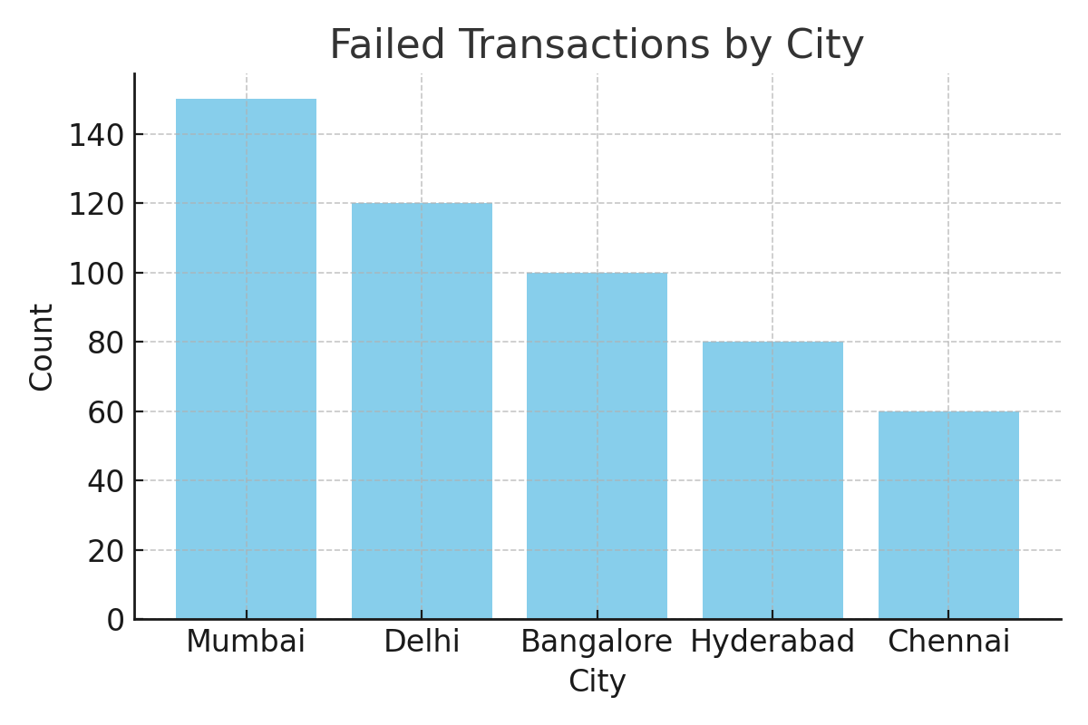
Visualization: Failed Transactions by City

