Slide 1
MSIA CULMINATING INTERNSHIP EXPERIENCE
INTERNSHIP PROJECT
A Java Backend Development Internship
SAI KUMAR JALADI | July / 2026 | IA699
Committee
Collen, Lynn A
Wang, Jieyu
Chen, Jim Q

Slide 2
AGENDA
What We’ll Cover
The Organization & Its Structure
The Problem & the DBP Project
01
02
Architecture, Security & Data
Process, Schedule & Deliverables
03
04
Lessons, Coursework & Impact
Learning Outcomes & Takeaways
05
06
Digital Banking Platform | MSIA Internship
2

Slide 3
SECTION 01 — THE ORGANIZATION
About the Organization
A regional retail bank serving a metropolitan area of the U.S., with a branch network, back-office operations, and a technology division.
MISSION
Reliable, safe, and convenient financial services for all customers — regardless of their comfort with technology.
Products include checking and savings accounts, consumer and business loans, credit cards, and digital account access.
Grew from a single community bank into a regional institution through a series of acquisitions and organic growth.
This mission drove real requirements: plain-language error messages and accessible design were treated as first-class, not an afterthought.
Vision: to be a trusted community bank that pairs strong in-branch service with banking that is both safe and easy to use online.
Digital Banking Platform | MSIA Internship
3

Slide 4
SECTION 01 — THE ORGANIZATION
Recent Transformation: The Digital Banking Platform
3
1
0
business units — branch, back-office, technology
flagship project: the Digital Banking Platform (DBP)
branch visits now required for routine servicing
Before DBP
After DBP
Balances, transfers, and interest postings required a branch visit and manual back-office reconciliation — slow, inconsistent, and hard to scale as the customer base grew.
Customers view balances, transfer funds, and track loans entirely online — matching the self-service experience customers already expect from digital banking.
Digital Banking Platform | MSIA Internship
4

Slide 5
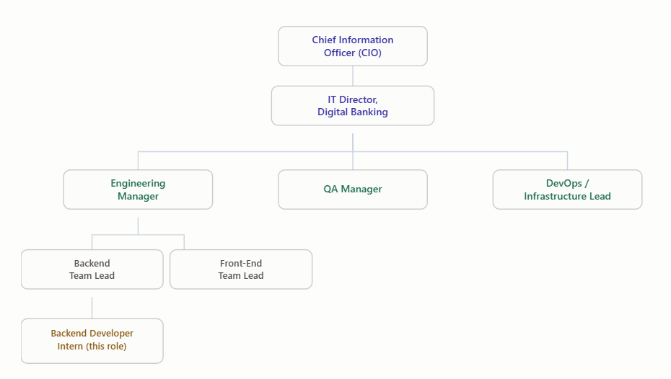
SECTION 01 — THE ORGANIZATION
Organizational Structure
Reporting Line
CIO → IT Director, Digital Banking → Engineering Manager → Backend Team Lead → this internship.
Day-to-day code decisions were resolved in minutes with the Backend Team Lead. Anything touching the shared API contract or budget moved through the Engineering Manager.
Digital Banking Platform | MSIA Internship
5

Slide 6
SECTION 02 — THE PROJECT
The Problem: A Structural Bottleneck
Root cause
No secure, self-service digital channel existed for routine account servicing.
“I remember one branch employee describing a personal notebook of interest-calculation shortcuts she’d worked out over years — knowledge nobody else on her team had.”
Effect
Every balance inquiry, transfer, or interest posting consumed branch staff time and carried manual-entry risk — a cost that grew with transaction volume.
That story made the cost of the old system concrete: undocumented, single-point-of-failure knowledge that a well-designed digital system is meant to eliminate.
Digital Banking Platform | MSIA Internship
6

Slide 7
SECTION 02 — THE PROJECT
Introducing the Digital Banking Platform (DBP)
A Java / Spring Boot application that lets customers view balances, transfer funds, and review loan information — without visiting a branch.
1
2
3
Account Management
Fund Transfers
Loan & Interest Tracking
Create, update, close, and look up balances
Transactional integrity under concurrent load
Automated interest calculation & audit trail
Digital Banking Platform | MSIA Internship
7

Slide 8
SECTION 02 — THE PROJECT
My Role on the Team
Technical Lead
Me — Java Backend Developer
Front-End Developer (x2)
QA Engineer
Owned Account Management, Fund Transfer, and Interest Calculation modules end to end.
Proposed implementation approaches and defended them in code review — not just following instructions.
Coordinated stable API contracts with the front-end team so both sides could build in parallel.
Digital Banking Platform | MSIA Internship
8

Slide 9
SECTION 03 — ARCHITECTURE, SECURITY & DATA
Technology Stack
Java
Spring Boot
Spring Data JPA
Spring Security
Core language
Application framework
Persistence layer
AuthN / AuthZ
MySQL
JUnit & Mockito
Postman
Jenkins
Relational database
Unit / integration tests
Manual API verification
CI/CD pipeline
Digital Banking Platform | MSIA Internship
9

Slide 10
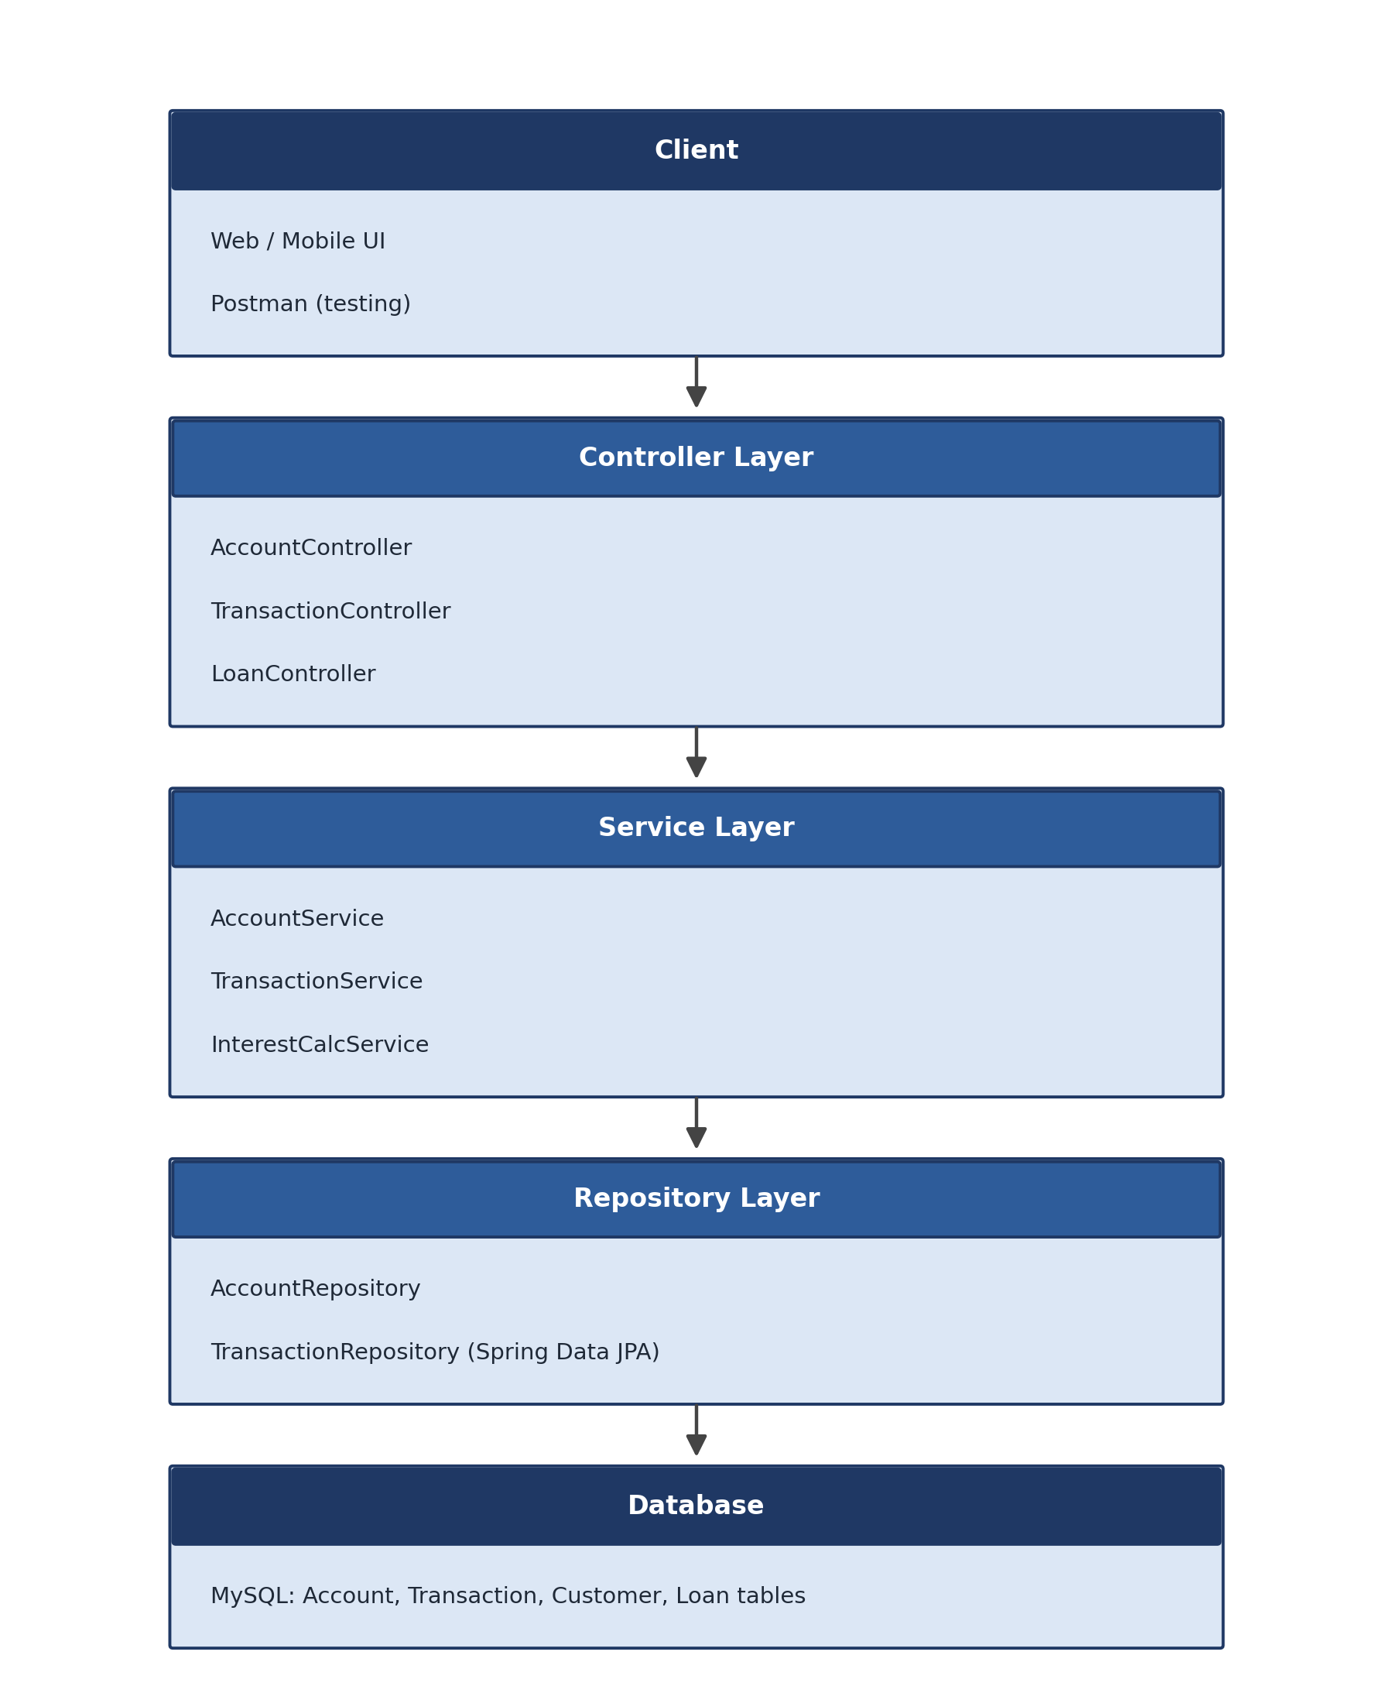
SECTION 03 — ARCHITECTURE, SECURITY & DATA
Layered Application Architecture
Client
Web / mobile UI and Postman for manual verification
Controller Layer
AccountController, TransactionController, LoanController
Service Layer
Business logic, including transactional guarantees
Repository Layer
Spring Data JPA over MySQL
Digital Banking Platform | MSIA Internship
10

Slide 11
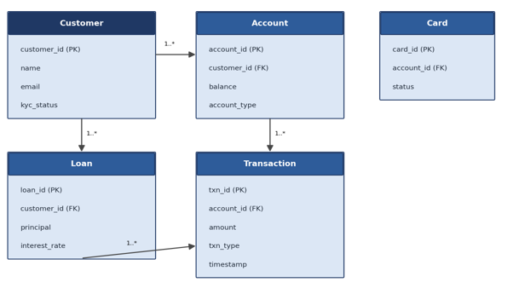
SECTION 03 — ARCHITECTURE, SECURITY & DATA
Database Design
WHY IT’S INTERDEPENDENT
A transfer touches the same account rows a balance inquiry reads. An interest posting is itself a specialized account update.
These modules were tracked separately on the backlog but could never be designed in isolation.
Entity-relationship diagram covering the customer, account, transaction, card, and loan entities.
Digital Banking Platform | MSIA Internship
11

Slide 12
SECTION 03 — ARCHITECTURE, SECURITY & DATA
Security: Defense in Depth
Public DMZ
Application Tier
Restricted Data Tier
Web application firewalls + network ACLs filter inbound traffic
TLS in transit; role-scoped services process requests
Encryption at rest for account and PII data
→
→
Each layer assumes the layer in front of it might eventually fail — an attacker who breaches the DMZ still has to defeat the application tier before ever reaching customer data.
Digital Banking Platform | MSIA Internship
12

Slide 13
SECTION 03 — ARCHITECTURE, SECURITY & DATA
Authentication & Role-Based Access Control
SPRING SECURITY
Passwords hashed with a salted, one-way algorithm — never stored in plain text or reversible encryption.
Three roles govern every endpoint on DBP:
Customer
Teller
Administrative actions (e.g., reversing a transaction) require an elevated role and are fully audited.
Administrator
Each audited action logs the acting user, timestamp, and affected account to reconstruct disputes.
For every new endpoint: which roles have a legitimate business reason to call it?
Digital Banking Platform | MSIA Internship
13

Slide 14
SECTION 03 — ARCHITECTURE, SECURITY & DATA
Data Protection, Logging & Compliance
1
2
3
4
Encryption
Audit Trail
Monitoring
Compliance
TLS in transit; encryption at rest for account numbers, balances, and PII.
Every sensitive action reconstructable by acting user, timestamp, and account.
Centralized logging across applications and infrastructure flags anomalies.
Security program aligned to PCI DSS and standard retention / incident rules.
Key lesson: sensitivity often lives in combinations of fields, not any single field — a masked account number plus a timestamp and session ID can still re-identify a customer.
Digital Banking Platform | MSIA Internship
14

Slide 15
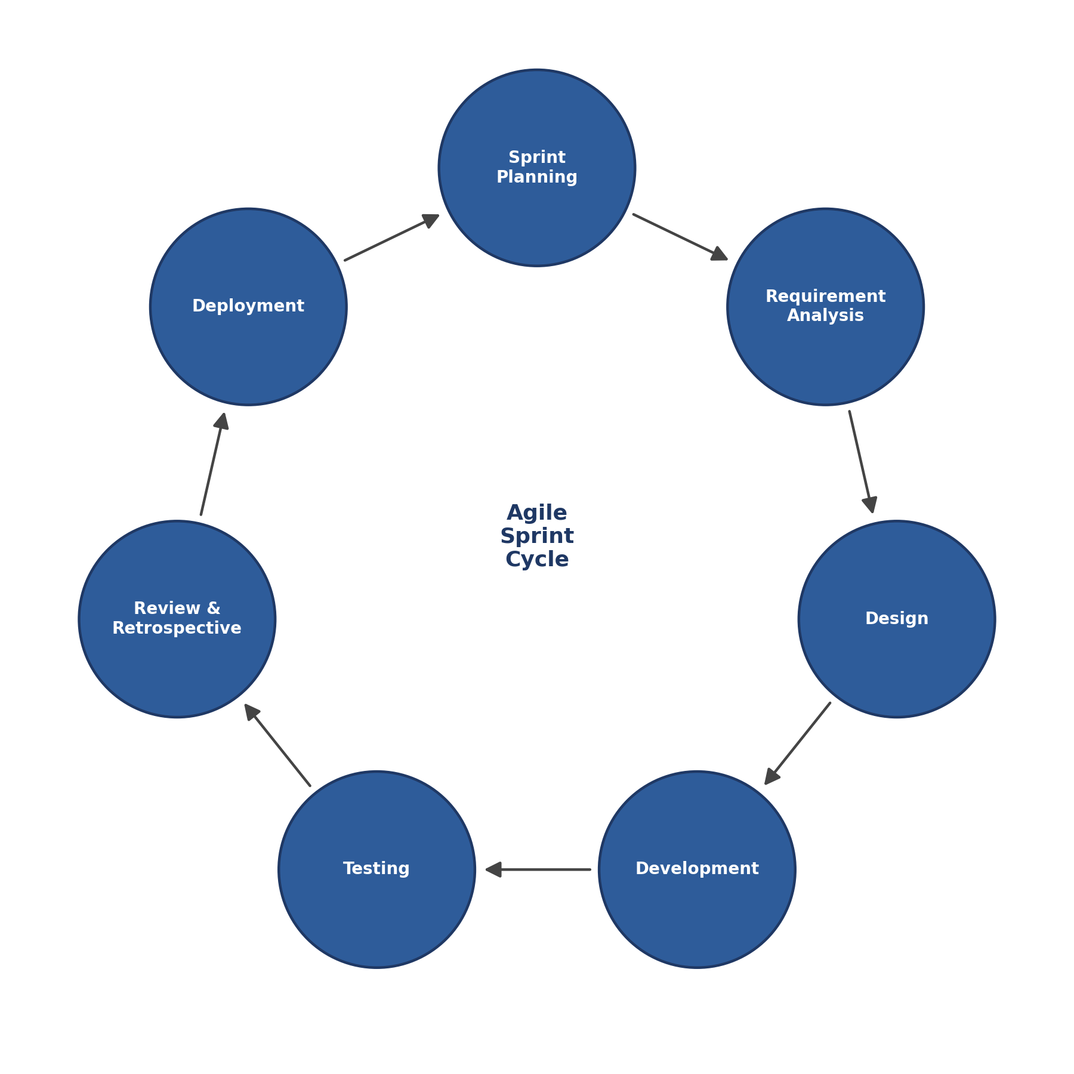
SECTION 04 — PROCESS & DELIVERY
Agile / SDLC Methodology
1
Plan & groom backlog
2
Build in two-week sprints
3
Demo to stakeholders
4
Retrospective — process, not blame
Retrospectives reframed every issue as a process question — not a person question — which made the team far more willing to surface mistakes early.
Digital Banking Platform | MSIA Internship
15

Slide 16
SECTION 04 — PROCESS & DELIVERY
Internship Timeline
18 sprints across 3 phases, from onboarding through production hand-off.
Phase 1
Phase 2
Phase 3
Sep–Dec 2025
Jan–Apr 2026
May–Jul 2026
Sprints 1–7
Sprints 8–14
Sprints 15–18
Schema, customer, account, card, and fund-transfer modules
Notifications, reporting, performance & security hardening
UAT, production deployment, hand-off & wrap-up
Digital Banking Platform | MSIA Internship
16

Slide 17
SECTION 04 — PROCESS & DELIVERY
Core Deliverables
Customer registration & authentication APIs
Account create / update / close / balance look-up
✓
✓
Fund transfer & withdrawal with transactional integrity
Automated interest calculation for loans
✓
✓
Normalized MySQL schema across all modules
Unit & integration test coverage (JUnit, Mockito)
✓
✓
Digital Banking Platform | MSIA Internship
17

Slide 18
SECTION 04 — PROCESS & DELIVERY
Engineering the Hard Part: Fund Transfers
THE CONSTRAINT
INTEREST CALCULATION TRADE-OFF
Money movement must be correct even when two transactions hit the same account at nearly the same moment.
Fastest option: overwrite each balance in place.
Chosen option: generate and store an explicit interest-posting record on every run.
Safeguards against near-simultaneous debits to the same account; rollback handling for partially failed transfers; later load-tested against simulated concurrent requests.
A small amount of extra processing time bought a complete, reconstructable audit history for every interest calculation the system ever performed.
Digital Banking Platform | MSIA Internship
18

Slide 19

SECTION 04 — PROCESS & DELIVERY
CI/CD Deployment Pipeline
Development
SIT
UAT
Production
Automated test gate must pass to promote
→
Automated test gate must pass to promote
→
Automated test gate must pass to promote
→
Monitored post-release
Digital Banking Platform | MSIA Internship
19

Slide 20
SECTION 04 — PROCESS & DELIVERY
Testing Strategy
JUnit & Mockito — verifying individual service and repository methods
Unit Tests
1
Cross-module flows spanning customer, account, transfer, card, and loan
Integration Tests
2
Postman checks before handoff — caught contract mismatches early
Manual Verification
3
“I started treating manual verification as part of the definition of ‘done’ — not an optional nicety — after it repeatedly caught mismatches between code and documented contract.”
Digital Banking Platform | MSIA Internship
20

Slide 21
SECTION 05 — LESSONS & IMPACT
Lesson: The API Contract Incident
WHAT HAPPENED
WHAT CHANGED
I changed an API field name without telling the front-end team — it broke the transfer confirmation screen for a short period.
An API contract is a shared agreement, not something I can modify unilaterally.
Afterward: version and document endpoint changes before merging, and proactively flag even minor field renames in the team channel before opening a pull request.
Digital Banking Platform | MSIA Internship
21

Slide 22
SECTION 05 — LESSONS & IMPACT
Lesson: Reasoning About Concurrency
Before
Turning Point
After
Code that “looked” correct — with little thought given to what happens when two operations compete for the same data.
A Technical Lead asked what would happen to a multi-step update if the database connection dropped halfway through.
Checking for concurrency issues became automatic — reviewing a pull request without asking “what if this runs twice at once” felt incomplete.
→
→
Digital Banking Platform | MSIA Internship
22

Slide 23
SECTION 05 — LESSONS & IMPACT
Coursework That Made a Difference
IA 643
IA 559
IA 560
Database Application Security & Auditing
Information Systems in Today’s World
Project Management
Shaped SQL-injection defense and least-privilege access design
Framed “does this improve the process” over “can this be built”
SMART goals & Gantt charts — directly useful for sprint planning
Digital Banking Platform | MSIA Internship
23

Slide 24
SECTION 05 — LESSONS & IMPACT
Contribution to the Organization
Transactional safeguards on fund transfers prevented a class of bug (inconsistent balances) that QA specifically tested for.
1
A stable, documented API surface let the front-end team build in parallel instead of waiting on backend progress.
2
Fresh-eyes questions surfaced stale validation assumptions the team had stopped questioning.
3
Digital Banking Platform | MSIA Internship
24

Slide 25
SECTION 05 — LESSONS & IMPACT
Contribution to My Growth
Reading code as documentation
Writing for future readers
Recent commit history often beats an out-of-date wiki page.
Commit messages evolved to explain why, not just what.
Owning API contracts
Thinking in failure modes
Every boundary-crossing change now gets a heads-up to the team.
“What happens if this runs twice at once” became automatic.
Digital Banking Platform | MSIA Internship
25

Slide 26
SECTION 06 — OUTCOMES & TAKEAWAYS
Learning Outcomes Achieved
SLO 1
SLO 2
Applied database design, secure coding, and OO design to real production constraints, not just coursework rubrics.
Communicated daily through stand-ups, planning, and retrospectives — surfacing blockers early, not silently.
SLO 3
SLO 4
Implemented transactional safeguards, RBAC, and secure coding as default design requirements.
Reflected on the API-contract incident and concurrency growth to build durable habits.
Digital Banking Platform | MSIA Internship
26

Slide 27
SECTION 06 — OUTCOMES & TAKEAWAYS
Key Takeaways
Speed of delivery never outweighs correctness on a system that handles real customer funds.
1
Defense in depth applies as much to code review habits as to network architecture.
2
An API contract is a shared agreement — treat every boundary-crossing change as a heads-up, not a surprise.
3
Treat every question from a reviewer, QA engineer, or operations employee as useful information, not criticism.
4
Digital Banking Platform | MSIA Internship
27

Slide 28
Thank You
Questions & Discussion
[Your Name] | [Your Email]

