Slide 1
SALIENCY DETECTION ON documents(resumes)
Sai Annapragada

Slide 2
INTRODUCTION
This research work is to find out the saliency prediction of an document especially resumes.
The motivation to this problem is based on the new approach to webpage saliency prediction by combining two independent sub-tasks task-specific attention shift prediction and task free saliency prediction

Slide 3
Dataset
Dataset was created using webgazer.js package which is an eyetracking tool.
In eye tracking, the gaze point refers to the location on a screen or visual display that a person is looking at with their eyes.
The gaze point is typically represented by a pair of X and Y coordinates, which correspond to the horizontal and vertical position of the person's gaze on the screen, respectively.

Slide 4
WebGazer.js generates eye tracking data as an object containing the following parameters:
x: The x-coordinate of the gaze point on the screen in pixels.
y: The y-coordinate of the gaze point on the screen in pixels.
time: The timestamp of the gaze point in milliseconds.
windowWidth: The width of the window in pixels.
windowHeight: The height of the window in pixels.

Slide 5
implementation
Created a simple http server using flask and integrated webgazer.js package in the webpage to access the eyetracking and the data generated by this server will be stored in an csv file.
For the POC phase I have used few resumes and and created an single csv file which has to preprocessed before implementing an model.

Slide 6
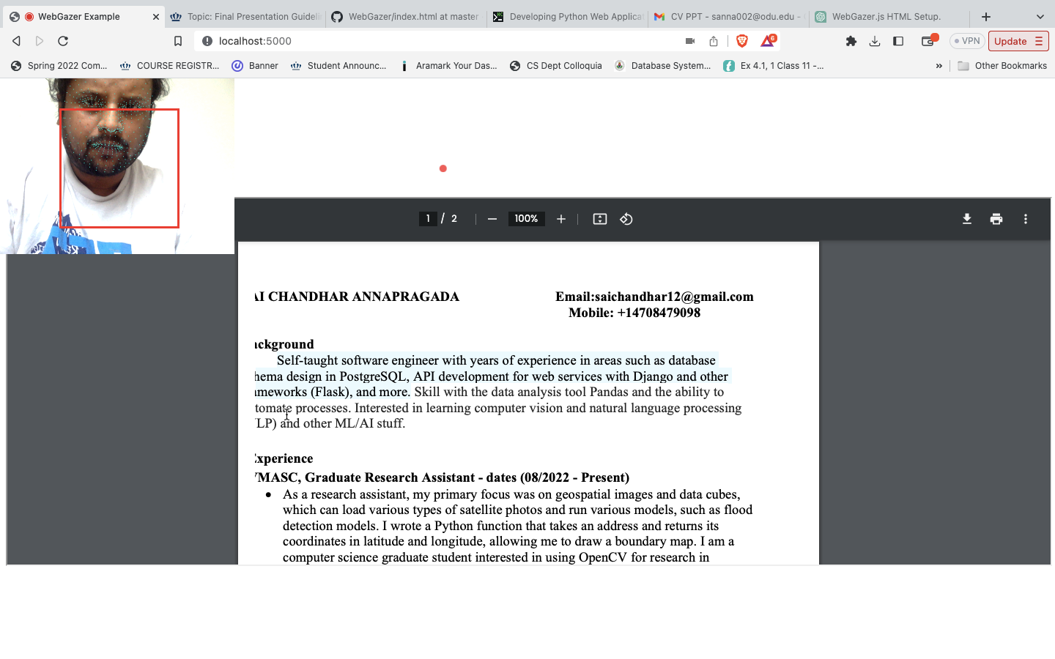

Slide 7
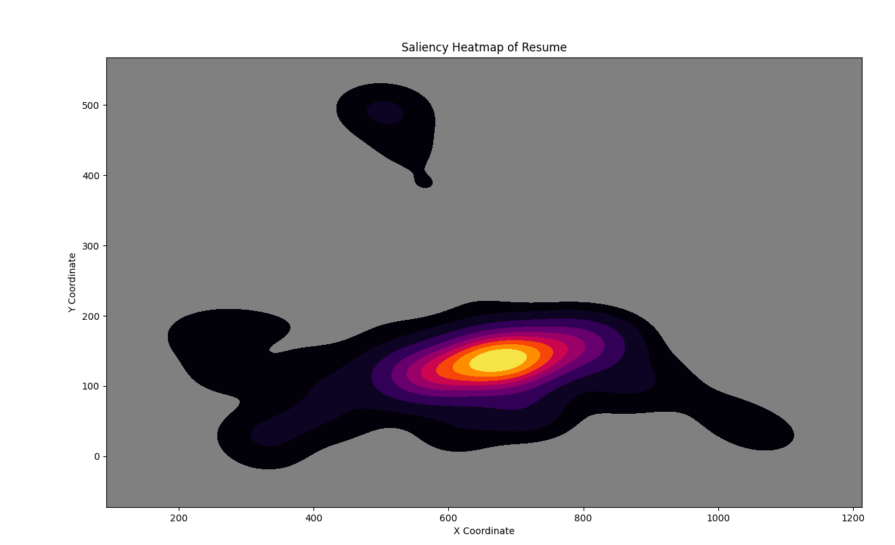
Saliency map of an resume

Slide 8
System(conceptual)
Data Preparation:
Collect a labeled dataset of resumes and their salient features. The dataset should contain information on which parts of the resume are most likely to be salient to a human reader. This can be done through eye-tracking experiments or manual labeling.
Preprocess the dataset by normalizing, scaling, and splitting it into training, validation, and test sets.
Model Architecture:
Design a deep neural network architecture that can take in a resume as input and output a saliency heatmap indicating the areas of the resume that are most likely to be salient to a human reader.
Some popular deep learning architectures for image processing, such as Convolutional Neural Networks (CNNs) or Recurrent Neural Networks (RNNs), can be adapted for this task.
Training:
Train the model on the labeled dataset using backpropagation and gradient descent.
The training process involves feeding the network with the training set, computing the loss between the predicted saliency heatmap and the ground truth, and updating the weights of the network to minimize the loss.
Monitor the performance of the model on the validation set to avoid overfitting.
Evaluation:
Evaluate the performance of the trained model on the test set using metrics such as mean absolute error, mean squared error, or correlation coefficients.
Visualize the saliency heatmap predicted by the model for a given resume and compare it to the ground truth.

Slide 9
FUTURE WORK
Future work would be creating an AI model that can take resume as an input and generate the saliency heatmap by saying which parts are the most effective in the resume.

