Slide 1
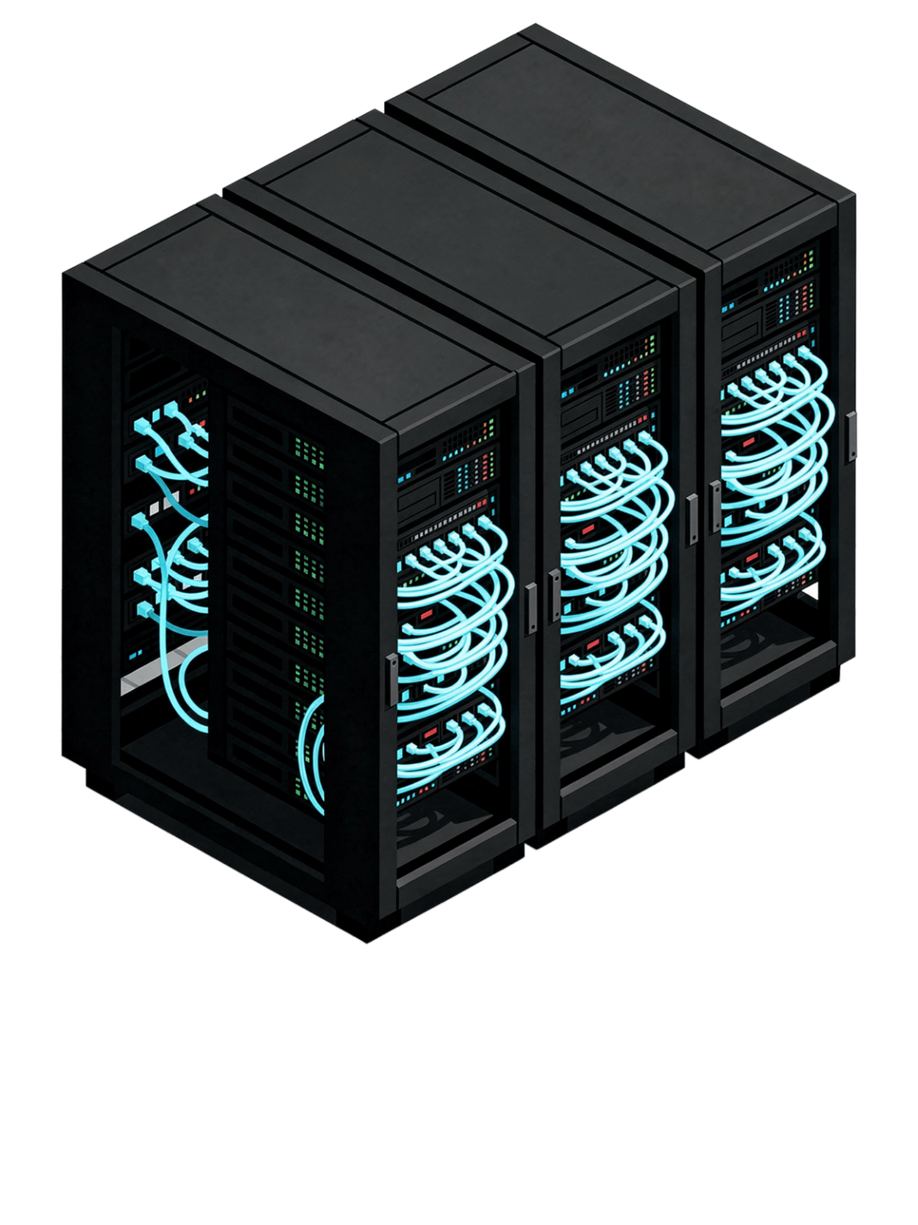
Banking Agentic AI
From call-centre bottleneck to a production-grade multi-agent banking system — built one layer at a time.
CONFERENCE / WORKSHOP EDITION
CLAUDE CODE IMPLEMENTATION BLUEPRINT

Slide 2
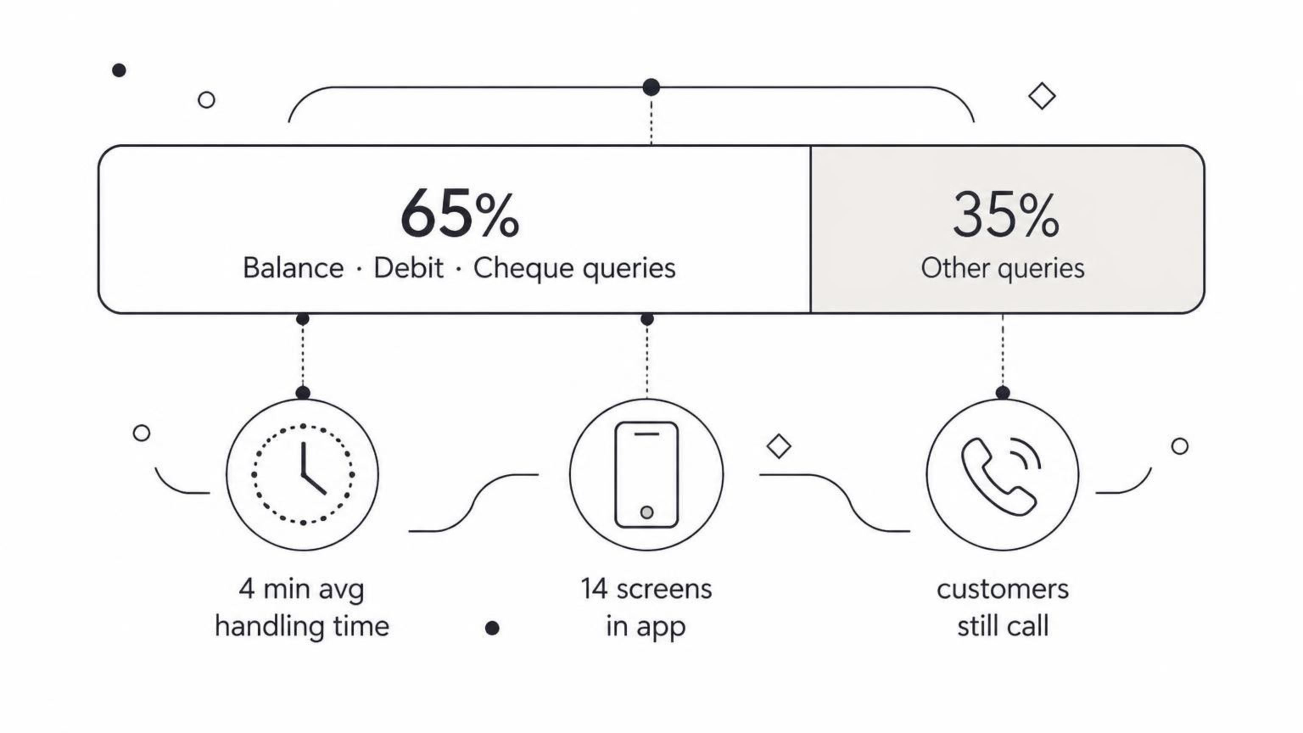
4.2 Lakh Calls a Month — and 65% Are Unnecessary
4.2L
Opening question for the room
"If the app already knows the answer, why are customers still calling?"
Inbound calls/month
Root cause: The netbanking app contains the answer distributed across 14 screens. Customers cannot navigate it and call instead — converting a self-service app into a call-centre driver.
Cost implication: Hundreds of agent-hours per day spent on fully automatable queries. At 4 min/call × 273,000 automatable calls/month, that is over 18,000 agent-hours monthly.
Every single month, 420,000 customers pick up the phone.
65%
Speaker note: Let this question hang. The rest of the deck is the answer.
Three simple queries
Account balance · Recent debit confirmation · Cheque-book status
4 min
Avg handling time
For information the app already holds — across 14 screens.

Slide 3
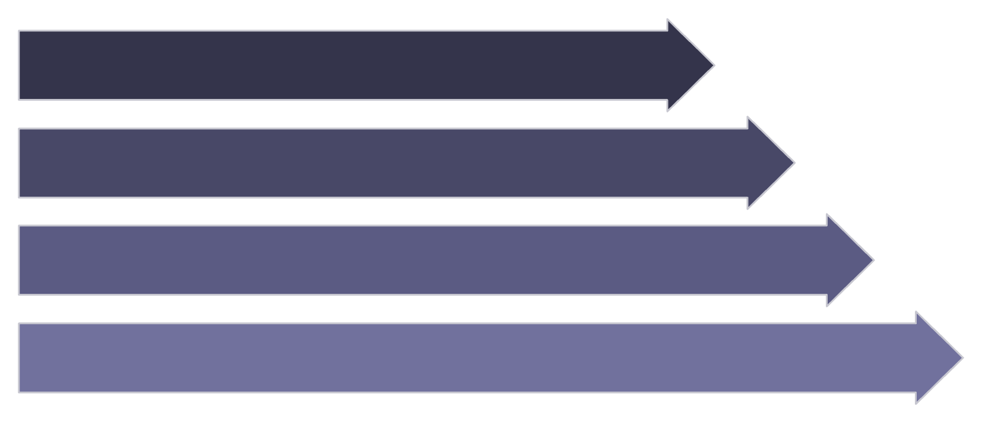


What We Want to Build
The Goal
Mental Model — System Flow
A conversational banking agent that answers natural-language queries using live bank data — eliminating the need to call for routine information.
User
Answers from authoritative data
Chat Interface
No hallucination. Every response must be grounded in live bank system output, not model training knowledge.
Banking Agent
Bank Systems
Grow safely, one layer at a time
No premature complexity. Each architectural layer is introduced only when the previous layer reveals a concrete problem.
The teaching approach mirrors the architecture: introduce each layer only when the previous layer reveals a problem. No component appears without a demonstrated reason.
Explainable and reversible
Speaker note: Establish the "problem → solution" rhythm here. Every slide follows this pattern. First live demo: run a minimal "What is my account balance?" interaction — no tools, no auth, just the raw agent.
Every architectural decision must be justifiable to engineering, compliance, and operations teams.

Slide 4


Step 1 — Naive Agent: One Box, Too Much Responsibility
BUILD STEP 1
Architecture: The Simplest Possible Pipeline
What Works — and What Breaks Immediately
✓ What works
✗ What breaks
Chat UI
Handles a single, well-scoped question in isolation. The pipeline is simple to deploy and debug.
The agent has no access to bank data. Any query requiring live account information fails immediately.
API
Agent
Customer: "What is my account balance?"
Agent: "Sorry, I don't have access to your bank accounts."
LLM
Four nodes. No tools. No authentication. No memory. The agent can only respond from its LLM training knowledge — it has no connection to any bank system.
Structural problem: As banking capabilities grow, this single agent becomes a single point of responsibility — and failure. The transition is clear: give the agent tools.
Speaker note: This is intentionally the "wrong" architecture. Show the demo failure before proposing the fix.

Slide 5
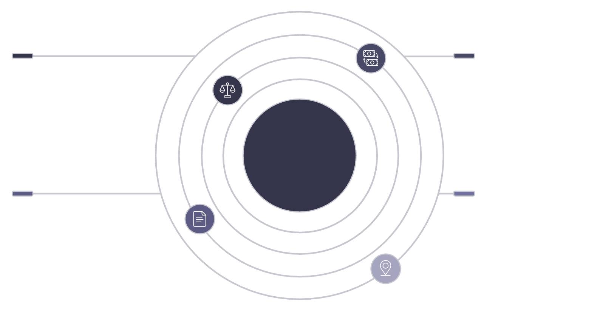

Step 2 — Give the Agent Banking Tools
BUILD STEP 2–3
LIVE DEMO
Architecture Change: Six Tool Connections
Six Banking Tools Exposed
Balance Enquiry
Transaction Details
Balance Enquiry
Transaction Details
Check account balances quickly
Retrieve recent transaction history
Statement Request
Change of Address
Agent Hub & Tool Connections
Cheque Book Request
KYC Update
Statement Request
Change of Address
Generate and send account statements
Update customer mailing address
How it works: The LLM decides which tool to invoke based on the user's natural-language intent. The balance query now succeeds — live data is returned from the banking API.
New problem surfacing: One agent now has unrestricted access to all six tools across all banking domains. A single misconfigured prompt could invoke any tool for any user.
Speaker note: Celebrate the win briefly, then immediately surface the "too much access" problem to set up the next slide. Demo: Balance enquiry via the tool path — show the tool call in the trace.

Slide 6

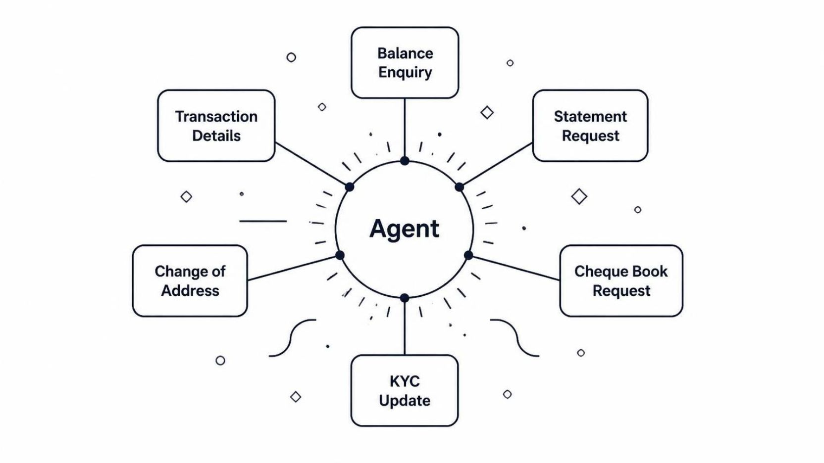


Step 3 — Problem: One Agent Does Everything
PROBLEM SLIDE
The Scaling Problem — Three Failure Modes
The Cross-Domain Exposure
Cognitive overload
The system prompt must describe every tool, every domain, every edge case. Prompt bloat directly degrades the model's reasoning quality as the context window fills with irrelevant instructions.
No separation of concern
An accounts query and a KYC update share the same agent context. A bug in one domain's tool handling can corrupt state in another domain — silently.
Audit and compliance risk
You cannot restrict what the agent can do per request. Every user implicitly has access to every tool — there is no principle of least privilege in this architecture.
"What is my balance AND show me my last 5 transactions?" — A cross-domain request. The single agent must juggle both domains simultaneously with no isolation between them.
Speaker note: The crowded agent diagram is intentional — the visual mess is the point. Ask the audience: "What happens when a request needs two banking domains at once?"

Slide 7
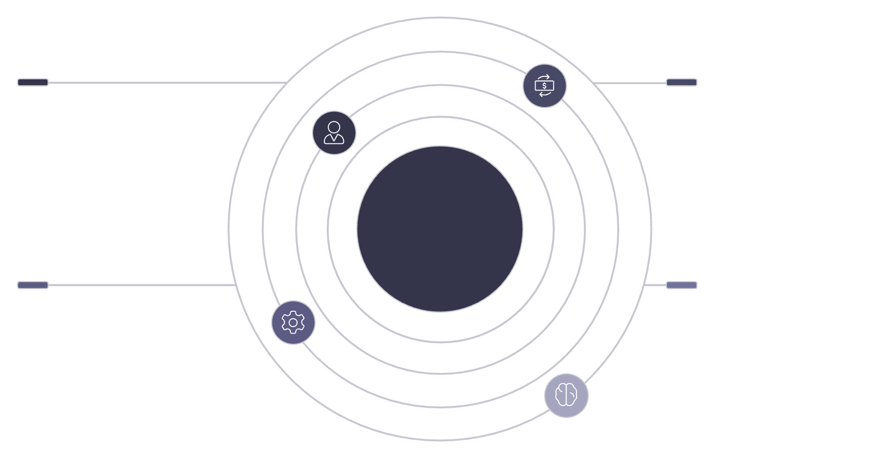



Step 4 — Split by Banking Domain: Specialist Agents
BUILD STEP 4
LIVE DEMO
Architecture Change: One General → Three Specialist Agents
Domain Boundaries and Benefits
Accounts Agent
Transaction Agent
Balance Enquiry only. Minimal system prompt. No awareness of transactions or service operations.
Transaction Details + Statement Request. Scoped to transaction history domain exclusively.
Accounts Agent
Transaction Agent
Handles balance enquiries only
Transaction details and statements
Top-Down Chat → API → Agent Architecture
Service Agent
Change of Address + Cheque Book Request + KYC Update. All service operations in one isolated domain.
Service Agent
LLM
Focused system prompts → better reasoning, smaller context
Address, cheque book, KYC updates
Shared model (dashed connections)
Tool access restricted by domain → principle of least privilege
Failures isolated → a Service Agent bug cannot affect Accounts
New problem: Who decides which specialist to call? Someone still has to coordinate them.
Speaker note: The specialist split is the right instinct. The missing piece is the coordinator — set it up as the obvious next step.

Slide 8
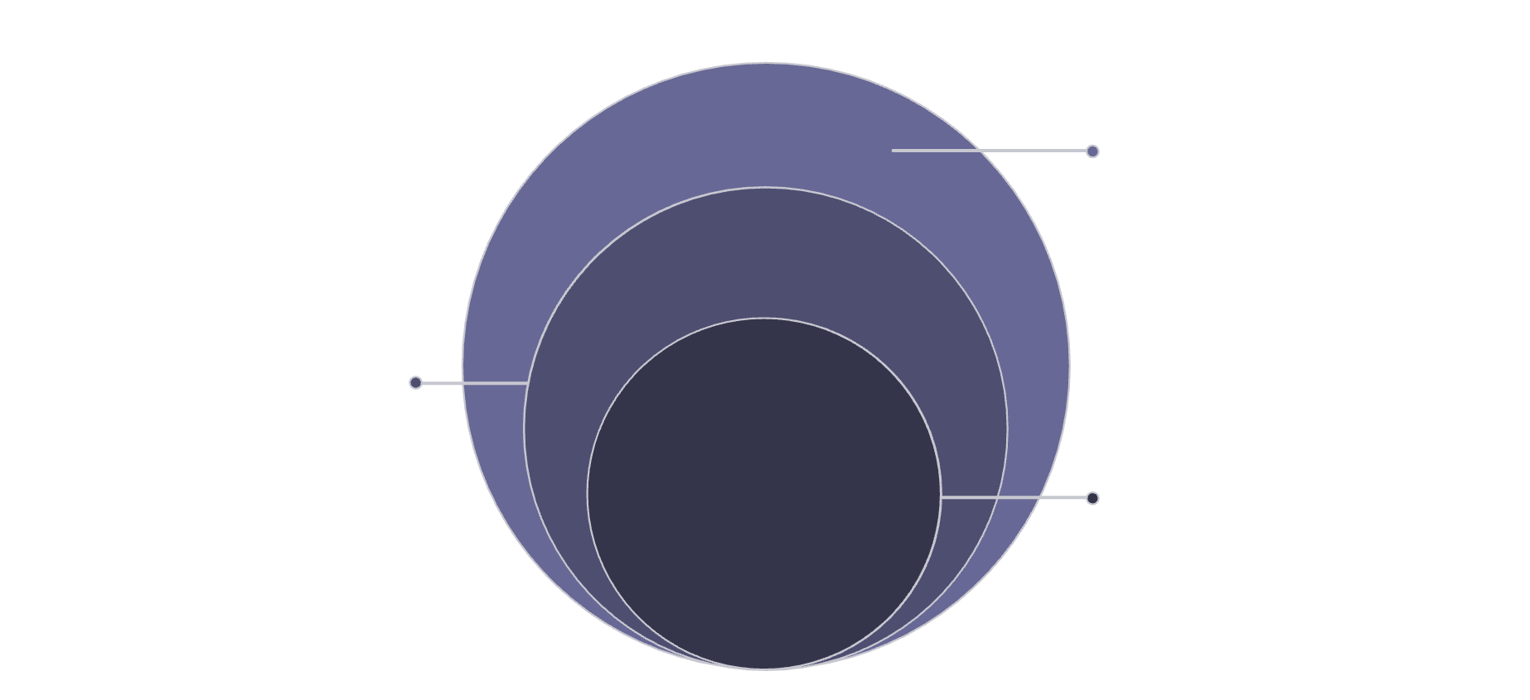


Step 5 — Coordinator Agent: The Decision-Maker
BUILD STEP 5
LIVE DEMO
Architecture: Coordinator Sits Above All Specialists
Coordinator Responsibilities
01
Specialists & Tools
Parse user intent
Accounts, Transaction, Service and their tools
Natural-language input is classified into one or more banking domains via the LLM.
02
Identify specialist(s) needed
LLM (Side)
Single-domain: route directly. Multi-domain: dispatch to multiple specialists.
Classifies intent; dashed-link to coordinator
Coordinator Agent
03
Decision-maker coordinating specialists
Dispatch in parallel or sequence
Balance + last 5 transactions → Accounts Agent AND Transaction Agent called simultaneously.
04
Merge and synthesise results
Coordinator assembles a coherent, unified response from multiple specialist outputs.
This is the first architecture that actually works for real banking queries. The coordinator solves the routing problem the specialist split created.
Remaining problem: Agents and tool implementations are tightly coupled — changing a tool requires changing the agent code directly.
Speaker note: Pause here — it's a milestone. Demo: Walk the mixed balance + transactions request end-to-end with the coordinator visible in the trace.

Slide 9

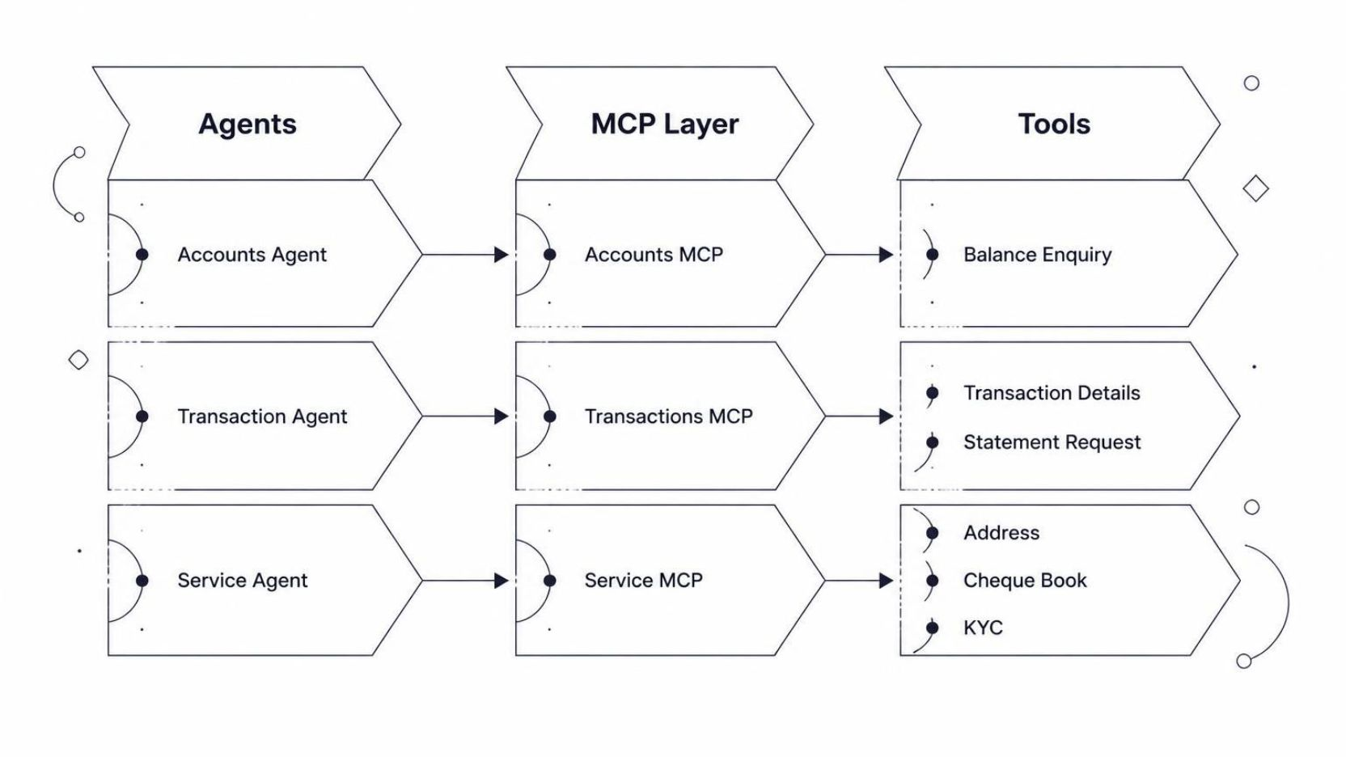


Step 6 — MCP: Loosely Coupled Tool Boundaries
BUILD STEP 6
LIVE DEMO
MCP: Model Context Protocol
Architecture Change and Benefits
A standard interface layer between agents and tool implementations. MCP decouples what the agent asks from how the tool responds.
Tool implementations change without touching agent code
Upgrade a banking API backend? Update the MCP server. The agent is unaffected.
MCP servers versioned and deployed independently
Each MCP server can be tested, rolled back, and scaled independently from the agent layer above it.
New tools without rewriting the agent
Add a new capability to an MCP server; the agent discovers it via the protocol without code changes.
Next gap: The system now has capability — but it still does not know who is asking. Any user can query any account.
Speaker note: MCP is the architectural boundary that makes the system production-maintainable. Emphasise the decoupling benefit for the Claude Code build.

Slide 10
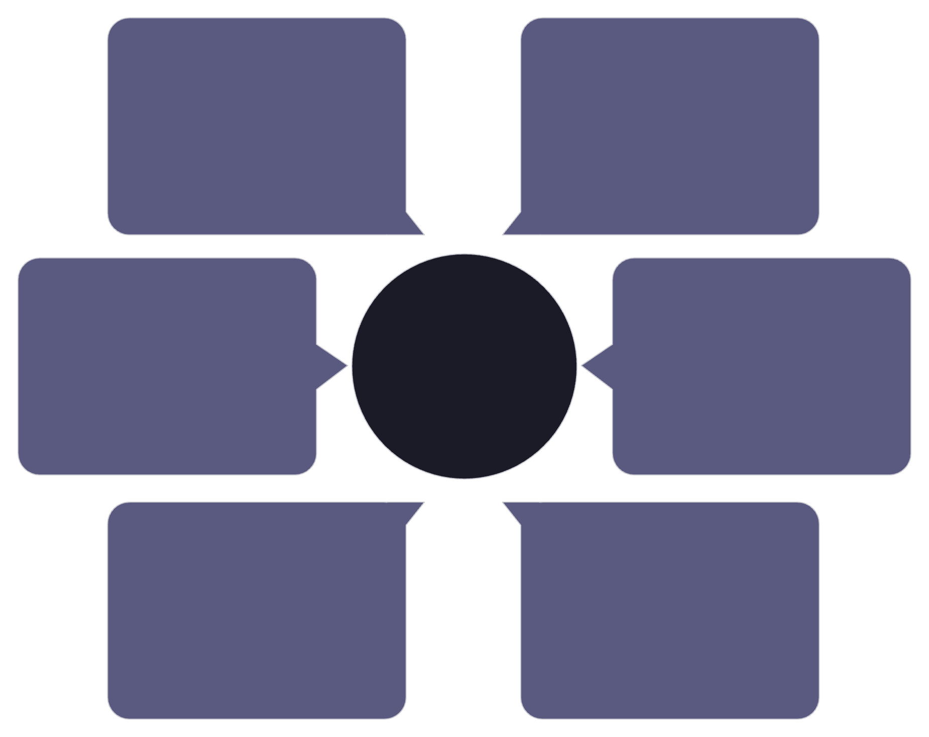

Step 7 — Authentication: The System Must Know Who Is Asking
BUILD STEP 7
LIVE DEMO
Authentication Flow with Token Propagation
What Identity Enables
Scoped data access
Per-user permission enforcement
Transaction Agent
Data is returned only for the authenticated account holder. Cross-account queries are blocked at the coordinator before any tool is invoked.
Elevated operations (e.g. credit limit increase) require elevated authentication — standard tokens are rejected.
User
Receives propagated token
Initiates session
Verified audit trail
Every agent action is tied to a verified identity — required for RBI and internal compliance reporting.
Authentication & Token Propagation
John (standard)
Sancy (restricted)
Accounts Agent
Requests credit limit increase → Approved ✓
Same request → Elevated auth required ✗ → redirected to customer support
Bank IdP / LDAP
Receives propagated token
Issues auth token
Speaker note: Authentication is non-negotiable in banking. The John vs Sancy contrast makes the permission model concrete and memorable.
Coordinator Agent
API Gateway
Locks context and forwards
Validates token
Implementation note: Customer ID is collected at session start. All downstream tool calls carry the authenticated context — no specialist operates without a verified identity token.

Slide 11

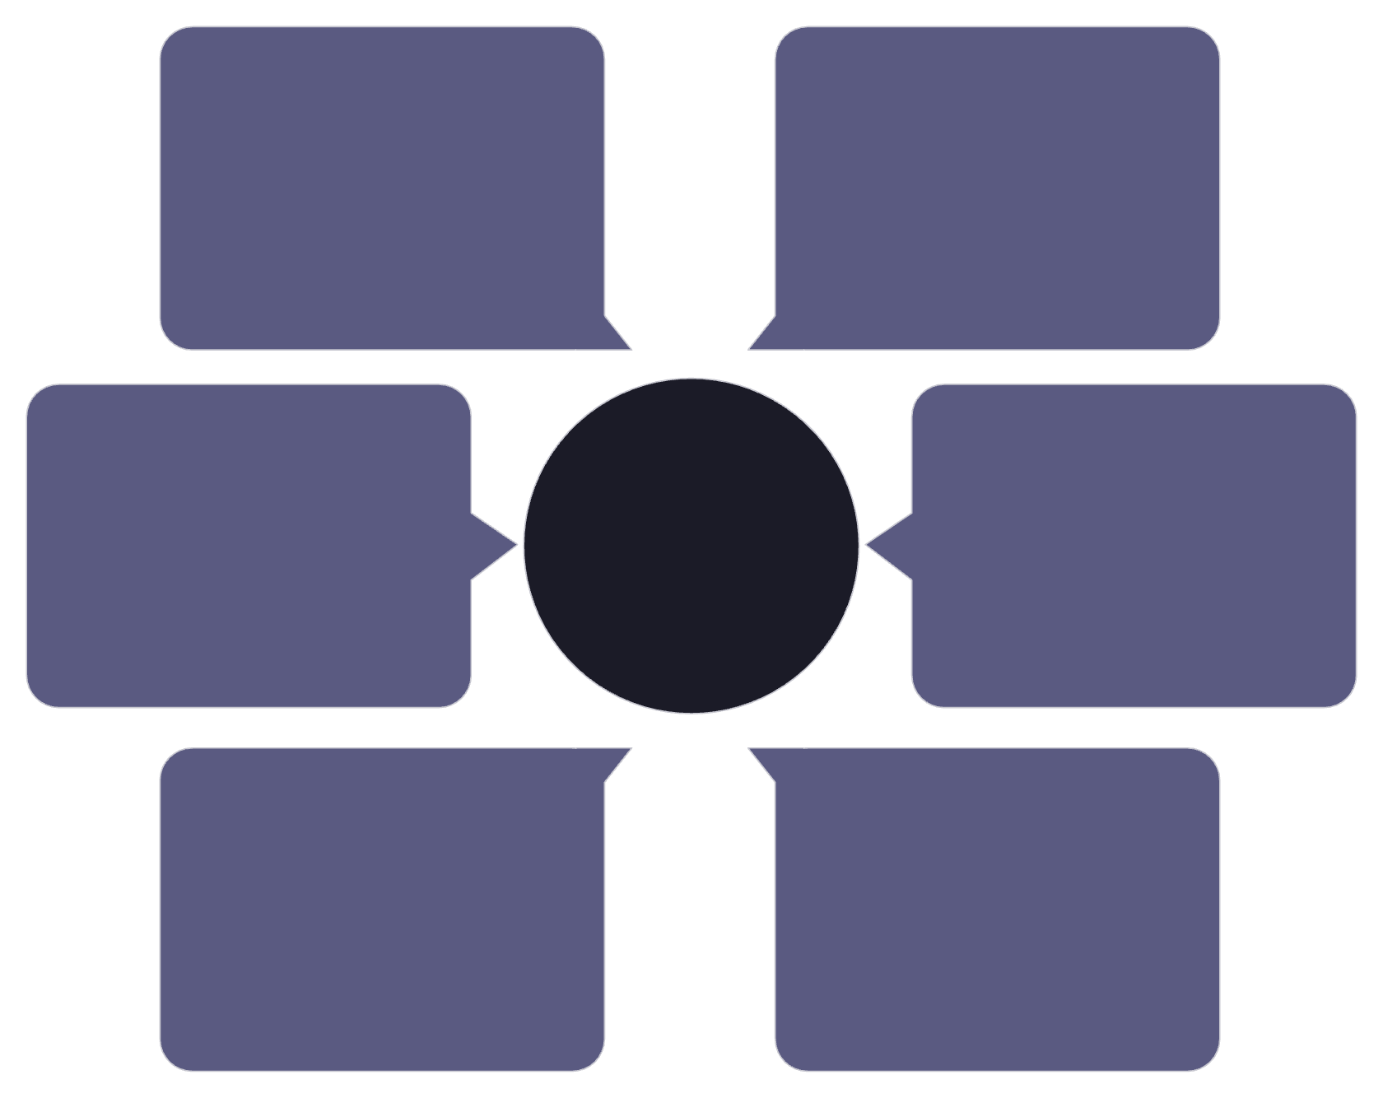
Step 8 — Session + Memory: State That Persists Across Turns
BUILD STEP 7 CONT.
The Problem: Stateless Conversations
Session Store Contents
Sanjay: "What happened with the suspicious transaction I flagged last week?"
Agent: "I have no record of a flagged transaction, please clarify."
Conversation history
Per-user, per-session message history. The agent can reference what was said at any prior turn — including flagged items, acknowledged queries, and in-progress requests.
Without session state, every message is a fresh conversation. The agent forgets what the user said two turns ago — let alone last week. For banking use cases, this is a critical usability failure.
Architecture Change: Session Store Added
Inter-agent shared state
Accounts Agent result available to Transaction Agent in the same session. No redundant API calls, no context loss between specialists.
LDAP/IdP init
Coordinator
Authentication context
Feeds identity into store
Routes tasks and syncs agents
No re-authentication per turn. Identity is established at session initialisation and persists for the duration of the conversation.
Design principle: State is controlled and purposeful — not everything is stored. Only what is needed for continuity is persisted, minimising data surface area for compliance.
Speaker note: The before/after contrast is the most effective teaching moment. Let the Sanjay failure land before showing the fix.
Session Store
Session Store & Agents
Specialist A
History, shared state, auth
Fraud analysis agent
Specialist C
Specialist B
Auth & context agent
Transaction retrieval agent

Slide 12
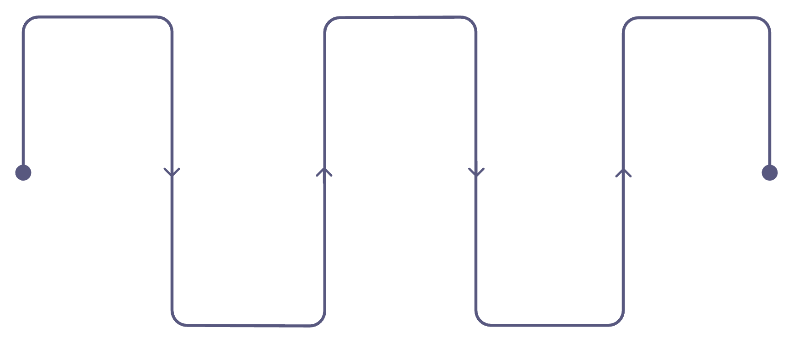
Step 9 — PII Protection: Sensitive Data Is Not Safe Context
BUILD STEP 8
LIVE DEMO
The Risk Scenario
What the PII Layer Does
01
"To verify your identity, please provide your credit card number and OTP."
If the agent passes this social-engineering prompt to the model unredacted, the PII is now in the LLM context window — and potentially in session history, observability traces, and cost logs. All of which are systems with broader access than the banking API.
Detect sensitive patterns
Card numbers, account numbers, OTPs, Aadhaar/national IDs — identified via regex and pattern matching before the model sees any input.
Architecture Change: PII Redaction Layer
02
Redact or tokenise
User Input
LLM Context
Logs & History
Sensitive values are replaced with tokens (e.g. [CARD_XXXX]) before passing to the LLM. The original value never enters model context.
Card number and OTP provided
Receives only redacted/tokenized text
Session history and observability get redacted text
03
Sanitise downstream systems
Session history, observability traces, and cost logs all receive only the redacted text. PII cannot leak via any observability path.
PII Redaction
Blocked Raw PII
Shielded layer redacts sensitive data
Raw sensitive data blocked (red X)
RBI Data Localisation
DPDP Act (India)
PCI-DSS
Speaker note: The phishing scenario is deliberately alarming. Use it to make the risk visceral before showing the architectural fix.

Slide 13
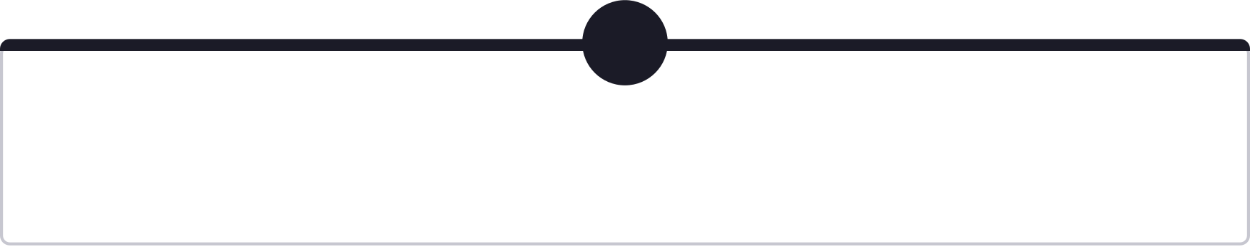
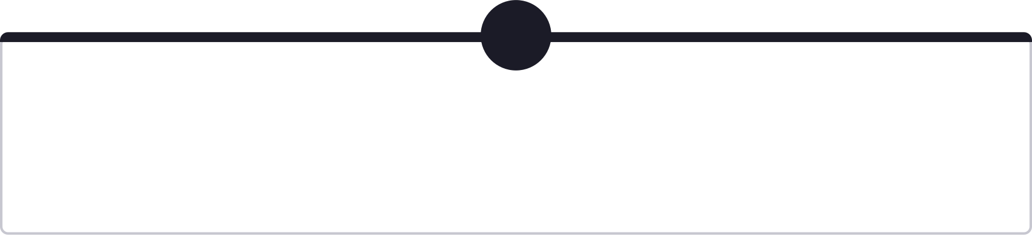

Step 10 — Evaluation: Is the Agent Doing the Right Thing?
BUILD STEP 9
LIVE DEMO
Evaluation Suite — Four Baseline Prompts
What to Evaluate — Four Dimensions
1
Routing accuracy
Tool selection
"What is my balance?"
Does the coordinator send balance queries to the Accounts Agent every time — not occasionally?
"Last 5 transactions" vs "monthly statement" — does the Transaction Agent pick the right tool?
Expected: → Accounts Agent → Balance Enquiry tool. Any other routing is a failure.
2
Edge cases
Regression
"Show me my last 5 transactions"
Ambiguous queries, multi-domain requests, out-of-scope requests — the system must handle all gracefully.
Does adding a new tool break existing query handling? Every build step must pass the full baseline suite.
Expected: → Transaction Agent → Transaction Details tool. Tests tool disambiguation.
3
Evaluation is the quality gate before observability. If a test fails, the next slide shows how to find out why.
"Balance and last 5 transactions"
Expected: → Coordinator → both Accounts Agent AND Transaction Agent. Tests multi-domain routing.
Speaker note: Demo — run all four prompts; show pass/fail results in the evaluation dashboard.
4
"Update my address"
Expected: → Service Agent → Change of Address tool. Tests service domain isolation.

Slide 14


Step 11 — Observability: Trace Every Step, Find Every Failure
BUILD STEP 9 CONT.
LIVE DEMO
Real-World Failure Scenario
What Observability Provides
A customer reports their balance shows ₹1,16,200 in the agent — but ₹52,340 in the mobile app. Which system is wrong? Where did the divergence happen?
Identify the exact failure step — stale cache in the Balance Tool returned ₹1,16,200; live API would have returned ₹52,340
Full Trace Path with Per-Hop Latency
Latency per hop — identify slow tools or slow model calls before they become SLA breaches
Agent decision log — why did the coordinator choose this specialist? What was the intent classification confidence?
Explainability — make agent behaviour auditable for operators and compliance teams
User
Coordinator
Tooling Options
Initiates request to check balance.
Routes call onward (5ms).
LangSmith
Langfuse
OpenTelemetry
Custom Structured Logging
Speaker note: The balance discrepancy is a real-world scenario. It makes observability feel urgent rather than optional. Demo: trace the request path live and identify the failing step.
Accounts Agent
Accounts MCP
Requests account data (12ms).
Aggregates sources (8ms).

Slide 15

Step 12 — Cost Tracking: Every Token and Tool Call Has a Price
BUILD STEP 10
Cost Per Interaction Type
What to Track Per Interaction
Interaction Type | Agent Calls | Tool Calls | Est. Tokens | Relative Cost
Balance enquiry | 2 | 1 | ~800 | 1×
Last 5 transactions | 2 | 1 | ~1,200 | 1.5×
Balance + transactions | 3 | 2 | ~2,000 | 2.5×
Address change | 2 | 1 | ~900 | 1.1×
LLM token usage
Input + output tokens per agent call. Coordinator calls tend to be larger (intent classification + synthesis). Specialist calls are smaller (tool-scoped context).
Tool and MCP round-trips
Number of tool/API calls invoked per request. MCP server round-trips add latency and infrastructure cost.
Evaluation and observability overhead
Multi-domain requests cost 2.5× more than single-tool queries. Routing efficiency has a direct, measurable cost impact at 4.2 lakh calls/month.
Evaluation runs and trace collection also consume tokens. Account for them in the total cost model — they are not free.
Cost data feeds capacity planning and pricing decisions. At scale, the difference between a 1× and 2.5× interaction type determines whether the system is economically viable.
Speaker note: Cost tracking is often skipped in demos. Including it signals production maturity to the audience.

Slide 16
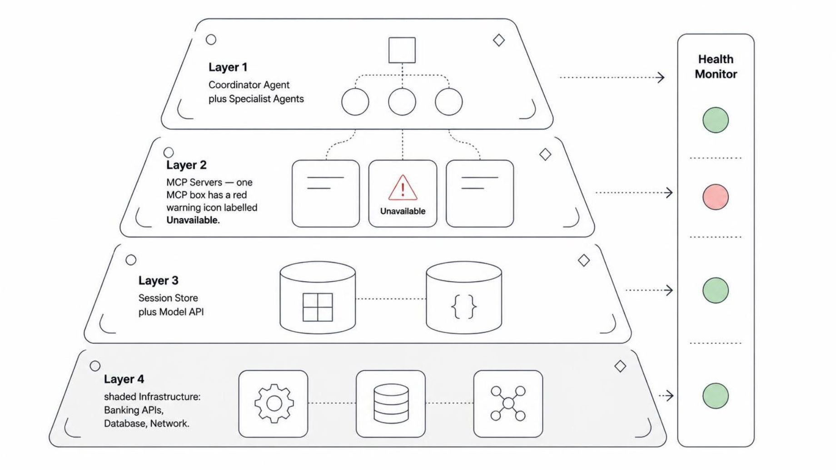

Step 13 — Infrastructure: Logical Correctness Is Not Enough
BUILD STEP 10 CONT.
LIVE DEMO
Layered Stack with Health Monitoring
Infrastructure vs Reasoning Failures
Reasoning failure
Infrastructure failure
The agent picks the wrong tool — caught by evaluation.
The right tool is unavailable — caught by health monitoring and circuit breakers.
What Must Run Reliably
Coordinator + specialist agents: Stateless, horizontally scalable — add instances without state migration
MCP servers: Each independently deployable and restartable — failure of one does not take down others
Session Store: Must survive agent restarts — stateful, requires persistence guarantees
Model API: Circuit breaker + fallback required — model unavailability must not produce hallucinated responses
MCP unavailable → coordinator receives tool error → agent responds "service temporarily unavailable" — not a hallucinated balance figure.
Speaker note: Infrastructure is the bridge from "it works in the demo" to "it works at 4.2 lakh calls/month". Don't skip it.

Slide 17
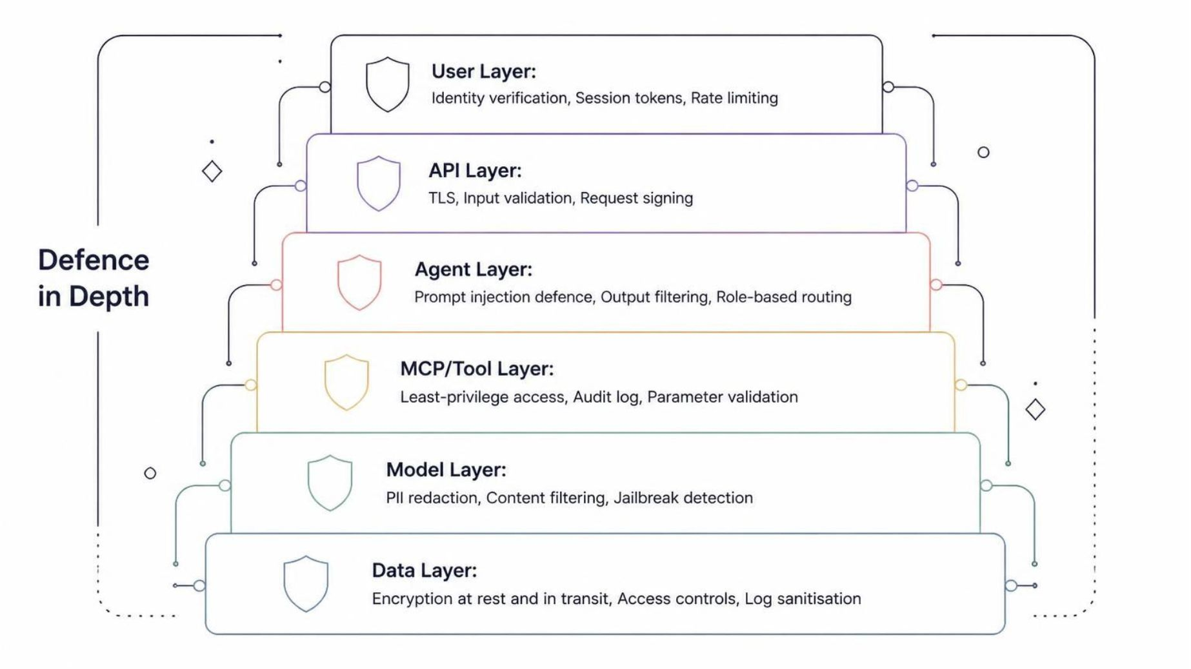

Step 14 — Layered Security: Every Layer Has a Control
SECURITY RECAP
Defence-in-Depth Security Stack
Controls Mapped to Source Problems
User + API layer
Identity verification and session tokens introduced in Step 7 (Authentication). Rate limiting and TLS are prerequisites from day one.
Agent layer
Prompt injection defence and role-based routing introduced in Step 5 (Coordinator). Output filtering added alongside evaluation in Step 10.
MCP / Tool layer
Least-privilege tool access introduced in Step 4 (Specialist Agents). Audit log formalised with observability in Step 11.
Model + Data layer
PII redaction introduced in Step 9. Encryption at rest and log sanitisation are compliance anchors: RBI · DPDP Act · PCI-DSS · ISO 27001.
Every control shown here was introduced to solve a specific, demonstrated problem. Nothing is new on this slide — it is a recap of the full teaching arc.
Speaker note: Walk the stack top-to-bottom. Ask the audience to match each control to the slide where the problem was introduced — it reinforces the entire narrative arc.

Slide 18
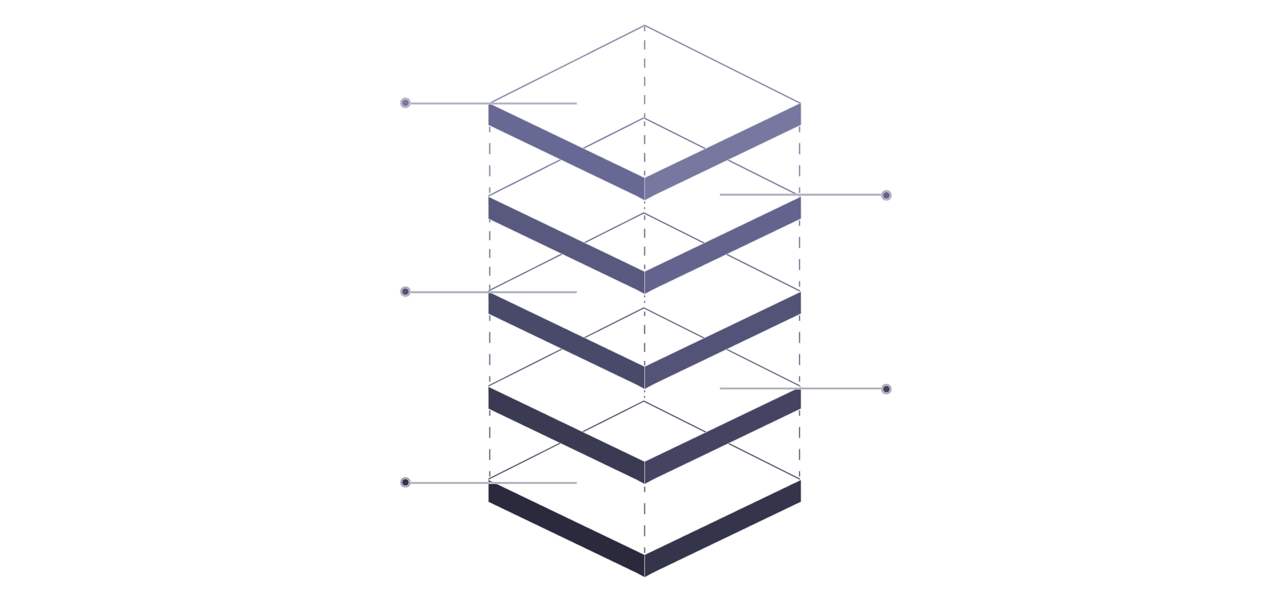
Final Architecture: Every Layer Earns Its Place
COMPLETE SYSTEM
END-TO-END DEMO
Service Agents
Accounts, Transactions, Services
Coordinator Agent
Classify intent and orchestrate
API Gateway
Route and enforce policies
Auth IdP
Authenticate and issue tokens
User Entry
External user initiates request
Main Flow — Left to Right
Cross-Cutting Vertical Layers
Entry
Session Store
PII Redaction
User → Bank Identity Provider → API Gateway
Conversation history + inter-agent state
Before model context and all logs
Orchestration
Evaluation Suite
Observability
Coordinator Agent: intent classification + routing + response synthesis
Routing + tool selection correctness
Full request trace with latency + decision log
Specialists
Cost Tracker
LLM
Accounts · Transaction · Service Agents — domain-isolated, least-privilege
Token + tool call accounting per interaction
Shared model layer: coordinator + all specialists
Tool boundary
Accounts MCP · Transactions MCP · Service MCP → Banking APIs
No component appears without a reason. Each was introduced to solve a specific, demonstrated problem. The architecture should feel inevitable — not complex.
Speaker note: This is the payoff slide. Demo: walk one end-to-end request — "What is my balance and show me my last 5 transactions?" — through every layer of the final architecture.

Slide 19
Build Roadmap: 10 Steps to Production
CLAUDE CODE BLUEPRINT
10-Step Incremental Build Sequence
Claude Code Handoff Rule
01
Give Claude Code one step at a time. Do not build the final architecture in one pass.
Simple chat
Each step requires all six of the following before moving to the next:
UI → API → Agent → LLM. No tools. Establish the baseline pipeline.
02
Files changed
One tool
Exact list of files created or modified in this step.
Add Balance Enquiry. Prove the tool-call loop works end-to-end.
Architecture change
03
What component was added, removed, or modified — and why.
Multiple tools
Add all six banking APIs. Surface the "too much access" problem deliberately.
Demo prompt
04
The exact user input that exercises the new capability.
Specialist agents
Expected output
Split into Accounts / Transaction / Service agents. Prove domain isolation.
What the agent must return for the demo prompt to pass.
05
Coordinator
Failure case
Add routing layer. Prove multi-domain requests work end-to-end.
What the agent returns if this step is implemented incorrectly.
06
MCP
Regression test
Introduce MCP servers as tool boundaries. Prove decoupling works.
All prior baseline prompts must still pass after this step is added.
07
Speaker note: This roadmap is the exact sequence for the Claude Code implementation. The presentation and the build stay in sync — every slide corresponds to a build milestone.
Authentication + session
Add identity provider and session store. Prove stateful, scoped access.
08
PII
Add redaction layer. Prove sensitive data does not reach the model unfiltered.
09
Evaluation + observability
Add test suite and tracing. Prove the system is debuggable and correct.
10
Cost + infrastructure
Add cost tracking and runtime health monitoring. Prove production readiness.

Slide 20
Sources
Primary Reference
Banking-Agent.docx
Source document providing technical architecture details, banking domain definitions, tool specifications, and implementation examples used throughout this presentation.

