Slide 1
Annotated Parse Tree Generation
CSA1475 - Compiler design
K. Vaibhav
(192211869)
T. sai krishna
(192211870)

Slide 2
CONTENT
Introduction
01
problem statement
04
02
Source code & output
03
conclusion

Slide 3
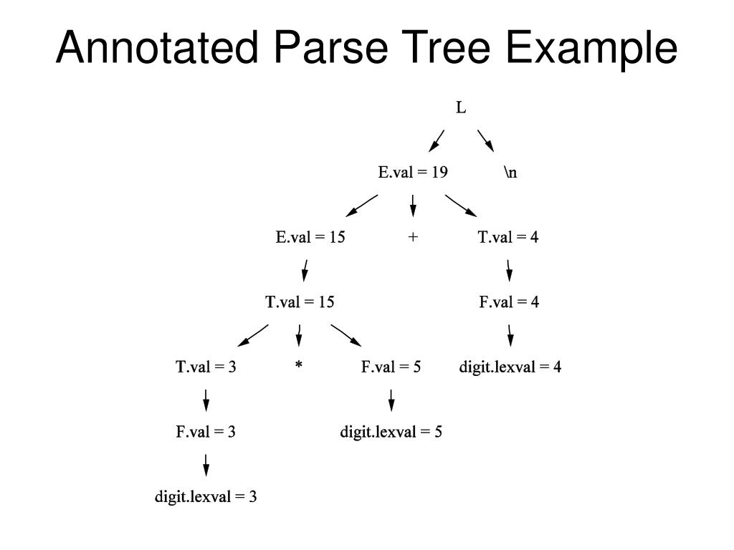
Introduction TO annotated parse tree
Annotated Parse Tree – The parse tree containing the values of attributes at each node for given input string is called annotated or decorated parse tree.
In modern software development, understanding and analyzing source code are essential tasks for ensuring correctness, maintainability, and scalability.
Annotated parse tree generation represents a pivotal approach to advancing source code analysis, offering developers deeper insights into their code bases.

Slide 4
Problem statement
Complexity of Source Code Analysis: Traditional source code analysis techniques often rely on syntactic parsing, which may not capture the full semantics and context of the code. This can lead to limited understanding and ineffective debugging, especially in complex software systems with intricate control flow and data dependencies.
Lack of Semantic Context: Without semantic annotations, parse trees offer only a structural representation of the code, lacking crucial information such as data types, variable scopes, and function definitions. This hampers developers' ability to perform comprehensive analysis and make informed decisions during software development.
Error Prone Semantic Analysis: Manual annotation of parse trees with semantic information is tedious and error-prone, especially for large codebases. Human errors in semantic analysis can lead to inaccuracies in the annotated parse tree, resulting in incorrect program behavior and wasted development time.

Slide 5
Applications of Annotated Parse Trees
Sentiment analysis: Analyzing the sentiment expressed in a sentence based on syntactic and semantic cues.
Information extraction: Extracting structured information from unstructured text using semantic annotations.
Question answering: Understanding and processing questions by analyzing syntactic and semantic structures.
Machine translation: Mapping syntactic and semantic structures between languages for translation purposes.

Slide 6
source code & output
SOURCE CODE:
#include <stdio.h>
#include <stdlib.h>
#include <string.h>
struct TreeNode {
char* type;
char* value;
struct TreeNode* left;
struct TreeNode* right;
};
struct TreeNode* createNode(char* type, char* value);
void addChild(struct TreeNode* parent, struct TreeNode* child);
void printTree(struct TreeNode* root, int depth, int isLeft);
struct TreeNode* createNode(char* type, char* value) {
struct TreeNode* newNode = (struct
TreeNode*)malloc(sizeof(struct TreeNode));
newNode->type = strdup(type);
newNode->value = strdup(value);
newNode->left = NULL;
newNode->right = NULL;
return newNode;
}
void addChild(struct TreeNode* parent, struct TreeNode* child) {
if (parent->left == NULL) {
parent->left = child;
} else {
parent->right = child;
}
}
}
void printTree(struct TreeNode* root, int depth, int isLeft) {
if (root == NULL) {
return;
}
for (int i = 0; i < depth - 1; i++) {
printf(" ");
}
if (depth > 0) {
if (isLeft) {
printf(" /");
} else {
printf(" \\");
}
printf("--- ");
}
printf("(%s, %s)\n", root->type, root->value);
printTree(root->left, depth + 1, 1);
printTree(root->right, depth + 1, 0);
}
int main() {
// Parse the input expression "2*3+5"
struct TreeNode* root = createNode("Expr", "");
struct TreeNode* plusNode = createNode("Operator", "+");
struct TreeNode* num2Node = createNode("Number", "5");
struct TreeNode* multNode = createNode("Operator", "*");
struct TreeNode* num3Node = createNode("Number", "2");
struct TreeNode* num5Node = createNode("Number", "3");
addChild(root, plusNode);
addChild(plusNode, num2Node);
addChild(plusNode, multNode);
addChild(multNode, num3Node);
addChild(multNode, num5Node);
printf("Annotated Parse Tree for Input Expression \"2*3+5\":\n");
printTree(root, 0, 0);
return 0;
}
INPUT:
Annotated Parse Tree for Input Expression "2*3+5":
(Expr, )
/--- (Operator, +)
/--- (Number, 5)
\--- (Operator, *)
/--- (Number, 2)
\--- (Number, 3)
OUTPUT:
Annotated Parse Tree Value =11

Slide 7
CONCLUSION
In the conclusion, the authors may also discuss the implications of their findings for software development practices, such as how the annotated parse tree generation could lead to more accurate code understanding and improved debugging processes. They might underscore the importance of semantic analysis and annotation in advancing the capabilities of automated code analysis tools and enhancing overall software quality. Furthermore, the conclusion could reiterate the significance of their research contributions and invite further exploration and experimentation in this area to fully harness the potential benefits of the proposed methodology.

Slide 8
references
1. Churcher, N.I., Keown, L.M. and Irwin, W., Virtual Worlds for Software Visualisation. in SoftVis99 Software Visualisation Workshop, (Sydney, Australia, 1999), 9-16.
2. Churcher, N.I. and Shepperd, M. Comment on "A Metrics Suite for Object Oriented Design". IEEE Transactions on Software Engineering, 21 (3). 263-265.
3. Churcher, N.I. and Shepperd, M. Towards a Conceptual Framework for OO Software Metrics. ACM SIGSOFT Software Engineering Notes, 20 (2). 69-75.
4. Conte, S.D., Dunsmore, H.E. and Shen, V.Y. Software Engineering Metrics and Models. Benjamin Cummings, Redwood City, CA, 1986.
5. Cook, C. Ph.D. Thesis: Towards Computer Supported Collaborative Software Engineering Department of Computer Science and Software Engineering, University of Canterbury, Christchurch, 2006.
6. Cook, C. and Churcher, N.I., Modelling and Measuring Collaborative Software Engineering. in Proc. ACSC2005:

Slide 9
references
7.Cook, C., Irwin, W. and Churcher, N.I., Towards Synchronous Collaborative Software Engineering. in APSEC '04: Proceedings of the 11th Asia-Pacific Software Engineering Conference, (Busan, Korea, 2004), IEEE Computer Society Press, 230- 239.
8. DeRemer, F.L. Ph.D. Thesis: Practical Translators for LR(k) Languages, MIT, Cambridge, MA, 1969.
9.DeRemer, F.L. Simple LR(k) Grammars. Communications of the ACM, 14 (7). 453- 460.
10.DeRemer, F.L. and Penello, J.P., Efficient Computation of LALR(1) Look-Ahead Sets. in Proceedings of the 1979 SIGPLAN Symposium on Compiler Construction, (Denver, CO, USA, 1979), ACM Press, 176-187.
11. Di Battista, G., Eades, P., Tamassia, R. and Tollis, I.G. Graph Drawing: Algorithms for the Visualization of Graphs. Prentice Hall, 1999.

Slide 10


