Slide 1
NIT Trichy vs
NIT Surathkal
DPCN RESEARCH MAPPING · TEAM 12 · STATISTICS REPORT
Research output, impact and networks of science and engineering faculty, 2016–2026
Live dashboard: saixbhargav.github.io/DPCN_assignment2/dashboard
Code: github.com/saiXbhargav/DPCN_assignment2
Ampilli Sai Venkata Naga Bhargav
Chaitanya Thogata
Pasumarthy Deepak
2023112014
2023113018
2023101109
767
18,343
264,423
181,189
regular science & engineering faculty
papers, 2016–2026
citations received
citation links mapped
Notes:
This is Team 12’s statistics report on NIT Trichy and NIT Surathkal, 2016 to 2026. We counted only regular science and engineering faculty, all ranks, current and former, taken from the institutes’ own faculty pages and their yearly archived copies. PhD students are not counted, and papers in business, economics, social sciences, psychology and arts are left out. That gives 767 faculty and 18,343 papers from OpenAlex, with 264,423 citations. One rule matters for the networks: if NIT Trichy cites its own paper written with IIT Madras, that is not counted as a link between NIT Trichy and IIT Madras. Every number here can be explored in our interactive dashboard.

Slide 2
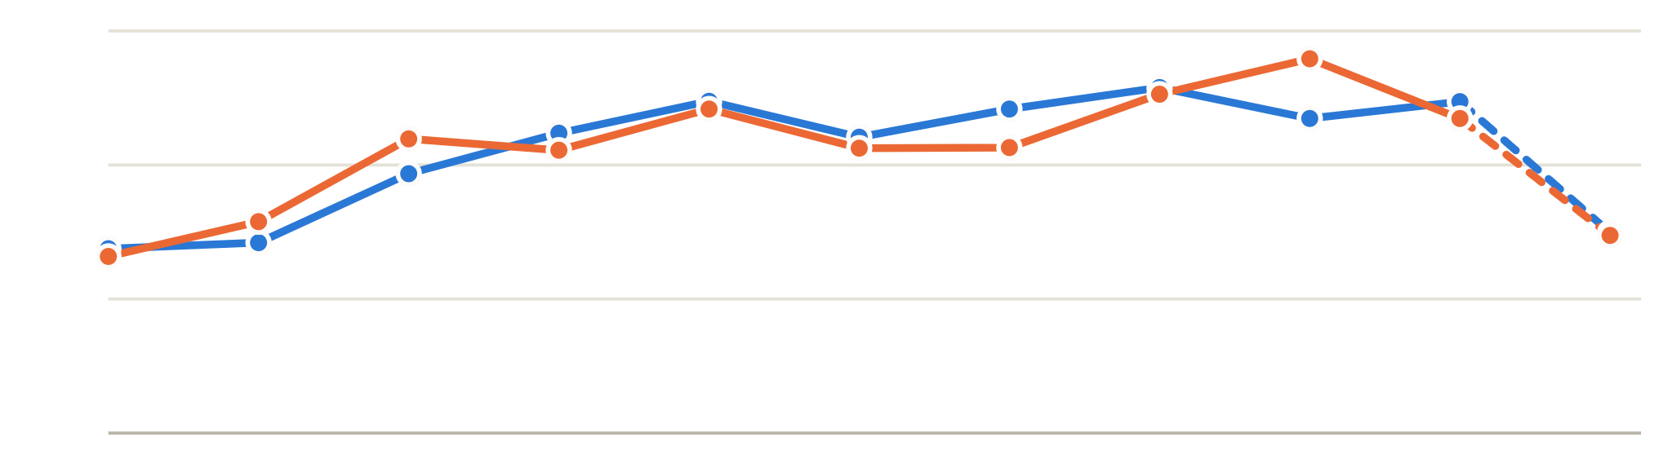
Ten years of steady growth, neck and neck
01 · PUBLICATION TREND
NIT Trichy
NIT Surathkal
papers per year · *2026 = January to mid-October
18,343 papers
1,200
9,184 Trichy · 9,206 Surathkal
800
1.8× growth
papers in 2025 vs 2016 (1,924 vs 1,071)
400
0
80% vs 68%
2016
2017
2018
2019
2020
2021
2022
2023
2024
2025
2026*
of papers are in journals; the rest are conference papers
Papers | 2016 | 2017 | 2018 | 2019 | 2020 | 2021 | 2022 | 2023 | 2024 | 2025 | 2026* | Total
NIT Trichy | 550 | 568 | 774 | 895 | 990 | 883 | 967 | 1,031 | 939 | 989 | 598 | 9,184
NIT Surathkal | 527 | 631 | 878 | 844 | 967 | 850 | 852 | 1,011 | 1,117 | 939 | 590 | 9,206
Both, unique | 1,071 | 1,197 | 1,644 | 1,736 | 1,953 | 1,728 | 1,814 | 2,040 | 2,052 | 1,924 | 1,184 | 18,343
Notes:
Both NITs grew together: about 540 papers each in 2016, and close to 1,000 a year each from 2020 on. In total, NIT Trichy has 9,184 papers and NIT Surathkal 9,206; 47 papers have faculty from both NITs, so the combined unique count is 18,343. Taken together, 2025 has 1.8 times as many papers as 2016. The drop in 2026 is only because the data was collected in October 2026. One difference in style: 80 percent of NIT Trichy’s papers are journal papers, against 68 percent at NIT Surathkal, which publishes more conference papers.

Slide 3
More than a third of journal papers are Q1
02 · JOURNAL QUALITY
NIT Trichy
Q1 · 35%
Q2 · 39%
Q3 · 20%
5%
NIT Surathkal
Q1 · 38%
Q2 · 37%
Q3 · 19%
5%
Bars: ranked journal papers by SCImago quartile (Q4 = 5% at both). Papers in journals with IF > 5: 2,413 Trichy (33.0%) vs 2,124 Surathkal (33.8%). IF > 10: 352 vs 280. IF = the journal’s 2-year mean citedness in OpenAlex.
NIT Trichy · top 5 journals
NIT Surathkal · top 5 journals
Journal | Quartile | Papers
Materials Today: Proceedings | not ranked | 288
Trans. Indian Institute of Metals | Q3 | 92
J. Materials Eng. & Performance | Q2 | 78
Journal of Alloys and Compounds | Q1 | 61
Materials Research Express | Q3 | 61
Journal | Quartile | Papers
Materials Today: Proceedings | not ranked | 230
IEEE Access | Q1 | 111
J. Materials Eng. & Performance | Q2 | 77
Materials Research Express | Q3 | 76
Journal of Alloys and Compounds | Q1 | 49
Notes:
Of the journal papers that SCImago ranks, 35.2 percent of NIT Trichy’s and 38.3 percent of NIT Surathkal’s are in Q1 journals, which is 2,391 and 2,222 papers. Trichy has more papers in high-impact journals in absolute numbers: 2,413 papers in journals with IF above 5 and 352 above 10, against 2,124 and 280 at Surathkal. As a share of journal papers the two are almost the same. IF here is OpenAlex’s 2-year mean citedness, the impact-factor formula on open data, because Clarivate’s JCR is not open. The top five journals overlap a lot: Materials Today: Proceedings, a conference-proceedings journal that SCImago does not rank, is number one at both, and materials and metallurgy journals dominate. IEEE Access is NIT Surathkal’s second journal, reflecting its larger computing output.

Slide 4
Engineering leads, and AI is spreading
03 · RESEARCH AREAS
NIT Trichy
papers by field
NIT Surathkal
AI across departments
4,524
Engineering
4,526
9% → 20%
1,444
Computer Science
1,639
1,023
Materials Science
854
of all papers are AI papers, 2016 → 2025
514
Environmental Science
585
1.9% → 8.7%
454
Energy
274
outside computing, papers that use an AI method; AI as a topic stayed flat (3.3% → 3.5%)
156
Mathematics
316
264
Chemistry
170
15 of 18
249
Medicine
145
departments now have 5%+ AI papers (10 in 2016–18)
555
All other fields
697
Notes:
The two NITs have almost the same research mix: about half of each NIT’s papers are in Engineering, then Computer Science and Materials Science. The differences are small but clear: NIT Surathkal has more Computer Science and twice as much Mathematics; NIT Trichy has more Materials Science, Energy, Chemistry and Medicine. On the right is our team’s AI analysis. AI papers rose from 9 percent of all papers in 2016 to 20 percent in 2025. Outside the computing departments, AI arrives as a tool, not a topic: papers whose topic is AI stayed flat at about 3.5 percent, but papers that use an AI method in their title rose from 1.9 to 8.7 percent. Fifteen of eighteen departments now have at least 5 percent AI papers; Chemistry, Physics and Metallurgy have almost none.

Slide 5
The ten most-cited papers
04 · MOST-CITED PAPERS
7 of the top 10 are NIT Trichy’s, and 4 have “review” in the title. FWCI 1.0 = world average for the same field and year.
# | Title | Journal | Year | Citations | FWCI | NIT
1 | A Review of Classical and Nonclassical Nucleation Theories | Cryst. Growth Des. | 2016 | 877 | 19.5 | Trichy
2 | Lignocellulosic biomass-based pyrolysis: A comprehensive review | Chemosphere | 2021 | 536 | 25.7 | Trichy
3 | Crop pest classification based on deep convolutional neural… | Comput. Electron. Agric. | 2019 | 514 | 28.7 | Trichy
4 | Characterization of raw and alkali treated new natural… | Int. J. Biol. Macromol. | 2018 | 474 | 18.4 | Trichy
5 | A review on composite materials and process parameters… | Virtual Phys. Prototyp. | 2017 | 457 | 22.4 | Trichy
6 | Influence of wood dust fillers on the mechanical, thermal… | J. Polym. Res. | 2019 | 456 | 13.3 | Trichy
7 | Are lead-free relaxor ferroelectric materials the most… | Prog. Mater. Sci. | 2022 | 426 | 20.7 | Trichy
8 | Green synthesis of iron nanoparticles using different leaf… | J. Clean. Prod. | 2016 | 408 | 11.9 | Surathkal
9 | Application of life cycle assessment in municipal solid… | J. Clean. Prod. | 2018 | 392 | 32.4 | Surathkal
10 | Enhancement of the properties of fly ash based geopolymer… | Constr. Build. Mater. | 2017 | 385 | 23.2 | Surathkal
Notes:
The ten most-cited papers, with full titles: 1. A Review of Classical and Nonclassical Nucleation Theories. 2. Lignocellulosic biomass-based pyrolysis: A comprehensive review. 3. Crop pest classification based on deep convolutional neural network and transfer learning. 4. Characterization of raw and alkali treated new natural cellulosic fibers from Tridax procumbens. 5. A review on composite materials and process parameters optimisation for the fused deposition modelling process. 6. Influence of wood dust fillers on the mechanical, thermal, water absorption and biodegradation characteristics of jute fiber epoxy composites. 7. Are lead-free relaxor ferroelectric materials the most promising candidates for energy storage capacitors? 8. Green synthesis of iron nanoparticles using different leaf extracts for treatment of domestic waste water. 9. Application of life cycle assessment in municipal solid waste management: A worldwide critical review. 10. Enhancement of the properties of fly ash based geopolymer paste by incorporating ground granulated blast furnace slag. Seven are NIT Trichy’s, which is why Trichy has more citations per paper. All ten have an FWCI between 12 and 32, meaning 12 to 32 times the world average for their field and year.

Slide 6
Surathkal faculty publish more per person
05 · FACULTY
h-index distribution
NIT Trichy (357)
NIT Surathkal (299)
Median h-index, 2016–2026
7 vs 9
129
Mann–Whitney p = 0.009
89
Median papers per faculty member
78
84
19 vs 31
69
70
p < 0.001; mean FWCI per person is not different (p = 0.15)
35
37
20
16
7
10
8
4
Top-ranked faculty (7-measure score)
1 · Ramesh M R · Surathkal · Mech.
0–4
5–9
10–14
15–19
20–24
25–29
30+
2 · S Suresh · Trichy · Mech.
h-index from each faculty member’s 2016–2026 papers · faculty with at least one paper
3 · D Krishna Bhat · Surathkal · Chem.
Notes:
The h-index here is computed from each faculty member’s own 2016 to 2026 papers. NIT Trichy has more faculty with papers, 357 against 299, and many more of them in the lowest h-index group, 0 to 4; it also has many more Assistant Professors. Per person, NIT Surathkal faculty publish more: a median of 31 papers against 19, and a median h-index of 9 against 7; both differences are significant in a Mann–Whitney test. But field-weighted impact per person is not significantly different. The ranking on the right is our team’s composite score: the average percentile on seven measures (papers, citations, h-index, mean FWCI, top-10 percent papers, Q1 or CORE A-star/A papers and papers in IF above 5 journals), for current faculty with at least 10 papers. The full name of number 3 is Denthaje Krishna Bhat. It measures research output only, not teaching or service.

Slide 7
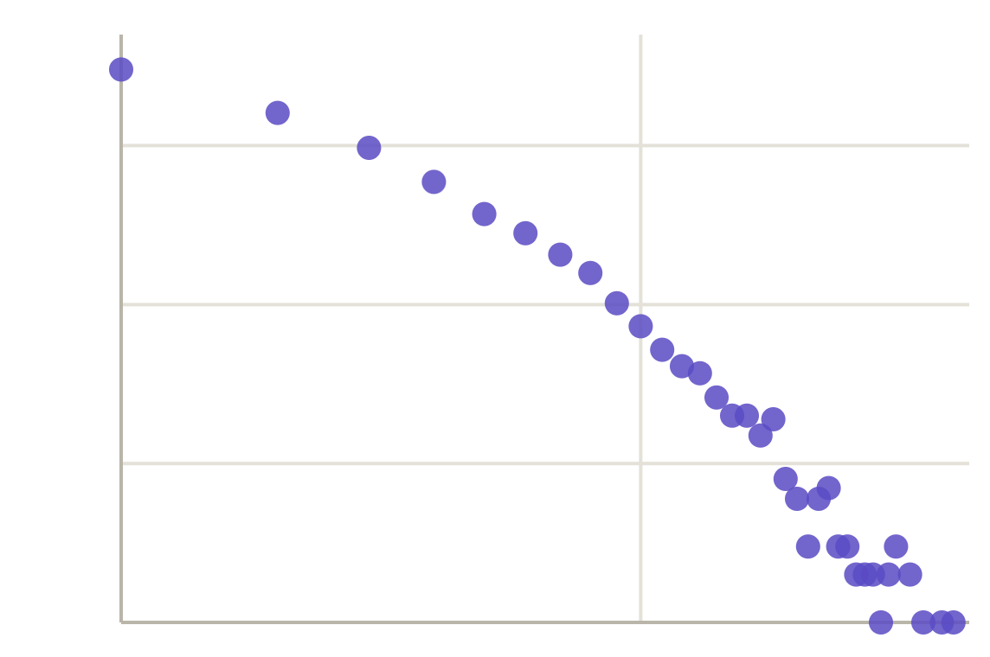
A few papers draw most internal citations
06 · CITATION NETWORK
In-degree distribution
Top 10 papers by PageRank
# | Title | NIT | Year | In-deg.
1 | Effect of particle surface treatment and… | Surathkal | 2016 | 33
2 | Myo-inositol based nano-PCM for solar… | Trichy | 2016 | 15
3 | Studies on the weldability, mechanical… | Trichy | 2018 | 17
4 | Printability of multiwalled SS 316L by… | Trichy | 2019 | 6
5 | Half-sandwich RuCl2(η6-p-cymene) core… | Trichy | 2016 | 40
6 | Investigating the contrast diurnal… | Trichy | 2022 | 21
7 | High Thermoelectric Performance of Co-Doped… | Surathkal | 2017 | 29
8 | Experimental investigation on the… | Trichy | 2016 | 9
9 | Effect of Oxide Fluxes on Depth of… | Trichy | 2016 | 2
10 | Hydrothermally Synthesized h-MoO3 and… | Trichy | 2016 | 7
1,000
100
10
1
1
10
40
Papers (y) by how many of our papers cite them (x), log–log. 58% are never cited from inside; the tail is heavy, and a log-normal fits it better than a power law.
Notes:
The citation network has one node per paper and an arrow when one paper cites another. PageRank and in-degree are computed on the 23,822 citations between our own 18,343 papers. The in-degree distribution is very skewed: 58 percent of our papers are never cited by another of our papers, about 3,000 are cited once, and only a handful are cited 30 to 40 times. Fitting with the powerlaw package shows a heavy tail, but a log-normal fits better than a pure power law. The top papers by PageRank are mostly older papers, from 2016 to 2019, that started local chains of follow-up work: for example syntactic foams at NIT Surathkal and welding and materials work at NIT Trichy. Full titles: 1. Effect of particle surface treatment and blending method on flexural properties of injection-molded cenosphere/HDPE syntactic foams. 2. Myo-inositol based nano-PCM for solar thermal energy storage. 3. Studies on the weldability, mechanical properties and microstructural characterization of activated flux TIG welding of AISI 321 austenitic stainless steel. 4. Printability of multiwalled SS 316L by wire arc additive manufacturing route with tunable texture. 5. Half-sandwich RuCl2 (η6-p-cymene) core complexes containing sulfur donor aroylthiourea ligands. 6. Investigating the contrast diurnal relationship of land surface temperatures with various surface parameters over Ahmedabad. 7. High Thermoelectric Performance of Co-Doped Tin Telluride. 8. Experimental investigation on the mechanical properties of Cyperus pangorei fibers and jute fiber-based composites. 9. Effect of Oxide Fluxes on Depth of Penetration in Flux Bounded TIG Welding of AISI 304L Stainless Steel. 10. Hydrothermally Synthesized h-MoO3 and α-MoO3 Nanocrystals.

Slide 8
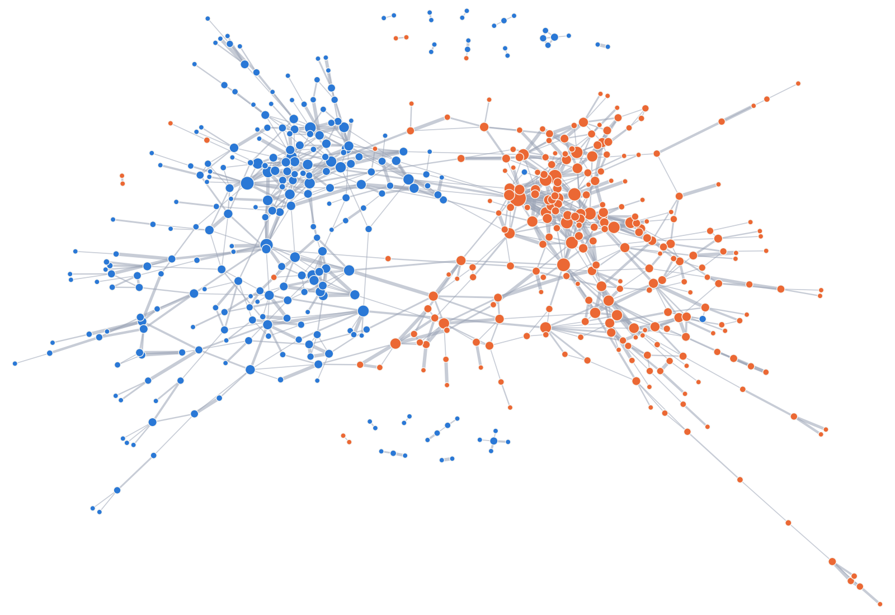
Departments, bridged by a few hubs
07 · AUTHORSHIP NETWORK
NIT Trichy
NIT Surathkal
size = faculty co-authors
Most central | NIT | Branch | Degree | Betweenness
Ramesh M R | Surathkal | Mechanical | 22 | 0.101
P Palanisamy | Trichy | ECE | 10 | 0.077
Gangadharan K V | Surathkal | Mechanical | 14 | 0.071
N Sivakumaran | Trichy | ICE | 13 | 0.060
Jeny Rajan | Surathkal | CSE | 10 | 0.060
161
NMI 0.68
Louvain communities, modularity 0.85
communities vs departments (0.24 if random)
539 faculty with a faculty co-author · 961 links · largest group 492
σ = 16.1
28
small world: clustering 0.21 vs 0.010 random
of the 961 links join the two NITs
Notes:
This is the faculty co-authorship network: one node per faculty member and a link when two faculty wrote at least one paper together. 656 faculty have papers; 539 have at least one faculty co-author, with 961 links, and the largest connected group has 492 people. Degree is the number of faculty co-authors; betweenness measures how often someone lies on the shortest path between others, so high betweenness marks the bridges. Ramesh M R of NIT Surathkal Mechanical is first on both. Louvain finds 161 communities with modularity 0.85; they follow departments closely (NMI 0.68 against 0.24 for random labels), and the leaders of the largest communities include Udaya Bhat K, S Suresh, Jeny Rajan and Ramesh M R. The network is a small world: clustering is about 21 times that of random graphs with the same degrees, while paths are only 1.35 times longer (sigma 16.1). Only 28 links join the two NITs. Our team also found that a shared co-author makes a new collaboration about 19 times more likely the next year.

Slide 9
We draw on IITs and labs; universities draw on us
08 · INDIAN CONNECTIVITY
Citation flow, 2016–2026
The knowledge hierarchy
NIT Trichy · ratio 0.86
Citations each type of institute gives us per citation we give it · dashed line = 1.0, balanced
36,970 received
43,057 given
DRDO
0.27
DAE
0.32
NIT Surathkal · ratio 0.82
CSIR labs
0.33
30,349 received
IISER / IISc
0.34
37,191 given
IITs
0.40
ISRO
0.42
Citations with other Indian institutes; ratio = received ÷ given. Co-authored papers never count as flow.
Other NITs
1.01
Universities, colleges
1.32
VIT
583 vs 411
37% vs 16%
cites us most: 1,953 citations to Trichy and 1,388 to Surathkal
joint papers with IITs, Surathkal vs Trichy; Trichy leads with DAE, ISRO, DRDO, industry
of joint papers vs citations are within 300 km: we work locally
Notes:
Task 3, Indian connectivity. With other Indian institutes, NIT Trichy received 36,970 citations and gave 43,057, an impact ratio of 0.86; NIT Surathkal received 30,349 and gave 37,191, a ratio of 0.82. Up to 2022 both gave more than they received; since 2023 they receive more than they give. The chart on the right shows a clear knowledge hierarchy: for every citation we give them, IITs give us only 0.40 back, IISc and IISERs 0.34, CSIR labs 0.33 and DRDO 0.27. With other NITs the exchange is balanced, and universities and colleges cite us 1.32 times as much as we cite them. VIT is the Indian institute that cites both NITs most. NIT Trichy co-authored with 464 Indian institutes and NIT Surathkal with 471. Surathkal works more with IITs and IISc (583 joint papers with IITs against 411); Trichy works more with the strategic labs, DAE, ISRO and DRDO, and with industry such as BHEL. Our team’s geography analysis shows that people work locally but knowledge travels: 37 percent of joint papers are with institutes within 300 km, but only 16 percent of citations; doubling the distance cuts joint papers by about 38 percent but citations by only about 11 percent.

Slide 10
Level overall, strong in different branches
09 · WHO PERFORMS BETTER, AND WHAT NEXT
Head to head
Branch strengths (FWCI, stronger NIT first)
Trichy
Surathkal
Surathkal stronger
Trichy stronger
Papers
9,184
9,206
CSE (1.54 vs 1.00)
Mathematics (1.48 vs 0.56)
EEE (1.23 vs 0.97)
Chemical (1.59 vs 1.27)
Citations / paper
15.2
13.6
Mechanical (1.63 vs 1.43)
ECE (1.18 vs 0.98)
Papers / faculty
25.7
30.8
No clear difference: Civil, Chemistry, Physics, MME
Mean FWCI
1.31
1.39
Q1 share
35%
38%
What to do next
Work together: only 47 joint papers. Pair Surathkal CSE, EEE, Mechanical with Trichy Maths, Chemical, ECE.
p = 0.23
New partners: close in topic and citing each other, but no joint papers yet: NSUT Delhi, SLIET Longowal, GLA.
Each paper’s FWCI regressed on the institute, controlling for branch, year, collaboration, venue and team size: Surathkal +1.2%, no significant difference.
Improve: foreign co-authorship in Trichy CSE, and impact in Surathkal Mathematics (FWCI 0.56).
Notes:
So which NIT performs better? On raw numbers each wins something: the same number of papers, more citations per paper at Trichy, more papers per faculty member at Surathkal, and slightly higher mean FWCI and Q1 share at Surathkal. But once each paper’s field-weighted impact is compared with controls for branch, year, foreign and Indian collaboration, venue and team size, the institute effect is plus 1.2 percent with p = 0.23: no significant difference. The real differences are inside branches. Bootstrap intervals show NIT Surathkal is stronger in CSE, EEE and Mechanical, and NIT Trichy in Mathematics, Chemical and ECE; Civil, Chemistry, Physics and MME show no clear difference. In the brackets the stronger NIT’s value comes first. Recommendations: the two NITs wrote only 47 papers together, so each should pair its strong branches with the other’s; approach partners that are close in topic and already exchange many citations but have no joint papers, such as NSUT Delhi, SLIET Longowal and GLA University; and improve foreign collaboration in NIT Trichy CSE and impact in NIT Surathkal Mathematics. Papers with more than 50 authors were checked separately: none remain after the filters, and every author cap gives the same rankings. Everything is in our interactive dashboard.

