Slide 1

Notes:
Human-AI collaboration at scale

Slide 2
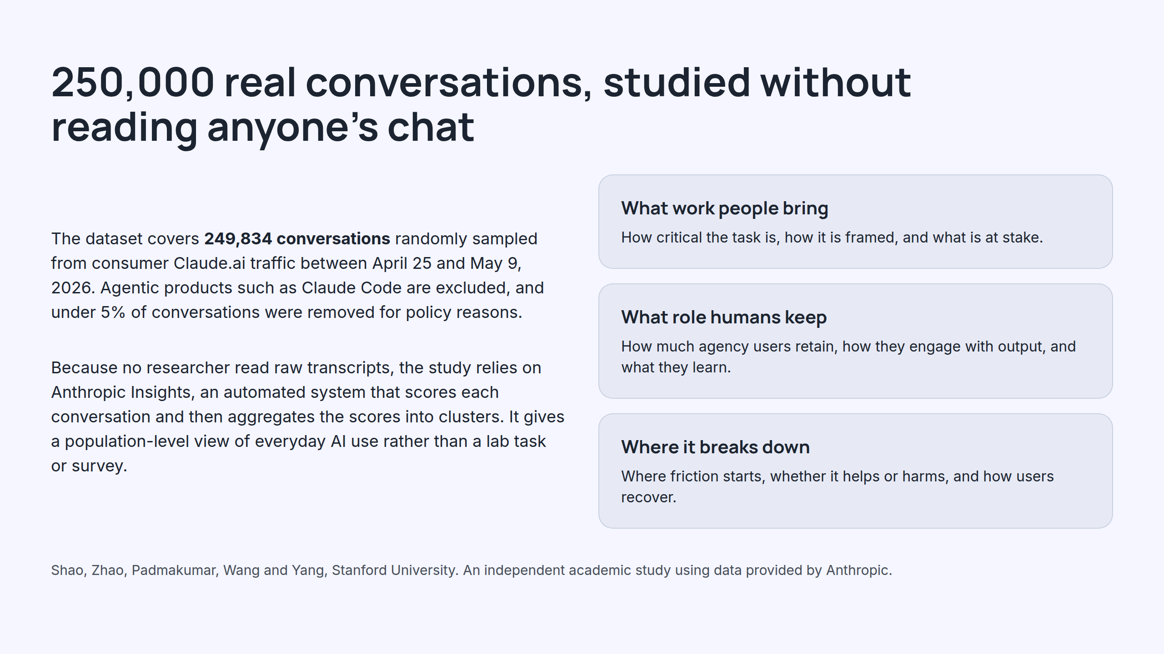
Notes:
250,000 real conversations, studied without reading anyone's chat

Slide 3
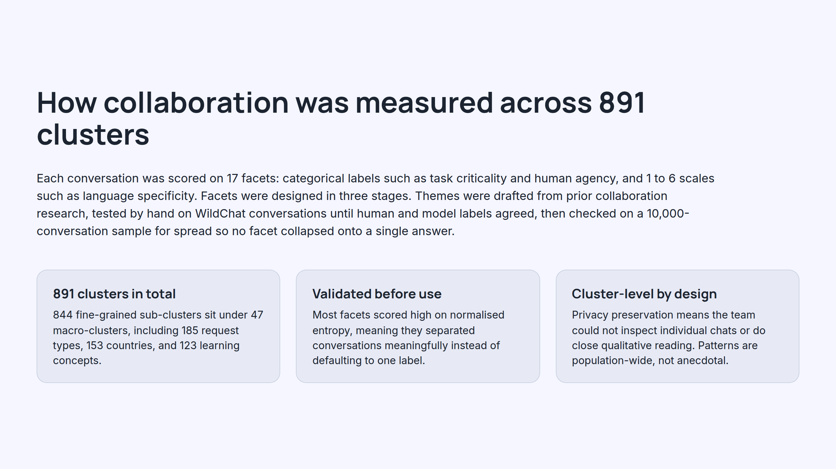
Notes:
How collaboration was measured across 891 clusters

Slide 4
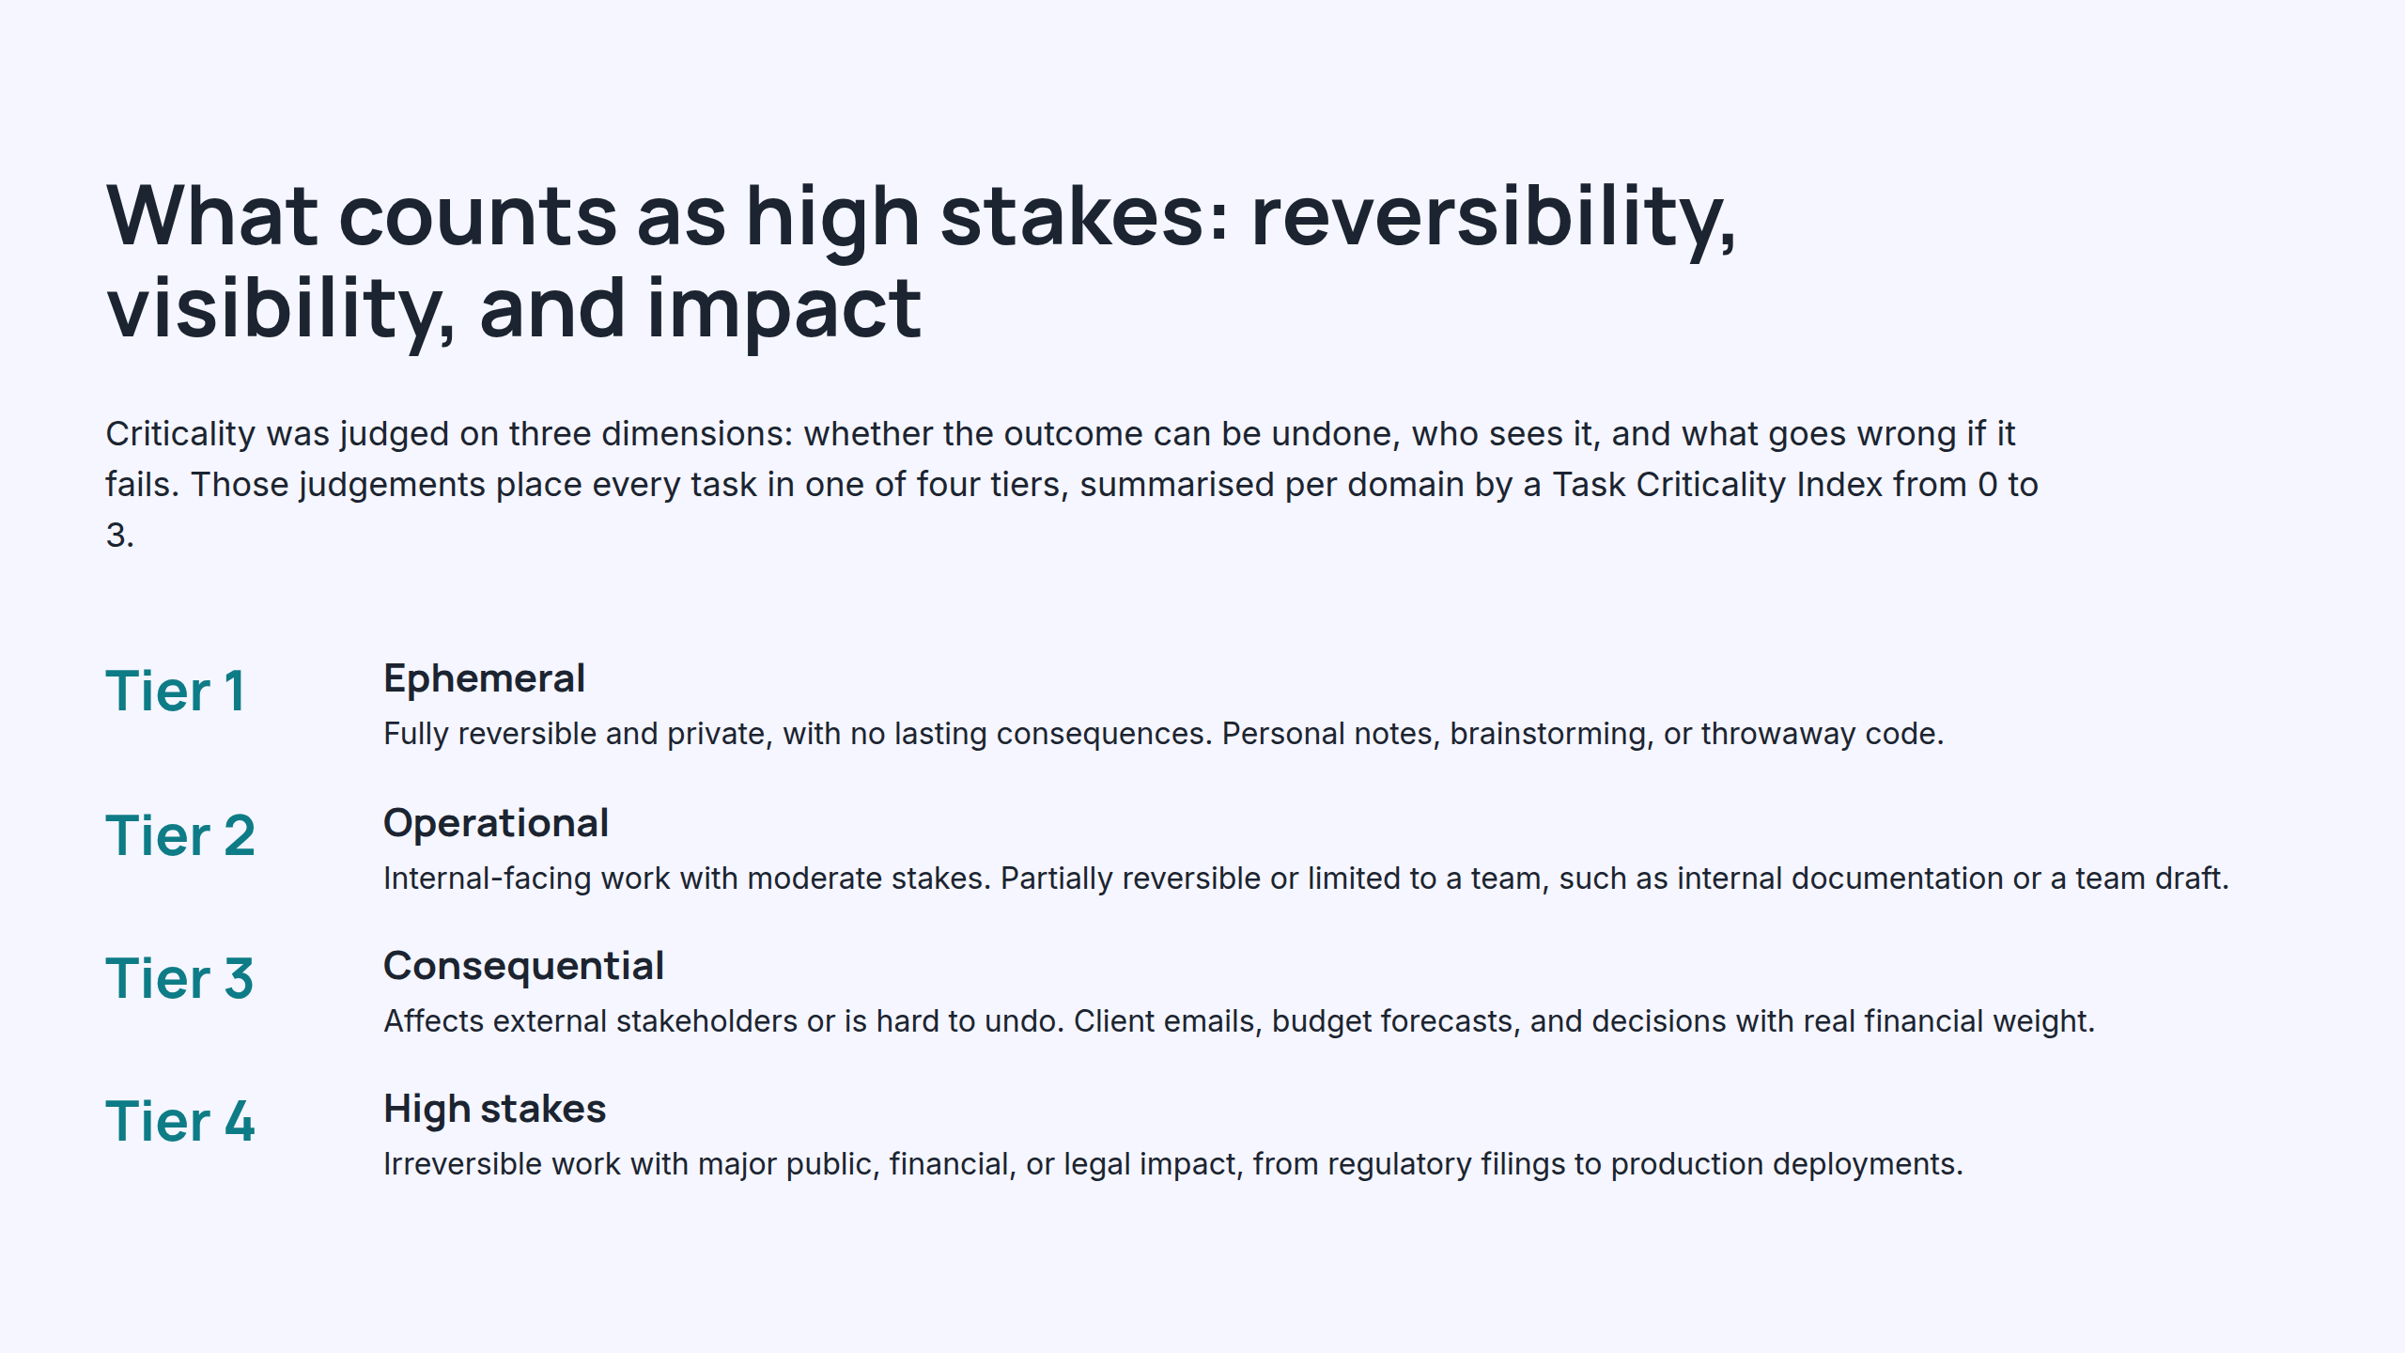
Notes:
What counts as high stakes: reversibility, visibility, and impact

Slide 5
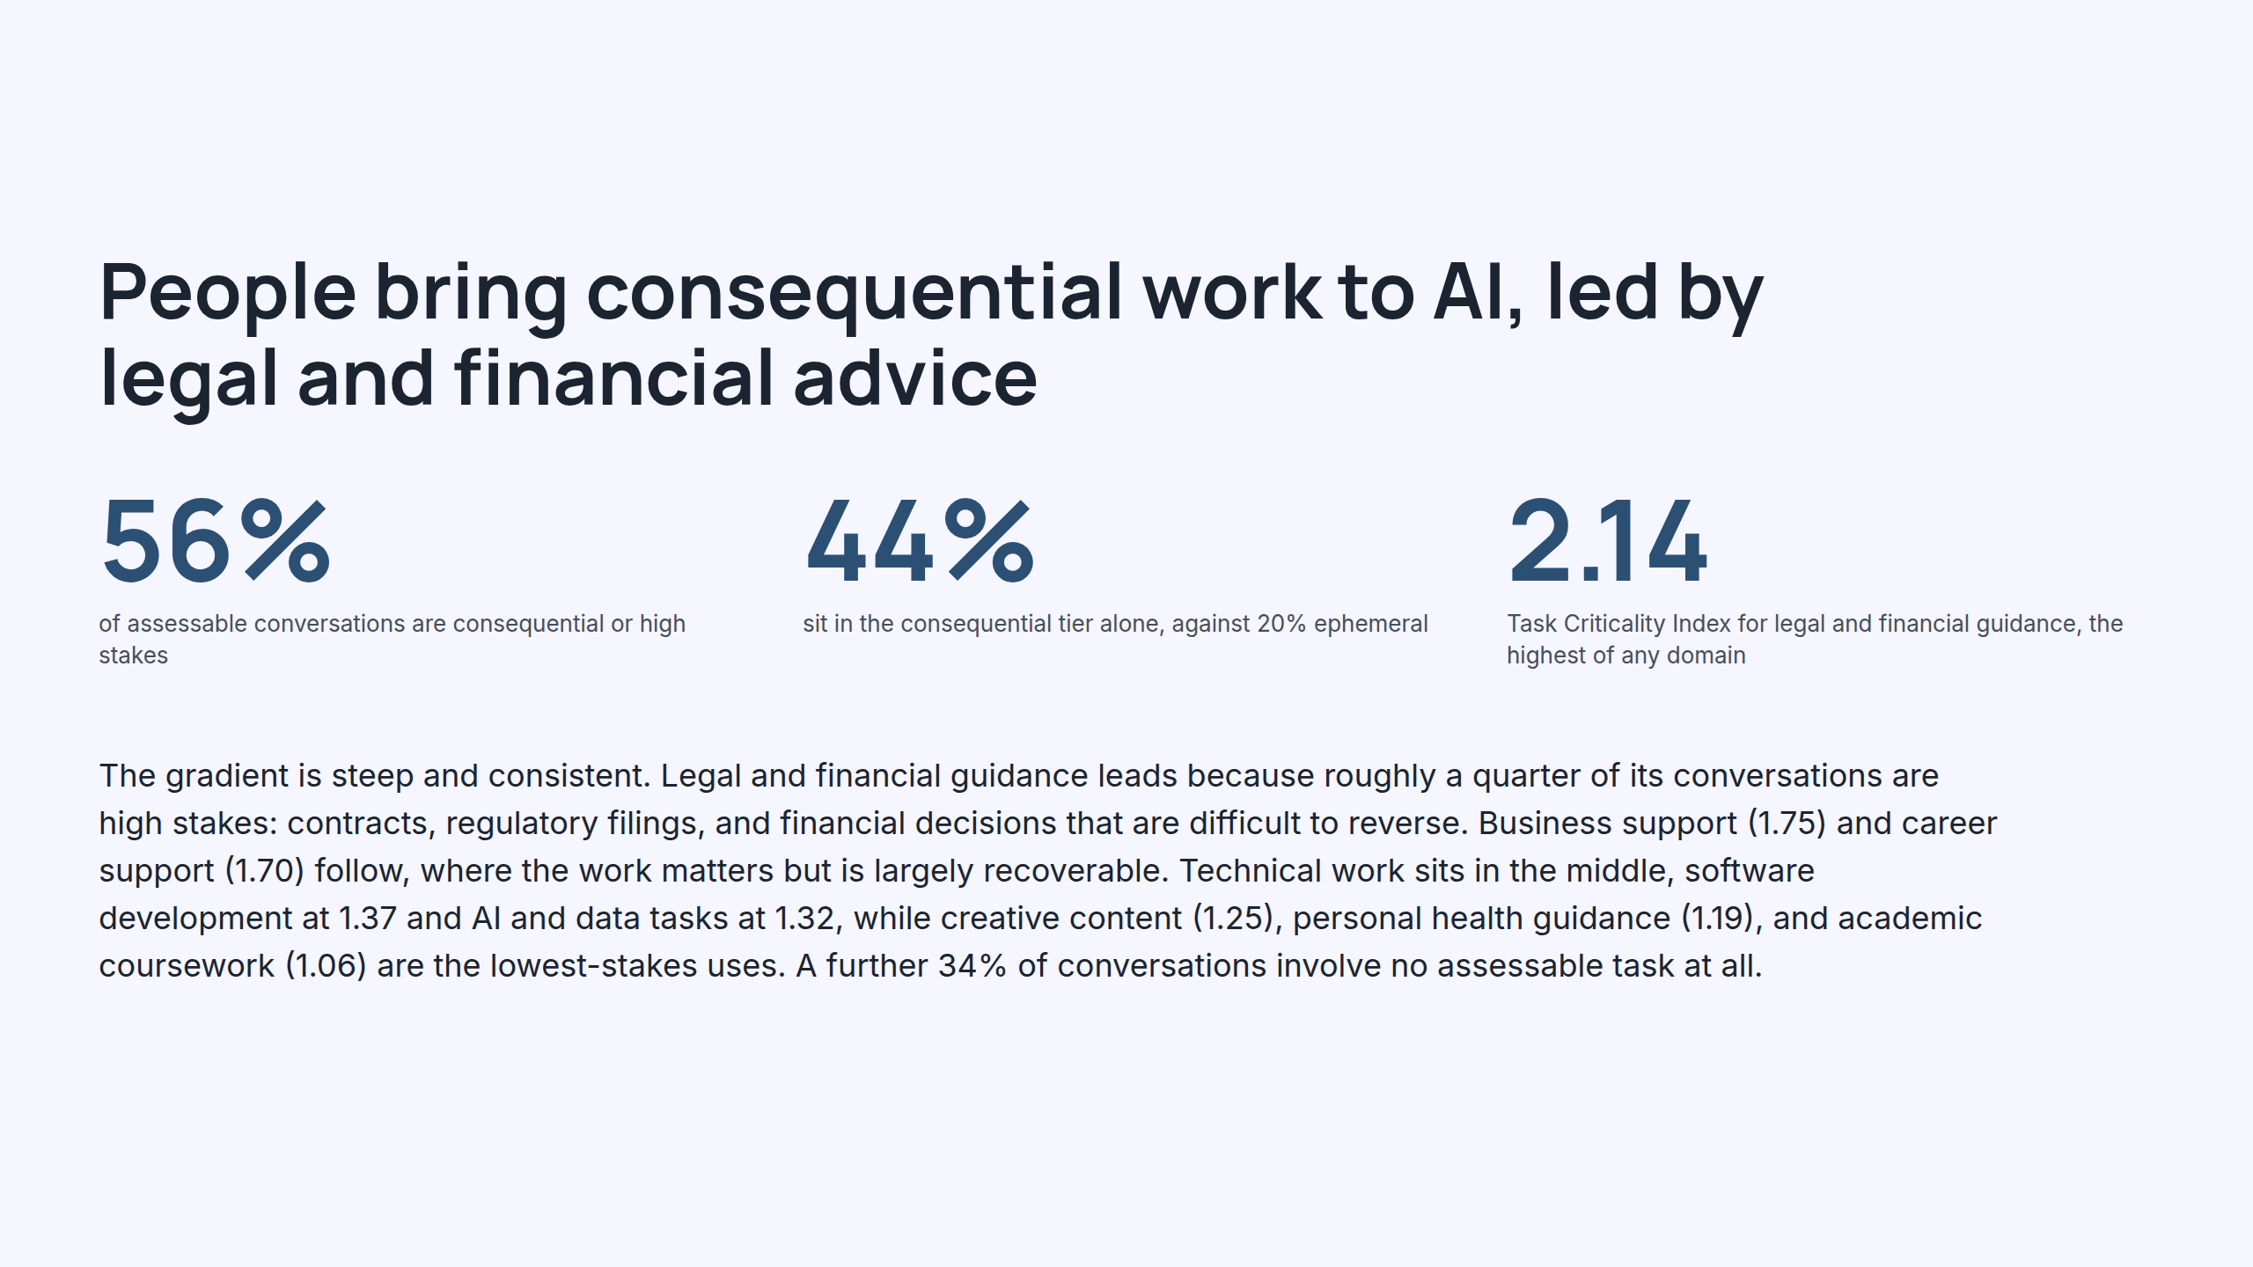
Notes:
People bring consequential work to AI, led by legal and financial advice

Slide 6
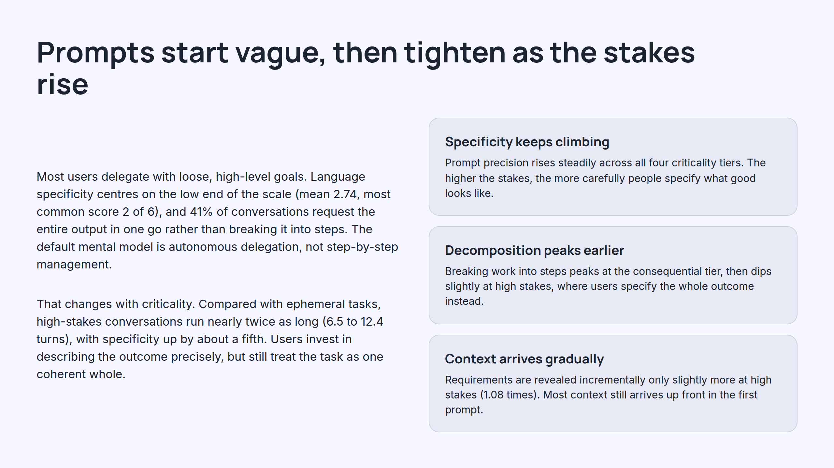
Notes:
Prompts start vague, then tighten as the stakes rise

Slide 7
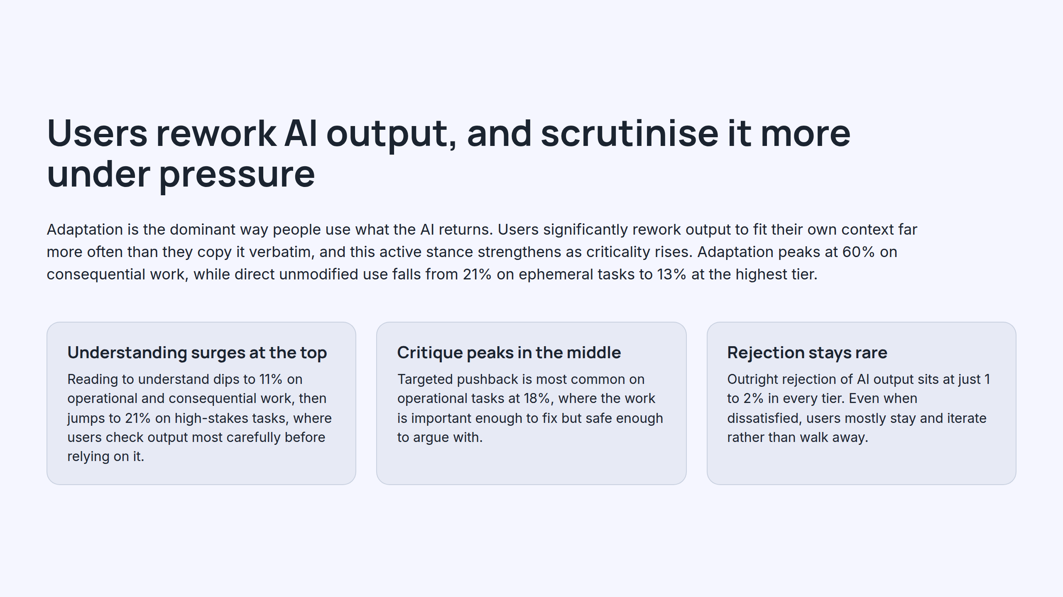
Notes:
Users rework AI output, and scrutinise it more under pressure

Slide 8
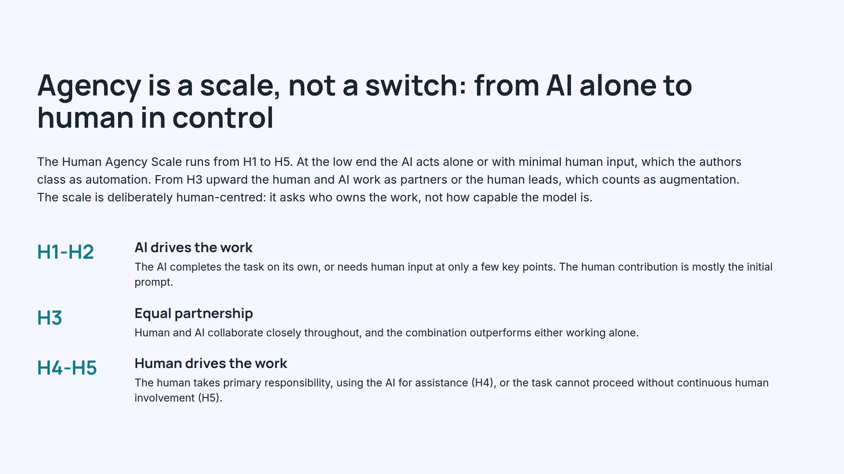
Notes:
Agency is a scale, not a switch: from AI alone to human in control

Slide 9
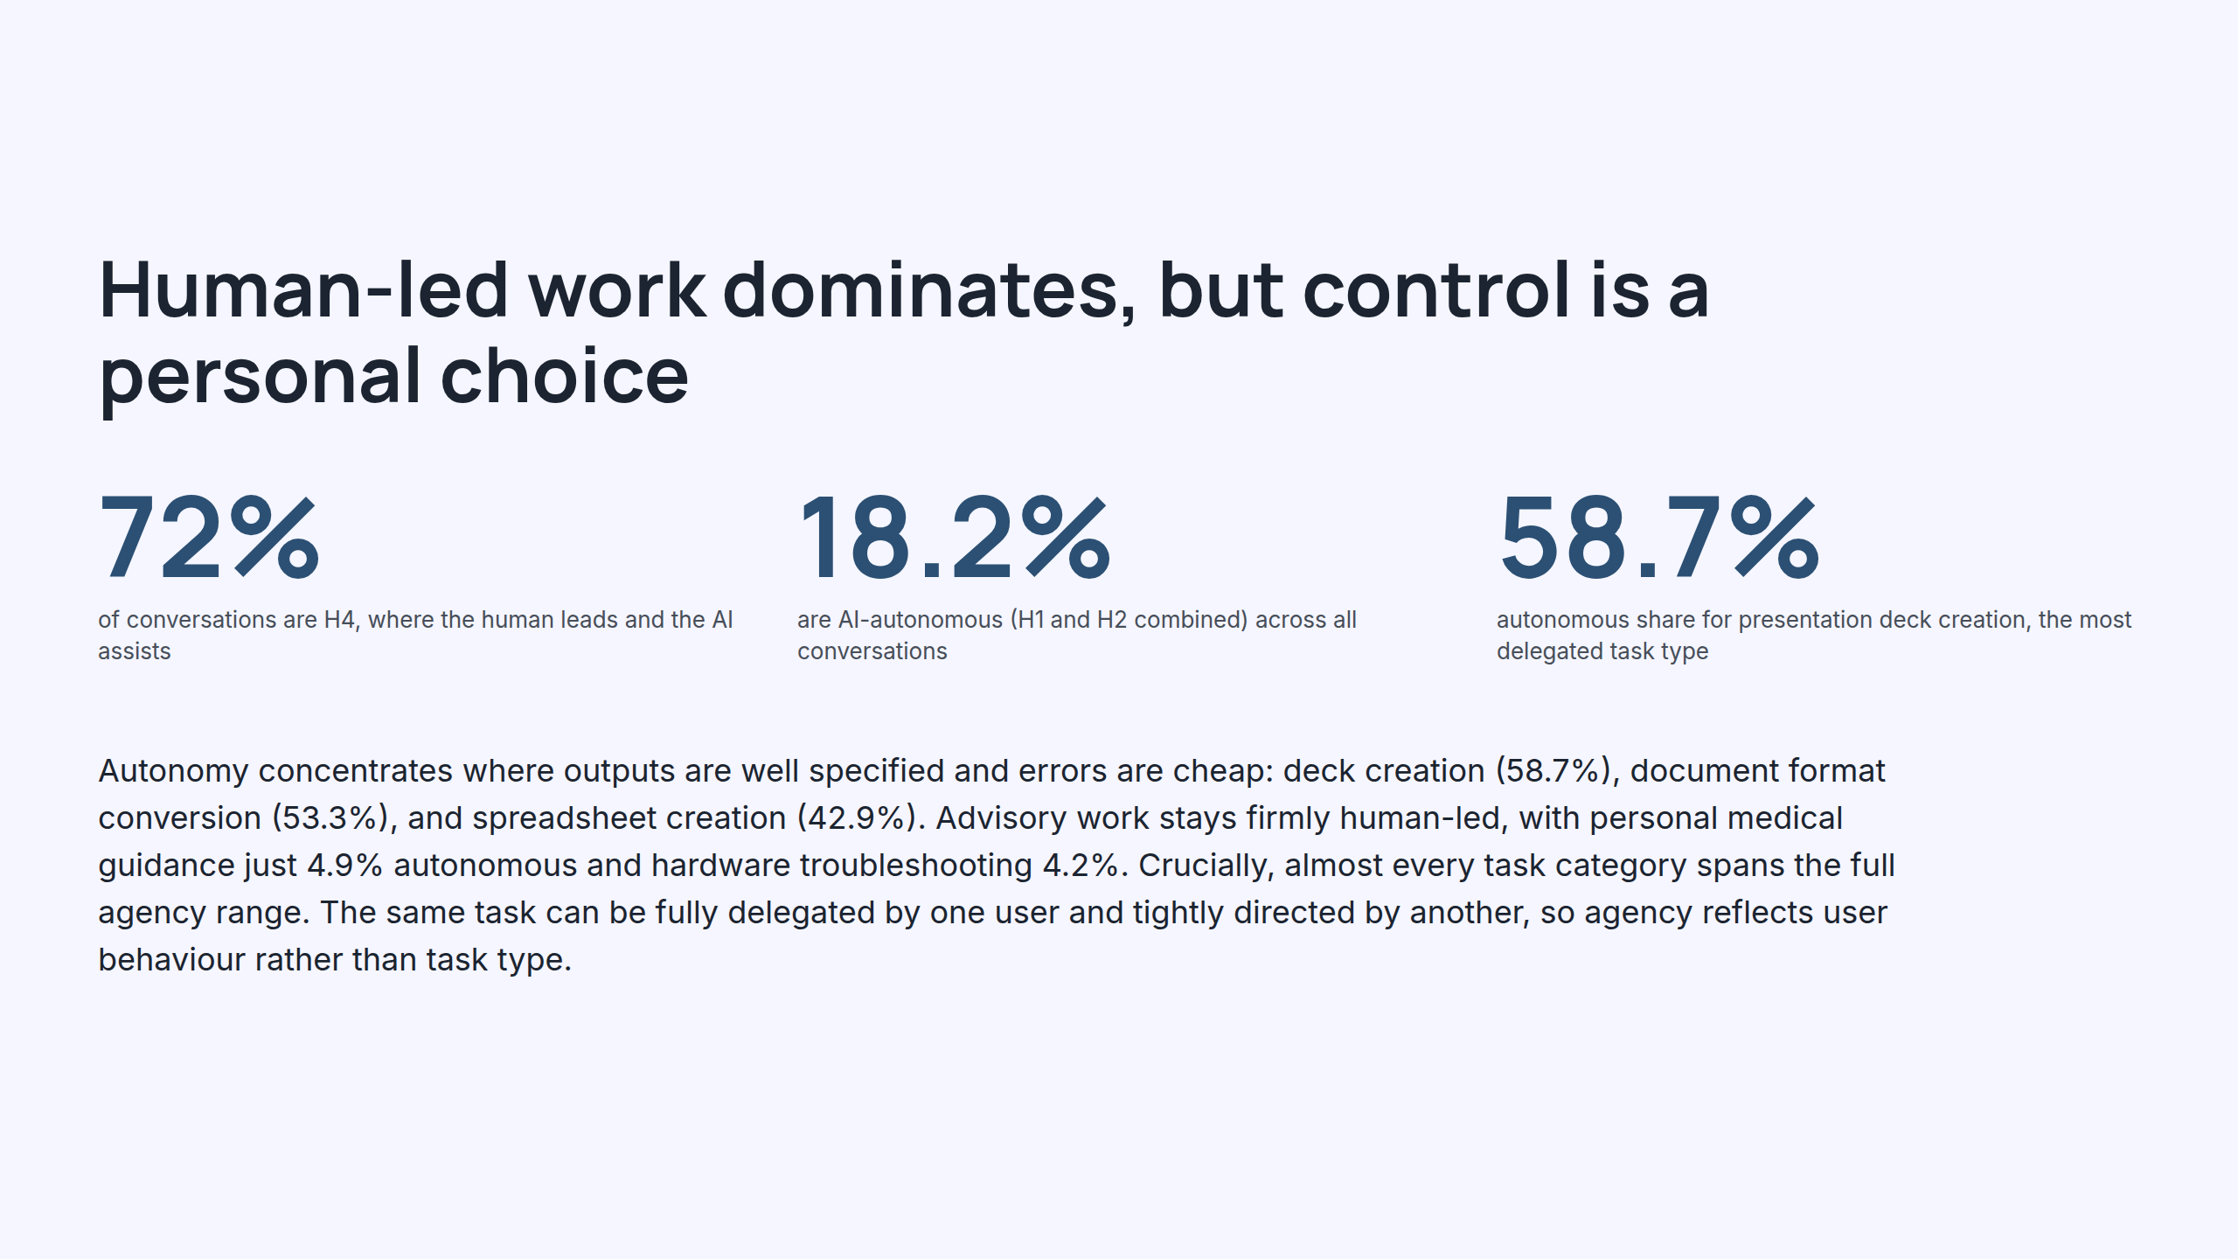
Notes:
Human-led work dominates, but control is a personal choice

Slide 10
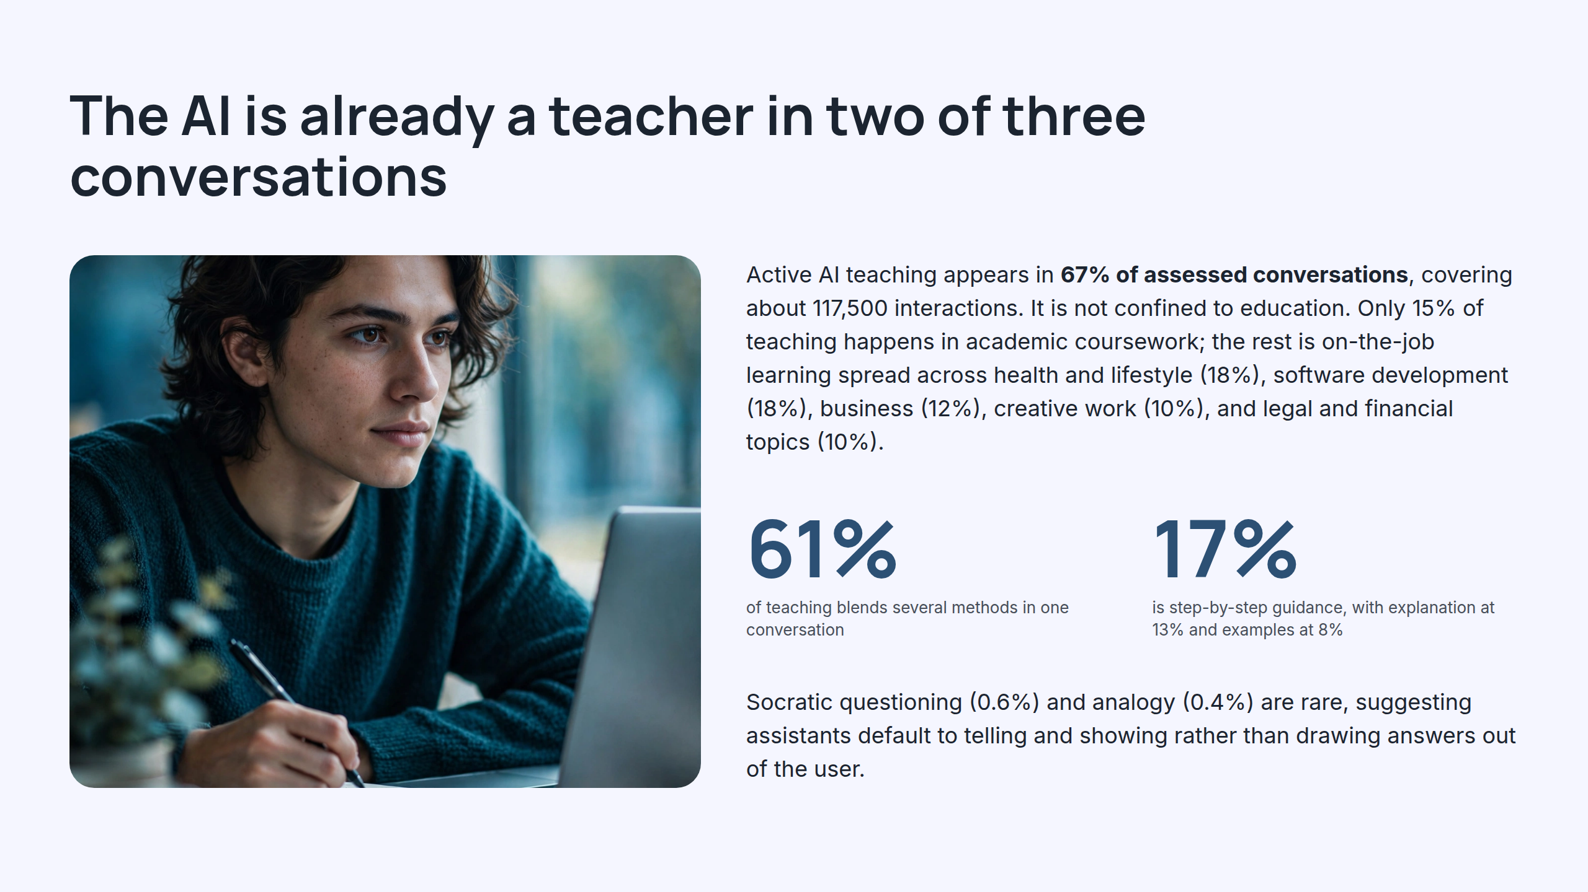
Notes:
The AI is already a teacher in two of three conversations

Slide 11
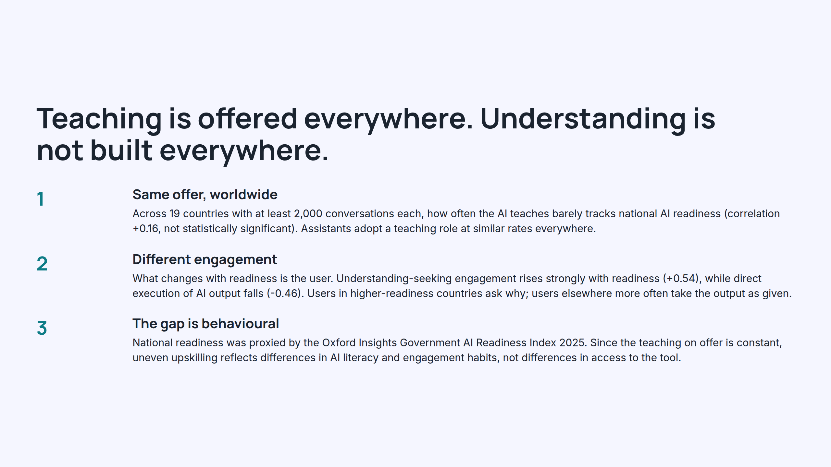
Notes:
Teaching is offered everywhere. Understanding is not built everywhere.

Slide 12
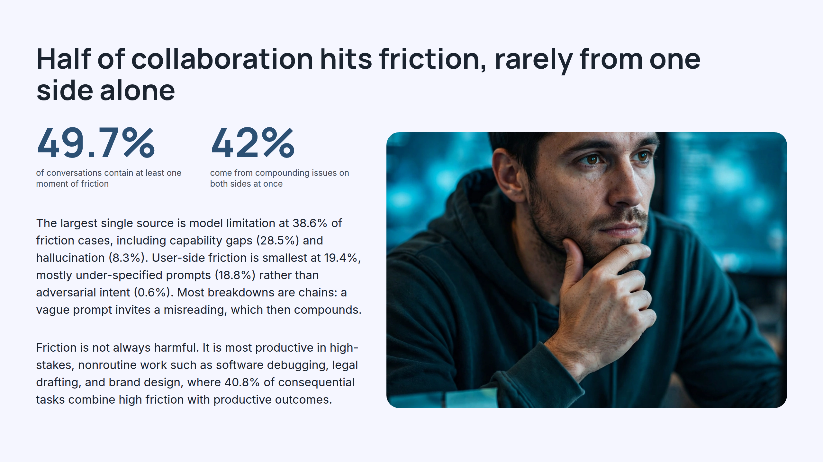
Notes:
Half of collaboration hits friction, rarely from one side alone

Slide 13
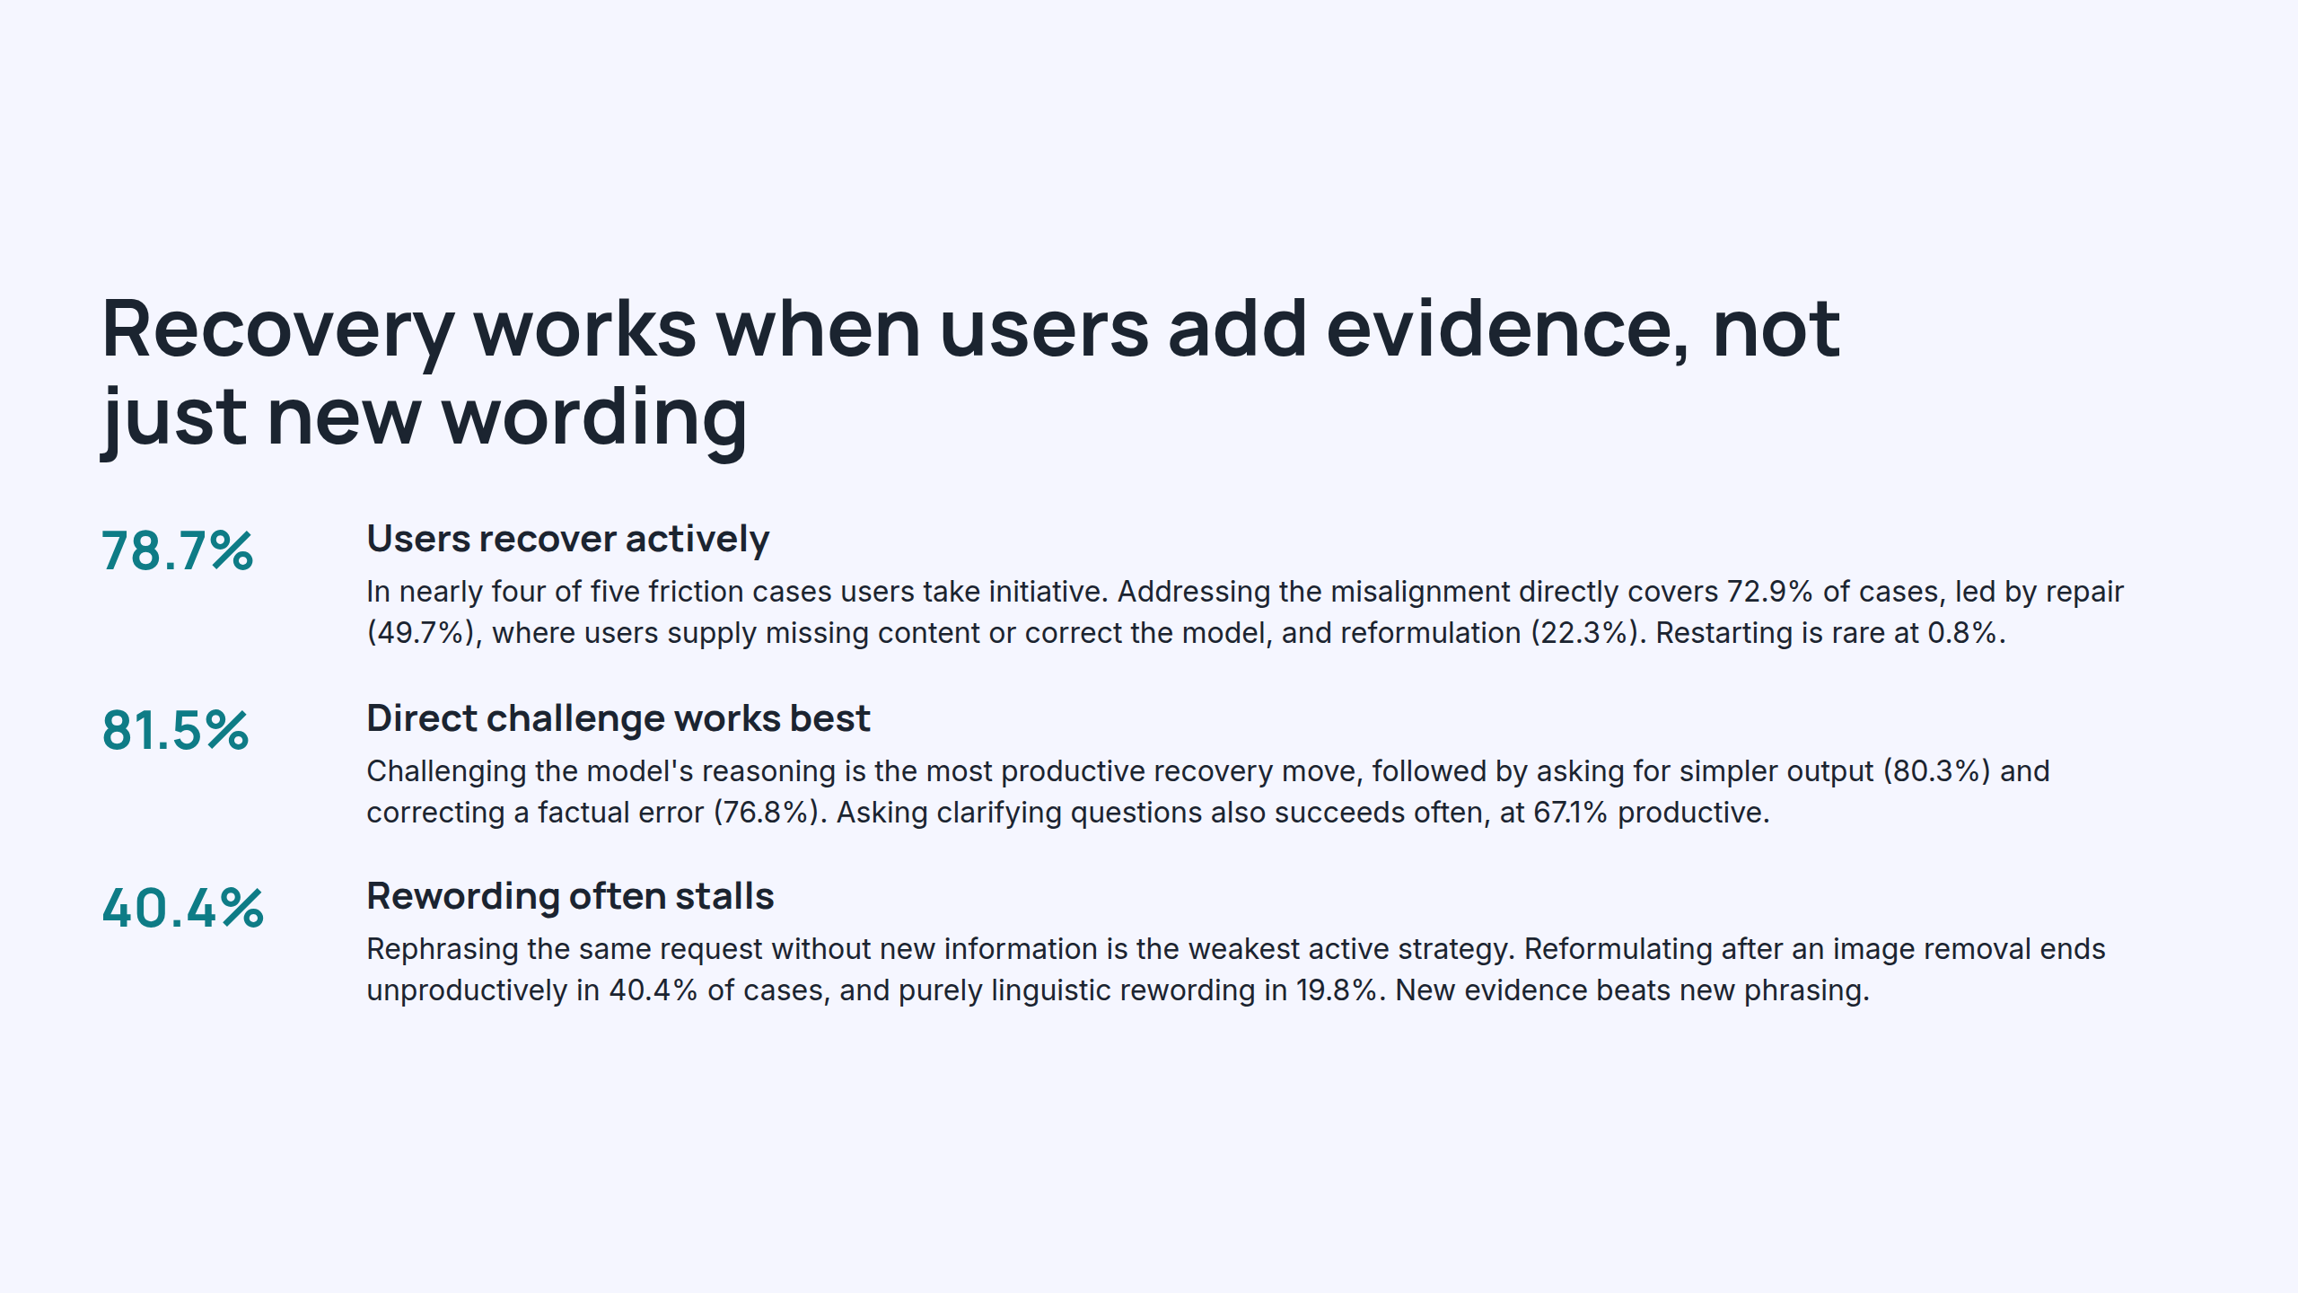
Notes:
Recovery works when users add evidence, not just new wording

Slide 14
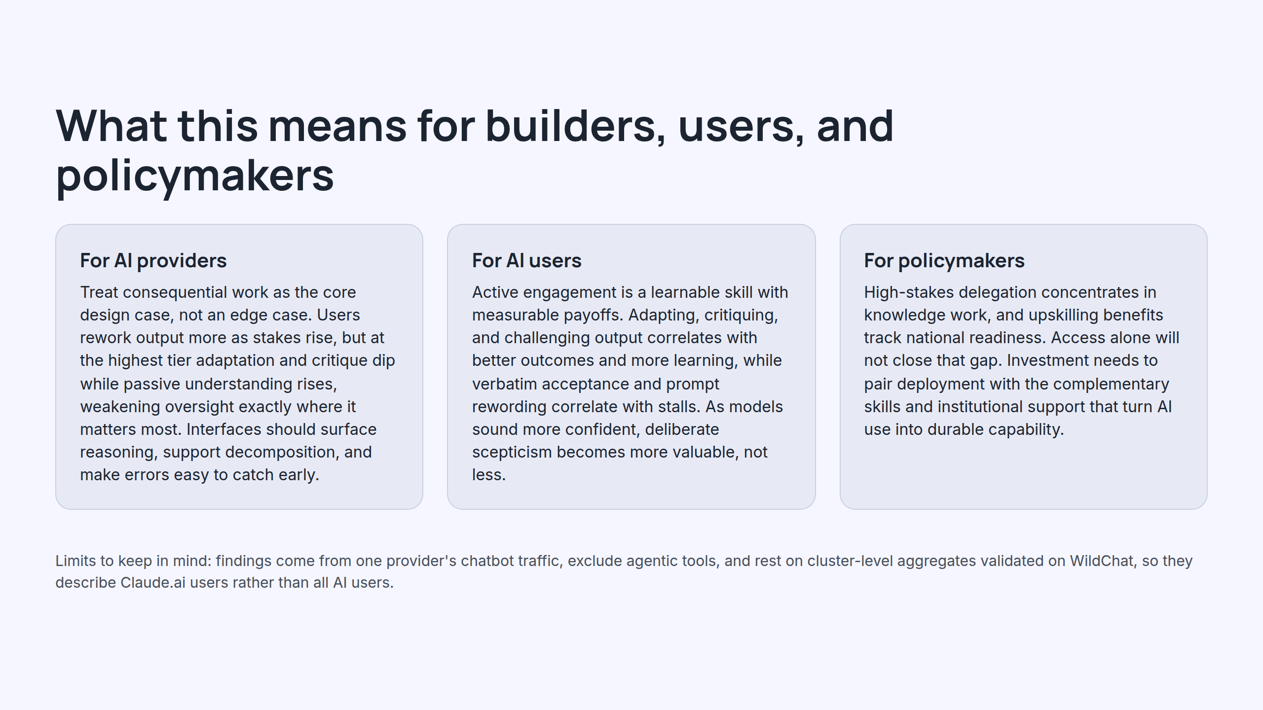
Notes:
What this means for builders, users, and policymakers

Slide 15
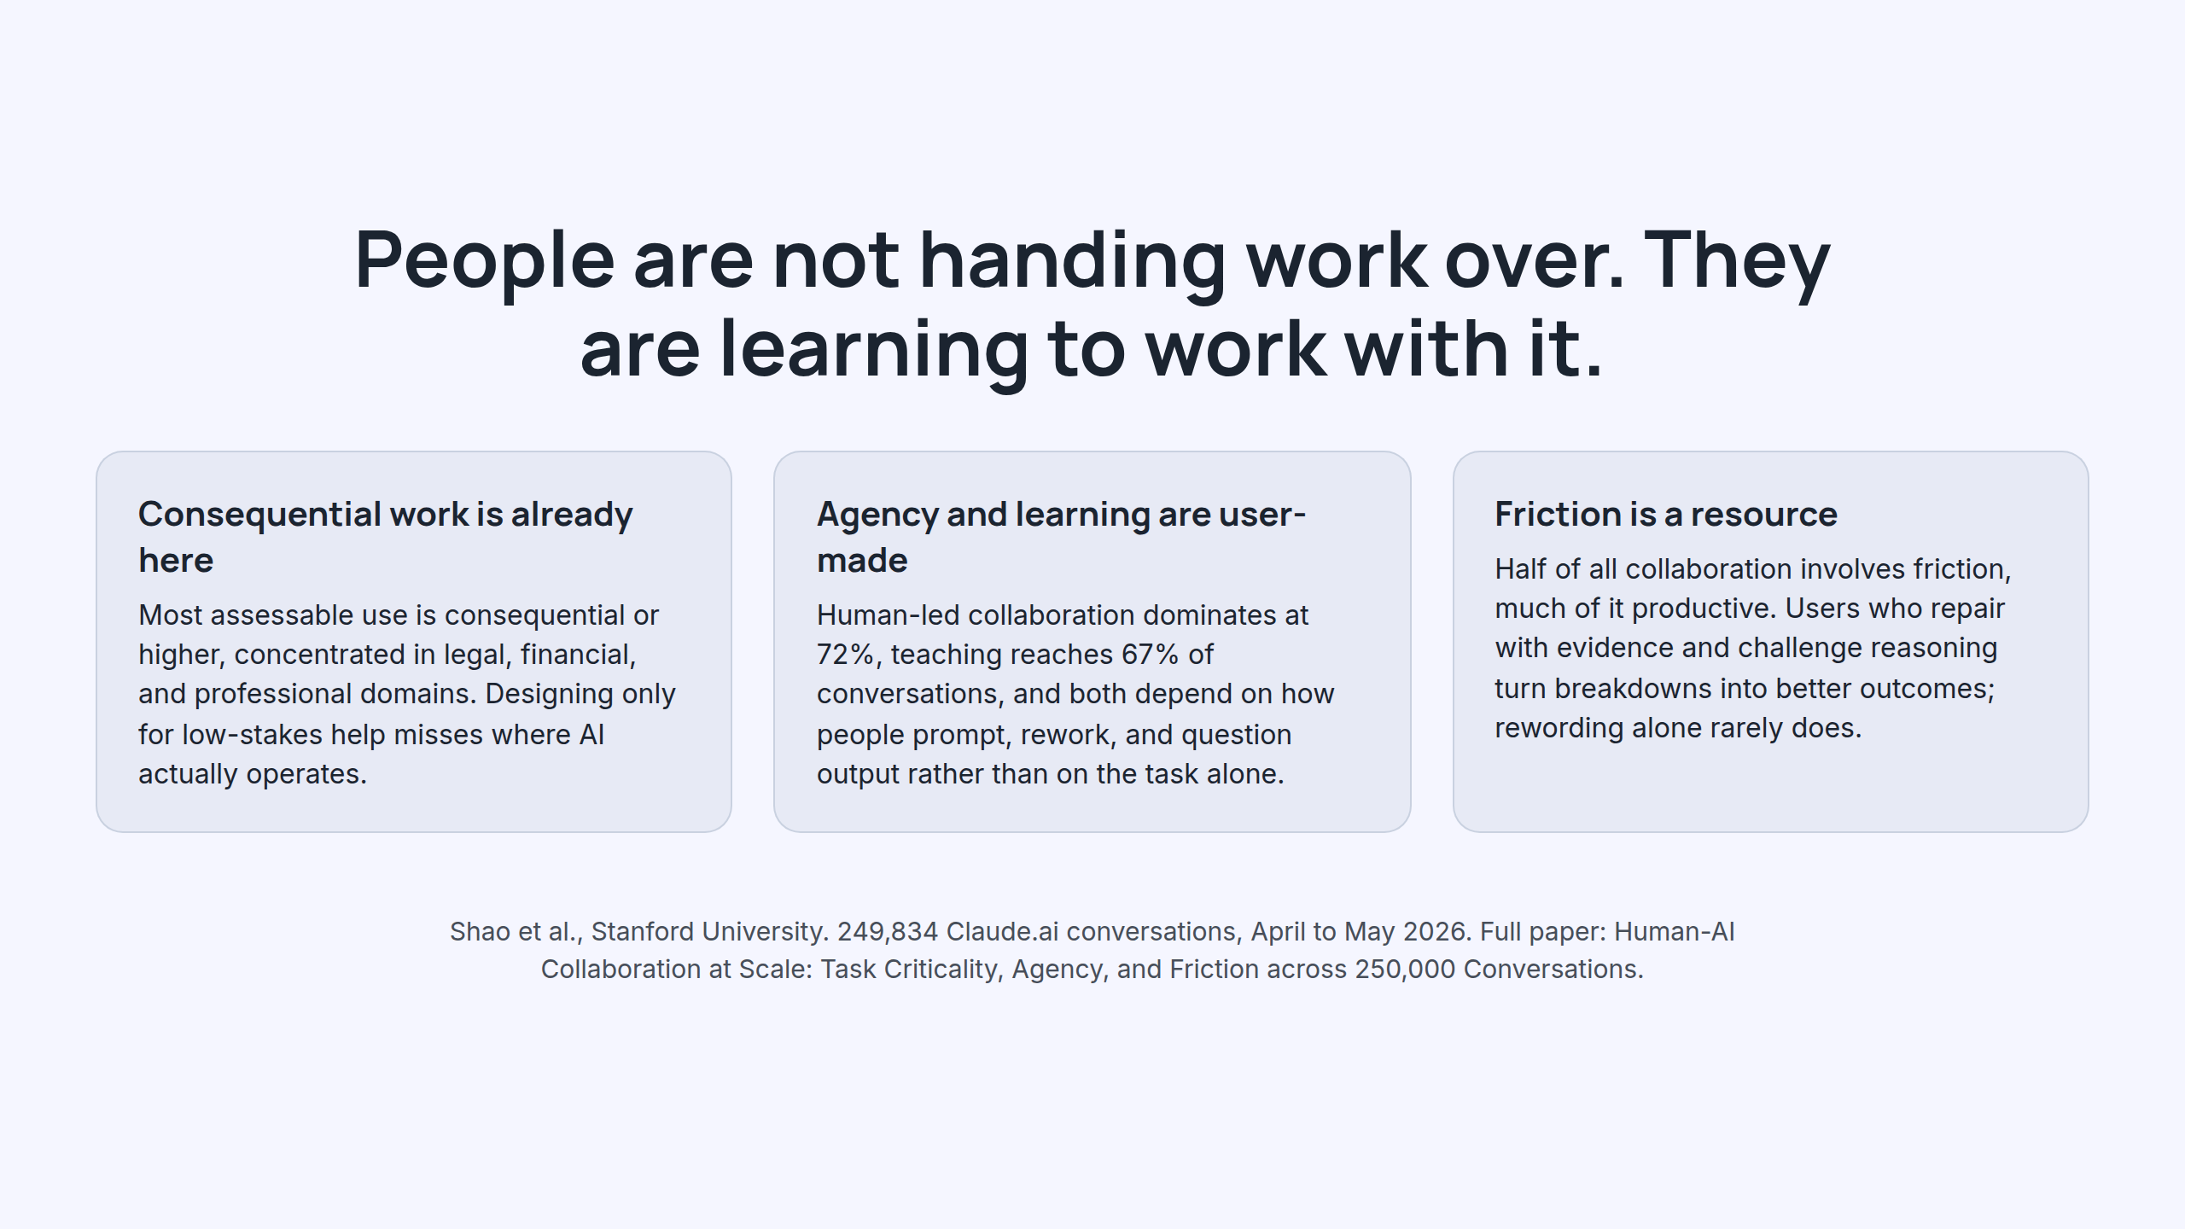
Notes:
People are not handing work over. They are learning to work with it.

