Slide 1
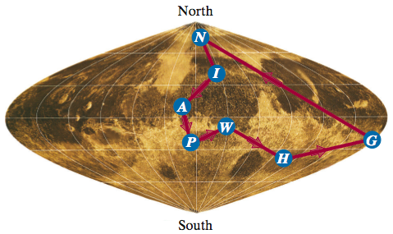
Approximation Algorithms
vertex-cover problem
traveling-salesman problem
set-covering problem

Slide 2
NP Hard & NP Complete
Polynomial Time |  | Exponential Time
Algorithm | Complexity | Algorithm | Complexity
Linear Search | n | 0/1 Knapsack | 2^{n}
Binary Search | log n | Travelling Salesman Problem | 2^{n}
Insertion Sort | n² | Sum of Subsets | 2^{n}
Merge Sort | n log n | Graph Coloring | 2^{n}
Matrix Multiplication | n³ | Hamiltonian Cycle | 2^{n}

Slide 3
NP Hard & NP Complete
NP is the set of those Non-Deterministic algorithms which is taking Polynomial time
NP
P is the set of those Deterministic algorithms which is taking Polynomial time
P

Slide 4





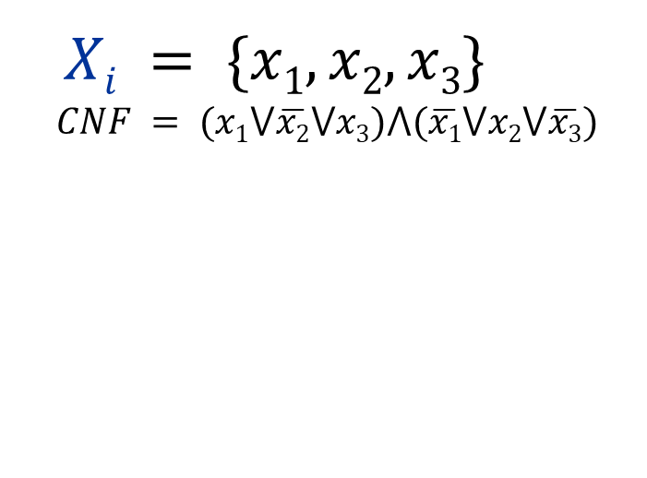









How to Solve
Satisfiability
If one is solved, then all can be solved
Exponential Time
Algorithm | Complexity
0/1 Knapsack | 2^{n}
Travelling Salesman Problem | 2^{n}
Sum of Subsets | 2^{n}
Graph Coloring | 2^{n}
Hamiltonian Cycle | 2^{n}
$Xi = \{x1, x2, x3\}$
$$CNF = (x1⋁\overline{x2}⋁x3)⋀(\overline{x1}⋁x2⋁\overline{x3})$$
$$x1=0$$
$$x1=1$$
$$x2=0$$
$$x2=1$$
$$x2=0$$
$$x2=1$$
$$x3=0$$
$x3=$1
$$x3=0$$
$x3=$1
$$x3=0$$
$x3=$1
$$x3=0$$
$x3=$1
Example: 0/1 Knapsack => Satisfiability Problem

Slide 5
NP Hard & NP Complete
We will discuss about NP-Complete and NP-hard.
but first we need to know what is reducibility .
Take two problems A and B both are NP problems.
Reducibility- If we can convert one instance of a problem A into problem B (NP problem) then it means that A is reducible to B.
NP-hard-- Now suppose we found that A is reducible to B, then it means that B is at least as hard as A. Satisfiability is NP Hard.
NP-Complete -- The group of problems which are both in NP and NP-hard are known as NP-Complete problem.
Now suppose we have a NP-Complete problem R and it is reducible to Q then Q is at least as hard as R and since R is an NP-hard problem. therefore Q will also be at least NP-hard , it may be NP-complete also.

Slide 6
NP Hard & NP Complete
NP
NP-Hard
NP Complete
P

Slide 7
Approximation Algorithms
Many problems of practical significance are NP-complete, yet they are too important to abandon merely because we don’t know how to find an optimal solution in polynomial time.
There are at least three ways to get around NP-completeness.
First, if the actual inputs are small, an algorithm with exponential running time may be perfectly satisfactory.
Second, we may be able to isolate important special cases that we can solve in polynomial time.

Slide 8
Approximation Algorithms
Third, we might come up with approaches to find near-optimal solutions in polynomial time (either in the worst case or the several expected cases).
In practice, near-optimality is often good enough. We call an algorithm that returns near-optimal solutions an approximation algorithm. We shall see few examples of polynomial-time approximation algorithms for NP-complete problems.

Slide 9
Approximation Algorithms
An approximate algorithm has an approximation ratio of ρ(n) if for any input of size n,
max(C/C*, C*/C) ≤ ρ(n)
where C = cost of solution produced by approximation algorithm.
C* = cost of optimal solution.
This definition applies to both minimization and maximization problems. Also called ρ(n)-approximation algorithm.
For a maximization problem, 0 < C ≤ C* and the ratio C* /C gives the factor by which the cost of an optimal solution is larger than the cost of the approximate solution.
Similarly, for a minimization problem, 0 < C* ≤ C, and the ratio C /C* gives the factor by which the cost of the approximate solution is larger than the cost of an optimal solution.
We assume that all solutions have positive cost and these ratios are always well defined.

Slide 10
The vertex-cover problem
A vertex cover of an undirected graph G=(V,E) is a subset V’≤ V such that if (u,v) is an edge of G, then either u ϵ V’ or v ϵ V’ (or both). The size of a vertex cover is the number of vertices in it.
The vertex-cover problem is to find a vertex cover of minimum size in a given undirected graph.
We call such a vertex cover an optimal vertex cover. This problem is the optimization version of an NP-complete decision problem.
Even though we don’t know how to find an optimal vertex cover in a graph G in polynomial time, we can efficiently find a vertex cover that is near-optimal.

Slide 11
Vertex Cover problem
The following approximation algorithm takes as input an undirected graph G and returns a vertex cover whose size is guaranteed to be no more than twice the size of an optimal vertex cover.
Approx-Vertex-Cover (G)
C := Ø;
E′ := E[G];
while E′ ≠ Ø do
select any (u,v) in E′ which was not selected before;
C:= C ∪ {u,v};
remove from E′ every edge incident on either u or v
return C

Slide 12
Vertex Cover problem
In the previous Algorithm, the variable C contains the vertex cover being constructed.
Line 1 initializes C to the empty set.
Line 2 sets E’ to be a copy of the edge set E[G] of the graph.
The loop of lines 3–6 repeatedly picks an edge (u;v) from E’, adds its endpoints u and v to C, and deletes all edges in E’ that are covered by either u or v.
Finally, line 7 returns the vertex cover C.
The running time of this algorithm is O(V+E), using adjacency lists to represent E’.

Slide 13
Example: APPROX. VERTEX COVER
b
c
d
a
e
f
g
The input graph G, which has 7 vertices and 8 edges.

Slide 14
APPROX. VERTEX COVER
b
c
d
a
e
f
g
The edge (b; c), shown heavy, is the first edge chosen by APPROX-VERTEX-COVER. Vertices b and c, shown lightly shaded, are added to the set C containing the vertex cover being created.
Edges (a; b), (c; e), and (c; d), shown dashed, are removed since they are now covered by some vertex in C.

Slide 15
APPROX. VERTEX COVER
b
c
d
a
e
f
g
Edge (e, f ) is chosen; vertices e and f are added to C.

Slide 16
APPROX. VERTEX COVER
b
c
d
a
e
f
g
Edge (d; g) is chosen; vertices d and g are added to C.

Slide 17
APPROX. VERTEX COVER
b
c
d
a
e
f
g
The set C, which is the vertex cover produced contains the six vertices {b; c; d; e; f; g }

Slide 18
APPROX. VERTEX COVER
b
c
d
a
e
f
g
The optimal vertex cover for this problem contains only three vertices: b, d, and e.

Slide 19
APPROX. VERTEX COVER
Approximate Vertex Cover algorithm is a 2-approximation algorithm or has a ratio bound of 2.
Proof: The set C of vertices that is returned by above algorithm is a vertex cover, since the algorithm loops until every edge in E[G] has been covered by some vertex in C.
Let A = set of edges selected.
Note that no two edges in A share a common endpoint which implies |C| = 2|A|.
Also implies |A| ≤ |C*|, because optimal cover C* must include at least one endpoint of each edge in A.
Hence, |C| ≤ 2|C*|.

Slide 20
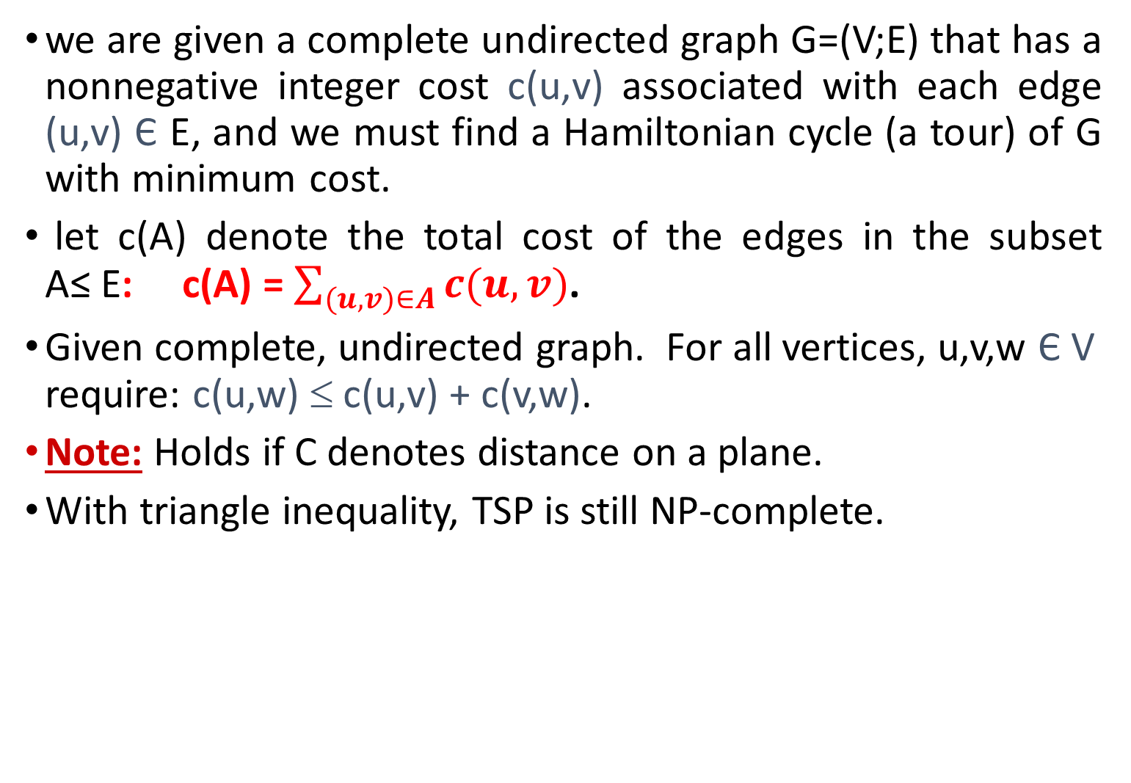
The traveling-salesman problem

Slide 21
Traveling-salesman problem with the triangle inequality
The following algorithm computes a near-optimal tour of an undirected graph G using minimum-spanning-tree algorithm (MST-PRIM).
We shall then use the minimum spanning tree to create a tour whose cost is no more than twice that of the minimum spanning tree’s weight, as long as the cost function satisfies the triangle inequality.
Approx- TSP-Tour(G,c)
1 select a vertex r ∈ v[G] to be a “root” vertex;
2 call MST-Prim(G,c,r) to construct MST with root r;
3 let L = vertices on preorder tree walk of MST;
4 let H = cycle that visits vertices in the order L;
return H

Slide 22
Approx. TSP
a
d
e
b
f
g
c
h
Let us consider a complete undirected graph. Vertices lie on intersections of integer grid lines. For example, f is one unit to the right and two units up from h. The cost function between two points is the ordinary Euclidean distance.

Slide 23
Approx. TSP
a
d
e
b
f
g
c
h
A minimum spanning tree T of the complete graph, as computed by MST-PRIM. Vertex a is the root vertex. Only edges in the minimum spanning tree are shown. The vertices happen to be labeled in such a way that they are added to the main tree by MST-PRIM in alphabetical order.

Slide 24
Approx. TSP
a
d
e
b
f
g
c
h
A walk of T , starting at a. A full walk of the tree visits the vertices in the order a; b; c; b; h; b; a; d; e; f; e; g; e; d; a.
A preorder walk of T lists a vertex just when it is first encountered, as indicated by the dot next to each vertex, yielding the ordering a; b; c; h; d; e; f; g.

Slide 25
Approx. TSP
a
d
e
b
f
g
c
h
Computed Tour

Slide 26
Approx. TSP
a
d
e
b
f
g
c
h
Optimal Tour

Slide 27
APPROX-TSP-TOUR is a polynomial-time 2-approximation algorithm for the Traveling-salesman problem with the triangle inequality.
Proof:
Let H* = optimal tour, T = MST.
Deleting an edge of H* yields a
spanning tree.
So, c(T) ≤ c(H *).
Consider full walk W of T.
Ex: a,b,c,b,h,b,a,d,e,f,e,g,e,d,a.
Visits each edge twice
⇒ c(W) = 2c(T).
Hence, c(W) ≤ 2c(H*).
Triangle inequality ⇒ can
delete any vertex from W and
cost doesn’t increase.
Deleting all but first appearance
of each vertex yields preorder walk.
Ex: a,b,c,h,d,e,f,g.
Corres. cycle H = W with some
edges removed.
Ex: a,b,c,h,d,e,f,g,a.
c(H) ≤ c(W).
Implies c(H) ≤ 2c(H*).

Slide 28
The set-covering problem
The set-covering problem is an optimization problem that models many resources- selection problems.
. Its corresponding decision problem generalizes the NP-complete vertex-cover problem, hence is also NP-hard.
The approximation algorithm developed to handle the vertex-cover problem doesn’t apply here and so we need to try other approaches.
We shall examine a simple greedy heuristic with a logarithmic approximation ratio. That is, as the size of the instance gets larger, the size of the approximate solution may grow, relative to the size of an optimal solution.
Because the logarithm function grows rather slowly, however, this approximation algorithm may on the other hand give useful results.

Slide 29


Set-covering problem
A case (X;F) of the set-covering problem consists of a finite set X and a family F of subsets of X, such that every element of X belongs to at least one subset in F :
We say that a subset SЄ F covers its elements. The problem is to find a minimum size subset C ≤ F whose members cover all of X:
We say that any C satisfying above equation covers X.

Slide 30
Set-covering problem
Greedy Algorithm:
Family of Sets.
Each set consists of elements from X.
Greedy-Set Cover( X, F)
U := X;
C := Ø;
while U ≠ Ø do
select S ∈F that maximizes |S ∩ U|;
U := U – S;
C := C ∪ {S}
return C

Slide 31
Set-covering problem
The algorithm works as follows: The set U contains, at each stage, the set of remaining uncovered elements. The set C contains the cover being constructed.
Line 4 is the greedy decision-making step, choosing a subset S that covers as many uncovered elements as possible. After S is selected, line 5 removes its elements from U, and line 6 places S into C. When the algorithm terminates, the set C contains a subfamily of F that covers X.
We can easily implement GREEDY-SET-COVER to run in time polynomial in |X| and |F|. Since the number of iterations of the loop on lines 3–6 is bounded from above by min.(|X| ; |F|), and we can implement the loop body to run in time :
O (|X| .|F|).

Slide 32
Set-covering problem
S₁
S₃
S₂
S₅
S₆
S₄
An instance (X; F) of the set-covering problem, where X consists of the 12 black points and F={S1; S2; S3; S4; S5; S6}.

Slide 33
Set-covering problem
S₁
S₃
S₂
S₅
S₆
S₄

Slide 34
Set-covering problem
S₁
S₃
S₂
S₅
S₆
S₄

Slide 35
Set-covering problem
S₁
S₃
S₂
S₅
S₆
S₄

Slide 36
Set-covering problem
The greedy algorithm produces a cover of size 4 by selecting either the sets S1, S4, S5, and S3 or the sets S1, S4, S5, and S6, in order.
S₁
S₃
S₂
S₅
S₆
S₄
Computed cover consists of 4 sets

Slide 37
Set-covering problem
A minimum-size set cover is C={S3; S4; S5 } with size 3
S₁
Set Cover
S₃
S₂
S₅
S₆
S₄
Optimal cover consists of 3 sets

Slide 38
Tutorials
Sl No. | Date | Topics
1 | 23-10-2019
2 | 25-10-2019 | MID Term-1 Class Test
3 | 01-11-2019 | Class Test
4 | 04-11-2019
5 | 06-11-2019
6 | 08-11-2019

