Slide 1
Graphs
1843
ORD
SFO
802
337
1743
LAX
1233
DFW

Slide 2
Graphs
A graph is a pair (V, E), where
V is a set of nodes, called vertices
E is a collection of pairs of vertices, called edges
Vertices and edges are positions and store elements
Example:
A vertex represents an airport and stores the three-letter airport code
An edge represents a flight route between two airports and stores the mileage of the route
849
PVD
1843
ORD
142
SFO
802
LGA
337
1743
1387
HNL
2555
1099
LAX
1233
DFW
1120
MIA

Slide 3
Can you think of other examples of graphs modelling real-world situations?
What are the nodes. (what data is stored)
What are the edges. (what data is stored)
Is it directed or undirected?

Slide 4
2 Edge Types
Directed edge (ARROW)
ordered pair of vertices (u,v)
first vertex u is the origin
second vertex v is the destination
e.g., a flight
Undirected edge (no arrow)
unordered pair of vertices (u,v)
e.g., a flight route
Directed graph
all the edges are directed
e.g., route network
Undirected graph
all the edges are undirected
e.g., flight network
flight
AA 1206
ORD
PVD
849
miles
ORD
PVD
A road between two points
Could be one way (directed)
Or two way (undirected)
Could have more than one edge
(e.g. toll road and public road)

Slide 5
Applications
Electronic circuits
Printed circuit board
Integrated circuit
Transportation networks
Highway network
Flight network
Computer networks
Local area network
Internet
Web
Databases
Entity-relationship diagram

Slide 6
Terminology
End vertices (or endpoints) of an edge
U and V are the endpoints of a
Edges incident on a vertex
a, d, and b are incident on V
Adjacent vertices
U and V are adjacent
Degree of a vertex
X has degree 5
Parallel edges
h and i are parallel edges
Self-loop
j is a self-loop
V
a
b
h
j
U
d
X
Z
c
e
i
W
g
f
Y

Slide 7
Terminology (cont.)
Path
sequence of alternating vertices and edges
begins with a vertex
ends with a vertex
each edge is preceded and followed by its endpoints
Simple path
path such that all its vertices and edges are distinct
Examples
P₁=(V,b,X,h,Z) is a simple path
P₂=(U,c,W,e,X,g,Y,f,W,d,V) is a path that is not simple
V
a
b
P₁
d
U
X
Z
P₂
h
c
e
W
g
f
Y

Slide 8
Terminology (cont.)
Cycle
circular sequence of alternating vertices and edges
each edge is preceded and followed by its endpoints
Simple cycle
cycle such that all its vertices and edges are distinct
Examples
C₁=(V,b,X,g,Y,f,W,c,U,a,↵) is a simple cycle
C₂=(U,c,W,e,X,g,Y,f,W,d,V,a,↵) is a cycle that is not simple
V
a
b
d
U
X
Z
C₂
h
e
C₁
c
W
g
f
Y

Slide 9
What operations do you think we can do to a graph
add an edge
add a node
Others……

Slide 10
Main Methods of the Graph ADT
Update (set or mutator) methods
insertVertex(o): insert a vertex storing element o
insertEdge(v, w, o): insert an edge (v,w) storing element o
removeVertex(v): remove vertex v (and its incident edges)
removeEdge(e): remove edge e
collection methods
incidentEdges(v): edges incident to v
vertices(): all vertices in the graph
edges(): all edges in the graph
Vertices and edges
are positions
store elements
Accessor (get) methods
endVertices(e): an array of the two endvertices of e
opposite(v, e): the vertex opposite of v on e
areAdjacent(v, w): true iff v and w are adjacent
replace(v, x): replace element at vertex v with x
replace(e, x): replace element at edge e with x

Slide 11
Connectivity
A graph is connected if there is a path between every pair of vertices
A connected component of a graph G is a maximal connected subgraph of G
Connected graph
Non connected graph with two connected components

Slide 12
Trees and Forests
A (free) tree is an undirected graph T such that
T is connected
T has no cycles
This definition of tree is different from the one of a rooted tree
A forest is an undirected graph without cycles
The connected components of a forest are trees
Tree
Forest

Slide 13
Implementing a Graph
To program a graph data structure, what information would we need to store?
For each vertex?
For each edge?
2
1
3
7
4
6
5

Slide 14
Implementing a Graph
What kinds of questions would we want to be able to answer (quickly?) about a graph G?
Where is vertex v?
Which vertices are adjacent to vertex v?
What edges touch vertex v?
What are the edges of G?
What are the vertices of G?
What is the degree of vertex v?
2
1
3
7
4
6
5

Slide 15
Graph Implementation Strategies
Edge List
Adjacency Matrix
Adjacency List

Slide 16
Edge List
edge list: an unordered list of all edges in the graph
2
1
3
1
1
1
2
2
3
5
5
5
7
7
2
5
6
7
3
4
6
7
4
4
4
6
5

Slide 17
Edge List: Pros and Cons
advantages
easy to loop/iterate over all edges
disadvantages
hard to tell if an edge exists from A to B
hard to tell how many edges a vertex touches (its degree)
1
1
1
2
2
3
5
5
5
7
2
5
6
7
3
4
6
7
4
4

Slide 18
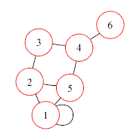
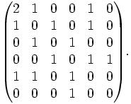
Adjacency Matrix
adjacency matrix: an n × n matrix where:
the nondiagonal entry a_{ij} is the number of edges joining vertex i and vertex j (or the weight of the edge joining vertex i and vertex j)
the diagonal entry a_{ii} corresponds to the number of loops (self-connecting edges) at vertex i

Slide 19
Adjacency Matrix: Pros and Cons
advantages
fast to tell whether edge exists between any two vertices i and j (and to get its weight)
disadvantages
consumes a lot of memory on sparse graphs (ones with few edges)
redundant information for undirected graphs

Slide 20
Adjacency Matrix Example
How do we figure out the degree of a given vertex?
How do we find out whether an edge exists from A to B?
How could we look for loops in the graph?
2
1 2 3 4 5 6 7
1
3
1
2
3
4
5
6
7
0
1
0
0
1
1
0
1
0
1
0
0
0
1
7
0
1
0
1
0
0
0
0
0
1
0
1
0
1
4
1
0
0
1
0
1
1
1
0
0
0
1
0
0
6
0
1
0
1
1
0
0
5

Slide 21
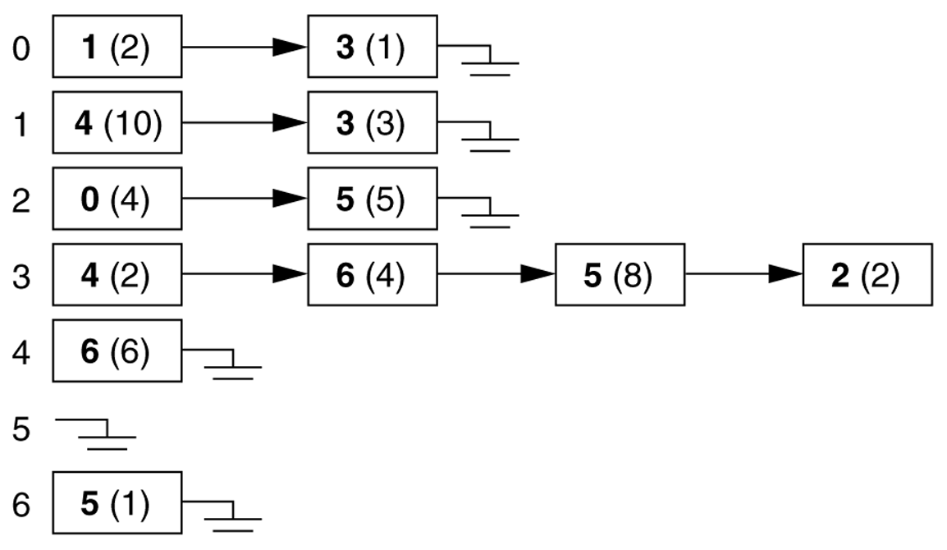
Adjacency Lists
adjacency list: stores edges as individual linked lists of references to each vertex's neighbors

Slide 22
Adjacency List: Pros and Cons
advantages:
new nodes can be added easily
new nodes can be connected with existing nodes easily
"who are my neighbors" easily answered
disadvantages:
determining whether an edge exists between two nodes: O(average degree)

Slide 23
Adjacency List Example
How do we figure out the degree of a given vertex?
How do we find out whether an edge exists from A to B?
How could we look for loops in the graph?
2
1
3
1
2
3
4
5
6
7
2
5
6
3
1
7
2
4
7
3
7
5
6
1
7
4
4
1
5
6
4
5
2
5

Slide 24
Runtime table
n vertices, m edges no parallel edges no self-loops | Edge List | Adjacency List | Adjacency Matrix
Space
Finding all adjacent vertices to v
Determining if v is adjacent to w
adding a vertex
adding an edge
removing vertex v
removing an edge
n vertices, m edges no parallel edges no self-loops | Edge List | Adjacency List | Adjacency Matrix
Space | n + m | n + m | n²
Finding all adjacent vertices to v | m | deg(v) | n
Determining if v is adjacent to w | m | deg(v) | 1
adding a vertex | 1 | 1 | n²
adding an edge to v | 1 | 1 | 1
removing vertex v | m | n? | n²
removing an edge from v | m | deg(v) | 1

