Slide 1
Multidimensional Arrays

Slide 2
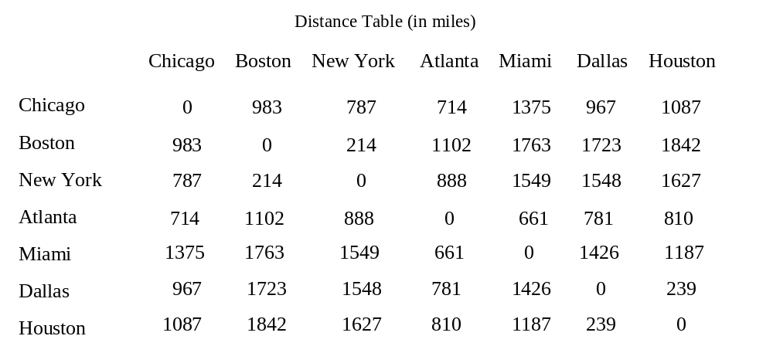
Motivations
Thus far, you have used one-dimensional arrays to model linear collections of elements. You can use a two-dimensional array to represent a matrix or a table. For example, the following table that describes the distances between the cities can be represented using a two-dimensional array.

Slide 3
Declare/Create Two-dimensional Arrays
// Declare array ref var
dataType[][] refVar;
// Create array and assign its reference to variable
refVar = new dataType[10][10];
// Combine declaration and creation in one statement
dataType[][] refVar = new dataType[10][10];
// Alternative syntax
dataType refVar[][] = new dataType[10][10];

Slide 4
Declaring Variables of Two-dimensional Arrays and Creating Two-dimensional Arrays
int[][] matrix = new int[10][10];
or
int matrix[][] = new int[10][10];
matrix[0][0] = 3;
for (int i = 0; i < matrix.length; i++)
for (int j = 0; j < matrix[i].length; j++)
matrix[i][j] = (int)(Math.random() * 1000);
double[][] x;

Slide 5
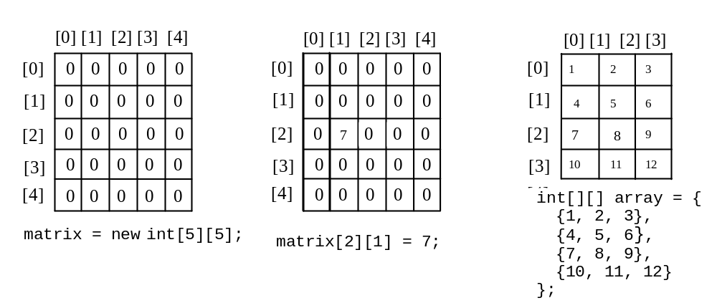
Two-dimensional Array Illustration
matrix.length? 5
matrix[0].length? 5
array.length? 4
array[0].length? 3

Slide 6
Declaring, Creating, and Initializing Using Shorthand Notations
You can also use an array initializer to declare, create and initialize a two-dimensional array. For example,
int[][] array = {
{1, 2, 3},
{4, 5, 6},
{7, 8, 9},
{10, 11, 12}
};
int[][] array = new int[4][3];
array[0][0] = 1; array[0][1] = 2; array[0][2] = 3;
array[1][0] = 4; array[1][1] = 5; array[1][2] = 6;
array[2][0] = 7; array[2][1] = 8; array[2][2] = 9;
array[3][0] = 10; array[3][1] = 11; array[3][2] = 12;
Same as

Slide 7
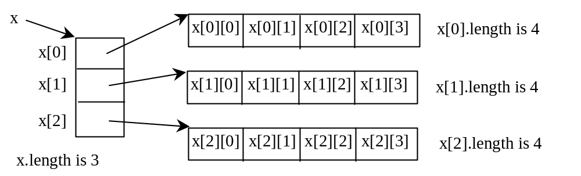
Lengths of Two-dimensional Arrays
int[][] x = new int[3][4];

Slide 8
Lengths of Two-dimensional Arrays, cont.
int[][] array = {
{1, 2, 3},
{4, 5, 6},
{7, 8, 9},
{10, 11, 12}
};
array.length
array[0].length
array[1].length
array[2].length
array[3].length
array[4].length ArrayIndexOutOfBoundsException

Slide 9
Ragged Arrays
Each row in a two-dimensional array is itself an array. So, the rows can have different lengths. Such an array is known as a ragged array. For example,
int[][] matrix = {
{1, 2, 3, 4, 5},
{2, 3, 4, 5},
{3, 4, 5},
{4, 5},
{5}
};
matrix.length is 5
matrix[0].length is 5
matrix[1].length is 4
matrix[2].length is 3
matrix[3].length is 2
matrix[4].length is 1

Slide 10
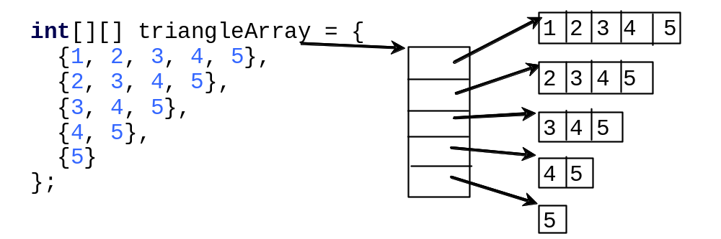
Ragged Arrays, cont.

Slide 11
Processing Two-Dimensional Arrays
See the examples in the text.
(Initializing arrays with input values)
(Printing arrays)
(Summing all elements)
(Summing all elements by column)
(Which row has the largest sum)
(Finding the smallest index of the largest element)
(Random shuffling)

Slide 12
Initializing arrays with input values
java.util.Scanner input = new Scanner(System.in);
System.out.println("Enter " + matrix.length + " rows and " +
matrix[0].length + " columns: ");
for (int row = 0; row < matrix.length; row++) {
for (int column = 0; column < matrix[row].length; column++) {
matrix[row][column] = input.nextInt();
}
}

Slide 13
Initializing arrays with random values
for (int row = 0; row < matrix.length; row++) {
for (int column = 0; column < matrix[row].length; column++) {
matrix[row][column] = (int)(Math.random() * 100);
}
}

Slide 14
Printing arrays
for (int row = 0; row < matrix.length; row++) {
for (int column = 0; column < matrix[row].length; column++) {
System.out.print(matrix[row][column] + " ");
}
System.out.println();
}

Slide 15
Summing all elements
int total = 0;
for (int row = 0; row < matrix.length; row++) {
for (int column = 0; column < matrix[row].length; column++) {
total += matrix[row][column];
}
}

Slide 16
Summing elements by column
for (int column = 0; column < matrix[0].length; column++) {
int total = 0;
for (int row = 0; row < matrix.length; row++)
total += matrix[row][column];
System.out.println("Sum for column " + column + " is "
+ total);
}

Slide 17
Random shuffling
for (int i = 0; i < matrix.length; i++) {
for (int j = 0; j < matrix[i].length; j++) {
int i1 = (int)(Math.random() * matrix.length);
int j1 = (int)(Math.random() * matrix[i].length);
// Swap matrix[i][j] with matrix[i1][j1]
int temp = matrix[i][j];
matrix[i][j] = matrix[i1][j1];
matrix[i1][j1] = temp;
}
}

Slide 18
Passing Tow-Dimensional Arrays to Methods
PassTwoDimensionalArray

Slide 19
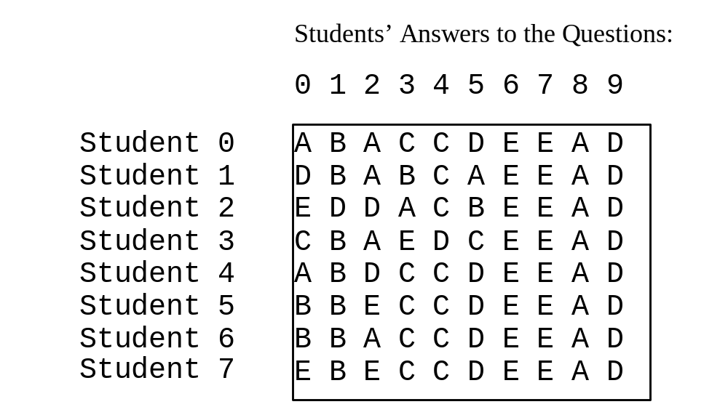
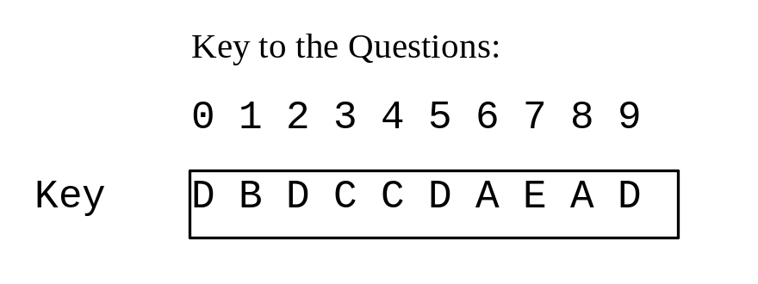
Problem: Grading Multiple-Choice Test
Objective: write a program that grades multiple-choice test.
GradeExam

Slide 20
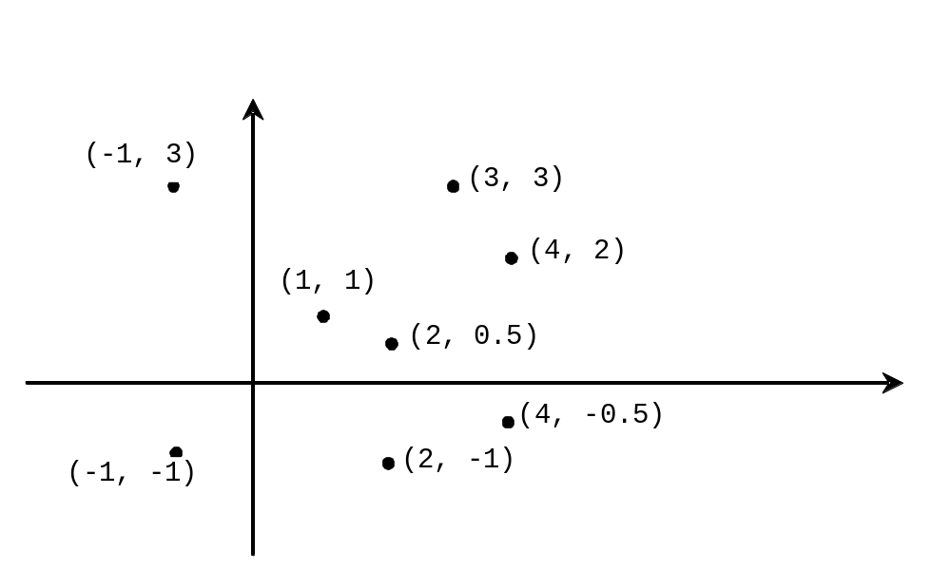
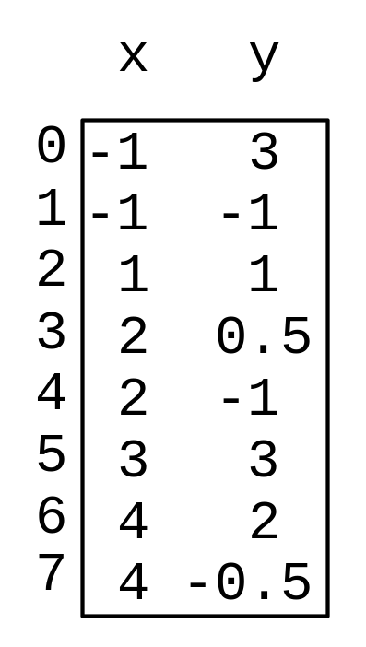
Problem: Finding Two Points Nearest to Each Other
FindNearestPoints

Slide 21
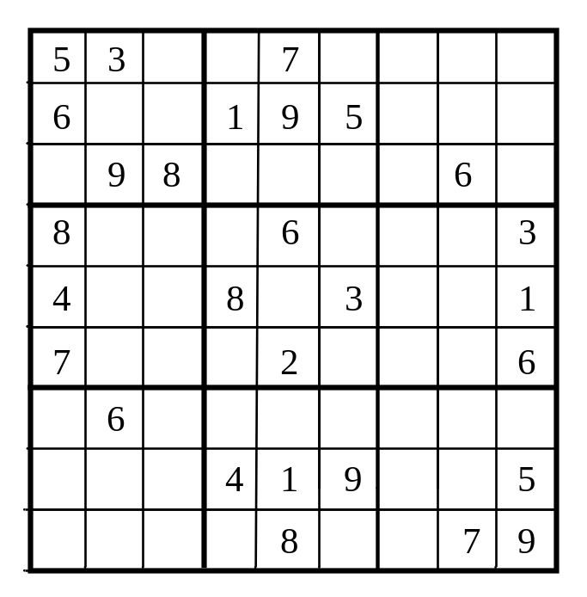
What is Sudoku?

Slide 22
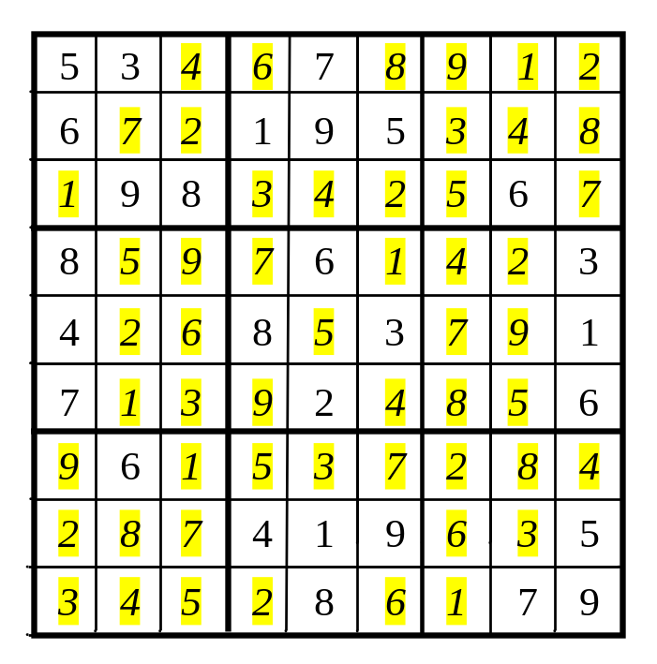
Every row contains the numbers 1 to 9

Slide 23
Every column contains the numbers 1 to 9
5 3
4
6
7
8
9
1
2
6
7
2
1 9 5
3
4
8
1
9 8
3
4
2
5
6
7
8
5
9
7
6
1
4
2
3
4
2
6
8
5
3
7
9
1
7
1
3
9
2
4
8
5
6
9
6
1
5
3
7
2
8
4
2
8
7
4 1 9
6
3
5
3
4
5
2
8
6
1
7 9

Slide 24
Every 3×3 box contains the numbers 1 to 9
5 3
4
6
7
8
9
1
2
6
7
2
1 9 5
3
4
8
1
9 8
3
4
2
5
6
7
8
5
9
7
6
1
4
2
3
4
2
6
8
5
3
7
9
1
7
1
3
9
2
4
8
5
6
9
6
1
5
3
7
2
8
4
2
8
7
4 1 9
6
3
5
3
4
5
2
8
6
1
7 9

Slide 25
Checking Whether a Solution Is Correct
CheckSudokuSolution

Slide 26
Multidimensional Arrays
Occasionally, you will need to represent n-dimensional data structures. In Java, you can create n-dimensional arrays for any integer n.
The way to declare two-dimensional array variables and create two-dimensional arrays can be generalized to declare n-dimensional array variables and create n-dimensional arrays for n >= 3.

Slide 27
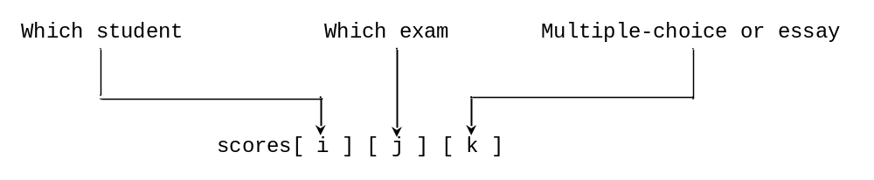
Multidimensional Arrays
double[][][] scores = {
{{7.5, 20.5}, {9.0, 22.5}, {15, 33.5}, {13, 21.5}, {15, 2.5}},
{{4.5, 21.5}, {9.0, 22.5}, {15, 34.5}, {12, 20.5}, {14, 9.5}},
{{6.5, 30.5}, {9.4, 10.5}, {11, 33.5}, {11, 23.5}, {10, 2.5}},
{{6.5, 23.5}, {9.4, 32.5}, {13, 34.5}, {11, 20.5}, {16, 7.5}},
{{8.5, 26.5}, {9.4, 52.5}, {13, 36.5}, {13, 24.5}, {16, 2.5}},
{{9.5, 20.5}, {9.4, 42.5}, {13, 31.5}, {12, 20.5}, {16, 6.5}}};

Slide 28
Problem: Calculating Total Scores
Objective: write a program that calculates the total score for students in a class. Suppose the scores are stored in a three-dimensional array named scores. The first index in scores refers to a student, the second refers to an exam, and the third refers to the part of the exam. Suppose there are 7 students, 5 exams, and each exam has two parts--the multiple-choice part and the programming part. So, scores[i][j][0] represents the score on the multiple-choice part for the i’s student on the j’s exam. Your program displays the total score for each student.
TotalScore

Slide 29
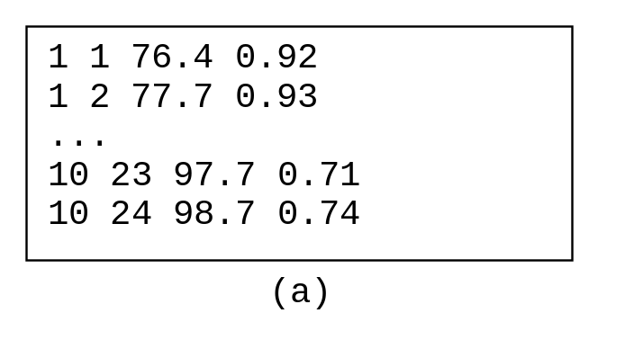
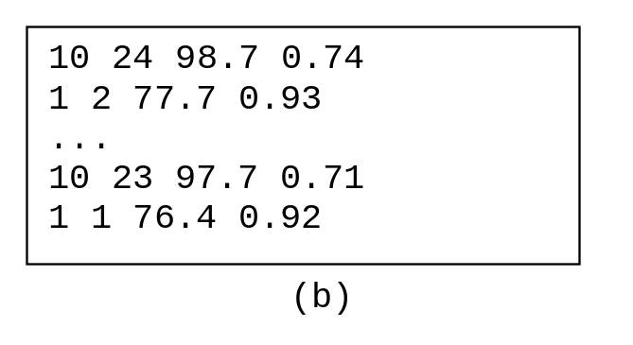
Problem: Weather Information
Suppose a meteorology station records the temperature and humidity at each hour of every day and stores the data for the past ten days in a text file named weather.txt. Each line of the file consists of four numbers that indicate the day, hour, temperature, and humidity. Your task is to write a program that calculates the average daily temperature and humidity for the 10 days.
Weather

Slide 30
Problem: Guessing Birthday
Listing 3.8, GuessBirthday.java, gives a program that guesses a birthday. The program can be simplified by storing the numbers in five sets in a three-dimensional array, and it prompts the user for the answers using a loop, as shown in Listing 7.6. The sample run of the program can be the same as shown in Listing 3.8.
GuessBirthdayUsingArray

