Slide 1
Introduction
Dr. Amit Kr Mandal

Slide 2
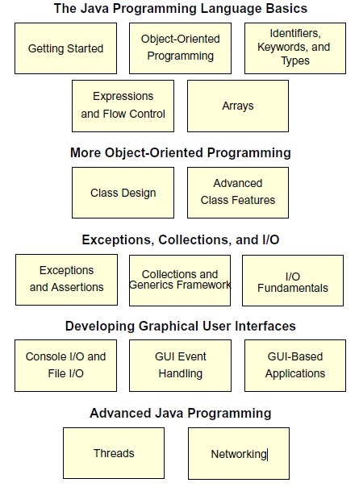
Course Map

Slide 3
How Prepared Are You?
Created and compiled programs with C or C++
Created and edited text files using a text editor
Eclipse
Netbeans
Used a World Wide Web (WWW) browser
Javadocs
StackOverflow

Slide 4
What Is the Java™ Technology?
Java technology is:
A programming language
A development environment
An application environment
A deployment environment
It is similar in syntax to C++.
It is used for developing both applets and applications.

Slide 5
Primary Goals of the Java Technology
Provides an easy-to-use language by:
Avoiding many pitfalls of other languages
Being object-oriented
Enabling users to create streamlined and clear code
Provides an interpreted environment for:
Improved speed of development
Code portability

Slide 6
Primary Goals of the Java Technology
Enables users to run more than one thread of activity
Loads classes dynamically; that is, at the time they are actually needed
Supports changing programs dynamically during runtime by loading classes from disparate sources
Furnishes better security

Slide 7
Primary Goals of the Java Technology
The following features fulfill these goals:
The Java Virtual Machine (JVM™)1
Garbage collection
The Java Runtime Environment (JRE)
JVM tool interface

Slide 8
The Java Virtual Machine
Provides hardware platform specifications
Reads compiled byte codes that are platform-independent
Is implemented as software or hardware
Is implemented in a Java technology development tool or a Web browser

Slide 9
The Java Virtual Machine
JVM provides definitions for the:
Instruction set (central processing unit [CPU])
Register set
Class file format
Stack
Garbage-collected heap
Memory area
Fatal error reporting
High-precision timing support

Slide 10
The Java Virtual Machine
The majority of type checking is done when the code is compiled.
Implementation of the JVM approved by Sun Microsystems (Now Oracle Corp.) must be able to run any compliant class file.
The JVM executes on multiple operating environments.

Slide 11
Garbage Collection
Allocated memory that is no longer needed should be deallocated.
In other languages, deallocation is the programmer’s responsibility.
The Java programming language provides a system-level thread to track memory allocation.

Slide 12
Garbage Collection
Garbage collection has the following characteristics:
Checks for and frees memory no longer needed
Is done automatically
Can vary dramatically across JVM implementations

Slide 13
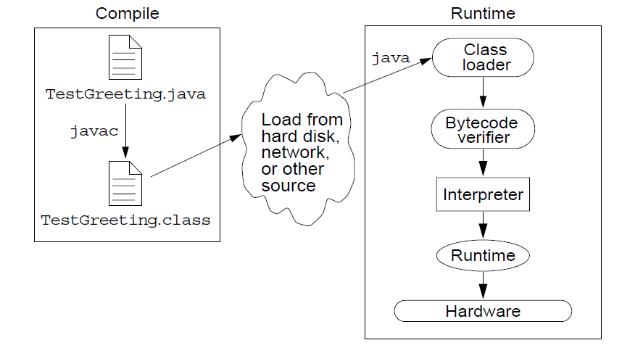
The Java Runtime Environment
The Java application environment performs as follows:

Slide 14
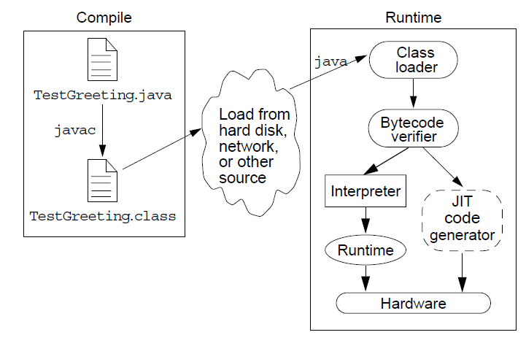
Operation of the JRE With a Just-In-Time (JIT) Compiler

Slide 15
JVM™ Tasks
The JVM performs three main tasks:
Loads code
Verifies code
Executes code

Slide 16
The Class Loader
Loads all classes necessary for the execution of a program
Maintains classes of the local file system in separate namespaces
Prevents spoofing

Slide 17
The Bytecode Verifier
Ensures that:
The code adheres to the JVM specification.
The code does not violate system integrity.
The code causes no operand stack overflows or underflows.
The parameter types for all operational code are correct.
No illegal data conversions (the conversion of integers to pointers) have occurred.

Slide 18
Programming Languages
Machine Language Assembly Language High-Level Language
Assembly languages were developed to make programming easy. Since the computer cannot understand assembly language, however, a program called assembler is used to convert assembly language programs into machine code. For example, to add two numbers, you might write an instruction in assembly code like this:
ADDF3 R1, R2, R3

Slide 19
Programming Languages
Machine Language Assembly Language High-Level Language
The high-level languages are English-like and easy to learn and program. For example, the following is a high-level language statement that computes the area of a circle with radius 5:
area = 5 * 5 * 3.1415;

Slide 20
Popular High-Level Languages

Slide 21
Interpreting/Compiling Source Code
A program written in a high-level language is called a source program or source code. Because a computer cannot understand a source program, a source program must be translated into machine code for execution. The translation can be done using another programming tool called an interpreter or a compiler.

Slide 22
Interpreting Source Code
An interpreter reads one statement from the source code, translates it to the machine code or virtual machine code, and then executes it right away, as shown in the following figure. Note that a statement from the source code may be translated into several machine instructions.

Slide 23
Compiling Source Code
A compiler translates the entire source code into a machine-code file, and the machine-code file is then executed, as shown in the following figure.

Slide 24
Operating Systems
The operating system (OS) is a program that manages and controls a computer’s activities. The popular operating systems for general-purpose computers are Microsoft Windows, Mac OS, and Linux. Application programs, such as a Web browser or a word processor, cannot run unless an operating system is installed and running on the computer.

Slide 25
Characteristics of Java
Java Is Simple
Java Is Object-Oriented
Java Is Distributed
Java Is Interpreted
Java Is Robust
Java Is Secure
Java Is Architecture-Neutral
Java Is Portable
Java's Performance
Java Is Multithreaded
Java Is Dynamic

Slide 26
Characteristics of Java
Java Is Simple
Java Is Object-Oriented
Java Is Distributed
Java Is Interpreted
Java Is Robust
Java Is Secure
Java Is Architecture-Neutral
Java Is Portable
Java's Performance
Java Is Multithreaded
Java Is Dynamic
Java is partially modeled on C++, but greatly simplified and improved. Some people refer to Java as "C++--" because it is like C++ but with more functionality and fewer negative aspects.

Slide 27
Characteristics of Java
Java Is Simple
Java Is Object-Oriented
Java Is Distributed
Java Is Interpreted
Java Is Robust
Java Is Secure
Java Is Architecture-Neutral
Java Is Portable
Java's Performance
Java Is Multithreaded
Java Is Dynamic
Java is inherently object-oriented. Although many object-oriented languages began strictly as procedural languages, Java was designed from the start to be object-oriented. Object-oriented programming (OOP) is a popular programming approach that is replacing traditional procedural programming techniques.
One of the central issues in software development is how to reuse code. Object-oriented programming provides great flexibility, modularity, clarity, and reusability through encapsulation, inheritance, and polymorphism.

Slide 28
Characteristics of Java
Java Is Simple
Java Is Object-Oriented
Java Is Distributed
Java Is Interpreted
Java Is Robust
Java Is Secure
Java Is Architecture-Neutral
Java Is Portable
Java's Performance
Java Is Multithreaded
Java Is Dynamic
Distributed computing involves several computers working together on a network. Java is designed to make distributed computing easy. Since networking capability is inherently integrated into Java, writing network programs is like sending and receiving data to and from a file.

Slide 29
Characteristics of Java
Java Is Simple
Java Is Object-Oriented
Java Is Distributed
Java Is Interpreted
Java Is Robust
Java Is Secure
Java Is Architecture-Neutral
Java Is Portable
Java's Performance
Java Is Multithreaded
Java Is Dynamic
You need an interpreter to run Java programs. The programs are compiled into the Java Virtual Machine code called bytecode. The bytecode is machine-independent and can run on any machine that has a Java interpreter, which is part of the Java Virtual Machine (JVM).

Slide 30
Characteristics of Java
Java Is Simple
Java Is Object-Oriented
Java Is Distributed
Java Is Interpreted
Java Is Robust
Java Is Secure
Java Is Architecture-Neutral
Java Is Portable
Java's Performance
Java Is Multithreaded
Java Is Dynamic
Java compilers can detect many problems that would first show up at execution time in other languages.
Java has eliminated certain types of error-prone programming constructs found in other languages.
Java has a runtime exception-handling feature to provide programming support for robustness.

Slide 31
Characteristics of Java
Java Is Simple
Java Is Object-Oriented
Java Is Distributed
Java Is Interpreted
Java Is Robust
Java Is Secure
Java Is Architecture-Neutral
Java Is Portable
Java's Performance
Java Is Multithreaded
Java Is Dynamic
Java implements several security mechanisms to protect your system against harm caused by stray programs.

Slide 32
Characteristics of Java
Java Is Simple
Java Is Object-Oriented
Java Is Distributed
Java Is Interpreted
Java Is Robust
Java Is Secure
Java Is Architecture-Neutral
Java Is Portable
Java's Performance
Java Is Multithreaded
Java Is Dynamic
Write once, run anywhere
With a Java Virtual Machine (JVM), you can write one program that will run on any platform.

Slide 33
Characteristics of Java
Java Is Simple
Java Is Object-Oriented
Java Is Distributed
Java Is Interpreted
Java Is Robust
Java Is Secure
Java Is Architecture-Neutral
Java Is Portable
Java's Performance
Java Is Multithreaded
Java Is Dynamic
Because Java is architecture neutral, Java programs are portable. They can be run on any platform without being recompiled.

Slide 34
Characteristics of Java
Java Is Simple
Java Is Object-Oriented
Java Is Distributed
Java Is Interpreted
Java Is Robust
Java Is Secure
Java Is Architecture-Neutral
Java Is Portable
Java's Performance
Java Is Multithreaded
Java Is Dynamic
Java’s performance Because Java is architecture neutral, Java programs are portable. They can be run on any platform without being recompiled.

Slide 35
Characteristics of Java
Java Is Simple
Java Is Object-Oriented
Java Is Distributed
Java Is Interpreted
Java Is Robust
Java Is Secure
Java Is Architecture-Neutral
Java Is Portable
Java's Performance
Java Is Multithreaded
Java Is Dynamic
Multithread programming is smoothly integrated in Java, whereas in other languages you have to call procedures specific to the operating system to enable multithreading.

Slide 36
Characteristics of Java
Java Is Simple
Java Is Object-Oriented
Java Is Distributed
Java Is Interpreted
Java Is Robust
Java Is Secure
Java Is Architecture-Neutral
Java Is Portable
Java's Performance
Java Is Multithreaded
Java Is Dynamic
Java was designed to adapt to an evolving environment. New code can be loaded on the fly without recompilation. There is no need for developers to create, and for users to install, major new software versions. New features can be incorporated transparently as needed.

Slide 37
JDK Versions
JDK 1.02 (1995)
JDK 1.1 (1996)
JDK 1.2 (1998)
JDK 1.3 (2000)
JDK 1.4 (2002)
JDK 1.5 (2004) a. k. a. JDK 5 or Java 5
JDK 1.6 (2006) a. k. a. JDK 6 or Java 6
JDK 1.7 (2011) a. k. a. JDK 7 or Java 7
JDK 1.8 (2014) a. k. a. JDK 8 or Java 8
JDK 1.9 (2017) a. k. a. JDK 9 or Java 9

Slide 38
JDK Editions
Java Standard Edition (J2SE)
J2SE can be used to develop client-side standalone applications or applets.
Java Enterprise Edition (J2EE)
J2EE can be used to develop server-side applications such as Java servlets, Java ServerPages, and Java ServerFaces.
Java Micro Edition (J2ME).
J2ME can be used to develop applications for mobile devices such as cell phones.

Slide 39
Popular Java IDEs
NetBeans
Eclipse

Slide 40
A Simple Java Program
Listing 1.1
//This program prints Welcome to Java!
public class Welcome {
public static void main(String[] args) {
System.out.println("Welcome to Java!");
}
}

Slide 41

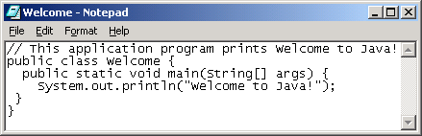
Creating and Editing Using NotePad
To use NotePad, type
notepad Welcome.java
from the DOS prompt.

Slide 42

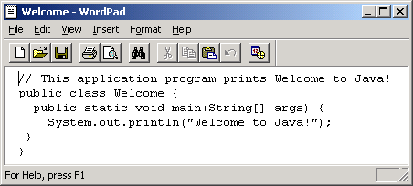
Creating and Editing Using WordPad
To use WordPad, type
write Welcome.java
from the DOS prompt.

Slide 43
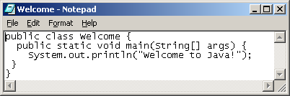
Creating, Compiling, and Running Programs

Slide 44
Compiling Java Source Code
You can port a source program to any machine with appropriate compilers. The source program must be recompiled, however, because the object program can only run on a specific machine. Nowadays computers are networked to work together. Java was designed to run object programs on any platform. With Java, you write the program once, and compile the source program into a special type of object code, known as bytecode. The bytecode can then run on any computer with a Java Virtual Machine, as shown below. Java Virtual Machine is a software that interprets Java bytecode.

Slide 45
Trace a Program Execution
Enter main method
//This program prints Welcome to Java!
public class Welcome {
public static void main(String[] args) {
System.out.println("Welcome to Java!");
}
}

Slide 46
Trace a Program Execution
Execute statement
//This program prints Welcome to Java!
public class Welcome {
public static void main(String[] args) {
System.out.println("Welcome to Java!");
}
}

Slide 47
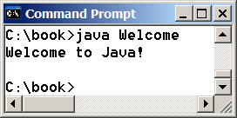
Trace a Program Execution
//This program prints Welcome to Java!
public class Welcome {
public static void main(String[] args) {
System.out.println("Welcome to Java!");
}
}
print a message to the console

Slide 48
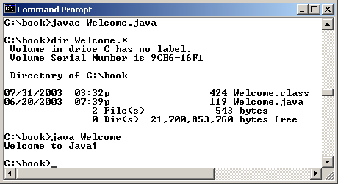
Compiling and Running Java from the Command Window
Set path to JDK bin directory
set path=c:\Program Files\java\jdk1.6.0\bin
Set classpath to include the current directory
set classpath=.
Compile
javac Welcome.java
Run
java Welcome

Slide 49
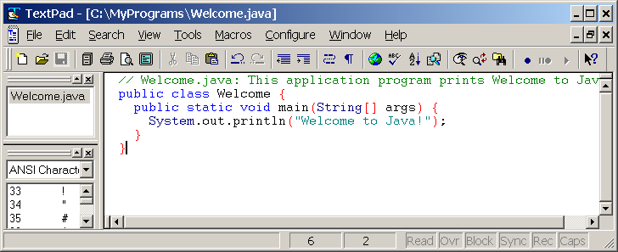
Compiling and Running Java from TextPad
See Supplement II.A on the Website for details

Slide 50
Anatomy of a Java Program
Class name
Main method
Statements
Statement terminator
Reserved words
Comments
Blocks

Slide 51
Class Name
Every Java program must have at least one class. Each class has a name. By convention, class names start with an uppercase letter. In this example, the class name is Welcome.
//This program prints Welcome to Java!
public class Welcome {
public static void main(String[] args) {
System.out.println("Welcome to Java!");
}
}

Slide 52
Main Method
Line 2 defines the main method. In order to run a class, the class must contain a method named main. The program is executed from the main method.
//This program prints Welcome to Java!
public class Welcome {
public static void main(String[] args) {
System.out.println("Welcome to Java!");
}
}

Slide 53
Statement
A statement represents an action or a sequence of actions. The statement System.out.println("Welcome to Java!") in the program in Listing 1.1 is a statement to display the greeting "Welcome to Java!“.
//This program prints Welcome to Java!
public class Welcome {
public static void main(String[] args) {
System.out.println("Welcome to Java!");
}
}

Slide 54
Statement Terminator
Every statement in Java ends with a semicolon (;).
//This program prints Welcome to Java!
public class Welcome {
public static void main(String[] args) {
System.out.println("Welcome to Java!");
}
}

Slide 55
Reserved words
Reserved words or keywords are words that have a specific meaning to the compiler and cannot be used for other purposes in the program. For example, when the compiler sees the word class, it understands that the word after class is the name for the class.
//This program prints Welcome to Java!
public class Welcome {
public static void main(String[] args) {
System.out.println("Welcome to Java!");
}
}

Slide 56
Blocks
A pair of braces in a program forms a block that groups components of a program.

Slide 57
Special Symbols

Slide 58
{ … }
// This program prints Welcome to Java!
public class Welcome {
public static void main(String[] args) {
System.out.println("Welcome to Java!");
}
}

Slide 59
( … )
// This program prints Welcome to Java!
public class Welcome {
public static void main(String[] args) {
System.out.println("Welcome to Java!");
}
}

Slide 60
;
// This program prints Welcome to Java!
public class Welcome {
public static void main(String[] args) {
System.out.println("Welcome to Java!");
}
}

Slide 61
// …
// This program prints Welcome to Java!
public class Welcome {
public static void main(String[] args) {
System.out.println("Welcome to Java!");
}
}

Slide 62
" … "
// This program prints Welcome to Java!
public class Welcome {
public static void main(String[] args) {
System.out.println("Welcome to Java!");
}
}

Slide 63
Programming Style and Documentation
Appropriate Comments
Naming Conventions
Proper Indentation and Spacing Lines
Block Styles

Slide 64
Appropriate Comments
Include a summary at the beginning of the program to explain what the program does, its key features, its supporting data structures, and any unique techniques it uses.
Include your name, class section, instructor, date, and a brief description at the beginning of the program.

Slide 65
Naming Conventions
Choose meaningful and descriptive names.
Class names:
Capitalize the first letter of each word in the name. For example, the class name ComputeExpression.

Slide 66
Proper Indentation and Spacing
Indentation
Indent two spaces.
Spacing
Use blank line to separate segments of the code.

Slide 67
Block Styles
Use end-of-line style for braces.

Slide 68
Programming Errors
Syntax Errors
Detected by the compiler
Runtime Errors
Causes the program to abort
Logic Errors
Produces incorrect result

Slide 69
Syntax Errors
public class ShowSyntaxErrors {
public static main(String[] args) {
System.out.println("Welcome to Java);
}
}

Slide 70
Runtime Errors
public class ShowRuntimeErrors {
public static void main(String[] args) {
System.out.println(1 / 0);
}
}

Slide 71
Logic Errors
public class ShowLogicErrors {
public static void main(String[] args) {
System.out.println("Celsius 35 is Fahrenheit degree ");
System.out.println((9 / 5) * 35 + 32);
}
}

Slide 72
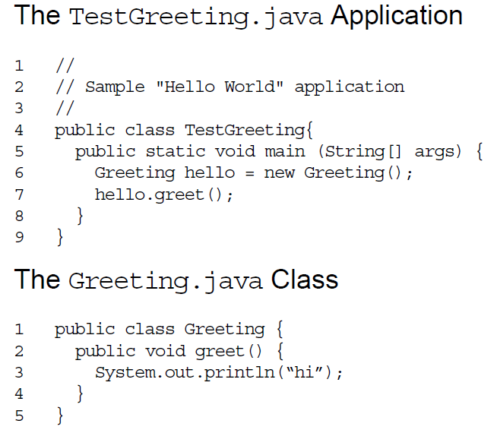
A Simple Java Application

Slide 73
Compiling and Running
Compile TestGreeting.java:
javac TestGreeting.java
The Greeting.java is compiled automatically.
Run the application by using the following command:
java TestGreeting
Locate common compile and runtime errors.

Slide 74
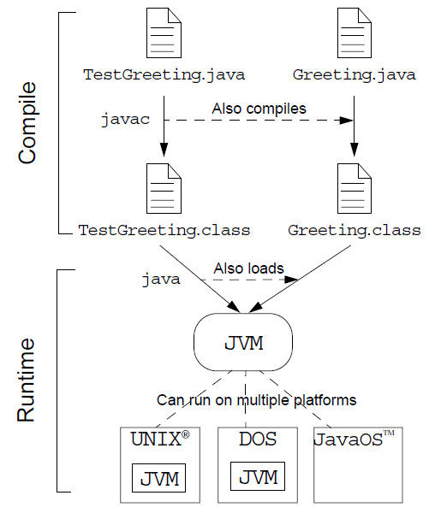
Java Technology Runtime Environment

