Slide 1
Methods
Amit Kr Mandal

Slide 2
Opening Problem
Find the sum of integers from 1 to 10, from 20 to 30, and from 35 to 45, respectively.

Slide 3
Problem
int sum = 0;
for (int i = 1; i <= 10; i++)
sum += i;
System.out.println("Sum from 1 to 10 is " + sum);
sum = 0;
for (int i = 20; i <= 30; i++)
sum += i;
System.out.println("Sum from 20 to 30 is " + sum);
sum = 0;
for (int i = 35; i <= 45; i++)
sum += i;
System.out.println("Sum from 35 to 45 is " + sum);

Slide 4
Problem
int sum = 0;
for (int i = 1; i <= 10; i++)
sum += i;
System.out.println("Sum from 1 to 10 is " + sum);
sum = 0;
for (int i = 20; i <= 30; i++)
sum += i;
System.out.println("Sum from 20 to 30 is " + sum);
sum = 0;
for (int i = 35; i <= 45; i++)
sum += i;
System.out.println("Sum from 35 to 45 is " + sum);

Slide 5
Solution
public static int sum(int i1, int i2) {
int sum = 0;
for (int i = i1; i <= i2; i++)
sum += i;
return sum;
}
public static void main(String[] args) {
System.out.println("Sum from 1 to 10 is " + sum(1, 10));
System.out.println("Sum from 20 to 30 is " + sum(20, 30));
System.out.println("Sum from 35 to 45 is " + sum(35, 45));
}

Slide 6
Defining Methods
A method is a collection of statements that are grouped together to perform an operation.

Slide 7
Method Signature
Method signature is the combination of the method name and the parameter list.

Slide 8
Formal Parameters
The variables defined in the method header are known as formal parameters.

Slide 9
Actual Parameters
When a method is invoked, you pass a value to the parameter. This value is referred to as actual parameter or argument.

Slide 10
Return Value Type
A method may return a value. The returnValueType is the data type of the value the method returns. If the method does not return a value, the returnValueType is the keyword void. For example, the returnValueType in the main method is void.

Slide 11
Calling Methods

Slide 12
Trace Method Invocation
i is now 5

Slide 13
Trace Method Invocation
j is now 2

Slide 14
Trace Method Invocation
invoke max(i, j)

Slide 15
Trace Method Invocation
invoke max(i, j)
Pass the value of i to num1
Pass the value of j to num2

Slide 16
Trace Method Invocation
declare variable result

Slide 17
Trace Method Invocation
(num1 > num2) is true since num1 is 5 and num2 is 2

Slide 18
Trace Method Invocation
result is now 5

Slide 19
Trace Method Invocation
return result, which is 5

Slide 20
Trace Method Invocation
return max(i, j) and assign the return value to k

Slide 21
Trace Method Invocation
Execute the print statement

Slide 22
CAUTION
A return statement is required for a value-returning method. The method shown below in (a) is logically correct, but it has a compilation error because the Java compiler thinks it possible that this method does not return any value.
To fix this problem, delete if (n < 0) in (a), so that the compiler will see a return statement to be reached regardless of how the if statement is evaluated.

Slide 23
Reuse Methods from Other Classes
NOTE: One of the benefits of methods is for reuse. The max method can be invoked from any class besides TestMax. If you create a new class Test, you can invoke the max method using ClassName.methodName (e.g., TestMax.max).

Slide 24
Call Stacks

Slide 25
Trace Call Stack
animation
i is declared and initialized

Slide 26
Trace Call Stack
animation
j is declared and initialized

Slide 27
Trace Call Stack
animation
Declare k

Slide 28
Trace Call Stack
animation
Invoke max(i, j)

Slide 29
Trace Call Stack
animation
pass the values of i and j to num1 and num2

Slide 30
Trace Call Stack
animation
Declare result

Slide 31
Trace Call Stack
animation
(num1 > num2) is true

Slide 32
Trace Call Stack
animation
Assign num1 to result

Slide 33
Trace Call Stack
animation
Return result and assign it to k

Slide 34
Trace Call Stack
animation
Execute print statement

Slide 35
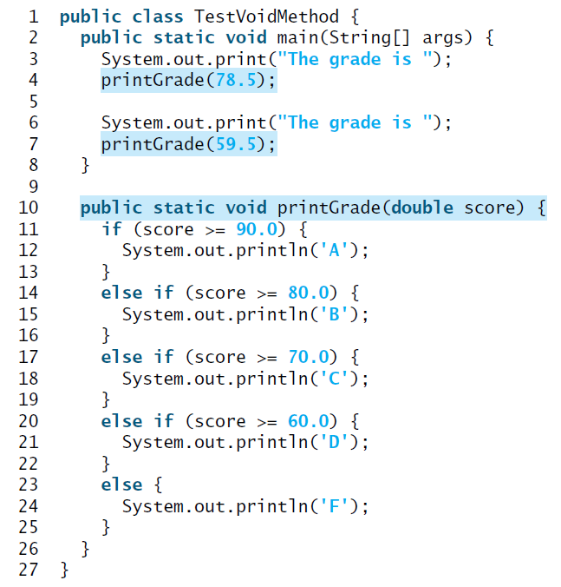
void Method
This type of method does not return a value. The method performs some actions.

Slide 36

void Method
This type of method does not return a value. The method performs some actions.

Slide 37
Passing Parameters
public static void nPrintln(String message, int n) {
for (int i = 0; i < n; i++)
System.out.println(message);
}
Suppose you invoke the method using
nPrintln(“Welcome to Java”, 5);
What is the output?
Suppose you invoke the method using
nPrintln(“Computer Science”, 15);
What is the output?
Can you invoke the method using
nPrintln(15, “Computer Science”);

Slide 38
Pass by Value
This program demonstrates passing values to the methods.
Click on the button below to see how it works
PassByValue

Slide 39
Pass by Value, cont.

Slide 40
Modularizing Code
Methods can be used to reduce redundant coding and enable code reuse. Methods can also be used to modularize code and improve the quality of the program.
GreatestCommonDivisorMethod
PrimeNumberMethod

Slide 41
Problem: Converting Decimals to Hexadecimals
Write a method that converts a decimal integer to a hexadecimal.
Decimal2HexConversion

Slide 42
Overloading Methods
Overloading the max Method
public static double max(double num1, double num2) {
if (num1 > num2)
return num1;
else
return num2;
}
TestMethodOverloading

Slide 43
Ambiguous Invocation
Sometimes there may be two or more possible matches for an invocation of a method, but the compiler cannot determine the most specific match. This is referred to as ambiguous invocation. Ambiguous invocation is a compilation error.

Slide 44
Ambiguous Invocation
public class AmbiguousOverloading {
public static void main(String[] args) {
System.out.println(max(1, 2));
}
public static double max(int num1, double num2) {
if (num1 > num2)
return num1;
else
return num2;
}
public static double max(double num1, int num2) {
if (num1 > num2)
return num1;
else
return num2;
}
}

Slide 45
Scope of Local Variables
A local variable: a variable defined inside a method.
Scope: the part of the program where the variable can be referenced.
The scope of a local variable starts from its declaration and continues to the end of the block that contains the variable. A local variable must be declared before it can be used.

Slide 46
Scope of Local Variables, cont.
You can declare a local variable with the same name multiple times in different non-nesting blocks in a method, but you cannot declare a local variable twice in nested blocks.

Slide 47
Scope of Local Variables, cont.
A variable declared in the initial action part of a for loop header has its scope in the entire loop. But a variable declared inside a for loop body has its scope limited in the loop body from its declaration and to the end of the block that contains the variable.

Slide 48
Scope of Local Variables, cont.

Slide 49
Scope of Local Variables, cont.
// Fine with no errors
public static void correctMethod() {
int x = 1;
int y = 1;
// i is declared
for (int i = 1; i < 10; i++) {
x += i;
}
// i is declared again
for (int i = 1; i < 10; i++) {
y += i;
}
}

Slide 50
Scope of Local Variables, cont.
// With errors
public static void incorrectMethod() {
int x = 1;
int y = 1;
for (int i = 1; i < 10; i++) {
int x = 0;
x += i;
}
}

Slide 51
Method Abstraction
You can think of the method body as a black box that contains the detailed implementation for the method.

Slide 52
Benefits of Methods
Write a method once and reuse it anywhere.
Information hiding. Hide the implementation from the user.
Reduce complexity.

Slide 53
The Math Class
Class constants:
PI
E
Class methods:
Trigonometric Methods
Exponent Methods
Rounding Methods
min, max, abs, and random Methods

Slide 54
Trigonometric Methods
sin(double a)
cos(double a)
tan(double a)
acos(double a)
asin(double a)
atan(double a)
Examples:
Math.sin(0) returns 0.0
Math.sin(Math.PI / 6) returns 0.5
Math.sin(Math.PI / 2) returns 1.0
Math.cos(0) returns 1.0
Math.cos(Math.PI / 6) returns 0.866
Math.cos(Math.PI / 2) returns 0
Radians
toRadians(90)

Slide 55
Exponent Methods
exp(double a)
Returns e raised to the power of a.
log(double a)
Returns the natural logarithm of a.
log10(double a)
Returns the 10-based logarithm of a.
pow(double a, double b)
Returns a raised to the power of b.
sqrt(double a)
Returns the square root of a.
Examples:
Math.exp(1) returns 2.71
Math.log(2.71) returns 1.0
Math.pow(2, 3) returns 8.0
Math.pow(3, 2) returns 9.0
Math.pow(3.5, 2.5) returns 22.91765
Math.sqrt(4) returns 2.0
Math.sqrt(10.5) returns 3.24

Slide 56
Rounding Methods
double ceil(double x)
x rounded up to its nearest integer. This integer is returned as a double value.
double floor(double x)
x is rounded down to its nearest integer. This integer is returned as a double value.
double rint(double x)
x is rounded to its nearest integer. If x is equally close to two integers, the even one is returned as a double.
int round(float x)
Return (int)Math.floor(x+0.5).
long round(double x)
Return (long)Math.floor(x+0.5).

Slide 57
Rounding Methods Examples
Math.ceil(2.1) returns 3.0
Math.ceil(2.0) returns 2.0
Math.ceil(-2.0) returns –2.0
Math.ceil(-2.1) returns -2.0
Math.floor(2.1) returns 2.0
Math.floor(2.0) returns 2.0
Math.floor(-2.0) returns –2.0
Math.floor(-2.1) returns -3.0
Math.rint(2.1) returns 2.0
Math.rint(2.0) returns 2.0
Math.rint(-2.0) returns –2.0
Math.rint(-2.1) returns -2.0
Math.rint(2.5) returns 2.0
Math.rint(-2.5) returns -2.0
Math.round(2.6f) returns 3
Math.round(2.0) returns 2
Math.round(-2.0f) returns -2
Math.round(-2.6) returns -3

Slide 58
min, max, and abs
max(a, b)and min(a, b)
Returns the maximum or minimum of two parameters.
abs(a)
Returns the absolute value of the parameter.
random()
Returns a random double value in the range [0.0, 1.0).
Examples:
Math.max(2, 3) returns 3
Math.max(2.5, 3) returns 3.0
Math.min(2.5, 3.6) returns 2.5
Math.abs(-2) returns 2
Math.abs(-2.1) returns 2.1

Slide 59
The random Method
Generates a random double value greater than or equal to 0.0 and less than 1.0 (0 <= Math.random() < 1.0).
Examples:
In general,

Slide 60
Case Study: Generating Random Characters
Computer programs process numerical data and characters. You have seen many examples that involve numerical data. It is also important to understand characters and how to process them.
As introduced in Section 2.9, each character has a unique Unicode between 0 and FFFF in hexadecimal (65535 in decimal). To generate a random character is to generate a random integer between 0 and 65535 using the following expression: (note that since 0 <= Math.random() < 1.0, you have to add 1 to 65535.)
(int)(Math.random() * (65535 + 1))

Slide 61
Case Study: Generating Random Characters, cont.
Now let us consider how to generate a random lowercase letter. The Unicode for lowercase letters are consecutive integers starting from the Unicode for 'a', then for 'b', 'c', ..., and 'z'. The Unicode for 'a' is
(int)'a'
So, a random integer between (int)'a' and (int)'z' is
(int)((int)'a' + Math.random() * ((int)'z' - (int)'a' + 1)

Slide 62
Case Study: Generating Random Characters, cont.
Now let us consider how to generate a random lowercase letter. The Unicode for lowercase letters are consecutive integers starting from the Unicode for 'a', then for 'b', 'c', ..., and 'z'. The Unicode for 'a' is
(int)'a'
So, a random integer between (int)'a' and (int)'z' is
(int)((int)'a' + Math.random() * ((int)'z' - (int)'a' + 1)

Slide 63
Case Study: Generating Random Characters, cont.
As discussed in Chapter 2., all numeric operators can be applied to the char operands. The char operand is cast into a number if the other operand is a number or a character. So, the preceding expression can be simplified as follows:
'a' + Math.random() * ('z' - 'a' + 1)
So a random lowercase letter is
(char)('a' + Math.random() * ('z' - 'a' + 1))

Slide 64
Case Study: Generating Random Characters, cont.
To generalize the foregoing discussion, a random character between any two characters ch1 and ch2 with ch1 < ch2 can be generated as follows:
(char)(ch1 + Math.random() * (ch2 – ch1 + 1))

Slide 65
The RandomCharacter Class
// RandomCharacter.java: Generate random characters
public class RandomCharacter {
/** Generate a random character between ch1 and ch2 */
public static char getRandomCharacter(char ch1, char ch2) {
return (char)(ch1 + Math.random() * (ch2 - ch1 + 1));
}
/** Generate a random lowercase letter */
public static char getRandomLowerCaseLetter() {
return getRandomCharacter('a', 'z');
}
/** Generate a random uppercase letter */
public static char getRandomUpperCaseLetter() {
return getRandomCharacter('A', 'Z');
}
/** Generate a random digit character */
public static char getRandomDigitCharacter() {
return getRandomCharacter('0', '9');
}
/** Generate a random character */
public static char getRandomCharacter() {
return getRandomCharacter('\u0000', '\uFFFF');
}
}
RandomCharacter
TestRandomCharacter

Slide 66
Stepwise Refinement (Optional)
The concept of method abstraction can be applied to the process of developing programs. When writing a large program, you can use the “divide and conquer” strategy, also known as stepwise refinement, to decompose it into subproblems. The subproblems can be further decomposed into smaller, more manageable problems.

Slide 67
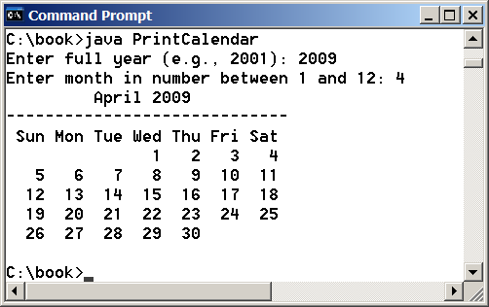
PrintCalender Case Study
Let us use the PrintCalendar example to demonstrate the stepwise refinement approach.
PrintCalendar

Slide 68
Design Diagram

Slide 69
Design Diagram

Slide 70
Design Diagram

Slide 71
Design Diagram

Slide 72
Design Diagram

Slide 73
Design Diagram

Slide 74
Implementation: Top-Down
Top-down approach is to implement one method in the structure chart at a time from the top to the bottom. Stubs can be used for the methods waiting to be implemented. A stub is a simple but incomplete version of a method. The use of stubs enables you to test invoking the method from a caller. Implement the main method first and then use a stub for the printMonth method. For example, let printMonth display the year and the month in the stub. Thus, your program may begin like this:
A Skeleton for printCalendar

Slide 75
Implementation: Bottom-Up
Bottom-up approach is to implement one method in the structure chart at a time from the bottom to the top. For each method implemented, write a test program to test it. Both top-down and bottom-up methods are fine. Both approaches implement the methods incrementally and help to isolate programming errors and makes debugging easy. Sometimes, they can be used together.

