Slide 1

Segmenting Consumers of Bath Soap
Sai Abhinav Mandumula
- KSU#811076848

Slide 2

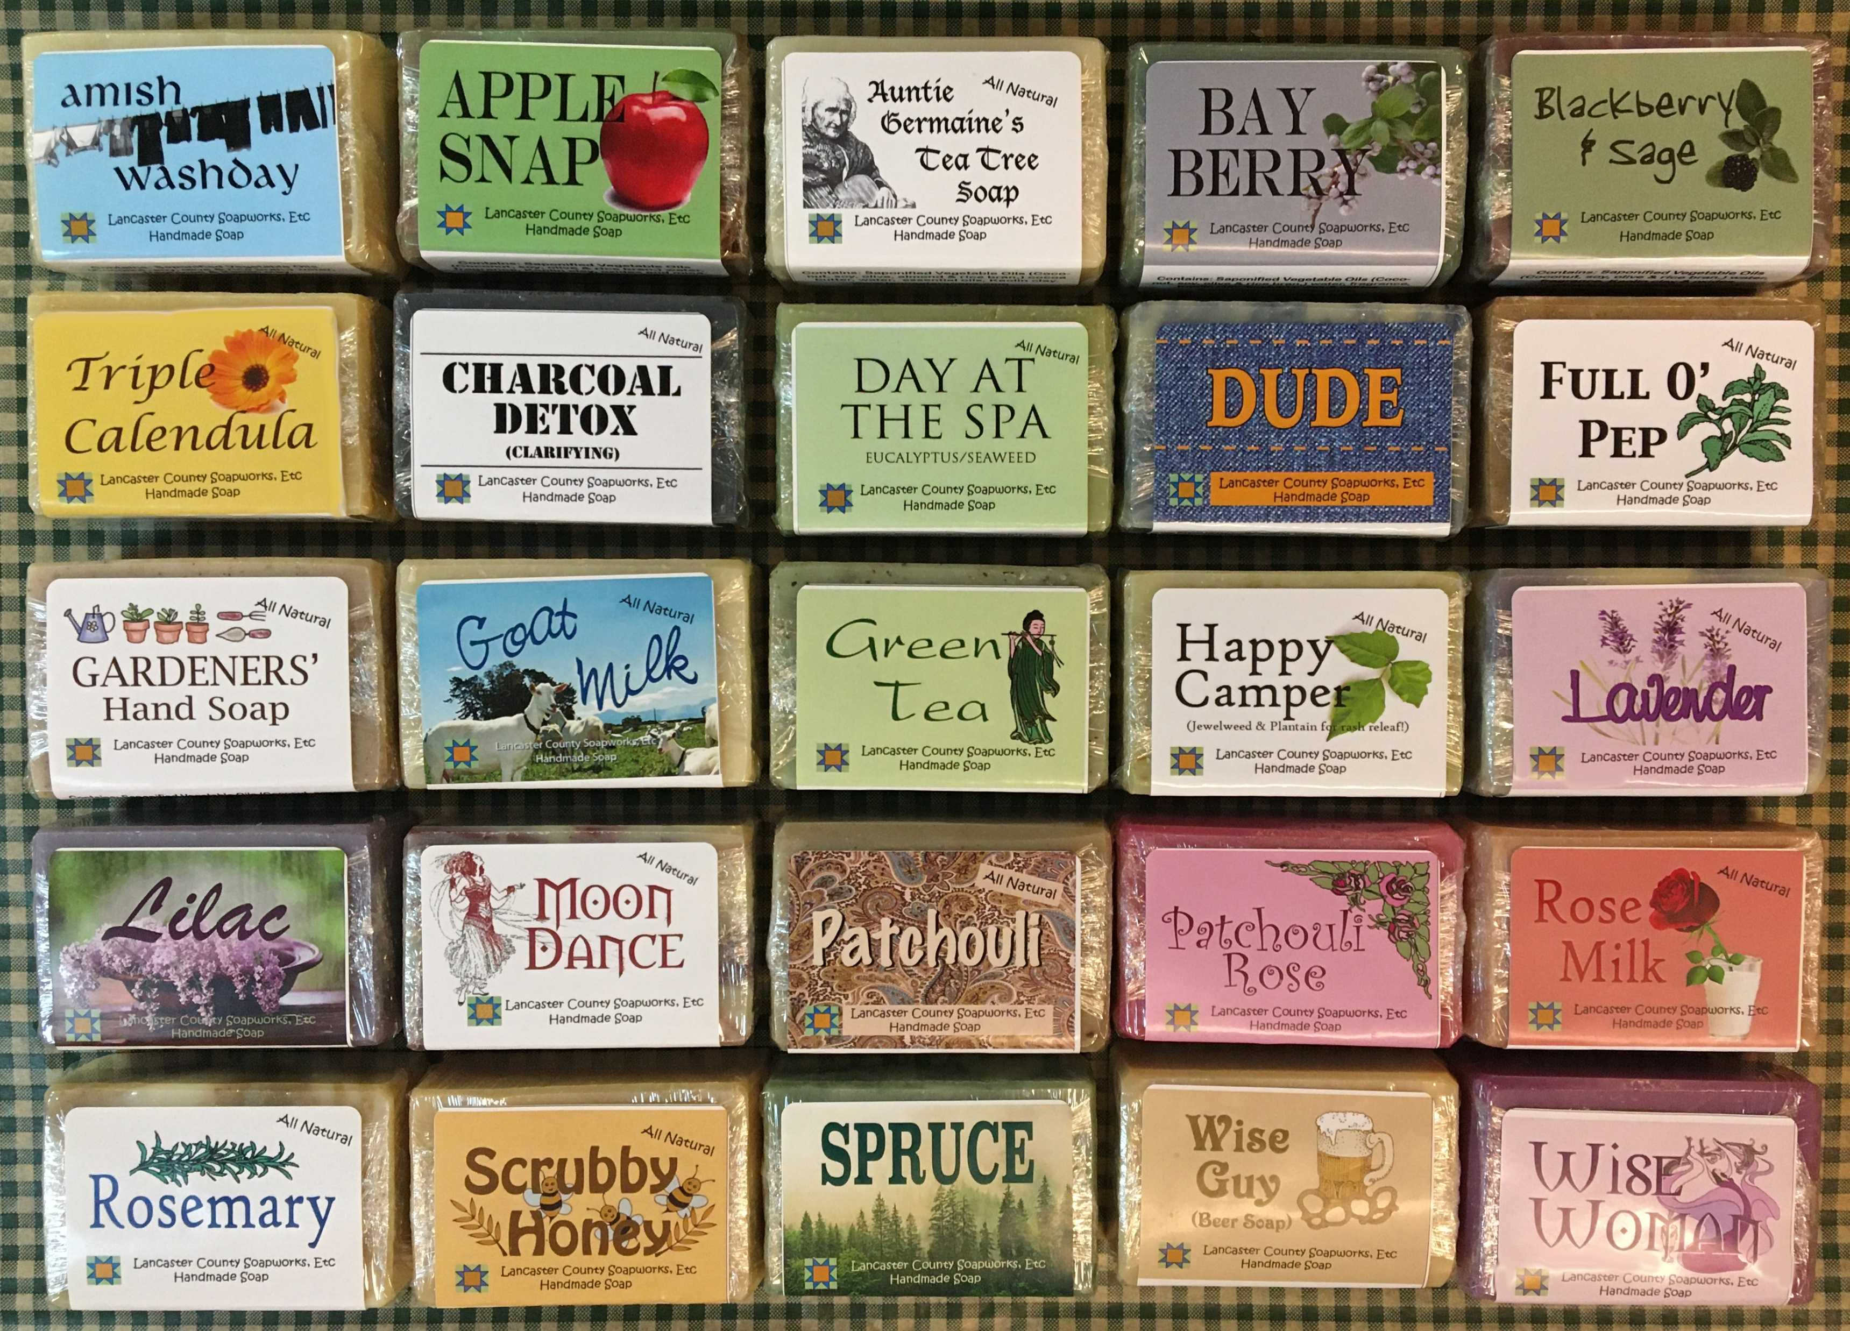
Problem
We look at classification model that classify customers into segments based on demographic data. in targeting direct-mail promotions – seasonal and design more effective customer reward systems and thereby increase brand loyalty and capture market.

Slide 3

Key Parameters
Purchase Behavior
Brand Loyalty
Basis of Purchase

Slide 4

Goal
Provide discounts , advertising and promotional campaigns based on customer behavior.

Slide 5
Customer Classification
Loyal Customers: There are more No.of Educated people and household members who tend to purchase products from various brand.
No.of Transactions are more.
TV owned customers are more. Customers are more likely to purchase products with discounts.
Rich Customers :Most of them belong to high economic class and avg purchase prices high with low transaction total and less brands.
More likely to buy with out any discounts.
Non-Loyal Buyers This contains low economic status customers with less household members with less no.of transactions and avg price is also low. Price catalogue falls

Slide 6
Conclusion
Every customers segment has different behavior of purchase.
Most of them are bending towards discounts so in order to grab them we can work on offering discounts mainly on loyal and non-loyal groups.

Slide 7

Thank you

