Slide 1


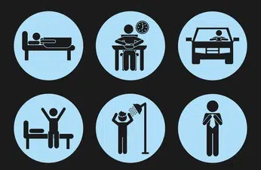
KESHAV MEMORIAL INSTITUTE OF TECHNOLOGY
Accredited by NBA & NAAC, Approved by AICTE,
Affiliated to JNTUH, Hyderabad
Automated Human Action Recognition and Classification framework using Long Recurrent Convolutional Network
Under the Guidance of:
Mr. M Srinivas
A Harshanth 20BD1A6603
B Maharshi 20BD1A6606
G R Hrishikesh 20BD1A6613
G Sai Abhinav 20BD1A6614

Slide 2
INTRODUCTION
Human Action Recognition is a fundamental task in computer vision and artificial intelligence that involves automatically identifying and categorizing human actions or activities in videos.
This technology has numerous real-world applications, such as video surveillance, human-computer interaction, sports analysis, and more.

Slide 3
OBJECTIVE
The main objective of this project is to implement and train a model for human action recognition in videos using a combination of CNN and LSTM layers.

Slide 4
LITERATURE SURVEY
Human Activity Recognition(2014):
Human activity recognition is an ability to interpret human body gesture or motion via sensors and determine human activity or action . Most of the human daily tasks can be simplified or automated if they can be recognized via HAR system
Human Action Recognition Based on Multi-level Feature Fusion(2020):
A deep learning-based method of multi- layer feature fusion for human motion recognition is presented. Combined with the Convolutional Autoencoder (CAE), it makes full use of the detailed features of the CNN middle layer.

Slide 5
Deep Learning for Human Action Recognition(April 2021) :
Neural Networks, Deep Learning, SVM, KTH, CNN, Action recognition, Confusion Matrix.High speed processors available for computing are not sufficient for processing deep learning models as the tensors of very large size created after preprocessing datasets.
Human Action Recognition From Various Data Modalities(2022):
HAR is an important task that has attracted signiﬁcant research attention in the past decades, and various data modalities with different characteristics have been used for this task. In this paper, we have given a comprehensive review of HAR methods using different data modalities

Slide 6
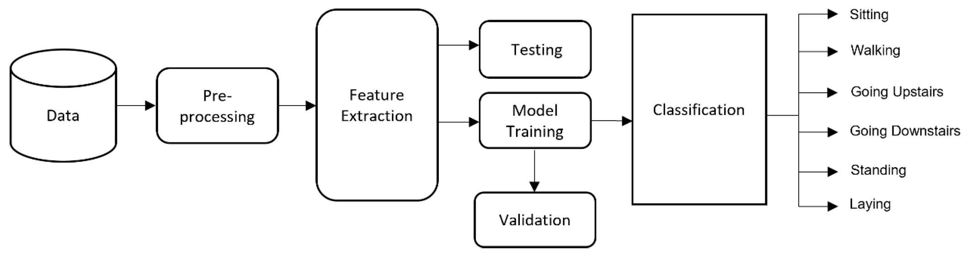
METHODOLOGY

Slide 7
METHODOLOGY
Step 1: Preprocess the Dataset. For this, we are using a Dataset
called UCF50-Action Recognition Dataset.
Step 2: Split the Data into Train and Test Set
Step 3: Implement the LRCN Approach
Step 4: Construct the Model
Step 5: Compile and Train the Model
Step 6: Plot Model’s Loss & Accuracy Curves

Slide 8
METHODOLOGY
Implement the LRCN approach
Construct the Model
Compile and train the model
The LRCN (Long-term Recurrent Convolutional Network) architecture is used for action recognition. The model combines CNN layers for spatial feature extraction and LSTM layers for temporal sequence modeling.

Slide 9
THANK YOU

