Slide 1
Travlr Chatbot
Problem description
A travel company would generally do business all round the globe and need someone to assist their customers 24/7 with wide range of queries with both company specific and general data
Using an human worker for this job would take lot of time and resources from the company which will bring down customer satisfaction and increase expense
This travel chatbot can assist multiple users parallelly with information on flights and hotels, travel packages we offer and answering frequently asked travel questions in very minimal time
This project involves designing and developing a travel chatbot that can interact with users in a natural and intuitive manner, providing them with personalized travel assistance.

Slide 2
Technical Approach
Frontend: Streamlit
Backend: Python
Database: SQLite
LLM: Google Gemini Pro
Intent Detection: NLTK, Logistic Regression, Random Forest, SVC, ensemble

Slide 3
ChatGPT will generate SQL Query based on user query
Execute SQL query and get data
ChatGPT convert extracted table data to natural language
USER Query
INTENT Detection Model
Database Query
ChatGPT Check for INTENT
General Query
ChatGPT will use its knowledge to answer
Output Response

Slide 4
Data Source
Used ChatGPT to generate various types of questions users would ask a travel chatbot in general terms
Specified SQL schema to ChatGPT and asked to generate all types of possible questions that could be answered using given tables
Given a question and queried to generate different other similar meaning questions humans would ask
Example of data generated from ChatGPT
Query: "what are packages available in india?" give me different similar sentences that users would ask an travel chatbot with same meaning like "packages to india“
Output:
"What travel packages are there for India?" "Show me travel packages to India."
"Can you list the available packages for India?"
"I'm interested in packages for India."
"What are my options for travel packages to India?"
"Could you recommend some travel packages to India?"
"Are there any vacation packages for India?"
"Tell me about the travel packages available in India."
"Show me the holiday packages to India."
"What kind of tour packages do you have for India?"

Slide 5
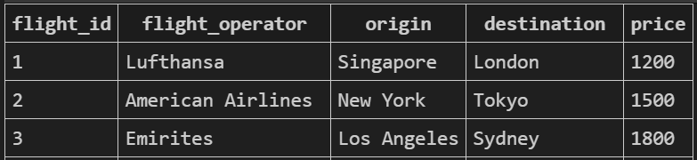
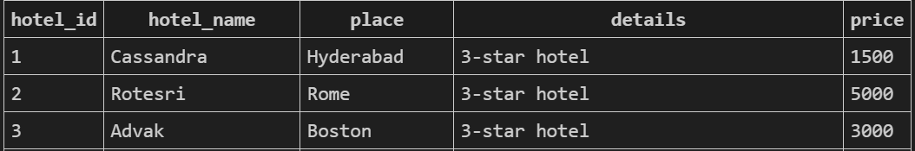
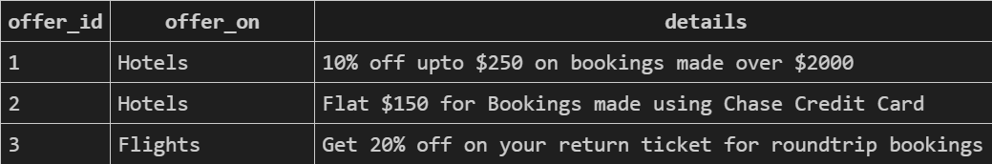
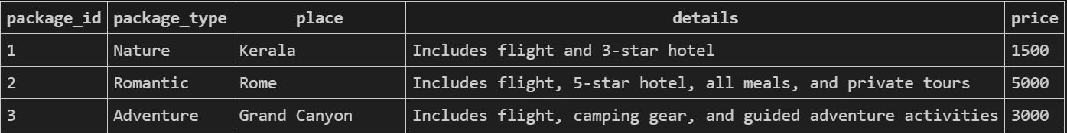
SQL Schema

Slide 6
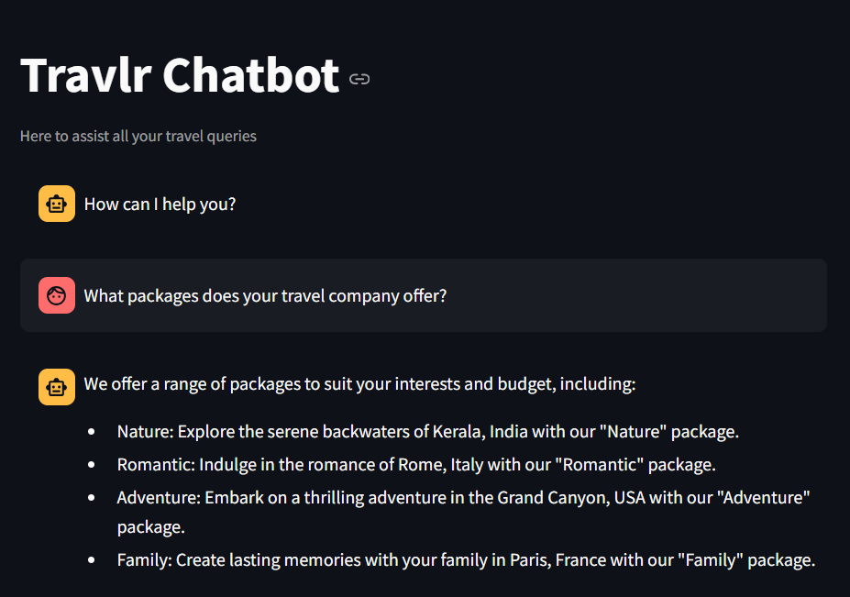
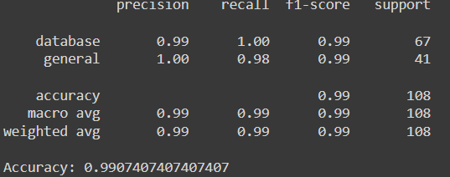
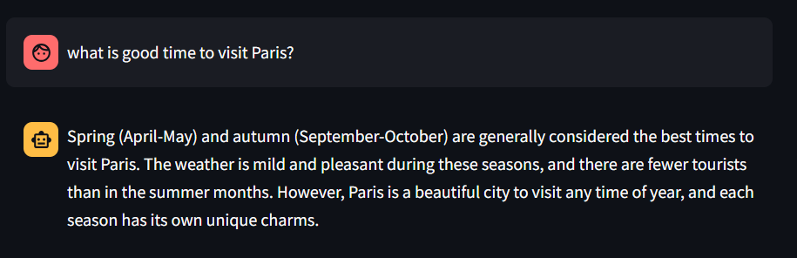
Results

Slide 7
Conclusion
Intent classification model performance for this project is satisfactory, and adding more different types of Realtime questions can improve accuracy further
Need to rewrite the ChatGPT prompts to get even better outputs
As part of future scope, I will be using Lang Chain to include memory and answer queries with collective information from previous queries.
Sai Abhishek Itta

