Slide 1
Fine Tuning CLIP Model
Sai Abhishek
002240088

Slide 2
Objective
Adjusting the model to generate outputs tailored for specific use cases (e.g., medical imaging, artistic styles, or product designs).
Example: Fine-tuning a generic image generator to create realistic skin disease images for dermatological research.

Slide 3
Dataset
Flickr 8k Dataset
https://www.kaggle.com/datasets/adityajn105/flickr8k
VAE and UNET Components
openai/clip-vit-large-patch14
Fine Tuned Clip Model
saiabhishek-itta/flick8-finetuned-clip

Slide 4
Tensor Structure
loss_fn = CrossEntropyLoss()
optimizer = AdamW(model.parameters(), lr=5e-6)
from torch.utils.data import DataLoader
dataloader = DataLoader(dataset, batch_size=4, collate_fn=collate_fn)

Slide 5
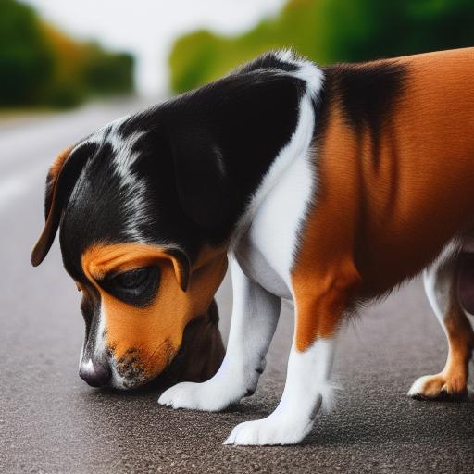
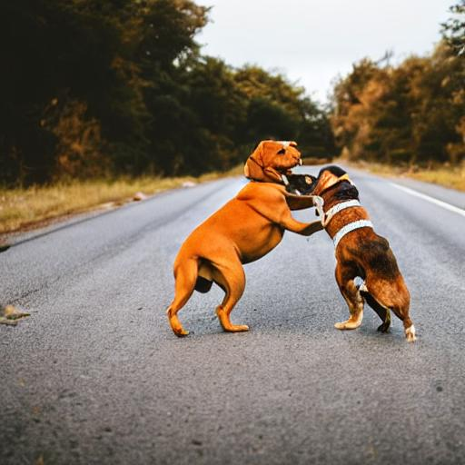
Comparison
Two dogs of different breeds looking at each other on the road .
Original
FineTuned

Slide 6
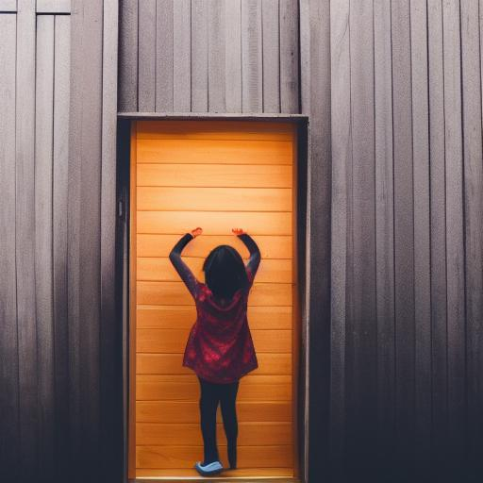
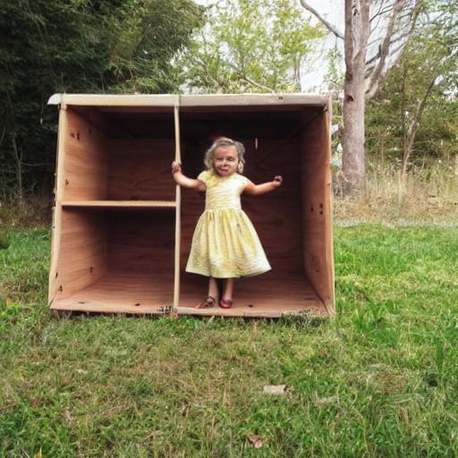
Comparison
A girl going in a wooden building
Original
FineTuned

Slide 7
Comparison
A girl going in a wooden building
Original
FineTuned

Slide 8
Future improvements
Will try to fine tune the model using certain set of images to better output
Parameter-Efficient Fine-Tuning
Low-Rank Adaptation (LoRA): Modifying only a subset of parameters, making fine-tuning faster and reducing memory requirements.
Adapters and Hypernetworks: Adding lightweight layers that can be trained while keeping the main model frozen.
Prompt-Based Tuning: Using textual prompts or embeddings to guide fine-tuning without altering the core model.

