Slide 1

Disease Diagnosis with Wrist Pulse Signal using Machine Learning (Vaatha, Pittha, Kapha)
Guided by
Mr. R Shanmughasundaram
Assistant Professor (Sr. Gr.)
Department of Electrical and Electronics Engineering
Project members:
Aathithya SV CB.EN.U4ELC20001
Achanta Sai Krishna CB.EN.U4ELC20004
Kuralanbu S CB.EN.U4ELC20033
Vimal Dharshan N CB.EN.U4ELC20081

Slide 2
INTRODUCTION
Nadi Pariksha (a pulse – based diagnosis), is a prominent method in Ayurveda, used to examine the pulse to assess a person’s overall health and well – being.
Nadi Pariksha is based on the belief that body is composed three doshas: Vaatha, Pittha, and Kapha.
Now, if we see machine learning techniques has been grown rapidly in variety of applications, including healthcare.
In context of Nadi Pariksha, machine learning can be used to develop new methods for diagnosing diseases and assessing overall health and well-being.
By benefiting the use of machine learning for Nadi Pariksha is that it can help to improve the accuracy of diagnosis.

Slide 3
OBJECTIVE
To train the machine learning algorithm to identify diseases in individuals, we employ a variety of methods including Decision Trees, X G Boost, Support Vector Machines, Logistic Regression, and K-Nearest Neighbors, utilizing a labeled dataset.
To classify dataset into four classes
Migraine
Arthritis
Diarrhea
Gastritis

Slide 4
MOTIVATION
Early Detection and Prevention of Diseases.
Non-invasive and Inexpensive screening.
Personalized Medicine.
Traditional Wisdom Integration.

Slide 5
LITERATURE SURVEY

Slide 6
SI.NO​S | Title​ | Summary​
1​ | Studies on Urdhwaga Amlapitta (Gastritis) and its Management with Shatavari Ghruta [1] | This research paper focused on Gastritis, its symptoms, remedies, and exercises, based on the different age groups. The gastritis disease is said to be classified as one of the dosha, that is 'pittha' dosha. There is a research conducted based on which type of gastritis problems, are affecting their body, behavioral conditions and dosage remedies.
2​ | Understanding Adolescents' Perceptions of Diarrhea: A Formative Research Study of a Visual Scale to Measure Self-Reported Diarrhea in Low-Resource Settings [2] | This research paper focuses on Diarrhea, and its symptoms. The diarrhea disease is said to be classified as one of the dosha, that is 'pittha' dosha. A research is done by qualitative and quantitative analysis of the data collected.

Slide 7
SI.NO​S | Title​ | Summary​
3 | Ayurveda for management of migraine: A narrative review of clinical evidence [3] | This research paper focused on Migraine, ayurvedic perspective, symptoms, cause factors, and treat. The migraine disease is said to be classified as one of the dosha, that is 'kapha' dosha.
4 | A Clinical Study of Jatiphala Taila Abhyanga on Vatarakta [4] | This research paper focuses on Arthritis, its types, symptoms, cause factors, and treatment. The arthritis disease is said to be classified as one of the dosha, that is 'vaatha' dosha. A research was conducted to assess the behavioural study of arthritis

Slide 8
SI.NO​S | Title​ | Summary​
5 | Pulse diagnosis System for Nadi Pariksha using parametric and statistical analysis. ​[5] | This research develops an electronic computer-aided diagnostic tool for Ayurvedic pulse diagnosis using Nadi Pariksha. An innovative Photoplethysmography (PPG) sensor interfaces with Arduino to collect wrist pulse signals.
6 | Predicting Ayurveda-Based Constituent Balancing in Human Body Using Machine Learning Methods. ​[6] | This research paper focuses on predicting human body constituents, known as Ayurveda Dosha, using machine learning models. They trained and tested the data using various machine learning techniques such as Artificial Neural Network (ANN), K-Nearest Neighbour (KNN), Support Vector Machine (SVM), Naive Bayes (NB), Decision Tree (DT). The study also compared other performance measures such as root mean square error (RMSE), precision, recall, and F-score across the different models. .

Slide 9
SI.NO​ | Title​ | Summary​
7​ | A prospective study to assess the association between emotion and disease: Wrist Pulse Signals.​ [7] | ​This research paper focuses on the use of pulse diagnosis in Ayurveda to understand the root cause of illnesses and diseases. Pulse diagnosis is done by observing fingertip palpations over the radial artery of a wrist. The paper highlights the importance of wrist pulse signals (WPS) in determining the physiological status of the entire human body and the close association between the heart and mind.
8 | Disease Diagnosis by Nadi Analysis Using Ayurvedic Methods with Portable Nadi Device & Web Application. ​[8] | This research paper proposes the development of a system for early human health diagnostics based on traditional Ayurvedic methods. The traditional Ayurvedic method of pulse examination, known as Nadi Pariksha, is utilized for diagnosing ailments. The pulse signals, representing Vata, Pitta, and Kapha, are examined to diagnose various diseases. The system combines pulse examination, questionnaire responses, and analysis of cough, eyes, and face to generate a prescription for the diagnosed disease.

Slide 10
SI.NO​ | Title​ | Summary​
9 | Wrist pulse signals analysis based on Deep Convolutional Neural Networks. [9] | ​This research paper focuses on computer-aided analysis of Traditional Chinese Medicine Pulse Diagnosis, specifically the recognition of wrist pulse signals. The authors propose a new methodology that combines the use of Hilbert Transform, and Deep Convolutional Neural Networks (DCNN) to improve the recognition effect. The DCNN is trained with added noise to increase the sample size and extract potential features.
10 | A Compound Pressure Signal Acquisition System for Multichannel Wrist Pulse Signal Analysis. [10] | The research paper discusses the limitations of traditional pulse diagnosis methods in traditional Chinese medicine and proposes a novel solution to improve the accuracy and efficiency of pulse signal acquisition. The authors highlight that most conventional pulse signal acquisition devices can only capture signals at one position and under a fixed pressure, limiting the amount of diagnostic information that can be obtained. The system is capable of capturing pulse signals at different positions and under different pressures, providing a more comprehensive and accurate representation of the patient's health condition.

Slide 11
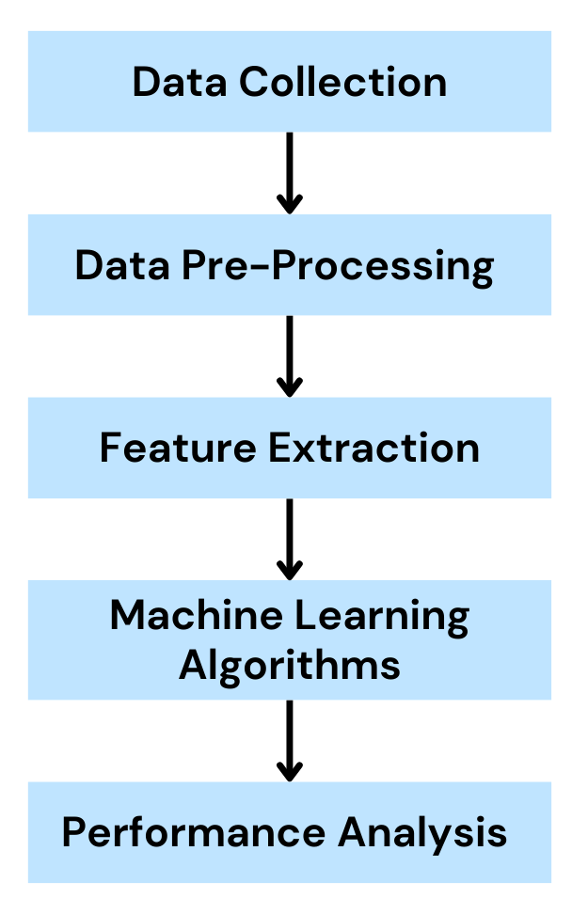
Project Block Diagram

Slide 12
DATASET DESCRIPTION
Full Dataset:
Number of samples in Migraine: 259
Number of samples in Arthritis: 259
Number of samples in Diarrhea: 280
Number of samples in Gastritis: 273
Total number of samples: 1071

Slide 13
METHODOLOGY
Data Collection:
The Dataset collected has been classified based on the disease diagnosed, and later classified based on the dosha, for the respective disease.
2. Data Cleaning:
Rectifying missing values, eliminating duplicate records, and mitigating data inconsistencies.

Slide 14
Data Transformation:
The Dataset consists of object feature data type, is transformed into numerical feature data types.
Methods used for data transformation:
Replace technique
Label encoding technique: It is used to convert object data type into numerical ones so that they can be fitted by machine learning models which only take numerical data.

Slide 15
Support Vector Machine:
Support Vector Machine (SVM) is a supervised machine learning algorithm used for both classification and regression.
The main objective of the SVM algorithm is to find the optimal hyperplane in an N-dimensional space that can separate the data points in different classes in the feature space.
The dimension of the hyperplane depends upon the number of features.
One reasonable choice as the best hyperplane is the one that represents the largest separation or margin between the two classes

Slide 16
Decision Tree:
A decision tree is a flowchart-like tree structure where each internal node denotes the feature , branches denote the rules and the leaf nodes denote the result of the algorithm (classes).
It is a versatile supervised machine-learning algorithm, which is used for both classification and regression problems.
The rules of classification rules form the paths from the root to the leaves.
The process of constructing a decision tree involves selecting the best feature at each node to split the data, aiming to maximize information gain or minimize impurity.

Slide 17
XGBoost (eXtreme Gradient Boosting):
XGBoost is an optimized distributed gradient boosting library designed for efficient and scalable training of machine learning models.
It is an ensemble learning method that combines the predictions of multiple weak models to produce a stronger prediction.
Basic boosting is done by building a model by using weak models in series.
XGBoost stands out due to its efficient implementation and optimization techniques, making it well-suited for both regression and classification tasks.

Slide 18
Logistic Regression:
Logistic regression is a supervised machine learning algorithm used for classification tasks where the goal is to predict the probability that an instance belongs to a given class or not.
An procedure used in statistics to examine the connection between two data components is called logistic regression.
The logistic regression's result must be between 0 and 1, and as it cannot be greater than this, it takes the shape of a "S" curve.

Slide 19
K Nearest Neighbours:
The KNN algorithm (KNN) is a supervised machine learning algorithm that is mainly used for classification purposes.
It has been widely used for disease prediction. KNN, a supervised algorithm, predicts the classification of unlabeled data by considering features and labels in the training data.
In general, the KNN algorithm can classify datasets with a training model similar to the test study by considering the k nearest training data points (neighbors) that are closest to the test study.

Slide 20
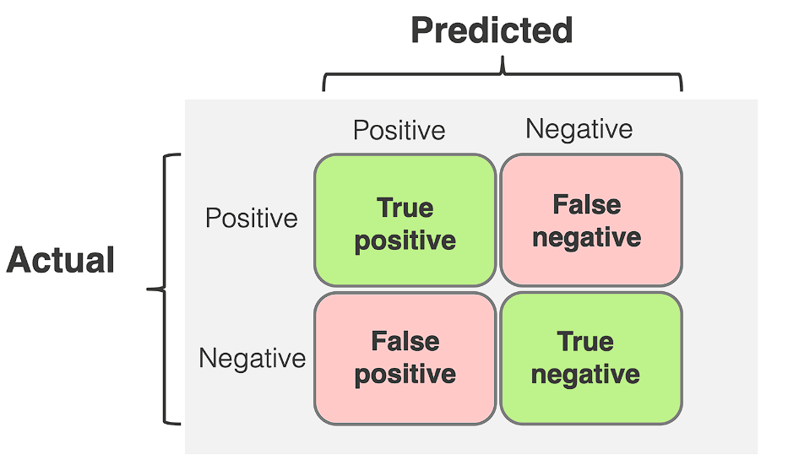
Confusion Matrix
The confusion matrix is a matrix used to determine the performance of the classification models for a given set of test data. It can only be determined if the true values for test data are known.

Slide 21
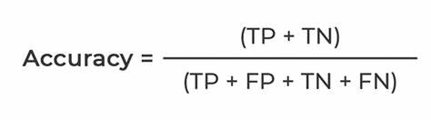
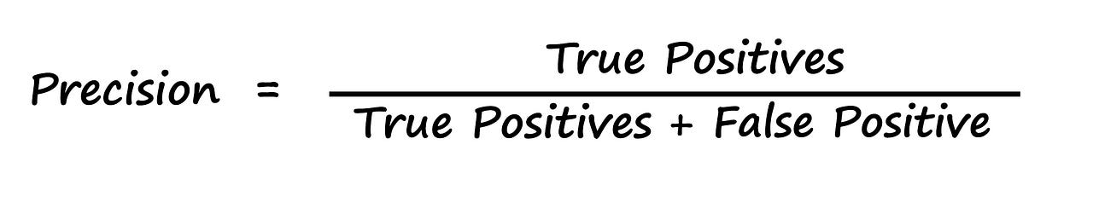
Accuracy
Accuracy is used to measure the performance of the model. It is the ratio of total correct instances to the total instances.
Precision
Precision is a measure of how accurate a model’s positive predictions are. It is defined as the ratio of true positive predictions to the total number of positive predictions made by the model.

Slide 22
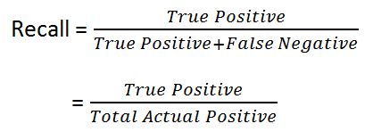
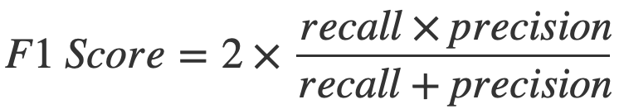
Recall
Recall measures the effectiveness of a classification model in identifying all relevant instances from a dataset. It is the ratio of the number of true positive (TP) instances to the sum of true positive and false negative (FN) instances.
F1-Score
F1-Score is used to evaluate the overall performance of a classification model. It is the harmonic mean of precision and recall

Slide 23
ML Algorithms Results - All Features
Machine Learning Algorithms | Accuracy | Precision | Recall | F1 - score
Decision Tree | 99.5 % | 100 % | 100 % | 100 %
X G Boost | 99.7 % | 100 % | 100 % | 100 %
Supported Vectored Machine | 96 % | 96 % | 96 % | 96 %
Logistic Regression | 94 % | 94 % | 93 % | 93 %
KNN | 99.4% | 99.5% | 99.5% | 99%

Slide 24
Principal Component Analysis(PCA)
Principal Component Analysis (PCA) is an unsupervised learning algorithm technique used to examine the interrelations among a set of variables.
The main goal of Principal Component Analysis (PCA) is to reduce the dimensionality of a dataset while preserving the most important patterns or relationships between the variables without any prior knowledge of the target variables.
PCA works by considering the variance of each attribute because the high attribute shows the good split between the classes, and hence it reduces the dimensionality.

Slide 25
Parameters of PCA
Correlation: It signifies that how strongly two variables are related to each other. Such as if one changes, the other variable also gets changed. The correlation value ranges from -1 to +1. Here, -1 occurs if variables are inversely proportional to each other, and +1 indicates that variables are directly proportional to each other.
Orthogonal: It defines that variables are not correlated to each other, and hence the correlation between the pair of variables is zero.
Eigenvectors: If there is a square matrix M, and a non-zero vector v is given. Then v will be eigenvector if Av is the scalar multiple of v.
Covariance Matrix: A matrix containing the covariance between the pair of variables is called the Covariance Matrix.

Slide 26
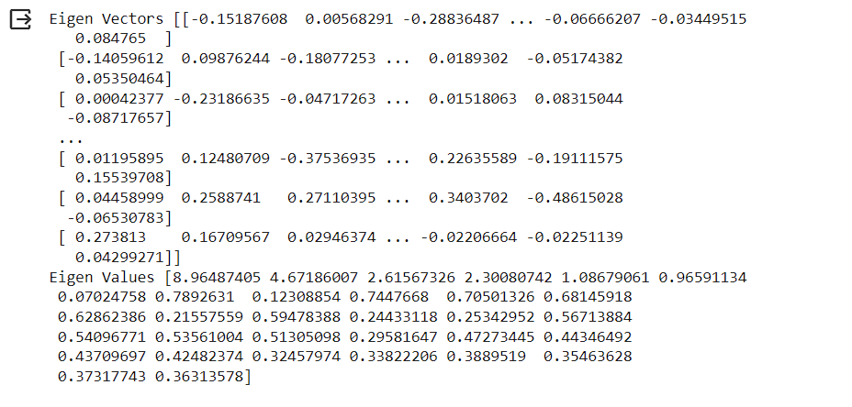
Feature Extraction Methods
Principal Component Analysis(PCA):
Eigen Vectors and Eigen Values:

Slide 27
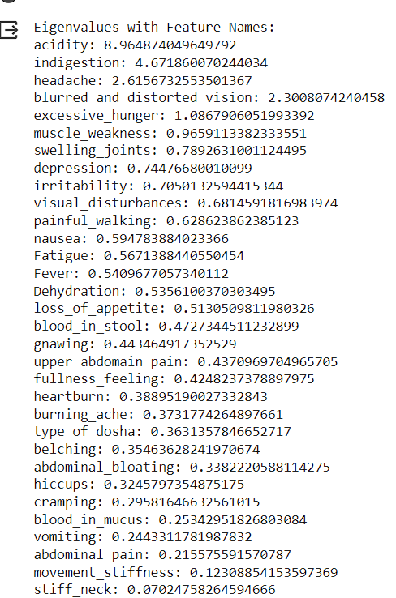
Eigen values with each feature:
Best Features: Acidity, Indigestion, Headache, Blurred and distorted vision, excessive hunger

Slide 28
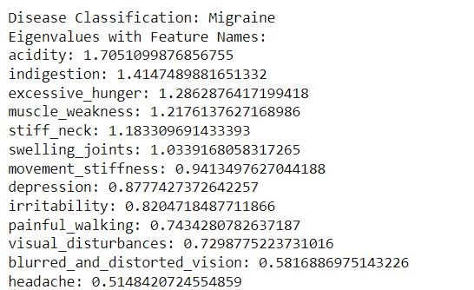
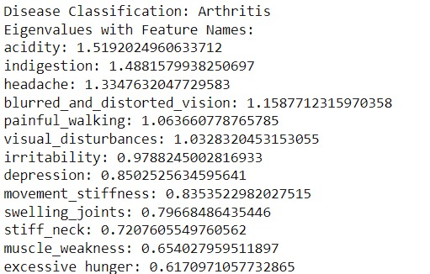
Major Features for Particular Disease:

Slide 29
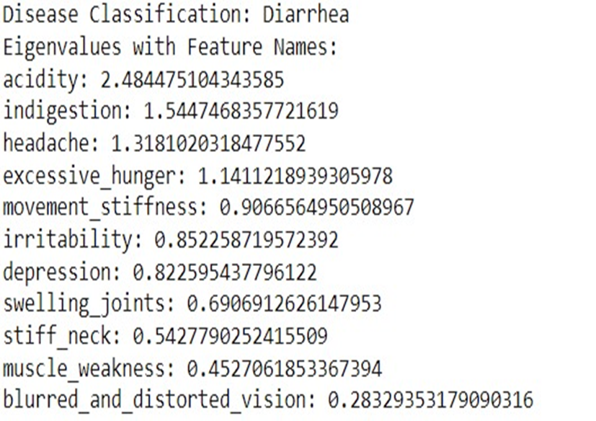
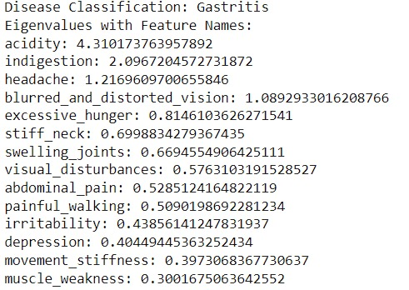
Major Features for Particular Disease:

Slide 30
Selected Features:
acidity
indigestion
blurred_and_distorted_vision
excessive_hunger
muscle_weakness
stiff_neck
swelling_joints
depression
abdominal_pain
vomiting
blood_in_mucus
fatigue
loss_of_appetite
heartburn

Slide 31
ML Algorithms Results - Selected Features
Machine Learning Algorithms | Accuracy | Precision | Recall | F1 - score
Decision Tree | 95 % | 96 % | 96 % | 96 %
X G Boost | 96 % | 96 % | 96 % | 96 %
Supported Vectored Machine | 96 % | 96 % | 96 % | 96 %
Logistic Regression | 94 % | 98 % | 94 % | 94 %
KNN | 94 % | 95 % | 94 % | 94 %

Slide 32
BEST ALGORITHM:
By comparing accuracy of all algorithm, we concluded that SVM (Support Vector Machine) with accuracy – 87.9% and X G boost with accuracy – 87.9% are the best algorithm for our dataset of reduced features.

Slide 33
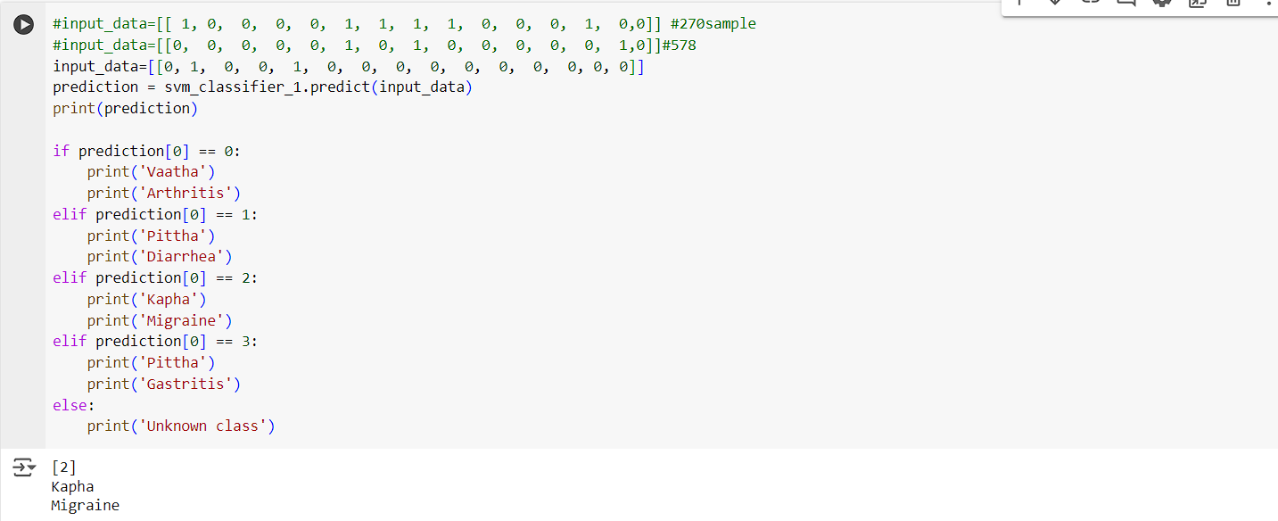
Predicting the Output using the Trained Model

Slide 34
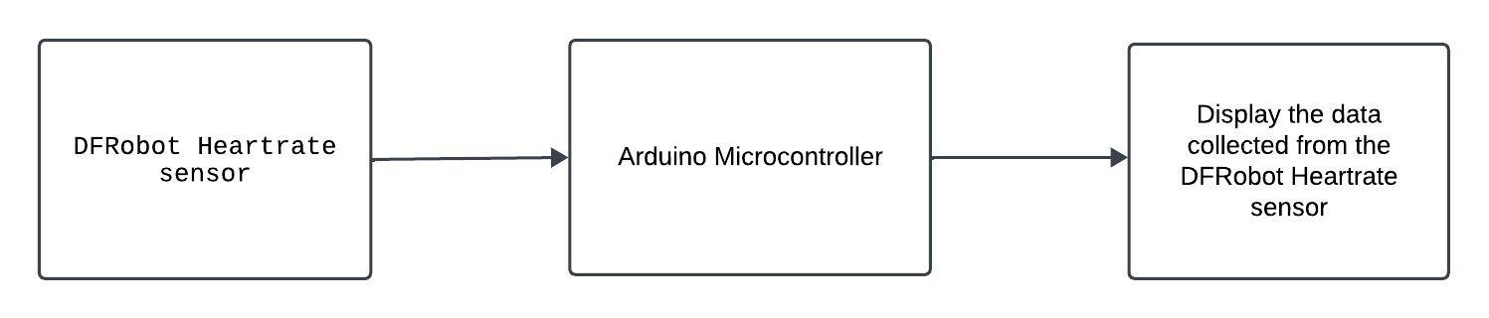
Project Block Diagram (Hardware)

Slide 35
Methodology
The instrumentation setup will be done by using Photoplethysmography Heart Rate sensor placed in the right-hand wrist for males and left-hand wrist for females to measure Vaatha, Pittha, Kapha pulse signals.
Calculating the average of the continuous 60 samples, the value will be checked through the heartrate abnormality table and identify which dosha is abnormal.
Based on the dosha abnormality, the input will be collected for the selected features.

Slide 36
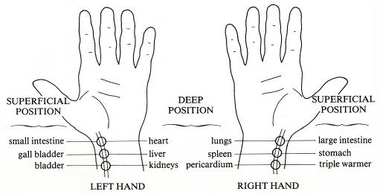
12 organs connection to 6 pulse positions in Human Wrists

Slide 37
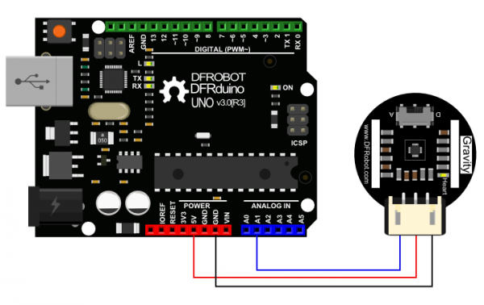
Experimental Setup:
First, we have connected 'Heart Rate Sensor', to the Arduino UNO board, by connections as follows:
Heart Rate Sensor | Arduino UNO
Ground | Ground
VCC | 5v
Signal | A1 (analog pin)

Slide 38
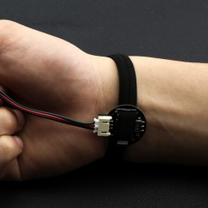
Experimental Setup:
Second, we place the 'Heart Rate Sensor' on the wrist for each dosha points respectively, to calculate the values of 'beats per minute' for Vaatha, Pittha, and Kapha per person.
We use, Arduino IDE software with inbuilt library of the sensor, we get the readings of the beats per minute of the pulse and convert the data into MS Excel File.

Slide 39
Experiment Results:
Name of the person | Vaatha | Pittha | Kapha
Sample 1 | 98 – 100 | 93 – 101 | 88 – 98
Sample 2 | 75 – 81 | 71 – 78 | 73 – 81
Sample 3 | 81 – 90 | 81 – 88 | 87 – 93
Sample 4 | 83 – 92 | 82 – 88 | 75 – 89
Sample 5 | 63 – 74 | 66 – 71 | 69 – 74
(Note: the heart rate values are calculated before consulted with Dr. S. Veera Alagiri)

Slide 40
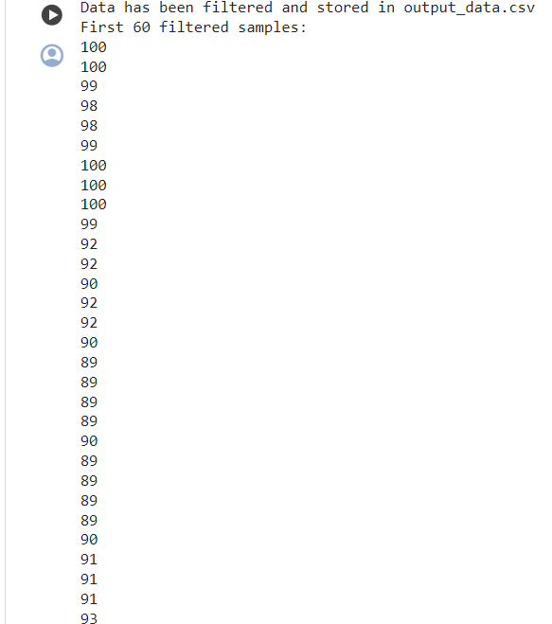
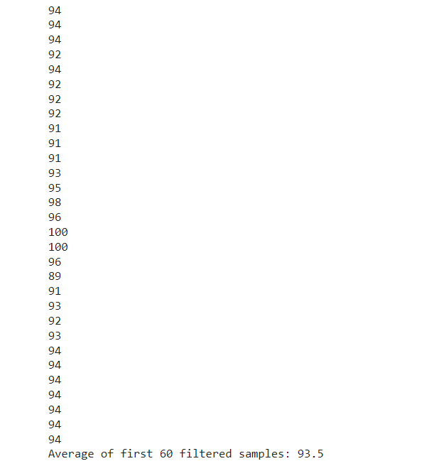

Slide 41
Dosha | Normal Range | Abnormal Range
Vaatha | 80 – 90 bpm | Less than 80 bpm Or More than 90 bpm
Pittha | 70 – 80 bpm | Less than 70 bpm Or More than 80 bpm
Kapha | 60 – 70 bpm | Less than 60 bpm Or More than 70 bpm

Slide 42
Dosha | High Heart Rate | Low Heart Rate
Vaatha | Headache, Abdominal Indigestion, Acidity, High B.P., Asthma, Breathing Suffocation, Heart Palpitations (stress, anxiety), Common Cold, Lung Problems, Body trembling, Shoulder Pain, Arthritis, Toothache, stroke | Low B.P., Heart Palpitations (medication side effects, electrolyte imbalance), Loose motion, Throat infection
Pithha | Headache, Allergy, Eyesight problems, Breathing Suffocation, Digestion Problem, Eye Cataract, High Weight, Joint Pain, Abdominal Indigestion, Gastritis, Diarrhea, Mental health, short temper, sleeping problem's, weight loss | Loose motion, Low masculinity, Low RBC, Low Iron Content, Dizziness, Dry Lips
Kapha | Headache, Shoulder pain, Body trembling, Heart Palpitation (stress, anxiety), Neck Stiffness, Hand trembling, Breathing Problems (Tachycardia), Throat Pain, common cold | Heart Palpitations (medication side effects, electrolyte imbalance), Breathing Problem (Bradycardia), lungs problems

Slide 44
Data Processing
Calculate the average of three doshas for each sample. E.g.: Sample 1 average: 93.5 bpm (Vaatha dosha)
Depending upon the average value, it is compared with the dosha abnormality table. So, the sample 1 vaatha average is higher than the normal range, i.e., sample 1 has higher rate in vaatha abnormality
Since, sample1 has higher rate, the details of the symptoms will be collected, and run through the machine learning model for verification as well as can cross verify with the expert.

Slide 45
CONCLUSION
Disease Prediction: The model accurately predicts which disease a patient is suffering from based on the input features.
Implementation: Our code processes the input features and outputs the predicted disease, demonstrating the practical application of machine learning in disease diagnosis.
Data Verification: Photoplethysmographic(PPG) sensor is used to collect the wrist pulse from the patient. Data processing is done to calculate the abnormality of the patient which is used to verify the output of Machine Learning model.

Slide 46
REFERENCES
S. S. Sanjore and G. Y. Kharche, “Studies on Urdhwaga Amlapitta (Gastritis) and its Management with Shatavari Ghruta,” Asian Journal of Pharmaceutical Research and Development, Jun. 2019, doi: 10.22270/ajprd.v7i3.518.
A. Gold-Watts, G. Aamodt, S. Gandhimathi, R. Sudha, and S. Bastien, “Understanding Adolescents’ perceptions of Diarrhea: A formative research study of a visual scale to measure Self-Reported Diarrhea in Low-Resource Settings,” Frontiers in Public Health, vol. 9, May 2021, doi: 10.3389/fpubh.2021.561367.
N. K, “WJPR - abstract.” https://www.wjpr.net/abstract_show/20507
U. Chikkanna et al., “Ayurveda for management of migraine: A narrative review of clinical evidence,” Journal of Family Medicine and Primary Care, vol. 11, no. 8, p. 4228, Jan. 2022, doi: 10.4103/jfmpc.jfmpc_2109_21.
Kadarmandalgi and M. Asaithambi, "Pulse diagnosis System for Nadi Pariksha using parametric and statistical analysis," 2019 Innovations in Power and Advanced Computing Technologies (i-PACT), Vellore, India, 2019, pp. 1-7, doi: 10.1109/i-PACT44901.2019.8960080.

Slide 47
REFERENCES (cont.)
V. Madaan and A. Goyal, "Predicting Ayurveda-Based Constituent Balancing in Human Body Using Machine Learning Methods," in IEEE Access, vol. 8, pp. 65060-65070, 2020, doi: 10.1109/ACCESS.2020.2985717.
N. Garg, A. Kumar and H. S. Ryait, "A prospective study to assess the association between emotion and disease: Wrist Pulse Signals," 2020 Sixth International Conference on Parallel, Distributed and Grid Computing (PDGC), Waknaghat, India, 2020, pp. 121-125, doi: 10.1109/PDGC50313.2020.9315739.
A. W. M. H. K. Bandara, N. K. Madanayake, P. K. K. Devaka, P. L. Geethan Madurange, S. Silva and P. Abeygunawardhna, "Disease Diagnosis by Nadi Analysis Using Ayurvedic Methods with Portable Nadi Device & Web Application," 2021 2nd International Informatics and Software Engineering Conference (IISEC), Ankara, Turkey, 2021, pp. 1-6, doi: 10.1109/IISEC54230.2021.9672342.
X. Hu, H. Zhu, J. Xu, D. Xu and J. Dong, "Wrist pulse signals analysis based on Deep Convolutional Neural Networks," 2014 IEEE Conference on Computational Intelligence in Bioinformatics and Computational Biology, Honolulu, HI, USA, 2014, pp. 1-7, doi: 10.1109/CIBCB.2014.6845525.
P. Wang, W. Zuo and D. Zhang, "A Compound Pressure Signal Acquisition System for Multichannel Wrist Pulse Signal Analysis," in IEEE Transactions on Instrumentation and Measurement, vol. 63, no. 6, pp. 1556-1565, June 2014, doi: 10.1109/TIM.2013.2267458.

Slide 48
REFERENCES (cont.)
N. N. Khaire and Y. V. Joshi, "Diagnosis of Disease Using Wrist Pulse Signal for classification of pre-meal and post-meal samples," 2015 International Conference on Industrial Instrumentation and Control (ICIC), Pune, India, 2015, pp. 866-869, doi: 10.1109/IIC.2015.7150864.
C. Choi et al., "PPG pulse direction determination algorithm for PPG waveform inversion by wrist rotation," 2017 39th Annual International Conference of the IEEE Engineering in Medicine and Biology Society (EMBC), Jeju, Korea (South), 2017, pp. 4090-4093, doi: 10.1109/EMBC.2017.8037755.
C. Xia et al., "Wrist Pulse Waveform Feature Extraction and Dimension Reduction with Feature Variability Analysis," 2008 2nd International Conference on Bioinformatics and Biomedical Engineering, Shanghai, China, 2008, pp. 2048-2051, doi: 10.1109/ICBBE.2008.841.
C. Xia et al., "A Practical Approach to Wrist Pulse Segmentation and Single-period Average Waveform Estimation," 2008 International Conference on BioMedical Engineering and Informatics, Sanya, China, 2008, pp. 334-338, doi: 10.1109/BMEI.2008.140.
aswet media. பாடம் 2 பஞ்சபூதங்களும் 12 உறுப்புகளின் நாடியும். (Oct. 5, 2021). [Online Video]. Available: https://www.youtube.com/live/pahdpU0966s?si=QuukQVb4YTZoq8Ii

Slide 49
REFERENCES (cont.)
16. “Heart_Rate_Sensor_SKU_SEN0203-DFRobot.” https://wiki.dfrobot.com/Heart_Rate_Sensor_SKU_SEN0203​
​
17. Amit-Kadarmandalgi, “GitHub - Amit-Kadarmandalgi/Nadi-Pariksha: Vedic Pulse diagnosis using statistical and parametric analysis,” GitHub. https://github.com/Amit-Kadarmandalgi/Nadi-Pariksha.git ​

Slide 50


