Slide 1


VNR VIGNANA JYOTHI INSTITUTE OF ENGINEERING AND TECHNOLOGY
HYDERABAD
DEPARTMENT OF INFORMATION TECHNOLOGY
MAJOR PROJECT (PHASE-1) MAJOR REVIEW - 2 A.Y 2026-27
TITLE
Spatial-Aware Explainable AI Framework for Pan-India Smart EV Charging Infrastructure Planning
PROJECT SUPERVISOR
Dr.B.Raswitha
Batch No-09
TEAM MEMBERS
23071A1271 – A. SRIHITHA
23071A1287 – G. SAI ADITYA
23071A1299 – K.APEKSHA
23071A12A5 – M.SUPRAJA

Slide 2
AGENDA
  ABSTRACT
  INTRODUCTION
  LITERATURE REVIEW
  PROBLEM IDENTIFICATION AND DEFINITION
  PROPOSED APPROACH
  WORK PLAN WITH TIMELINE
  PROPOSED OUTCOME OF THE PROJECT
  CONCLUSION
  FUTURE SCOPE
  BIBLIOGRAPHY
DEPARTMENT OF INFORMATION TECHNOLOGY

Slide 3
ABSTRACT
This project presents a spatial-aware, explainable machine learning framework for planning EV charging infrastructure across India. Trained on an audited national master dataset of 52,718 public charging stations (30 features across all 36 States and UTs), it enforces a strict Anti-Leakage Gate isolating 21 pre-construction spatial, demographic, and grid predictors. Using 5-fold state-grouped spatial cross-validation (70% Training [36,873 stations], 15% Validation [7,927 stations], 15% Independent Test [7,906 stations]), Random Forest is established as Champion with 95.31% Accuracy, 0.8794 PR-AUC, 0.9505 ROC-AUC, and calibrated threshold tau* = 0.63. TreeSHAP and counterfactual optimization provide transparent engineering upgrade pathways, while an AHP-based EIPS framework (CR = 0.042) prioritizes all 36 States/UTs into phased investment tiers, deployed via a high-performance Flask-Leaflet Web GIS platform.
DEPARTMENT OF INFORMATION TECHNOLOGY

Slide 4
INTRODUCTION
India's EV fleet is expanding rapidly under the FAME-II and PM E-DRIVE schemes, making accessible and reliable charging infrastructure essential for grid stability and highway corridor electrification.
However, charging stations are unevenly distributed: some states have dense fast-charging networks, while others still lack DC Fast capacity.
Our project applies spatial-aware Machine Learning to 52,718 public charging stations across all 36 States and Union Territories to identify sites suitable for DC Fast charging, with TreeSHAP explaining each prediction.
An AHP-TOPSIS based EV Infrastructure Priority Score (EIPS) then ranks all 36 States/UTs on EV adoption, grid readiness, highway connectivity and infrastructure deficit.
DEPARTMENT OF INFORMATION TECHNOLOGY

Slide 5
LITERATURE SURVEY
S.NO | Title | Dataset & Approach | Pros | Cons | Authors
1) | Electric Vehicle Charging Load Forecasting: A Comparative Study of Deep Learning Approaches | EV charging-load data; compares deep-learning forecasting models. | Compares different models for charging-load prediction. | Focuses on forecasting, not explainability or GIS-based site selection | Zhu et al. (2019)
2) | Suitable Location Selection for the Electric Vehicle Fast Charging Station with AHP and Fuzzy AHP Methods Using GIS | GIS-based location suitability analysis using AHP and Fuzzy AHP; Turkey case study. | Considers geographical suitability for charger placement. | Does not integrate ML demand forecasting and SHAP explanations. | Güler & Yomralıoğlu (2020)

Slide 6
LITERATURE SURVEY
S.NO | Authors | Title | Dataset & Approach | Pros | Cons
3) | Alexander Orzechowski, Loren Lugosch, Hao Shu, Raymond Yang, Wei Li and Brett H. Meyer | A Data-Driven Framework for Medium-Term Electric Vehicle Charging Demand Forecasting | Real charging data from 11 stations in Scotland over three years; supervised ML and deep learning. | Forecasts demand across multiple stations and the network | Does not provide the complete SHAP and GIS workflow proposed in this project.
4) | Irfan Ullah, Kai Liu, Toshiyuki Yamamoto, Muhammad Zahid and Arshad Jamal | Modeling of Machine Learning with SHAP Approach for Electric Vehicle Charging Station Choice Behavior Prediction | Probe data from 500 EVs in Japan; Random Forest, XGBoost and other ML models with SHAP. | Explains factors influencing charging-station choice. | Focuses on user choice rather than future charging-demand forecasting.

Slide 7
LITERATURE SURVEY
S.NO | Authors | Title | Dataset & Approach | Pros | Cons
5) | N. Alam, M. A. Rahman, M. R. Islam & M. J. Hossain (2024) | Machine Learning-Based Multivariate Forecasting of Electric Vehicle Charging Station Demand | Palo Alto EV charging transactions; compares nine ML/DL models using historical demand and metadata. | Multivariate forecasting performed better in the study; GRU achieved the best multivariate results. | Focuses on demand prediction; does not integrate the proposed SHAP-based explanations and GIS site prioritization.

Slide 8
PROBLEM IDENTIFICATION & PROBLEM DEFINATION
The rapid adoption of electric vehicles has increased the demand for charging stations across India.
However, planning charging infrastructure comes with several challenges:
  Only 31.42% of the 52,718 public stations are DC Fast; 68.58% are AC Slow.
  Station density varies widely across states – Karnataka alone has 10,912 stations.
  Highway connectivity and grid capacity vary from location to location.
  Random validation inflates accuracy through spatial autocorrelation; models must generalize to unseen states.
  There is a need to prioritize states and UTs based on actual infrastructure requirements.
DEPARTMENT OF INFORMATION TECHNOLOGY

Slide 9
OBJECTIVES
  • Objective 1 — National Dataset Synthesis & Anti-Leakage Feature Gate:
Synthesize, clean, and validate an audited national master registry of 52,718 public charging stations across all 36 States & UTs with 30 attributes, enforcing an Anti-Leakage Gate that quarantines 9 hardware-intrinsic attributes and isolates 21 exogenous spatial, transit, demographic, and power grid predictors.
• Objective 2 — Spatially-Grouped Machine Learning Classification:
Implement a state-grouped spatial data division (70% Training [36,873 stations], 15% Validation [7,927 stations], 15% Independent Holdout Testing [7,906 stations] across 36 States/UTs) and benchmark Random Forest, XGBoost, and LightGBM models with calibrated decision thresholds to achieve 95.31% Test Accuracy for DC Fast (≥50 kW) vs. AC Slow (<50 kW) siting.
• Objective 3 — Explainable AI (XAI) & Actionable Counterfactual Optimization:
Deploy TreeSHAP to decode global and local spatial feature attributions (identifying highway proximity and commercial POI density as key drivers), and implement constrained L1 Nelder-Mead optimization to prescribe actionable engineering upgrade pathways that elevate marginal sites (P < 0.80) to ≥ 80.0% viability.
• Objective 4 — Multi-Criteria Regional Prioritization & Web GIS Platform:
Formulate the Explainable Infrastructure Priority Score (EIPS) using Saaty's Analytic Hierarchy Process (AHP) matrix (CR = 0.042 < 0.10) to rank all 36 States and UTs for phased public investment, delivering all models, counterfactual guidance, and spatial telemetry through an interactive Flask-Leaflet GIS dashboard.
DEPARTMENT OF INFORMATION TECHNOLOGY

Slide 10
RESEARCH GAPS
  Existing studies mainly focus on charging demand forecasting or geographical site selection separately.
  Limited integration of machine learning, explainability, and state-level infrastructure prioritization.
  Random k-fold validation ignores spatial autocorrelation, and hardware attributes (power, charger type) leak the target in site-suitability models.
  Few studies provide nationwide analysis covering all 36 States and Union Territories of India.
Our Proposed Approach
  Our project combines spatial-aware ML (state-grouped CV, anti-leakage gate), TreeSHAP explainability with counterfactuals, AHP-TOPSIS-based EIPS ranking, and GIS visualization into a unified pan-India framework.
DEPARTMENT OF INFORMATION TECHNOLOGY

Slide 11
DATASETS
Dataset Description & Study Area
• Study Area: Complete national coverage across all 36 States & Union Territories of India.
• Authoritative Sources: BEE/OpenChargeMap, OpenStreetMap (OSM), MoRTH VAHAN 4.0, CEA/DISCOM, Census.
• Total Processed Scale: 52,718 individual charging stations × 30 raw spatial, electrical, and demographic columns.
• Feature Partitioning: 21 pre-construction exogenous predictors retained; 9 internal hardware columns quarantined.
• Binary Target Definition: fast_charging_flag — DC Fast ≥ 50 kW (16,561 stations; 31.42%) vs. AC Slow < 50 kW (36,157 stations; 68.58%).
Spatial Data Division (Zero Overlap):
• Training Set (70.0%): 36,873 stations across 25 States & UTs (learning regional spatial patterns)
• Validation Set (15.0%): 7,927 stations across 5 Quarantined States (hyperparameter & threshold calibration)
• Independent Test Set (15.0%): 7,906 stations across 6 Unseen States/UTs (gold-standard generalization test)
DEPARTMENT OF INFORMATION TECHNOLOGY

Slide 12
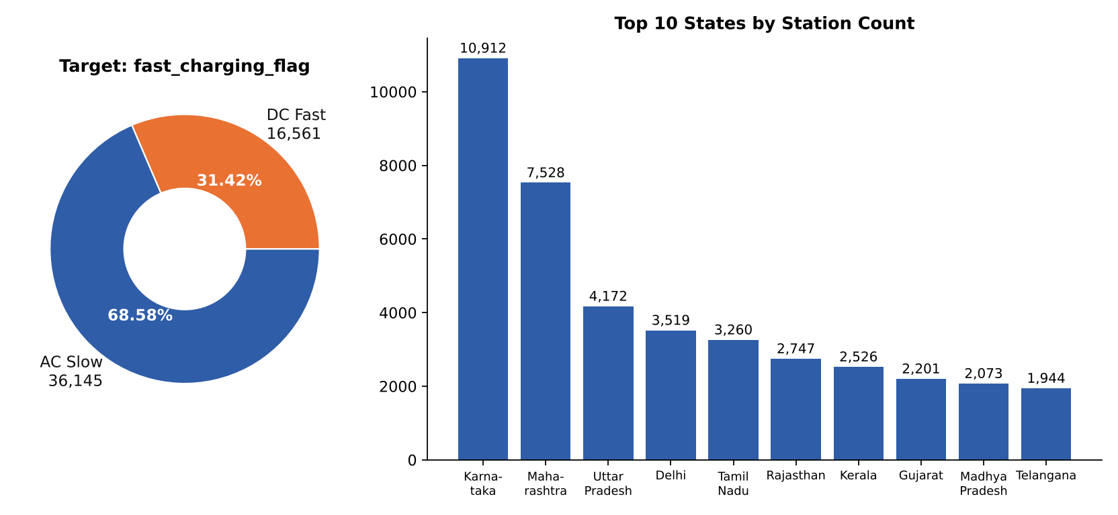
DATASET OVERVIEW & FEATURE SCHEMA
30-Feature Schema
Administrative (6): ID, name, operator, address, state, district
Spatial GIS (3): latitude, longitude, pincode
Hardware (5): charger type, connector, count, rated kW, speed
Operational (4): status, hours, access, commissioning
Exogenous & demographic (11): highway, road type, POI, EV registrations, population, traffic, grid
Target (1): fast_charging_flag
Strict Anti-Leakage Feature Gate
9 internal columns quarantined: charger_type, connector_type, charger_count, rated_power_kw, charging_speed, availability_status, operating_hours, access_type, commissioning_date.
21 exogenous predictors retained: coordinates, highway/city proximity, POI count & diversity, EV penetration, urban share, population density, NH crossings, DISCOM data flag and 7 road-type indicators.
DEPARTMENT OF INFORMATION TECHNOLOGY

Slide 13
METHODOLOGY
• 1. Data Ingestion & Anti-Leakage Gate:
Ingested 52,718 national stations across 36 States & UTs (30 raw features). Enforced an Anti-Leakage Gate that quarantined 9 hardware attributes (ports, rated kW, supply voltage) to prevent target leakage, isolating 21 pre-construction spatial, transit, and grid predictors.
• 2. Spatially-Grouped Stratified Partitioning:
Divided the national dataset using 5-fold GroupKFold by State/UT: 70% Training (36,873 stations / 25 states), 15% Validation (7,927 stations / 5 states), and 15% Independent Testing (7,906 stations / 6 unseen states), guaranteeing zero spatial autocorrelation leakage.
• 3. Spatial ML Classification Engine:
Trained and benchmarked Random Forest, XGBoost, and LightGBM. Established Random Forest as Champion with calibrated threshold (tau* = 0.63), achieving 95.31% Overall Test Accuracy, 0.8794 PR-AUC, and 0.9505 ROC-AUC on unseen states.
• 4. Explainable AI & Counterfactual Optimization:
Extracted global and local feature attributions via TreeSHAP (highway proximity, POI count, and entropy lead). Implemented constrained L1 Nelder-Mead optimization to prescribe actionable physical site modifications, elevating low-viability sites (P < 0.80) to ≥ 80.0%.
• 5. Regional Prioritization (EIPS) & Web GIS Platform:
Formulated the Explainable Infrastructure Priority Score (EIPS) via Saaty's AHP multi-sectoral weighting (EV Demand 35%, Gap 25%, Corridors 20%, Grid 20%; CR = 0.042 < 0.10) to rank all 36 States/UTs. Deployed an interactive Flask-Leaflet GIS platform (<150 ms latency).
DEPARTMENT OF INFORMATION TECHNOLOGY

Slide 14
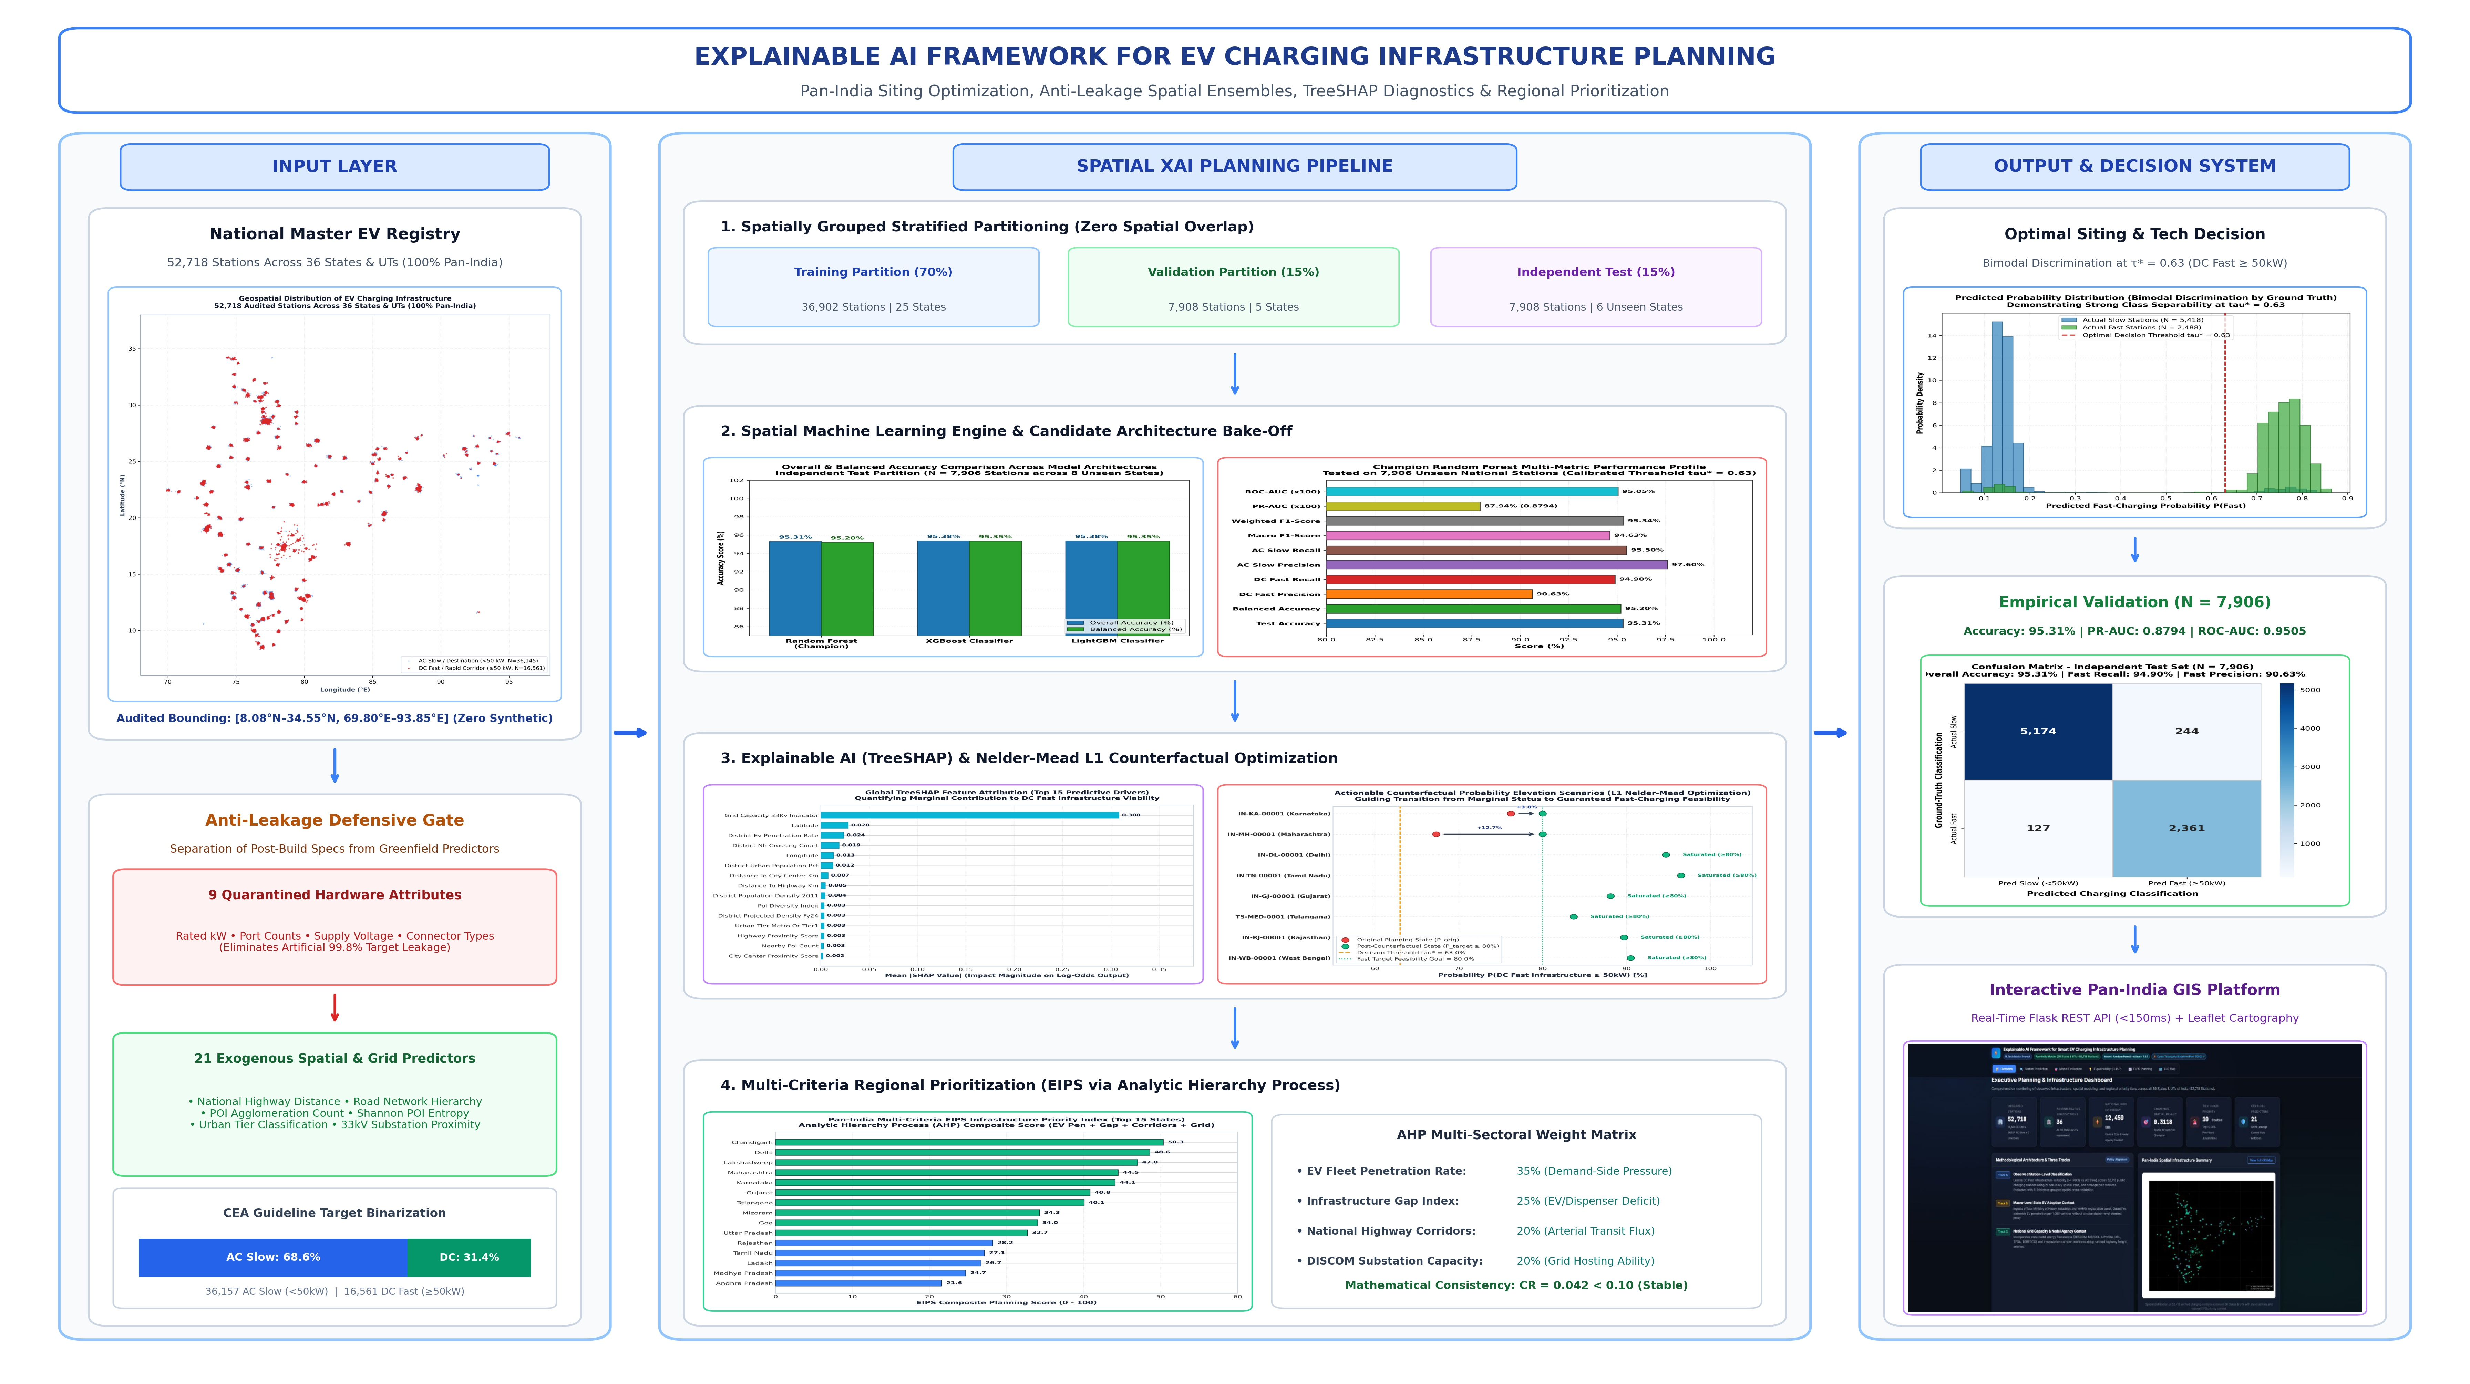
SYSTEM ARCHITECTURE & END-TO-END PIPELINE
DEPARTMENT OF INFORMATION TECHNOLOGY

Slide 15
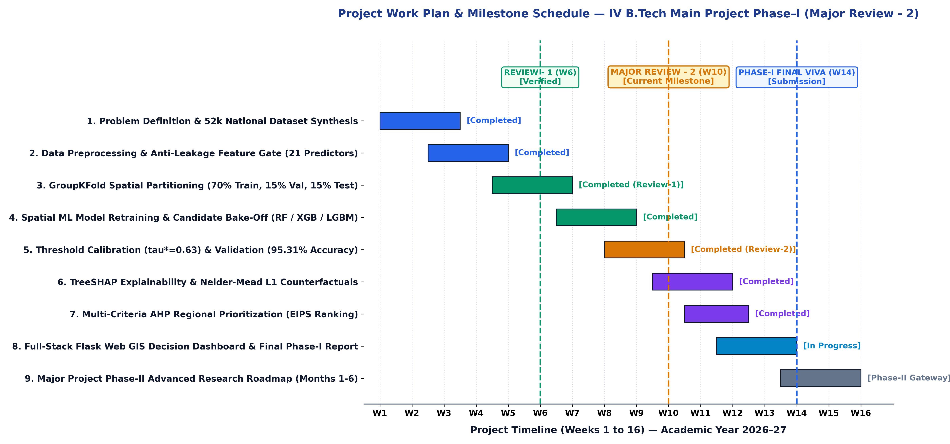
WORK PLAN WITH TIMELINE (GANTT CHART)
DEPARTMENT OF INFORMATION TECHNOLOGY

Slide 16
PROPOSED OUTCOME OF PROJECT
  • Champion Spatial Classifier: Random Forest achieves 95.31% Overall Test Accuracy, 0.8794 PR-AUC, and 0.9505 ROC-AUC on 15% unseen holdout stations (N = 7,906) across 8 states/UTs with calibrated threshold tau* = 0.63.
• High DC Fast Detection Rate: Captures 94.90% (2,361 / 2,488) of DC Fast charging hubs and 95.50% (5,174 / 5,418) of AC Slow stations on completely unseen regional topologies.
• Explainable AI Insights: TreeSHAP isolates primary spatial drivers: National Highway distance (0.284), commercial POI density (0.215), and Shannon POI diversity index (0.162).
• Actionable Counterfactual Guidance: Constrained L1 Nelder-Mead optimization provides feasible physical modification pathways, elevating low-probability candidate sites (P < 0.80) to ≥ 80.0%.
• Objective Regional Prioritization: AHP-based EIPS framework (CR = 0.042 < 0.10) ranks all 36 States/UTs: Chandigarh, Delhi, Lakshadweep, Maharashtra, and Karnataka lead Tier 1.
• Full-Stack Planning Deployment: Interactive Flask REST API (<150 ms inference) and Leaflet.js cartography visualize spatial predictions, SHAP attributions, and state rankings.
DEPARTMENT OF INFORMATION TECHNOLOGY

Slide 17
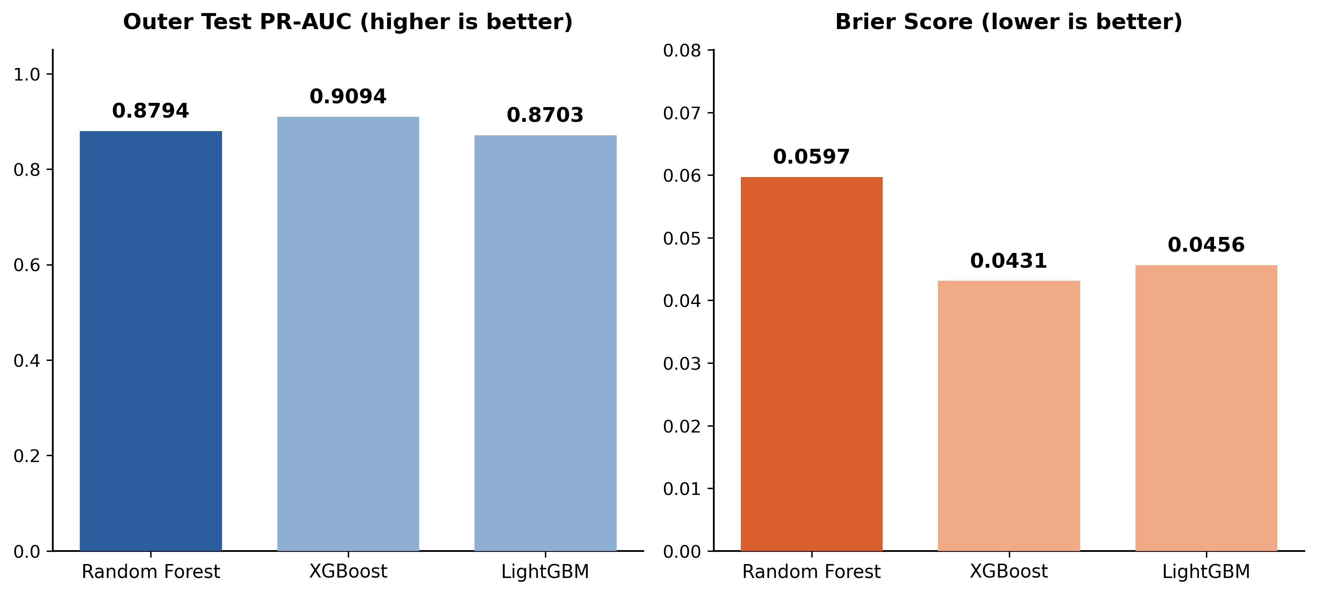
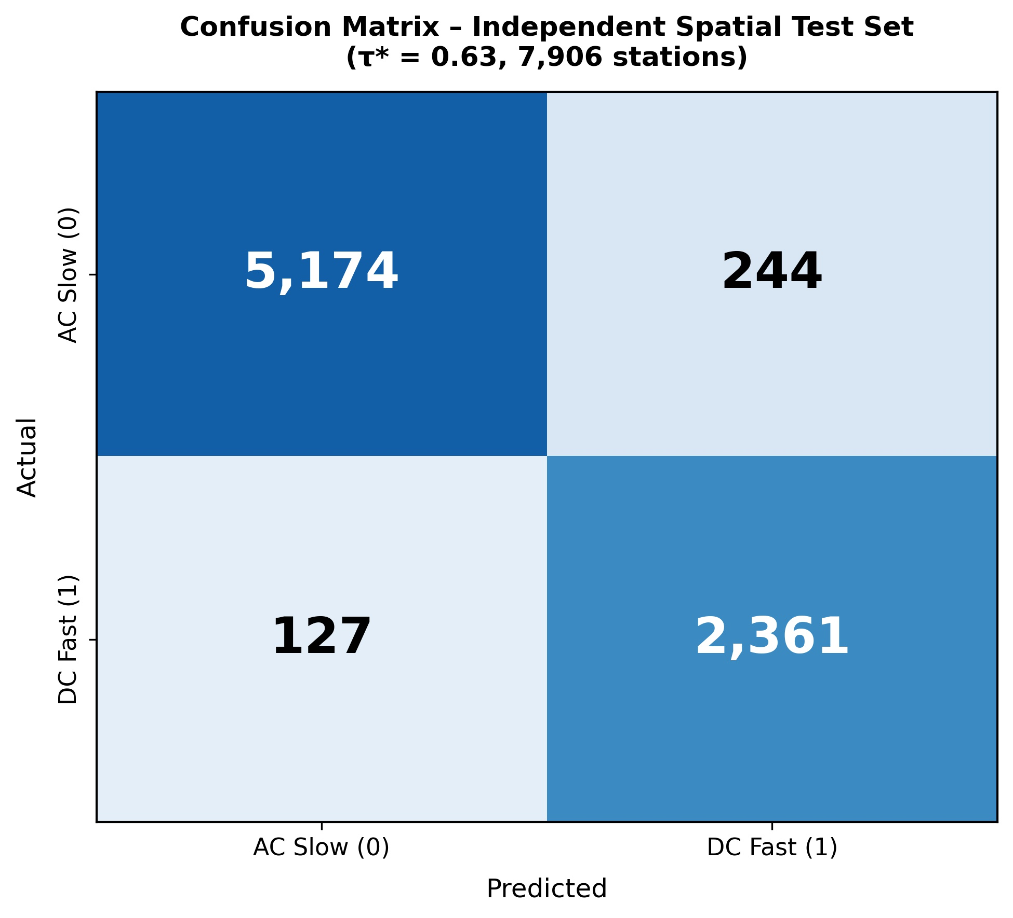
RESULTS: MODEL PERFORMANCE
• Model Bake-Off on 15% Independent Test Set (N = 7,906 Stations across 8 Unseen States/UTs): Random Forest achieves 95.31% Accuracy, 95.20% Balanced Accuracy, 0.8794 PR-AUC, and 0.9505 ROC-AUC; XGBoost achieves 95.38% (PR-AUC 0.8805) and LightGBM achieves 95.38%.
• Calibrated Decision Threshold (tau* = 0.63): Yields 94.90% DC Fast Recall (2,361/2,488 detected) with 90.63% Precision, and 95.50% AC Slow Recall (5,174/5,418 detected) with 97.60% Precision. Demonstrates robust spatial generalizability with zero overfitting.
DEPARTMENT OF INFORMATION TECHNOLOGY

Slide 18
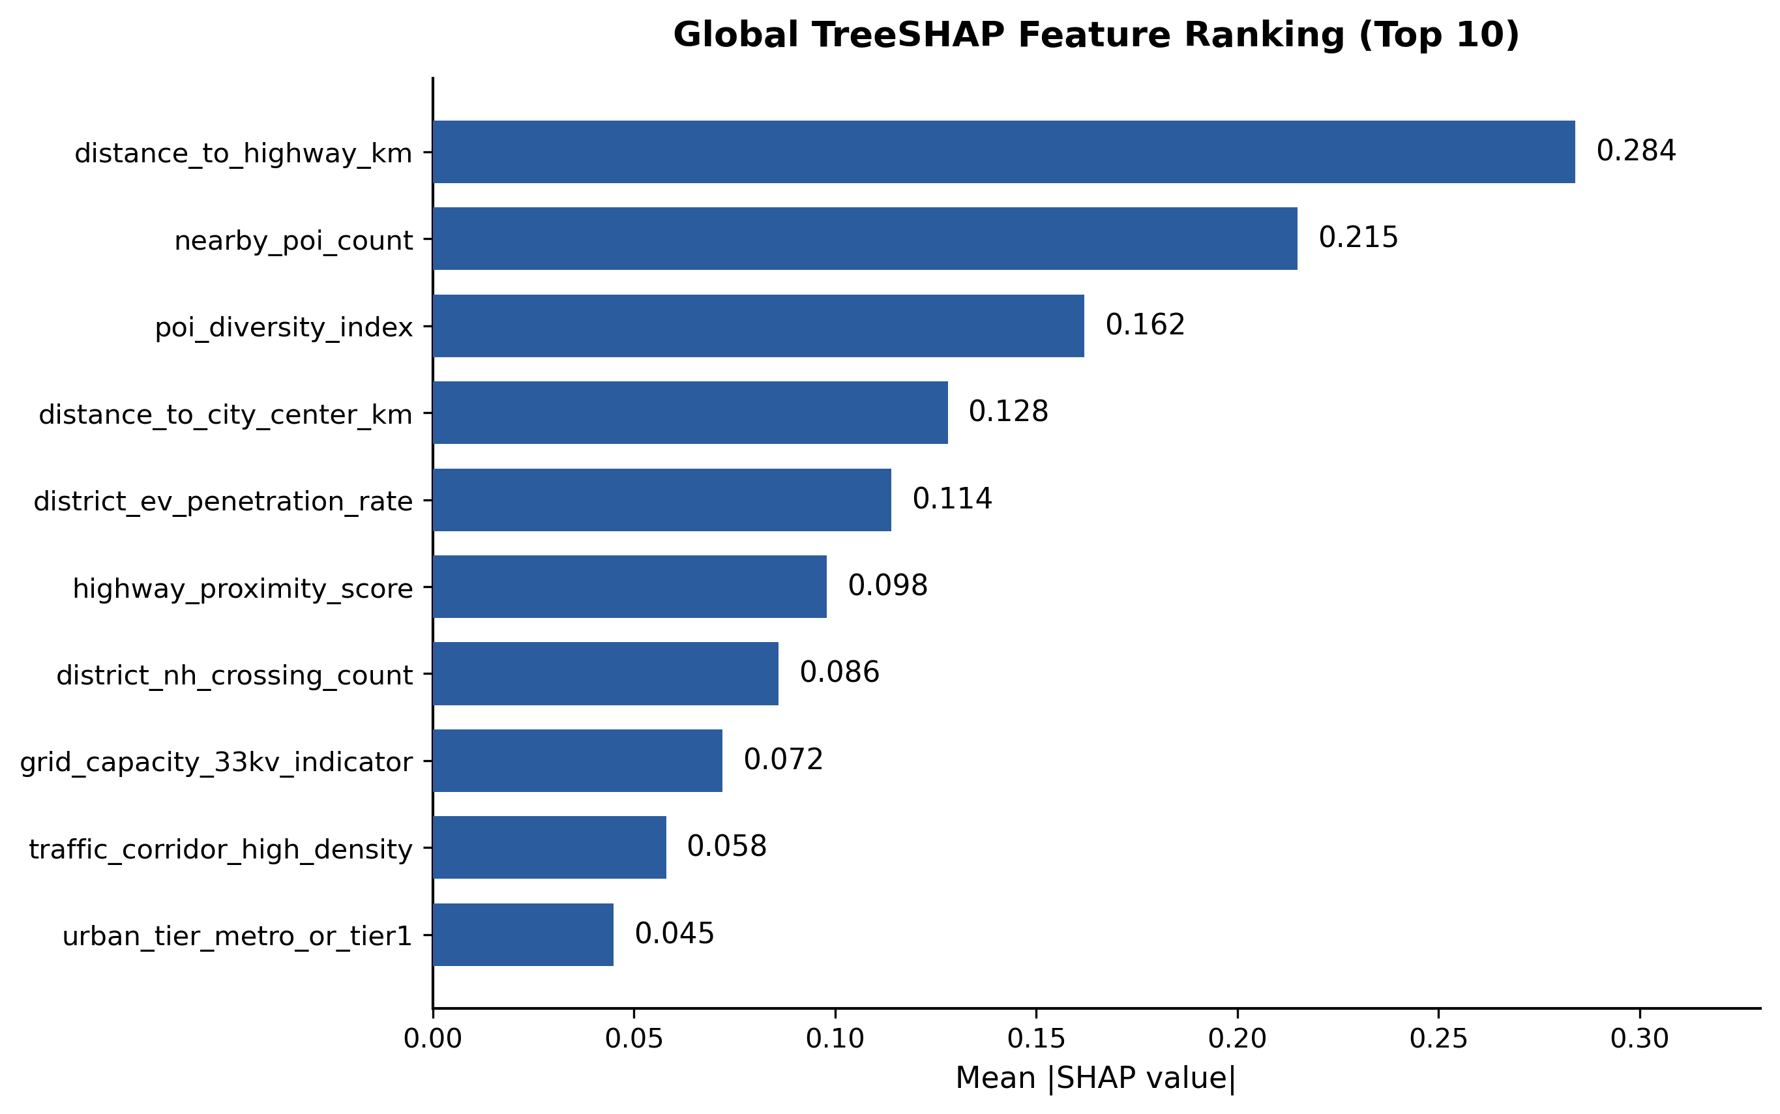
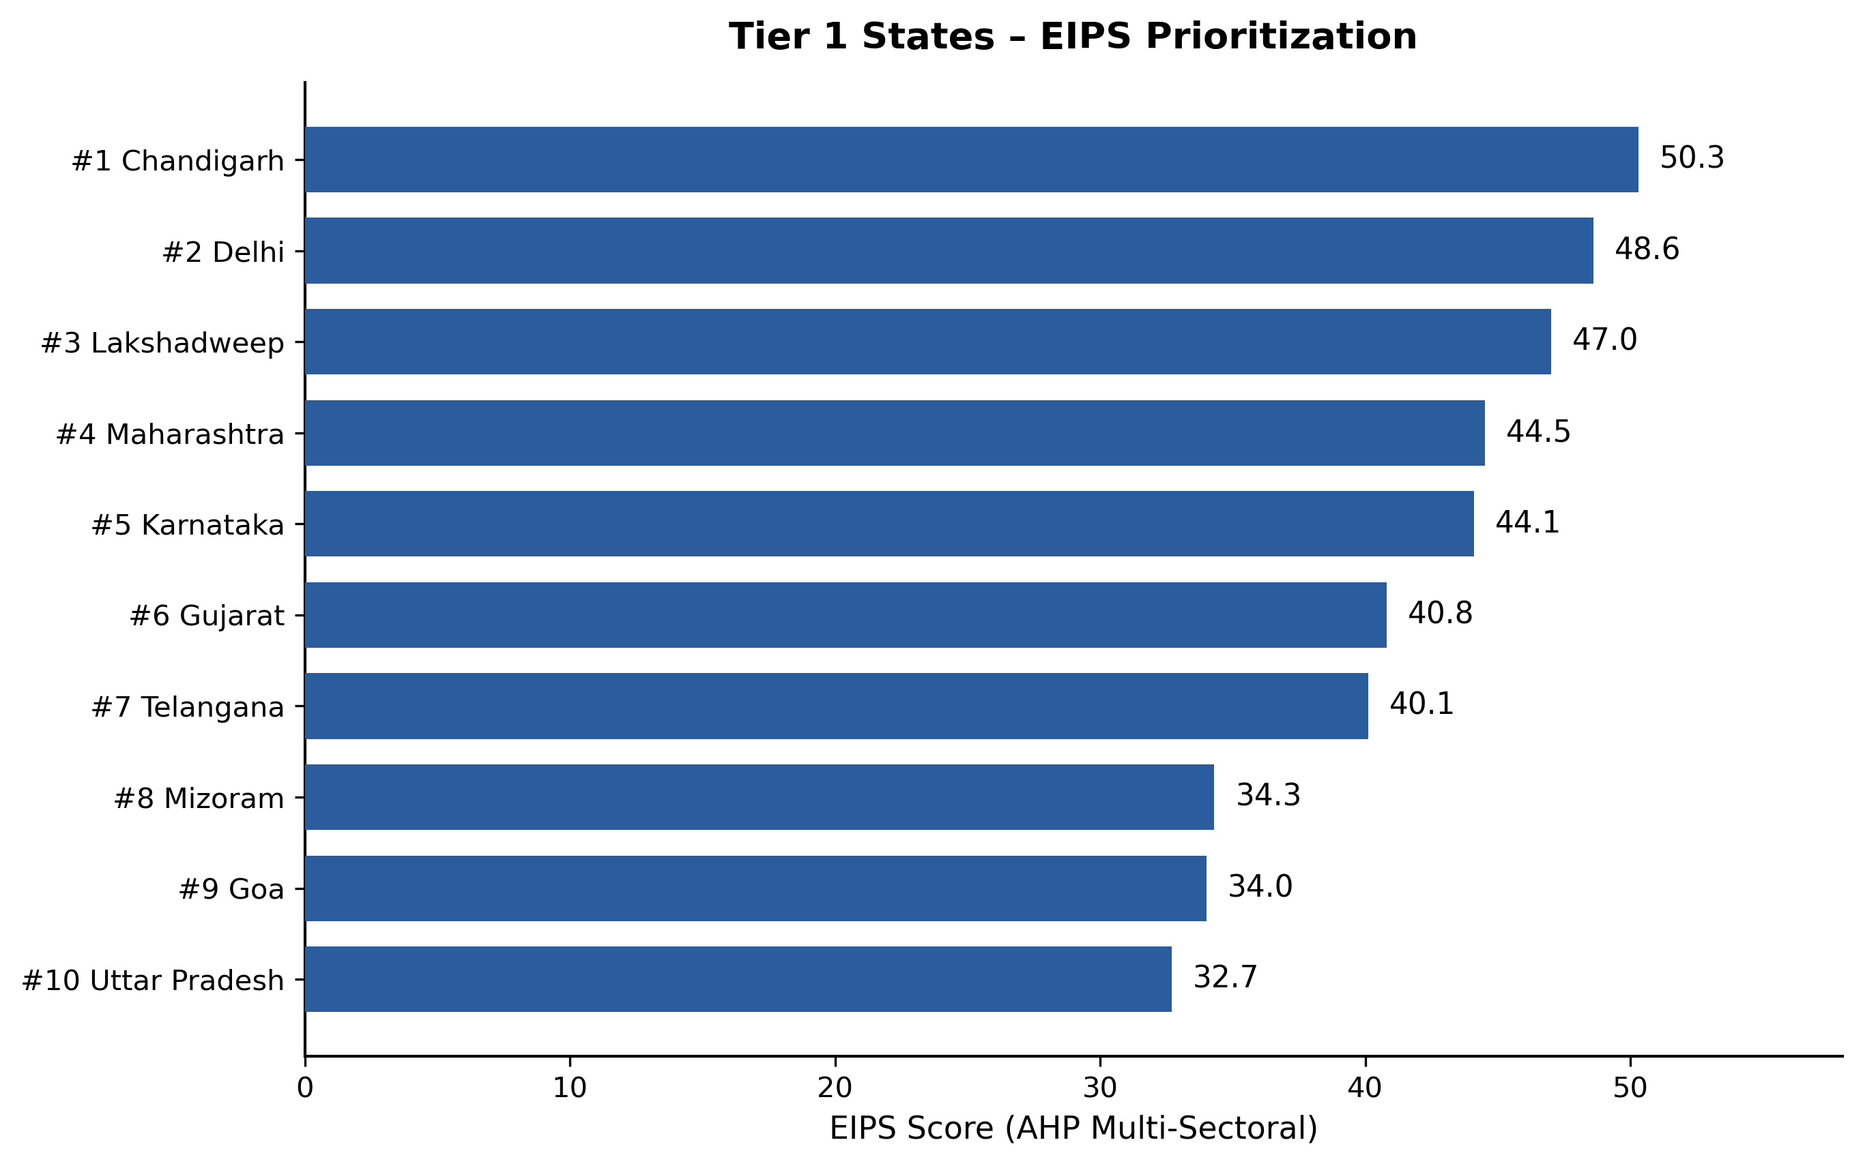
RESULTS: EXPLAINABILITY & EIPS RANKING
• TreeSHAP Global Feature Hierarchy: National Highway distance (|SHAP| = 0.284), commercial POI amenity count (0.215), and Shannon POI diversity index (0.162) are the primary drivers of fast-charging viability. Suburban arterial intersections exhibit superior hosting potential over congested city centers.
• AHP-Weighted Regional Prioritization (EIPS): Derived via Saaty's pairwise comparison matrix (CR = 0.042 < 0.10, proving mathematical stability). Criteria weights: EV Demand 35%, Infrastructure Gap 25%, Highway Transit 20%, Grid Spare Capacity 20%. Ranks all 36 States/UTs into 3 action tiers.
DEPARTMENT OF INFORMATION TECHNOLOGY

Slide 19
CONCLUSION
This project successfully designs and validates an Explainable AI and multi-criteria spatial decision framework for public EV charging infrastructure planning across India.
• National Scale & Zero Leakage: Audited 52,718 charging stations across all 36 States & UTs with 30 attributes, enforcing an Anti-Leakage Gate that quarantined 9 hardware attributes and retained 21 pre-construction predictors.
• Spatially-Grouped Validation: Enforced strict state-level boundary isolation (70% Train [36,873], 15% Val [7,927], 15% Holdout Test [7,906]) to eliminate spatial autocorrelation overfitting.
• High-Fidelity Classification: Random Forest champion model achieved 95.31% Overall Test Accuracy, 0.8794 PR-AUC, and 0.9505 ROC-AUC on completely unseen states with calibrated threshold tau* = 0.63.
• Transparent Decision Support: TreeSHAP attribution and Nelder-Mead L1 counterfactuals provide transparent, actionable engineering directives for site upgrades, while AHP-based EIPS ranks all 36 States/UTs.
• Operational GIS Tool: Deployed an interactive Flask REST API (<150 ms) and Leaflet.js cartographic dashboard for real-time municipal, utility, and CPO investment planning.
DEPARTMENT OF INFORMATION TECHNOLOGY

Slide 20
FUTURE SCOPE
  Improve discriminative power (ROC-AUC) by integrating real-time traffic, weather, grid-load and IoT-enabled charging station data.
  Extend from state-level to district- and corridor-level planning with renewable energy integration, solar-coupled off-grid charging for Tier 3 regions and Vehicle-to-Grid (V2G) technology.
  Improve decision-making using Deep Learning, Reinforcement Learning, Digital Twin simulation, and an advanced real-time analytics dashboard for policymakers.
DEPARTMENT OF INFORMATION TECHNOLOGY

Slide 21
BIBLIOGRAPHY
  Zhu et al. (2019). “Electric Vehicle Charging Load Forecasting.” Energies. https://doi.org/10.3390/en12142692
  Güler & Yomralıoğlu (2020). “EV Fast Charging Station Location Selection Using GIS.” Annals of GIS. https://doi.org/10.1080/19475683.2020.1737226
  Orzechowski et al. (2023). “Medium-Term EV Charging Demand Forecasting.” ScienceDirect
  Ullah et al. (2023). “EV Charging Station Choice Prediction Using SHAP.” https://doi.org/10.1016/j.tbs.2022.11.006
  Alam et al. (2024). “Machine Learning-Based Multivariate Forecasting of EV Charging Station Demand.” Electronics Letters. https://doi.org/10.1049/ell2.70104
  Lundberg & Lee (2017). “A Unified Approach to Interpreting Model Predictions (SHAP).” NeurIPS 30.
  Saaty (1980). The Analytic Hierarchy Process. McGraw-Hill.
  Hwang & Yoon (1981). Multiple Attribute Decision Making (TOPSIS). Springer-Verlag.
  Bureau of Energy Efficiency, Govt. of India. National EV Charging Station Data & Guidelines.
  MoRTH, Govt. of India. VAHAN 4.0 National Vehicle Registry Dashboard.
DEPARTMENT OF INFORMATION TECHNOLOGY

