Slide 1

TWITTER DATABASE
PREPARED BY
KULASEKHAR REDDY NARPALA
INDRAJA REDDY
JALLA MAMATHA
SAI AKASH
AVINASH

Slide 2
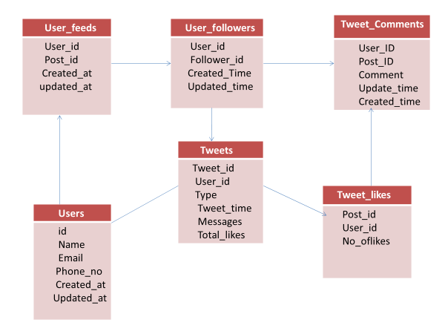
TWITTER SCHEMA

Slide 3
E-R DIAGRAM OF TWITTER

Slide 4
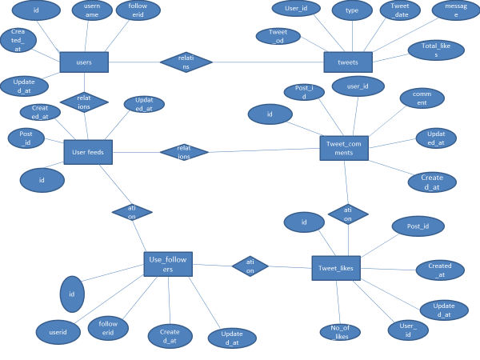

Slide 5
CREATING DATABASE
CREATING DATABASE
COMMNAD
CREATE DATBASE TWITTERDB;
USING DATABASE
COMMAND
USE TWITTERDB;

Slide 6
CREATING TABLES
CREATING USERS TABLE
CREATING USER_FOLLOWERS TABLE
CREATING TWEETS TABLE
CREATING USERFEEDS TABLE
CREATING COMMENT TABLE
CREATING TWEET_LIKES TABLE

Slide 7
INSERTING DATA
DATA INSERTED SUCCESSFULLY FOR ALL TABLES

Slide 8
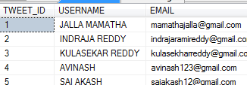
QUERIES
QUERIES FROM SAI AKASH
/*WRITE A QUERY TO SELECT TWEET ID,USERNAME,EMAIL,BY USING FULL JOIN*/
SELECT T.TWEET_ID,U.USERNAME,U.EMAIL FROM TWEETS T FULL JOIN USERS U ON T.USER_ID=U.ID;

Slide 9

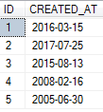
/*WRITE A QUERY TO SELECT TWEET ID AND TYPE EXCEPT TWEET_ID IS 1*/
SELECT TWEET_ID,TYPE FROM TWEETS EXCEPT SELECT TWEET_ID,TYPE FROM TWEETS WHERE TWEET_ID=1;
/*WRITE A QUERY TO SELECT USER FEEDID,CREATE DATE WHERE NO OF LIKES GREATER THAN 300 */
SELECT UF.ID,UF.CREATED_AT FROM USERFEEDS UF WHERE UF.ID IN(SELECT TL.ID FROM TWEET_LIKES TL WHERE NO_OF_LIKES>=300);

Slide 10
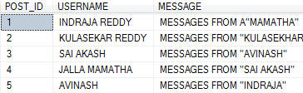
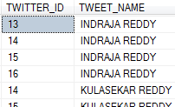
/*WRITE A QUERY TO SELECT POSTID,USERNAME,MESSAGE USING WHERE CLAUSE*/
SELECT TL.POST_ID,U.USERNAME,T.MESSAGE FROM TWEET_LIKES TL,USERS U,TWEETS T WHERE TL.ID=U.ID AND U.ID=T.TWEET_ID;
/*WRITE A QUERY TO SELECT FOLLOWERID AS TWITTERID AND USERNAME AS TWEET_NAME USING ALIAS*/
SELECT FOLLOWERID AS TWITTER_ID,USERNAME AS TWEET_NAME FROM USER_FOLLOWERS UF,USERS U WHERE UF.ID>
(SELECT U.ID FROM TWEET_LIKES WHERE UPDATED_AT='2016-06-12');

Slide 11

QUERIES FROM MAMATHA
/*1.WRITE A QUERY TO DISPLAY TWEETS POSTED BY USER AND TYPE NAME END WITH S*/
SELECT * FROM TWEETS T WHERE USER_ID=1 AND TYPE LIKE'%S' ORDER BY TWEET_DATE DESC;
/*2.WRITE A QUERY TO DISPLAY TWEETS OF THE FOLLOWERS NEED TO BE ACCESSED USING A JOIN */
SELECT T.USER_ID,T.TOTAL_LIKES,F.FOLLOWERID FROM TWEETS T JOIN USER_FOLLOWERS F
ON (USER_ID = ID) WHERE FOLLOWERID =15 ORDER BY TWEET_ID DESC;

Slide 12
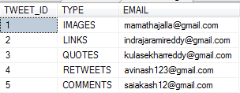
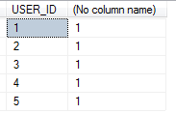
/*3.WRITE A QUERY TO DISPLAY TWEETS_ID,TYPE ,EMAIL FROM USERS AND TWEETS TABLE USING WHERE CLUASE*/
SELECT T.TWEET_ID,T.TYPE,U.EMAIL
FROM TWEETS T,USERS U
WHERE T.USER_ID = U.ID;
/*4.WRITE A QUERY DISPLAY TO USERID AND NO.OF USERID FROM TWEETS TABLE USING GROUP BY AND HAVING */
SELECT USER_ID,COUNT(USER_ID) FROM TWEETS
GROUP BY USER_ID
HAVING COUNT(USER_ID)>=1;

Slide 13
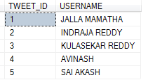
/*5.WRITE A QUERY DISPLAY TWEET_ID,USERNAME FROM TWO TABLES USING INNER JOIN*/
SELECT TWEETS.TWEET_ID,USERS.USERNAME
FROM USERS INNER JOIN TWEETS ON USERS.ID = TWEETS.USER_ID;

Slide 14
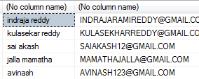
QUERIES FROM INDRAJA
/*2.WRITE A QUERY TO DISPLAY USERNAME AND EMAIL BY USING SINGLE ROW FUNCTIONS */
SELECT LOWER(USERNAME),UPPER(EMAIL) FROM USERS;
/*1.WRITE A QUERY TO SELECT USERID IS GREATER THAN EQUAL TO 1 AND TWEET_ID IS LESS THAN EQUAL TO 2*/
SELECT USENAME U,U.ID FROM USERS U WHERE ID>=1
UNION ALL
SELECT T.TWEET_ID FROM TWEETS T WHERE TWEET_ID<=2;

Slide 15

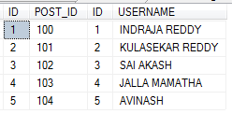
/*3.WRITE A QUERY TO DISPLAY THE POST_ID IF THEY ARE CREATED INT THE YEAR 2016 */
SELECT POST_ID,CREATED_AT FROM USERFEEDS WHERE CREATED_AT LIKE'%16';
/*4.WRITE A QUERY TO DISPLAY POSTID AND USER NAME FROM TWO TABLES USING INNER JOIN */
SELECT UF.ID,UF.POST_ID,U.ID,U.USERNAME FROM USERFEEDS UF INNER JOIN USERS U ON UF.ID=U.ID;

Slide 16
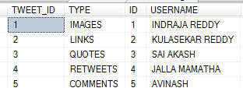
/*5.WRITE A QUERY TO DISPLAY POSTID AND USER NAME FROM TWO TABLES USING INNER JOIN */
SELECT UF.ID,UF.POST_ID,U.ID,U.USERNAME FROM USERFEEDS UF INNER JOIN USERS U ON UF.ID=U.ID;

Slide 17


QUERIES FROM KULASEKHAR
/*WAQ TO SELECT THE DETAIL OF THE USERNAME WHOSE NAME*/
SELECT * FROM USERS WHERE USERNAME LIKE '%E__%';
/*WAQ TO SELECT TWEETS OF THE USERS WHOSE TOTAL LIKES BETWEEN 3000 AND 4000*/
SELECT * FROM TWEETS WHERE TOTAL_LIKES BETWEEN 3000 AND 4000;

Slide 18


/*WAQ TO DISPLAY ID,MESSAGE FROM USER FOLLOWERS USING INNER JOIN AND TOTAL LIKES IN 3429,3472 */
SELECT DISTINCT UF.ID,T.MESSAGE FROM USER_FOLLOWERS UF INNER JOIN TWEETS T
ON UF.ID=T.TWEET_ID AND T.TOTAL_LIKES IN(3429,3472);
/*WAQ TO DISPLAY TOP 3 NO_OF_LIKES FROM TWEET_LIKES*/
SELECT TOP 3 * FROM TWEET_LIKES ORDER BY NO_OF_LIKES;

Slide 19
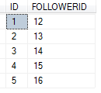
/*WAQ TO SELECT ID,FOLLOWERID FROM USERFOLLOWERS USING SUBQUERY AND TOTAL LIKES IS GREATER THAN 3000 */
SELECT UF.ID,UF.FOLLOWERID FROM USER_FOLLOWERS UF WHERE UF.ID IN(SELECT T.TWEET_ID FROM TWEETS T WHERE TOTAL_LIKES>=3000);

Slide 20
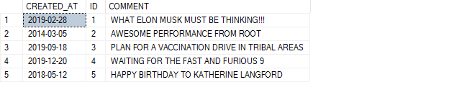
QUERIES FROM AVINASH
WRITE A QUERY TO FETCH UNIQUE VALUES OF COMMENTS TABLE
SELECT DISTINCT CREATED_AT,ID, COMMENT FROM COMMENTS;

Slide 21
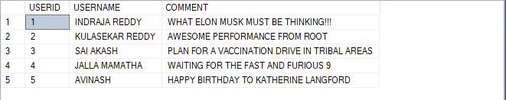
WAQ TO SELECT USERID,USERNAME AND COMMENT FROM THE USERS BY USING WHERE CLAUSE
SELECT U.ID AS USERID,U.USERNAME,C.COMMENT FROM USERS U,COMMENTS C WHERE U.ID=C.ID;

Slide 22
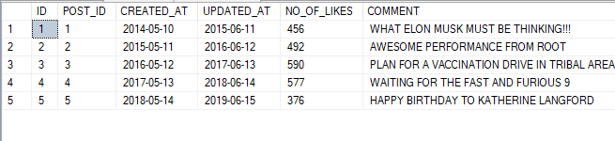
WRITE A QUERY TO DISPLAY NO LIKES OF FOR COMMNETS BY USING RIGHT JOIN
SELECT TWEET_LIKES.ID,TWEET_LIKES.POST_ID,TWEET_LIKES.CREATED_AT,TWEET_LIKES.UPDATED_AT,TWEET_LIKES.NO_OF_LIKES,COMMENTS.COMMENT FROM TWEET_LIKES RIGHT JOIN COMMENTS
ON TWEET_LIKES.ID=COMMENTS.ID;

Slide 23

WRITE A QUERY TO DISPLAY WHOSE COMMENT STARTS WITH LETTER W
SELECT *FROM COMMENTS
WHERE COMMENT LIKE 'W%';

Slide 24

WAQ TO DISPLAY THE SUM,AVG AND MAX NO LIKES
SELECT SUM(NO_OF_LIKES) AS SUM_LIKES,AVG(NO_OF_LIKES) AS AVG_LIKES,
MAX(NO_OF_LIKES)AS MAX_LIKES FROM TWEET_LIKES;

Slide 25

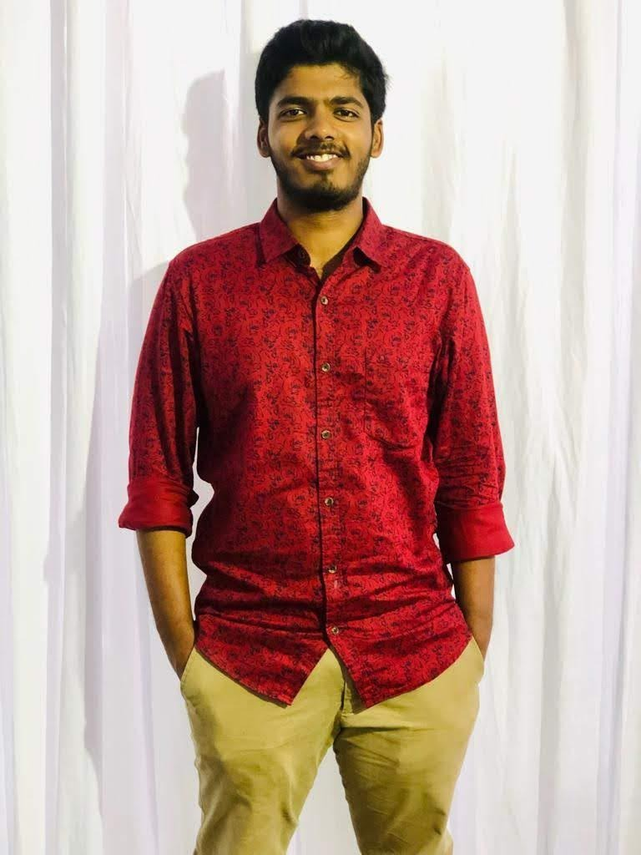

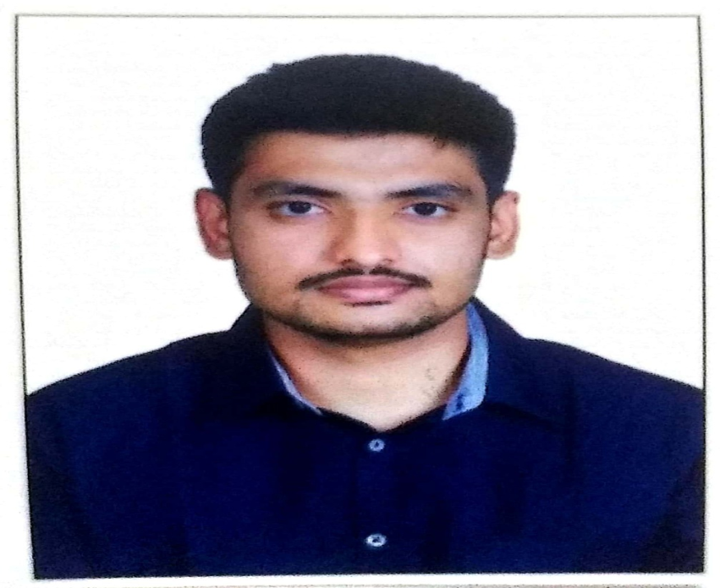
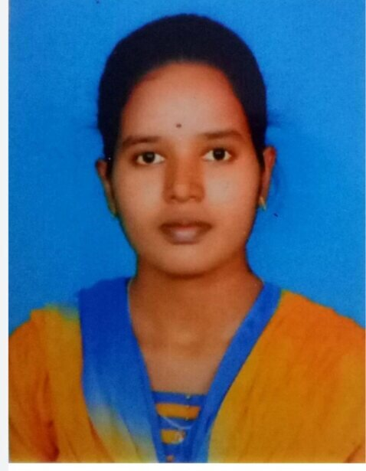
KULASEKHAR REDDY
ASSOCIATE ENG. VIRTUSA
SAI AKASH
ASSOCIATE ENG.
VIRTUSA
INDRAJA REDDY
ASSOCIATE ENG.
VIRTUSA
A
V
I
N
A
S
H
ASSOCIATE ENG.
VIRTUSA
M
A
M
A
T
H
A
ASSOCIATE ENG.
VIRTUSA
OUR TEAM

Slide 26
THANK YOU

