Slide 1
User_feeds
User_id Post_id Created_at updated_at
User_followers
User_id Follower_id Created_Time Updated_time
Tweet_Comments
User_ID Post_ID Comment Update_time Created_time
Tweets
Tweet_id User_id Type Tweet_time Messages Total_likes
Tweet_likes
Post_id User_id No_oflikes
Users
id Name Email Phone_no Created_at Updated_at

Slide 3
CREATE DATABASE TWITTER;
USE TWITTER;
CREATE TABLE TWEET_LIKES
(
ID INT PRIMARY KEY,
POST_ID INT,
USER_ID INT,
CREATED_AT DATE,
UPDATED_AT DATE,
NO_OF_LIKES INT,
);

Slide 4
INSERT INTO TWEET_LIKES VALUES(1,001,1000,'2014-05-10','2015-06-11',456);
INSERT INTO TWEET_LIKES VALUES(2,002,1001,'2015-05-11','2016-06-12',492);
INSERT INTO TWEET_LIKES VALUES(3,003,1002,'2016-05-12','2017-06-13',590);
INSERT INTO TWEET_LIKES VALUES(4,004,1003,'2017-05-13','2018-06-14',577);
INSERT INTO TWEET_LIKES VALUES(5,005,1004,'2018-05-14','2019-06-15',376);

Slide 5


Slide 6
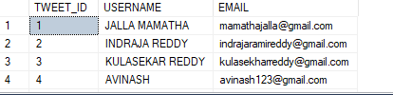
QUERIES NO 1: //TO SELECT TWEET ID ,USERNAME, EMAIL ,BY USING FULL JOIN// SELECT T.TWEET_ID,U.USERNAME ,U.EMAIL FROM TWEETS T FULL JOIN USERS1 U ON T.USER_ID= U.ID;

Slide 7
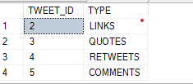
QUERY NO:2 //WAQ TO SELECT TWEET ID AND TYPE EXCEPT TWEET_ID IS 1 // SELECT TWEET_ID,TYPE FROM TWEETS EXCEPT SELECT TWEET_ID,TYPE FROM TWEETS WHERE TWEET_ID=1; OUTPUT:

Slide 8

QUERY NO:03 //WAQ TO SELECT USER FEEDID,CREATE DATE, WHERE NO OF LIKES GREATER THAN 300//
SELECT UF.ID,UF.CREATED_AT
FROM USERFEEDS1 UF
WHERE UF.ID IN(SELECT TL.ID FROM TWEET_LIKES TL WHERE NO_OF_LIKES>=300);
OUTPUT:

Slide 9

Query no:04 //query to find the postid ,username,message// SELECT TL.POST_ID,U.USERNAME,T.MESSAGE FROM TWEET_LIKES ,USERFEEDS1 ,USERS1 WHERE TL.ID=U.ID AND U.ID=T.TWEET_ID; output:

Slide 10
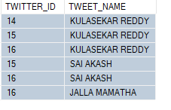
Queries no:05 //WAQ TO DISPLAY THE TWITTERID AND TWEETNAME AFTER 2016//
select FOLLOWERID AS TWITTER_ID,USERNAME AS TWEET_NAME
FROM USER_FOLLOWERS UF, USERS1 U
WHERE UF.ID >(SELECT U.ID
FROM TWEET_LIKES
WHERE UPDATED_AT = ' 2016-06-12 ') ;
Output:

