Slide 1
Hypothesis Testing Exercise
A F&B manager wants to determine whether there is any significant difference in the diameter of the cutlet between two units. A randomly selected sample of cutlets was collected from both units and measured? Analyze the data and draw inferences at 5% significance level. Please state the assumptions and tests that you carried out to check validity of the assumptions.
Minitab File : Cutlets.mtw

Slide 2
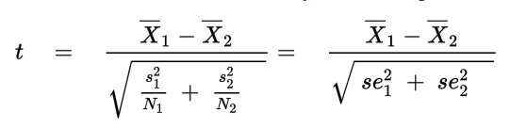
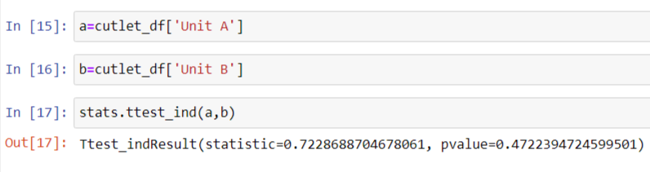
Identifying null and alternate Hypothesis:
H0 → There is no significant difference between the diameters of μ₁ and μ₂
Ha → There is a significant difference between the diameters of μ₁ and μ₂
The above data given has 2 samples with unequal variance so we use →
Conclusion : As the p value → 0.47 >0.05 so we accept the Null Hypothesis i.e.
→ There is no significant difference between the diameters of 2 units of cutlets samples

Slide 3
Hypothesis Testing Exercise
A hospital wants to determine whether there is any difference in the average Turn Around Time (TAT) of reports of the laboratories on their preferred list. They collected a random sample and recorded TAT for reports of 4 laboratories. TAT is defined as sample collected to report dispatch.
Analyze the data and determine whether there is any difference in average TAT among the different laboratories at 5% significance level.
Minitab File: LabTAT.mtw

Slide 4
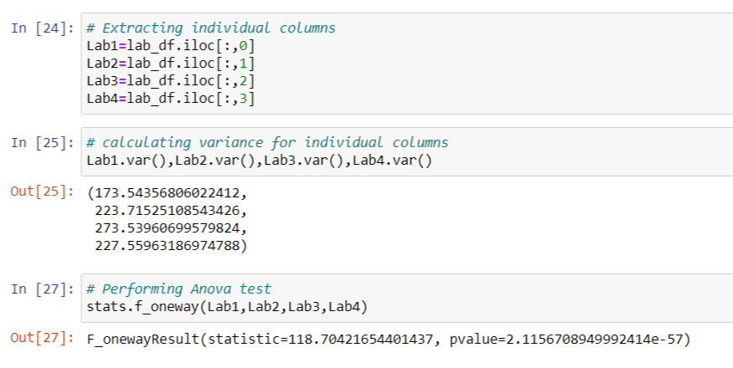
Identifying null and alternate hypothesis:
H₀=There is no significant difference between 4 laboratories Turn around time(TAT)
H_{a}=There is significant difference between 4 laboratories Turn around time(TAT). At least one laboratory TAT ≠ other laboratories
F test=
P- value < 0.05 → We reject null hypothesis
Conclusion:
There is significant difference between 4 laboratories TAT

Slide 5
Hypothesis Testing Exercise
Sales of products in four different regions is tabulated for males and females. Find if male-female buyer rations are similar across regions.
 | East | West | North | South
Males | 50 | 142 | 131 | 70
Females | 550 | 351 | 480 | 350
Check p-value
If p-Value < alpha, we reject Null Hypothesis
H0
All proportions are equal
Ha
Not all Proportions are equal
Buyer Ratio.mtw

Slide 6
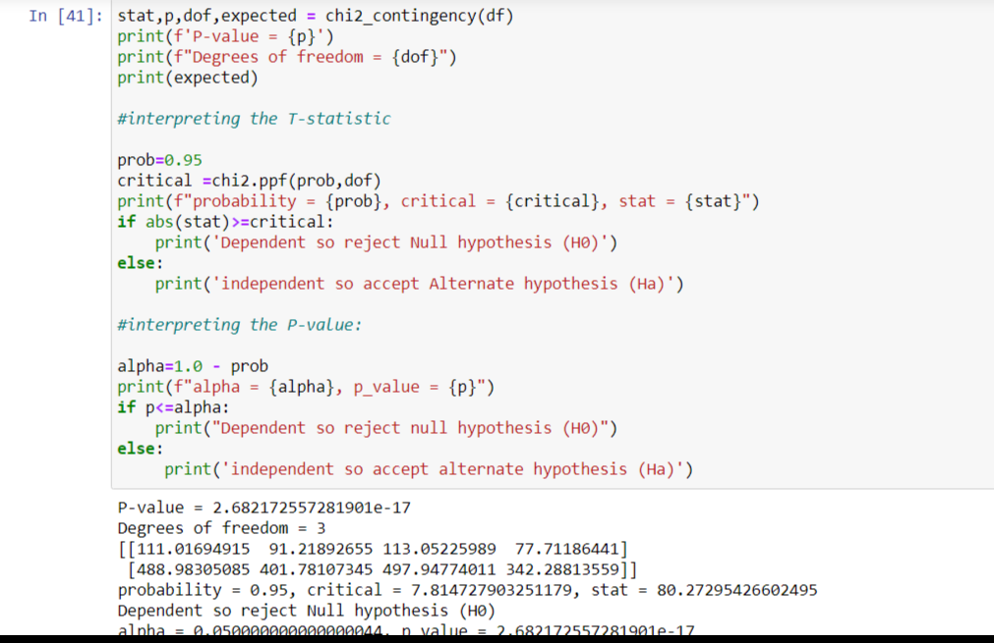
H₀=All proportions are equal /There is no significant difference between the proportions
H_{a}=All proportions are not equal/There is significant difference between the proportions
We use Chi Square test→
X²=Σ(observed-expected)²
Expected
As P value <0.05 → We reject null hypothesis → All proportions are not equal

Slide 7
Hypothesis Testing Exercise
TeleCall uses 4 centers around the globe to process customer order forms. They audit a certain % of the customer order forms. Any error in order form renders it defective and has to be reworked before processing. The manager wants to check whether the defective % varies by centre. Please analyze the data at 5% significance level and help the manager draw appropriate inferences
Minitab File: CustomerOrderForm.mtw
Fantaloons Sales managers commented that % of males versus females walking in to the store differ based on day of the week. Analyze the data and determine whether there is evidence at 5 % significance level to support this hypothesis.
Minitab File: Fantaloons.mtw

Slide 8
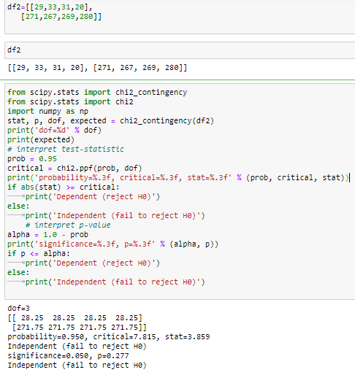
H₀=All Centre’s defective percentages are equal
H_{a}=All Centre’s defective percentages are not equal
Given Alpha value is 5% so
Conclusion: Since P value is greater than 0.05 and conclude that all centers defectives
Are equal

Slide 9
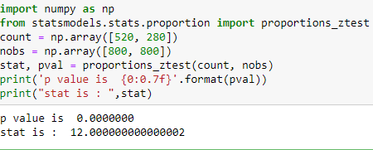
H₀=There is no significant difference between males, females shopping based on day of the week
H_{a}=There is significant difference between males, females shopping based on the day of the week . Alpha = 5%
Here We use two proportion z test and compare the test statistic with critical value
Conclusion :Since z statistic calculated value is greater than critical value so we can conclude that the males females shopping differs based on the weekdays and weekends

