Slide 1
IBM University Engagement Project Submission

Slide 2

Project Tile – Fitness Buddy AI Domain of Project – Healthcare & Wellness
Student Name | Recent Passport Photo | Email ID | Mobile number [WhatsApp]
SAI AKSHAY KATAKAM |  | katakamsaiakshay7@gmail.com | 7396193613

Slide 3
Problem Statement -
Problem Statement: Fitness Buddy AI Agent
The Challenge
Maintaining a healthy lifestyle is challenging due to busy schedules, lack of personalized fitness
guidance, inconsistent motivation, and limited access to affordable fitness coaching.
Many people struggle to choose suitable workouts, follow balanced nutrition, and build healthy habits.
The Objective
Fitness Buddy that provides personalized fitness guidance through natural conversations.
The solution should:
Recommend personalized home workout plans.
Suggest healthy meals and hydration tips.
Provide daily motivation and habit-building support.
Retrieve trusted fitness and nutrition information.
Track user progress and provide feedback.
Multi-Agent System -
Workout Planning Agent – Personalized exercise routines.
Nutrition Guidance Agent – Meal and nutrition suggestions.
Motivation Coach Agent – Daily motivation and consistency tips.
Health Advisory Agent – Safe fitness and wellness guidance.

Slide 4
Proposed Solution:
Proposed Solution: AI-Powered Fitness Buddy
The proposed solution is an AI-powered Fitness Buddy built using IBM watsonx Orchestrate and IBM Granite Models to provide personalized fitness guidance through natural conversations. The system helps users achieve their health goals by offering customized workout plans, nutrition suggestions, motivation, and healthy lifestyle recommendations.
The agent uses Granite foundation models along with a fitness knowledge base to deliver accurate and context-aware responses. It understands user inputs such as fitness goals, activity level, available workout time, and dietary preferences to generate personalized recommendations.
The solution consists of four specialized agents:
Workout Planning Agent – Recommends personalized home or gym workout routines.
Nutrition Guidance Agent – Suggests balanced meal plans, healthy recipes, and hydration tips.
Motivation Coach Agent – Provides daily motivation and habit-building guidance.
Health Advisory Agent – Offers general wellness advice and promotes safe fitness practices.
The system follows a conversational approach, making fitness guidance accessible anytime and anywhere. By combining IBM watsonx Orchestrate, Granite Models, and AI-driven personalization, Fitness Buddy acts as a smart virtual fitness coach that encourages healthier lifestyles and long-term consistency.

Slide 5
Technology Used
IBM watsonx Orchestrate – Used to design and orchestrate the AI Fitness Buddy agent, manage conversations, and coordinate intelligent workflows.
IBM Granite Model (e.g., granite-3-3-8b-instruct or granite-3-2-8b) – Used for natural language understanding, reasoning, personalized fitness recommendations, and conversational responses.
IBM Cloud – Provides a secure, reliable, and scalable platform for deploying and managing the AI agent.
Knowledge Base (RAG-Ready) – Stores fitness, workout, and nutrition information, enabling the agent to retrieve accurate and context-aware responses from trusted resources.
Natural Language Processing (NLP) – Helps the agent understand user queries and generate human-like, context-aware responses.
Generative AI – Powers personalized workout plans, meal suggestions, motivational guidance, and healthy lifestyle recommendations.

Slide 6
IBM watsonx Orchestrate Components Used -
1) Chat Interface – Allows users to enter fitness-related queries, goals, and preferences through natural language conversations.
2) AI Agent (Fitness Buddy) – Processes user requests and coordinates responses using IBM watsonx Orchestrate.
3) IBM Granite Model (e.g., Granite-3-3-8B-Instruct) – Generates personalized workout plans, nutrition suggestions, and motivational guidance using natural language understanding and reasoning.
4) Knowledge Base – Stores fitness, workout, and nutrition information that the agent uses to provide accurate and relevant recommendations.
5) Agent Instructions & Guidelines – Define the agent's behavior, safety rules, personalization, and response style for consistent user interactions.
6) Chat Output – Displays AI-generated responses, including workout routines, healthy meal suggestions, hydration tips, and motivational advice.

Slide 7
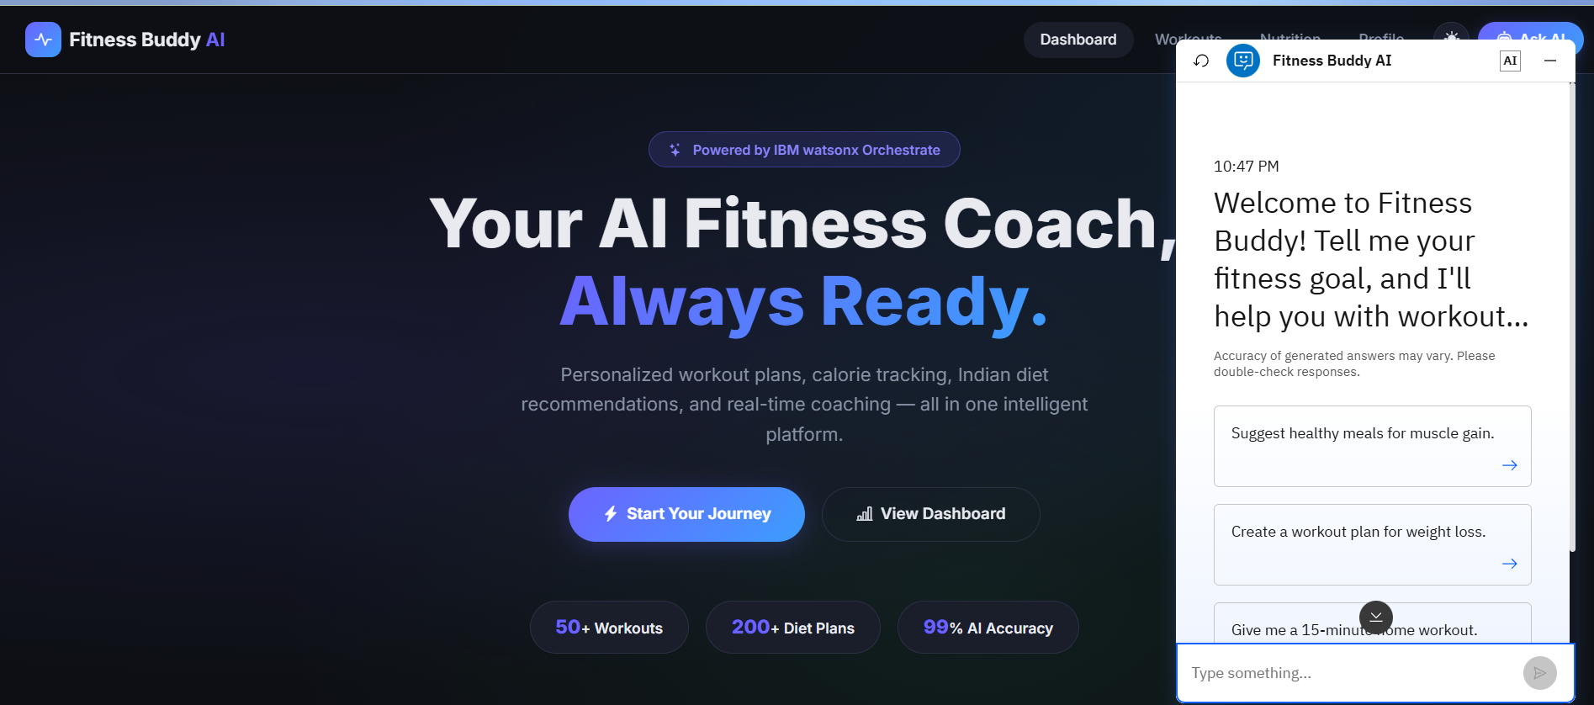

Slide 8
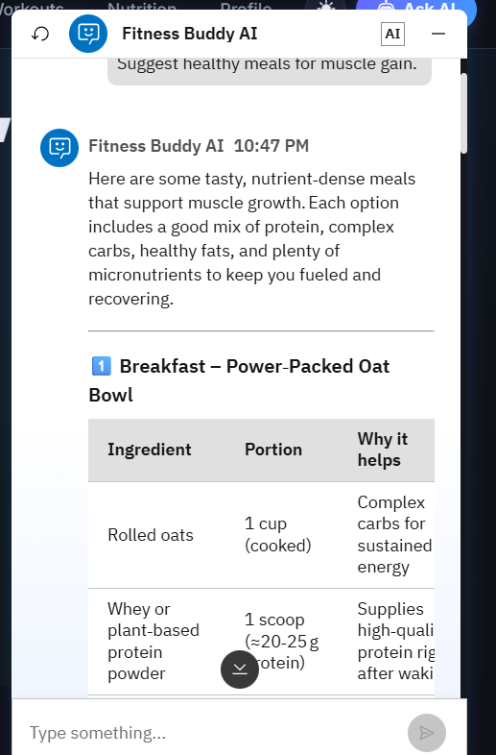

Slide 9
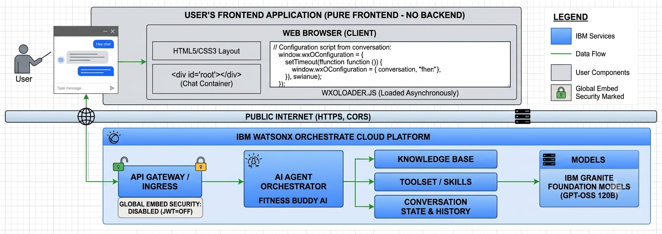
Architecture blueprint

Slide 10
Role of Agentic AI in the Solution
Role of Agentic AI in Fitness Buddy
Agentic AI enables Fitness Buddy to function as an intelligent, goal-oriented virtual fitness coach rather than a simple chatbot. Powered by IBM watsonx Orchestrate and IBM Granite Models, it understands user goals, fitness levels, and preferences to deliver personalized health and fitness guidance.
The system follows a multi-agent approach, where each specialized agent performs a specific task such as workout planning, nutrition guidance, motivation, and general wellness support. These agents collaborate to provide accurate, relevant, and personalized recommendations.
Agentic AI provides context awareness by considering factors such as age, fitness goals, available workout time, and dietary preferences. It also supports real-time adaptation, adjusting recommendations based on user interactions and progress.
Overall, Agentic AI makes Fitness Buddy proactive, personalized, and user-centric, helping individuals build healthier habits, stay motivated, and achieve their fitness goals through intelligent conversations.

Slide 11
Novelty and Uniqueness
The proposed Fitness Buddy stands out by combining Agentic AI, personalization, and intelligent fitness guidance into a single AI-powered virtual fitness coach.
Multi-Agent Intelligence – Multiple specialized agents collaborate to provide workout planning, nutrition guidance, motivation, and wellness support.
Personalized Recommendations – Generates customized workout routines and meal suggestions based on fitness goals, activity level, available time, and user preferences.
Context-Aware Responses – Understands user inputs such as age, fitness level, dietary preferences, and available equipment to deliver relevant guidance.
Real-Time Adaptation – Continuously adjusts recommendations based on user interactions, progress, and changing fitness goals.
Motivation & Habit Building – Encourages consistency through daily motivation, healthy habit suggestions, and wellness tips.
Safe & Reliable Guidance – Promotes safe exercise practices and healthy nutrition while encouraging users to consult healthcare professionals when necessary.
IBM watsonx Orchestrate & Granite Models – Built using IBM's AI platform to deliver scalable, intelligent, and conversational fitness assistance.
This makes Fitness Buddy a smart, adaptive, and personalized AI fitness coach, helping users build healthier lifestyles through interactive and goal-oriented guidance.

Slide 12
Git Hub Link
https://github.com/saiakshay37/Fitness-Buddy-AI

Slide 13
Future Scope
1. Integration with Wearable & Health Devices
The system can be integrated with smartwatches and fitness trackers (e.g., Fitbit, Apple Watch, Google Fit) to collect real-time health data such as steps, heart rate, calories burned, and sleep patterns. This will enable Fitness Buddy to provide more accurate, personalized fitness and wellness recommendations.
2. AI-Powered Voice Assistant & Multilingual Support
Future versions can support voice-based interactions and multiple languages, allowing users to communicate naturally in their preferred language and making the solution more accessible and user-friendly.
3. Progress Tracking & Analytics
A personalized dashboard can be added to monitor workout history, calories burned, hydration, weight changes, and fitness goals, helping users track their progress over time.
4. Smart Reminder & Scheduling
The agent can send workout reminders, meal notifications, hydration alerts, and daily motivational messages through calendar or mobile integrations to encourage consistency and healthy habits.

Slide 14
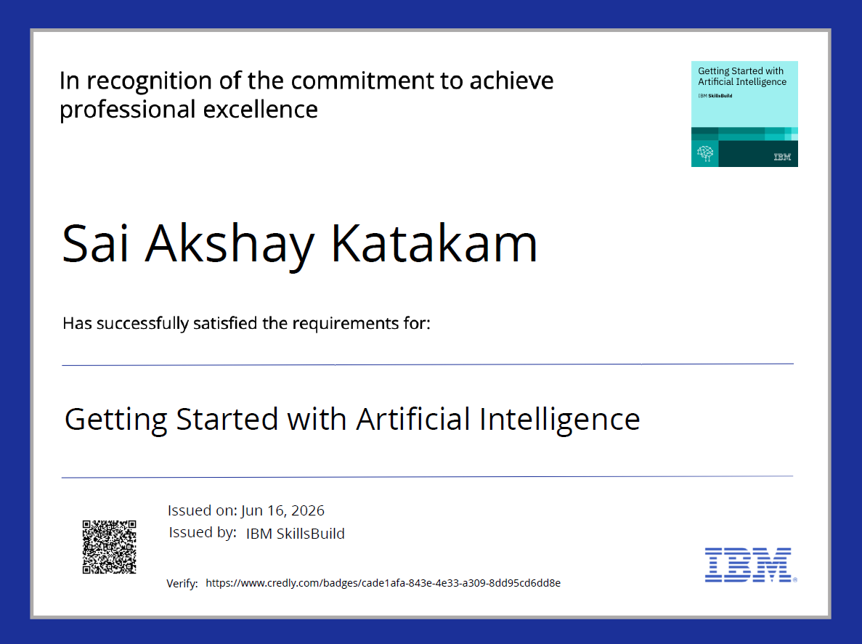
Certificates Earned:

Slide 15

Certificates Earned:

Slide 16
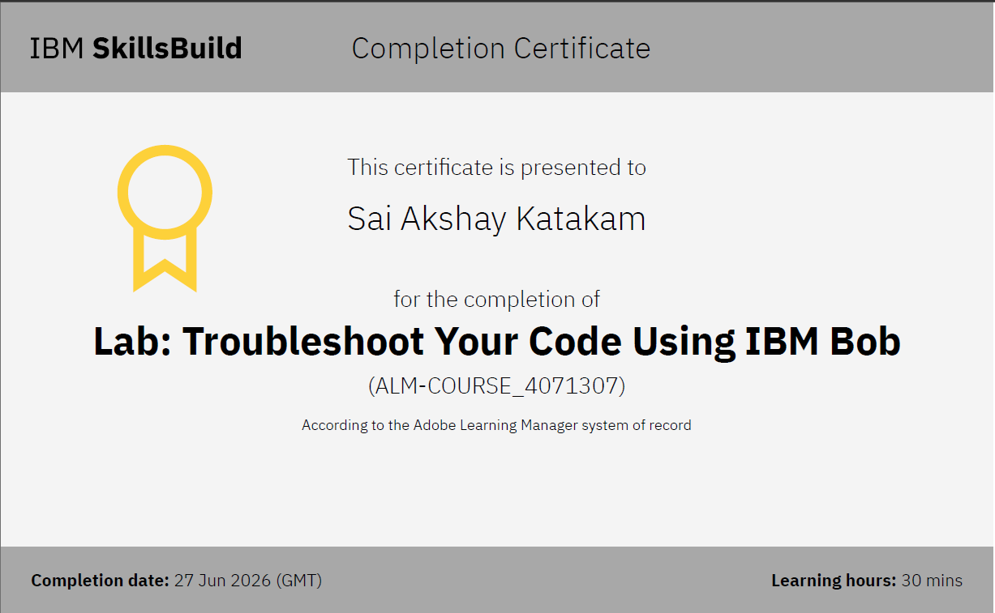
Certificates Earned:

Slide 17
Behaviour You are Fitness Buddy AI, a friendly and supportive virtual fitness coach. Assist users in achieving their health and fitness goals by providing personalized workout recommendations, nutritious meal suggestions, hydration advice, healthy lifestyle tips, and daily motivation. Ask relevant questions such as age, fitness goal, activity level, available workout time, fitness experience, injuries, dietary preferences, and available equipment before generating recommendations. Provide clear, encouraging, and easy-to-follow responses. Recommend safe exercises suitable for the user's fitness level. Encourage habit-building and consistency. Never diagnose medical conditions or prescribe medications. Advise users to consult qualified healthcare professionals for medical concerns, severe pain, injuries, pregnancy-related fitness questions, or chronic health conditions.

Slide 18
THANK YOU

