Slide 1

Data Analytics and Visualization (24DSB3101)
An Explainable Machine Learning Framework for Predictive
Financial Risk Assessment and Early Warning
PROJECT REVIEW – 2
Under the Guidance of
Dr. K. Swapnika
Assistant Professor
Department of Computer Science and Engineering
Submitted by: Batch 8
2420080024 – P. Sai Akshitha
2420080065 – K. Nithya Sri
2420080100 – Syed Zuvaria
2420090076 – S. Sushmita

Slide 2
Contents
Proposed Methodology
Dataset & Preprocessing
System Design / Architecture
Baseline Machine Learning Models
Optuna-Based Model Optimization
Model Evaluation & Selection
Explainable AI – SHAP & LIME
Risk Score Generation
Early-Warning Mechanism
Interactive Dashboard
Modern Tools & Technologies
Implementation & Expected Results
Research Paper Draft Progress
tle

Slide 3
Proposed Methodology
Financial Dataset
↓
Data Preprocessing & EDA
↓
Feature Engineering & Selection
↓
Class Imbalance Handling
↓
Baseline ML Models
Logistic Regression | Random Forest | XGBoost | LightGBM | CatBoost
↓
Optuna Hyperparameter Optimization
↓
Best Optimized Model
↓
SHAP + LIME Explainability
↓
Risk Score Generation
↓
Low / Medium / High Risk Classification
↓
Early-Warning Mechanism
↓
Interactive Financial Risk Dashboard

Slide 4
Dataset & Data Preprocessing
Dataset Processing
Give Me Some Credit Dataset
↓
Data Cleaning
Handle missing values and duplicates
↓
Exploratory Data Analysis (EDA)
Study feature distributions, correlations, outliers and risk-class distribution
↓
Outlier Handling
↓
Feature Scaling
↓
Feature Engineering & Selection
↓
Class Imbalance Handling
SMOTE / Class Weights
↓
Train-Test Split
↓
Model Training
Final System Output
Default/Risk Probability
↓
Risk Score: 0–100
↓
Risk Category
🟢 Low Risk | 🟠 Medium Risk | 🔴 High Risk
Dataset: Give Me Some Credit
Purpose:
The dataset will be used to develop a machine-learning model for predicting customer credit/default risk.

Slide 5
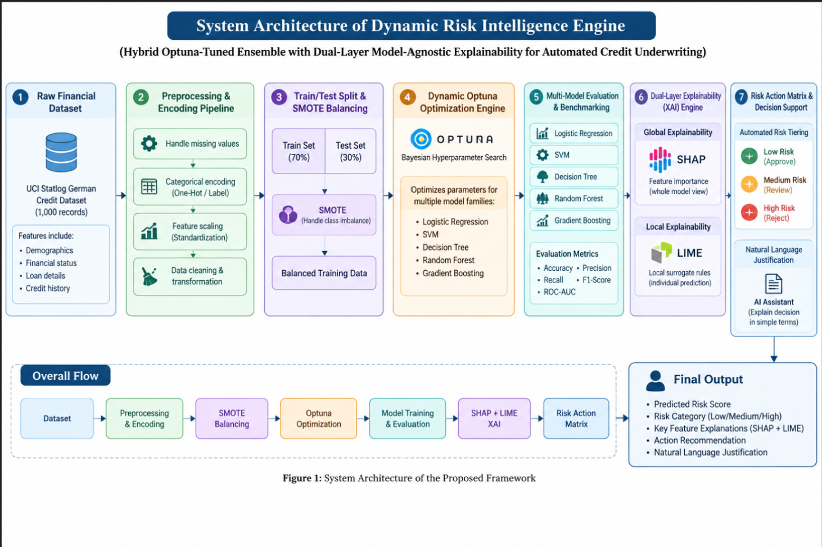
System Architecture

Slide 6
Raw Financial Dataset – We start with the UCI Statlog German Credit dataset containing demographic, financial, loan, and credit-history features.
Preprocessing – Missing values are handled, categorical data is encoded, features are standardized, and the data is cleaned.
SMOTE Balancing – The data is divided into 70% training and 30% testing. SMOTE is applied to the training data to handle class imbalance.
Optuna Optimization – Optuna performs hyperparameter optimization for five models: Logistic Regression, SVM, Decision Tree, Random Forest, and Gradient Boosting.
Model Evaluation – The models are trained and compared using Accuracy, Precision, Recall, F1-Score, and ROC-AUC.
Explainable AI – SHAP provides global explanations of which features influence the model, while LIME explains individual predictions.
Risk Decision Support – Based on the predicted risk score, the system categorizes applicants into Low, Medium, or High Risk, with corresponding actions such as approval, review, or rejection.
Final Output – The system produces the risk score, risk category, important feature explanations, recommended action, and a natural-language justification.
Dataset → Preprocessing → SMOTE → Optuna Optimization → Model Training & Evaluation → SHAP + LIME → Risk Decision → Final Explanation

Slide 7
Baseline Machine Learning Models
Baseline Model Training
Multiple machine-learning models will first be trained using their initial/default configurations.
Model | Purpose
Logistic Regression | Simple baseline model
Random Forest | Handles nonlinear relationships
XGBoost | Boosting-based risk prediction
LightGBM | Efficient gradient boosting
CatBoost | Handles complex/categorical features
Why Multiple Models?
Different ML algorithms may perform differently on financial data.
`
Therefore, we:
Train → Evaluate → Optimize → Compare → Select Best Model
`
Evaluation Metrics
Accuracy | Precision | Recall | F1-Score | ROC-AUC| Infidelity| Fidelity | Stability

Slide 8
Optuna-Based Model Optimization
Why Optimization?
Default model parameters may not provide the best prediction performance.
Therefore, we use:
Optuna Hyperparameter Optimization
Optuna automatically searches for better combinations of model hyperparameters.
Example – XGBoost
Optuna can optimize parameters such as:
n_estimators
max_depth
learning_rate
subsample
colsample_bytree

Slide 9
Model Evaluation & Selection
Models Considered
Logistic Regression
Random Forest
XGBoost
LightGBM
CatBoost
Evaluation Metrics
Accuracy – Overall percentage of correct predictions.
Precision – How many predicted risky cases are actually risky.
Recall – How many actual risky cases are correctly detected.
F1-Score – Balance between Precision and Recall.
ROC-AUC – Measures the model's ability to distinguish between risk classes.
Selection
The model will be selected based on its overall performance across these evaluation metrics, with particular attention to Recall, F1-Score and ROC-AUC for risk detection.
Preprocessed Dataset
↓
Train–Test Split
↓
Train Multiple ML Models
↓
Generate Predictions
↓
Calculate Evaluation Metrics
↓
Compare Models
↓
Select Best Model

Slide 10

Explainable AI – SHAP & LIME
Best ML Model
↓
Risk Prediction
↓
SHAP + LIME
↓.
Feature Contribution
↓
Reason for Prediction
Feature Contribution
---------------- ----------------
Credit Amount ↑ Risk
Credit Duration ↑ Risk
Credit History ↓ Risk
Savings Account ↓ Risk
Age ↓ Risk
SHAP
Explains how each feature contributes to a model prediction.
LIME
Explains individual predictions using a local interpretable model.

Slide 11
Risk Score Generation
Model Prediction
↓
Default / Risk Probability
↓
Risk Score: 0–100
↓
Risk Category
3 types of risk:
Low Risk
Medium Risk
High Risk

Slide 12
Early-Warning Mechanism
Customer Data
↓
Risk Prediction
↓
Risk Score
↓
Risk Category
↓
Check Risk Threshold
↓
Early Warning Alert
↓
Recommended Action

Slide 13
Optimization Process
Baseline Model
↓
Define Hyperparameter Search Space
↓
Optuna Trials
↓
Evaluate Each Combination
↓
Identify Best Parameters
↓
Optimized Model

Slide 14
Modern Tools & Technologies
Tool | Purpose
Python | Main programming language
Pandas | Data preprocessing & analysis
Matplotlib | Data visualization
Scikit-learn | ML models & evaluation
XGBoost / LightGBM / CatBoost | Advanced ML models
SHAP + LIME | Explainable AI

Slide 15
Implementation & Expected Results
Dataset Loading ✓
Data Preprocessing ✓
Missing Value Analysis ✓
Duplicate Analysis ✓
EDA ✓
Descriptive Analysis ✓
Outlier Analysis ✓
Feature Engineering ✓
Feature Selection ✓

Slide 16
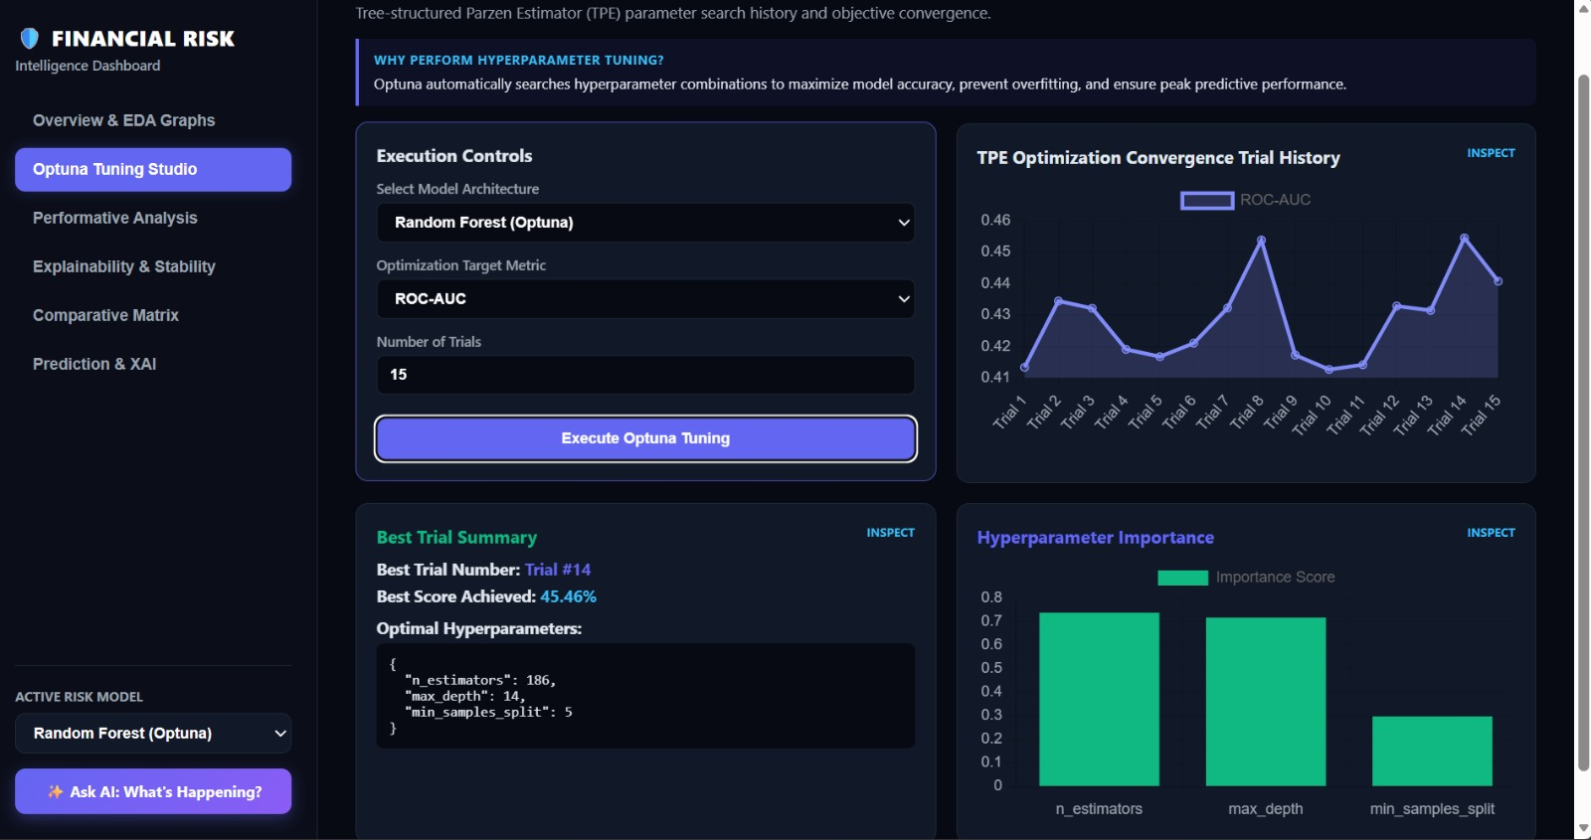
Interactive Dashboard
Optuna Optimization: The system tested 15 trials and identified the best Random Forest configuration at Trial 14, achieving a 45.46% ROC-AUC for the selected optimization run.

Slide 17
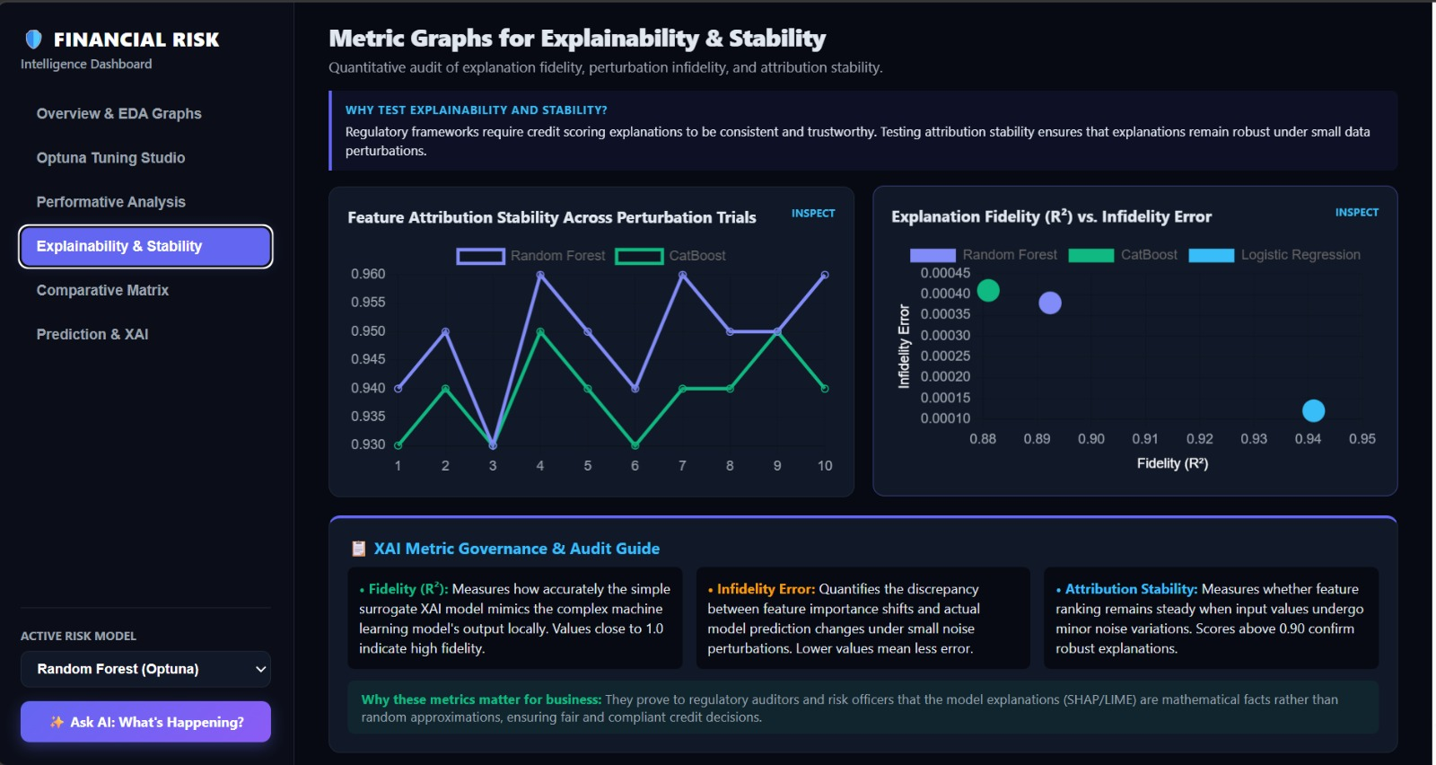
Explainability & Stability: SHAP and LIME explanations are evaluated using Fidelity, Infidelity, and Stability. Fidelity indicates how closely the explanation represents the model, while lower infidelity indicates less explanation error.

Slide 18
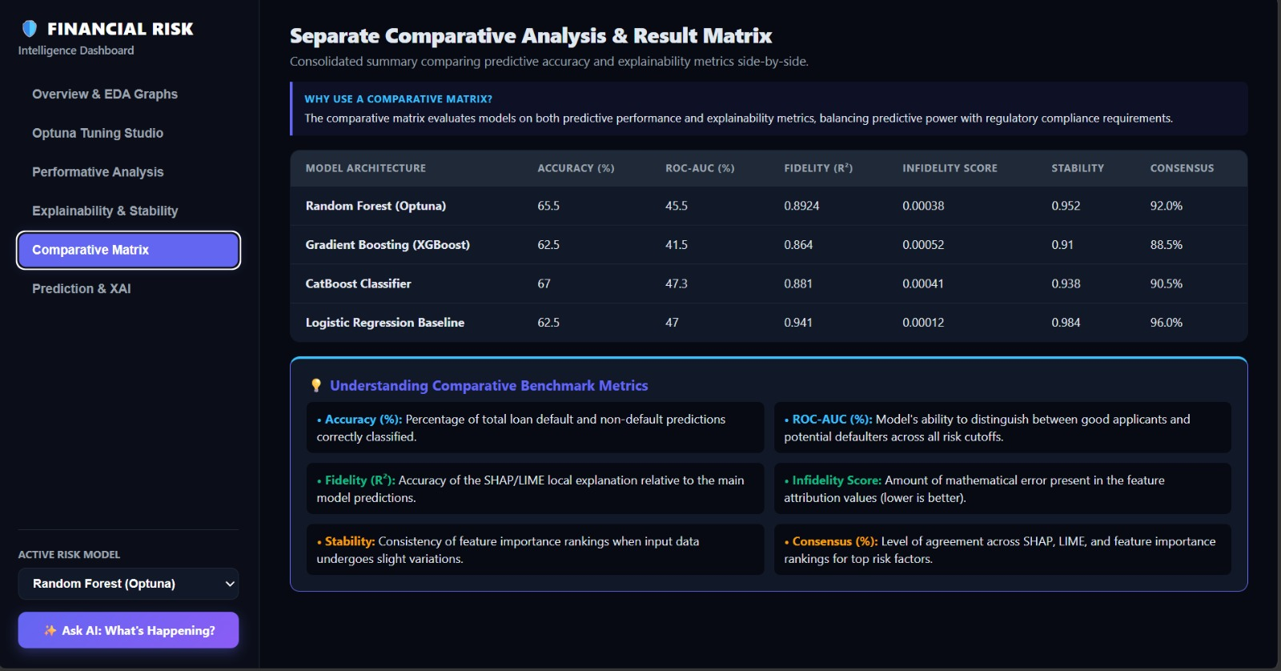
Comparative Results: The models are compared using Accuracy, ROC-AUC, Fidelity, Infidelity, Stability, and Consensus, giving a combined view of both prediction performance and explanation reliability.

Slide 19

THANK YOU

