Slide 1

Data Analytics and Visualization (24DSB3101) An Explainable Machine Learning Framework For Predictive Financial Risk Assessment And Early Warning
Under the Esteemed guidance of
Dr K. Swapnika
Assistant Professor
Department Of Computer Science and Engineering
Submitted by: Batch 8
Team Members:
2420080024 – P. Sai Akshitha
2420080065 – K. Nithya Sri
2420080100 – S. Zuvaria
2420090076 – S. Sushmita

Slide 2
Contents
Introduction / Abstract
Problem Statement
Project Objectives
Literature Survey
Project flow diagram
Research Gap Identification
Novelty
Innovation
Feasibility & Project Plan

Slide 3
Introduction
Financial institutions handle large amounts of customer, credit, loan, and transaction data. Traditional risk assessment methods may struggle to identify complex patterns within such data.
Machine learning can analyze historical financial information and identify patterns associated with financial risk. In this project, different ML models will be compared to classify customers into Low, Medium, and High-Risk categories.
The project also incorporates Explainable AI (XAI) to explain why a particular customer is classified as risky.

Slide 4
Problem Statement
Traditional financial risk assessment methods may fail to capture complex and changing patterns in financial data. Although machine learning improves prediction, many models behave like black boxes, making their decisions difficult for financial stakeholders to understand.
The proposed system addresses this by providing:
Risk Prediction + Risk Score + Explainability + Early Warning
It aims to identify potentially high-risk cases and explain the major factors responsible for the prediction.

Slide 5
Objectives
Develop financial-risk prediction models using Random Forest, XGBoost and CatBoost
Handle class imbalance using SMOTE / Class Weights.
Perform feature engineering and feature selection.
Apply SHAP to explain individual risk predictions.
Generate a calibrated financial risk score and risk category.
Provide an early-warning mechanism for potentially high-risk cases.
Build an integrated dashboard-based decision-support system.

Slide 6
Literature Survey
No. | Year | Research Paper / Study | Technique / Framework | Key Contribution | Research Gap
1 | 2026 | Enterprise Financial Risk Prediction Model Based on Machine Learning Algorithm | SVM, ANN, Logistic Regression / FinRiskNet | Uses multiple classifiers for enterprise financial-risk prediction | Mainly prediction-focused; explainability and integrated early warning can be improved
2 | 2026 | Application of Generative AI in Corporate Financial Risk Early Warning | Multimodal Fusion, GNN, Temporal GAN, Interpretable Generation | Combines multiple data sources and generates risk reports/recommendations | Complex architecture and high computational requirements
3 | 2025 | Enterprise Financial Risk Prediction Model Based on Modified Machine Learning Classifier Algorithms | Modified ML Classifiers | Uses internal and global financial factors for prediction and early warning | Focuses more on accuracy than transparent decision support
4 | 2025 | Enterprise Financial Risk Prediction and Intelligent Early Warning Model Based on Deep Learning | BiLSTM + Attention | Captures temporal financial patterns and provides early warnings | Deep-learning models are difficult to interpret and require sufficient temporal data
5 | 2025 | Enhancing Credit Risk Prediction through an Ensemble of Explainable Model | XGBoost + Multiple Explanation Methods + K-Means | Combines ensemble prediction with explainability | Broader financial-risk scoring, risk trajectory and early-warning mechanisms can be explored

Slide 7
Literature Survey
No. | Year | Research Paper / Study | Technique / Framework | Key Contribution | Research Gap
6 | 2025 | Systemic Financial Risk Prediction Based on Machine Learning: The Role of FinTech | ML + FinTech Indicators | Uses a FinTech index to improve the timeliness of systemic-risk prediction | Focuses on systemic risk rather than customer/enterprise-level risk
7 | 2025 | Graph-Based Inductive Learning for Credit Risk Prediction with Imbalance Mitigation | Graph-Based ML + Imbalance Mitigation | Addresses class imbalance and relational information in credit-risk predict | Requires complex relationship/graph data that may not always be available
8 | 2025 | Sustainable Credit Risk Prediction: Applying Machine Learning for Responsible Lending | Feature Engineering + Ensemble ML + CatBoost | Applies ensemble ML to credit-risk prediction and responsible lending | Explainable early-warning integration remains an opportunity
9 | 2024 | Prediction of Bank Credit Worthiness Through Credit Risk Analysis: An Explainable Machine Learning Study | Explainable Machine Learning | Uses ML and XAI to predict bank creditworthiness | Can be extended toward broader risk scoring and early-warning mechanisms
10 | 2024 | Financial Risk Forewarning with an Interpretable Ensemble Learning Approach | Bagging + LightGBM + SHAP + MOPSO | Combines ensemble learning, optimization and SHAP for financial-distress warning | Primarily focused on listed-company financial distress

Slide 8
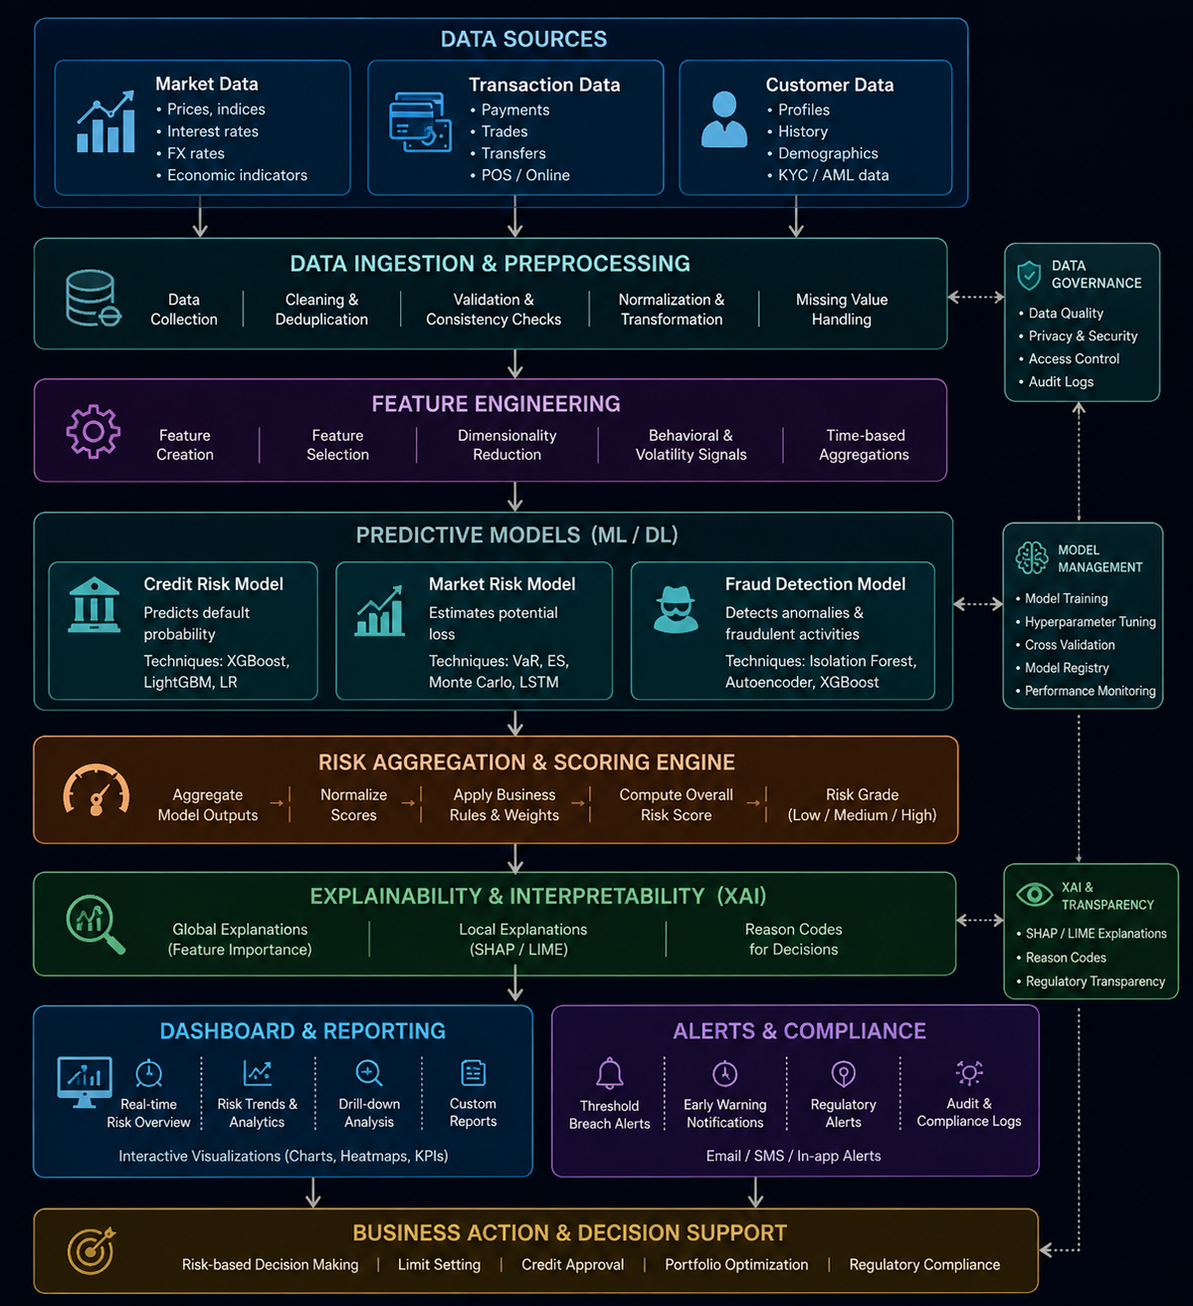
Project Workflow

Slide 9
Research Gap
1. Fragmented Risk Management Existing research often concentrates on individual risk types rather than a flexible framework.
2. Prediction vs. Explainability High-performing models such as XGBoost can be difficult to interpret.
3. Limited Risk Scoring Many systems provide only binary predictions such as Default/Non-Default.
4. Limited Early Warning Prediction and continuous risk monitoring are often treated separately.
5. Class Imbalance High-risk/default cases are usually much fewer than low-risk cases.
6. Limited Decision Support Many systems do not combine:
7. Risk Score → Risk Level → Important Factors → Recommended Action
These six gaps are specifically identified in your review document.

Slide 10
Novelty
Explainable Risk Prediction: Integrates Explainable AI techniques such as SHAP/LIME with machine learning models to clearly identify the key factors contributing to an individual's or organization's financial risk.
Early Warning System: Develops a predictive early-warning mechanism that detects increasing financial risk before major financial problems occur, enabling timely preventive decisions.
Hybrid & Integrated Framework: Combines multiple ML models, financial indicators, and explainability techniques into a unified framework to improve prediction accuracy, transparency, and decision-making compared with traditional financial risk assessment methods.

Slide 11
Innovation
Machine Learning Prediction
↓
Risk Score
↓
Risk Classification
↓
SHAP Explanation
↓
Early Warning
↓
Recommended Action

Slide 12
Feasibility
Technical Feasibility: The system can be developed using Python, Scikit-learn, XGBoost/LightGBM, SHAP, Imbalanced-learn, and Streamlit.
Dataset Feasibility: Public financial datasets such as German Credit, Give Me Some Credit, and Lending Club Loan Dataset are available for experimentation.
Computational Feasibility: Ensemble ML models can be trained on normal academic computing systems without requiring expensive deep-learning infrastructure.
Implementation Feasibility: Open-source tools can support data preprocessing, risk prediction, explainability, early warning, and dashboard development.

Slide 13
Project Plan
Phase 1: Literature Survey & Research Gap Identification ↓ Phase 2: Dataset Collection & Preprocessing ↓ Phase 3: Feature Engineering & Feature Selection ↓ Phase 4: Class Imbalance Handling using SMOTE / Class Weights ↓ Phase 5: Baseline Model Training ↓ Phase 6: Ensemble Model Development using XGBoost / LightGBM ↓ Phase 7: Model Evaluation & Comparative Analysis ↓ Phase 8: SHAP-Based Explainable AI ↓ Phase 9: Risk Score & Early-Warning Development ↓ Phase 10: Interactive Dashboard Development ↓ Phase 11: Testing & Performance Validation ↓ Phase 12: Documentation & Final Presentation

Slide 14
THANK YOU
THANK YOU

