Slide 1
MIE 1624 : Final Exam Project
COVID-19 Data Analysis in USA
Sai Anirudh Basamsetty
1006042747

Slide 2
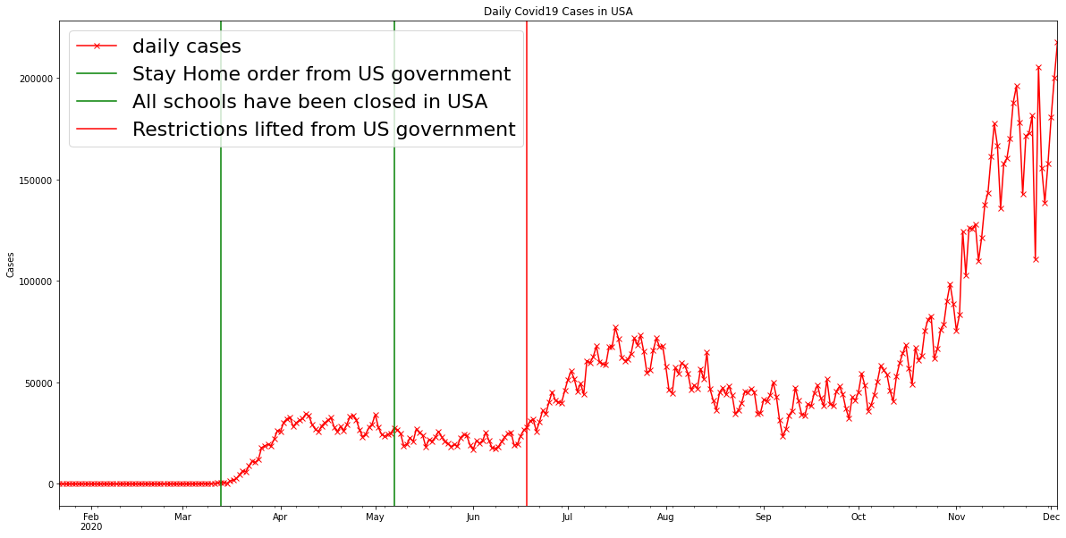
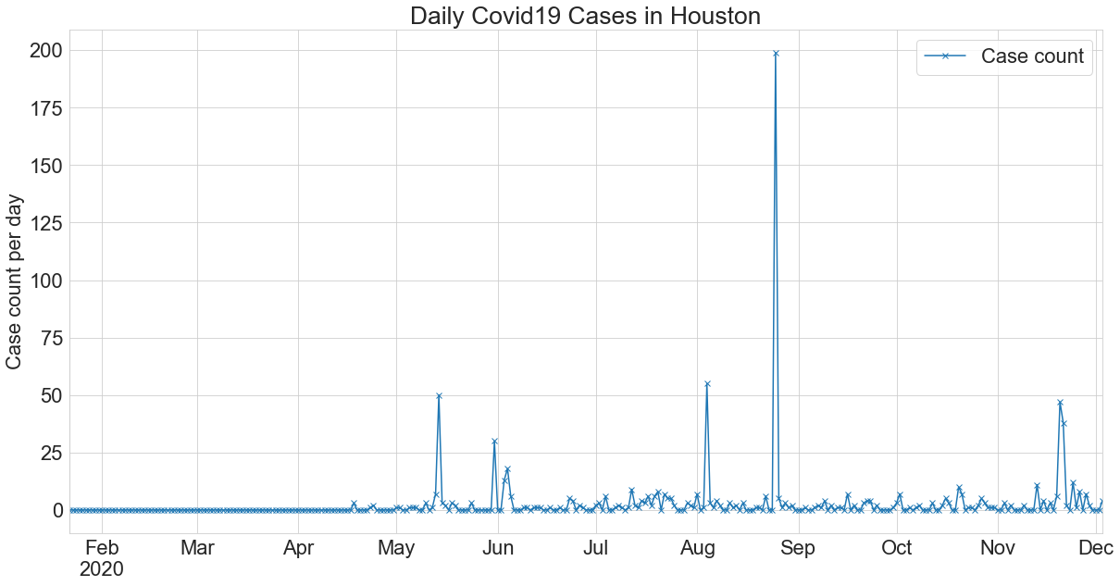
Data Visualizations

Slide 3
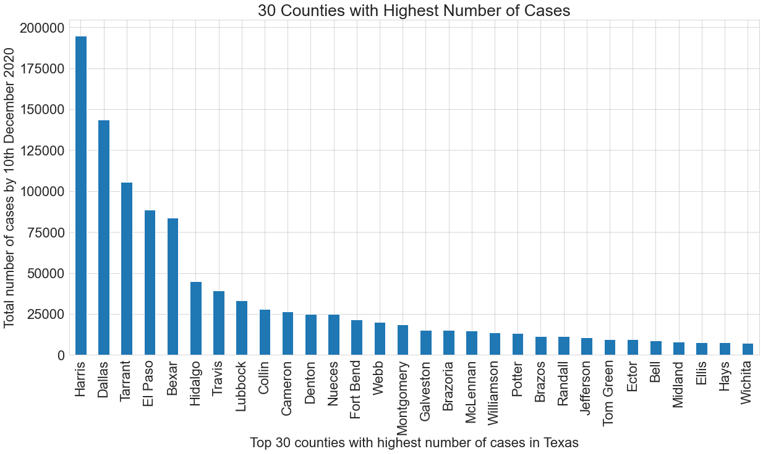
Data Visualizations

Slide 4
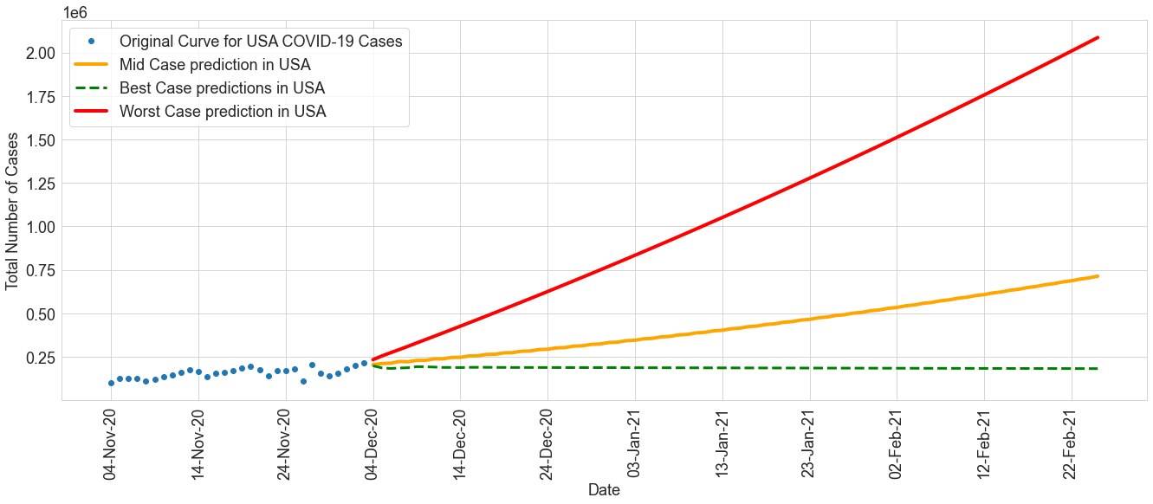
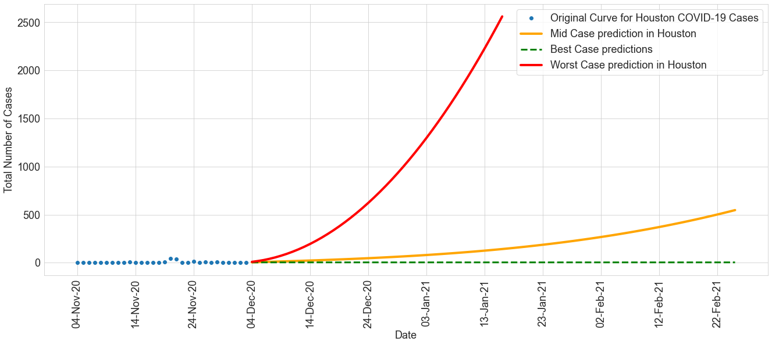
ARIMA model Projections

Slide 5
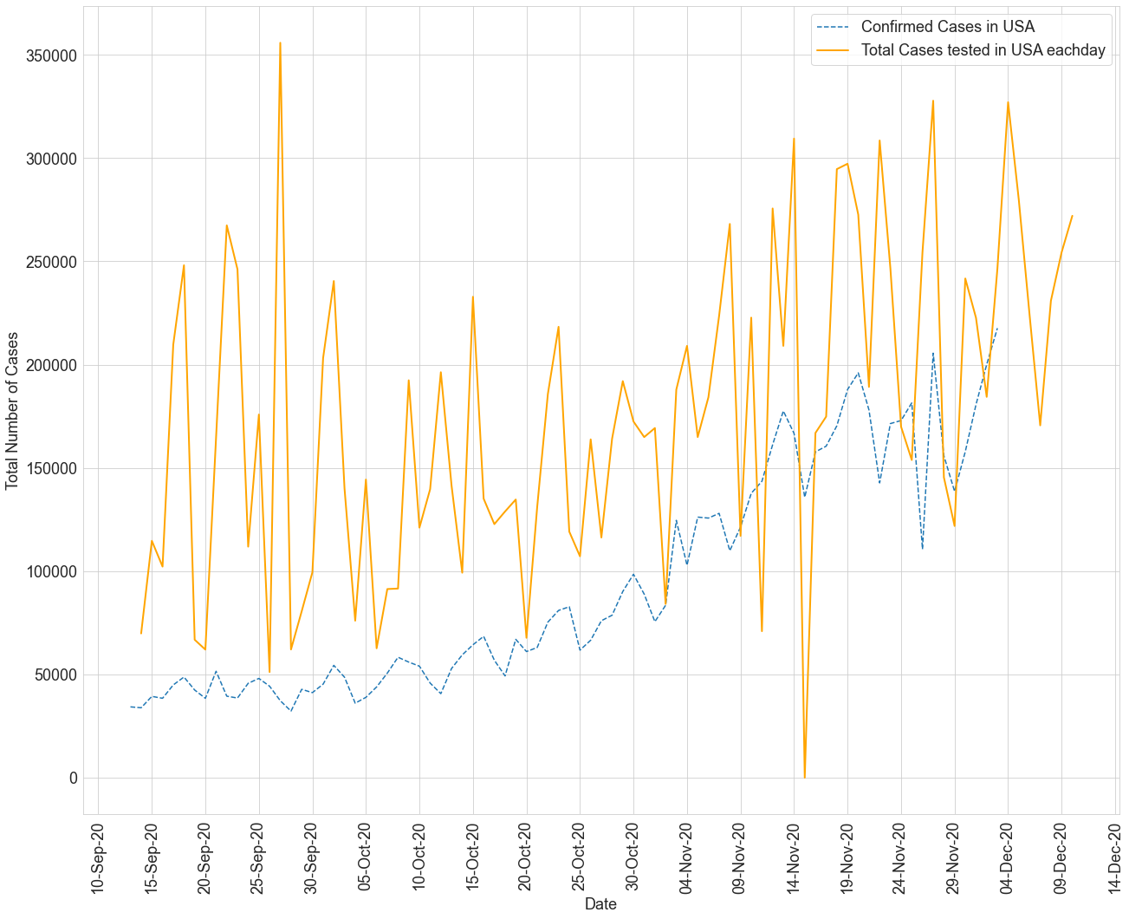
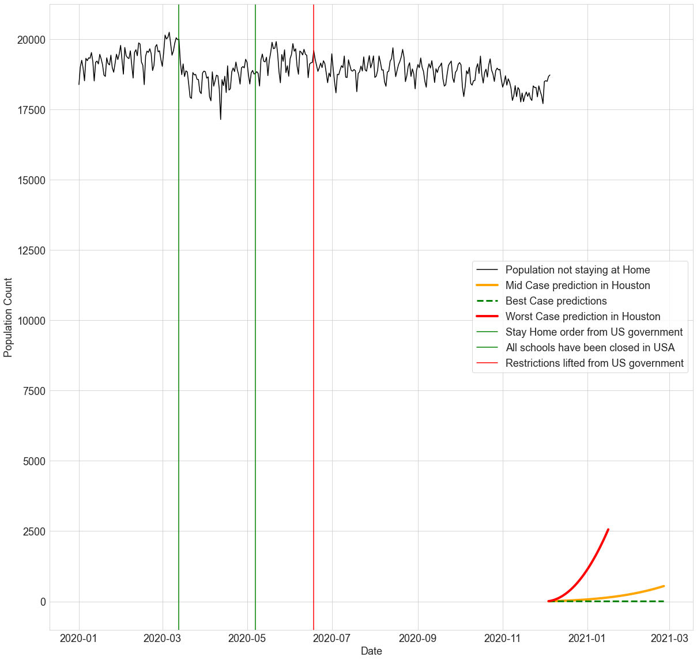
Part – 4

Slide 6
Policy Insights
The spread of COVID 19 in USA has reached to an uncontrollable extent, such that the total cases as of 3rd December is more than 16M with around 3000 Deaths. People must realize the effect of virus and take certain precautions like wearing masks to control the spread.
If the government of USA does not impose strict restrictions like closing of public gathering services, the cases might follow the worst projection as predicted by the model. Since vaccinating the entire USA population is a time taking process, it is better to take precautions to prevent spread of COVID which leads to decline in number of cases as predicted by the best case projection. Else, the case numbers might follow the worst case projection as plotted in Part-3.
In-spite of the orders from government of USA, people have not stayed home which is the cause to highest number of cases in USA. Fines should be imposed for those who violate restrictions and this is the best way to force people to stay home and control COVID spread. Restaurants, malls must be closed to control the mobility of people. In addition to this, the Government of USA has to take measures to speed up the PCR testing process, so that infected people can avoid contact with others to prevent the spread of Virus.

