Slide 1
MIE1624 : Introduction to DataScience and Analytics
Assignment – 1
Sai Anirudh Basamsetty : 1006042747

Slide 2
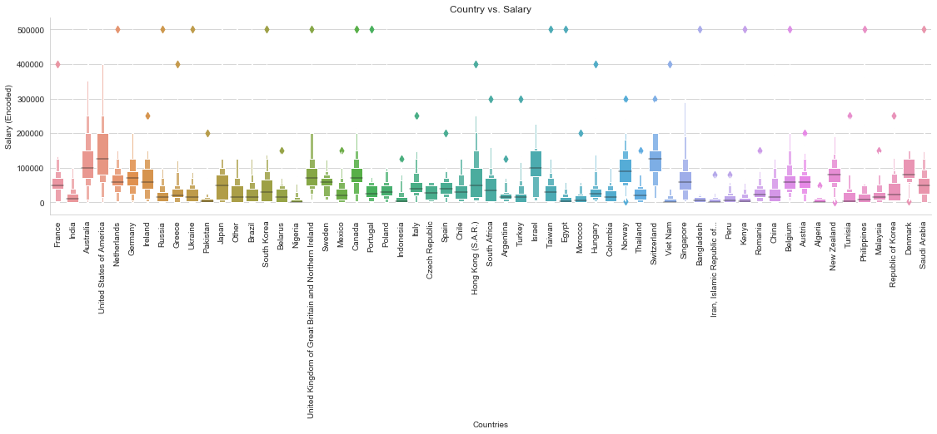
Trends in Data
Countries Vs Salary

Slide 3
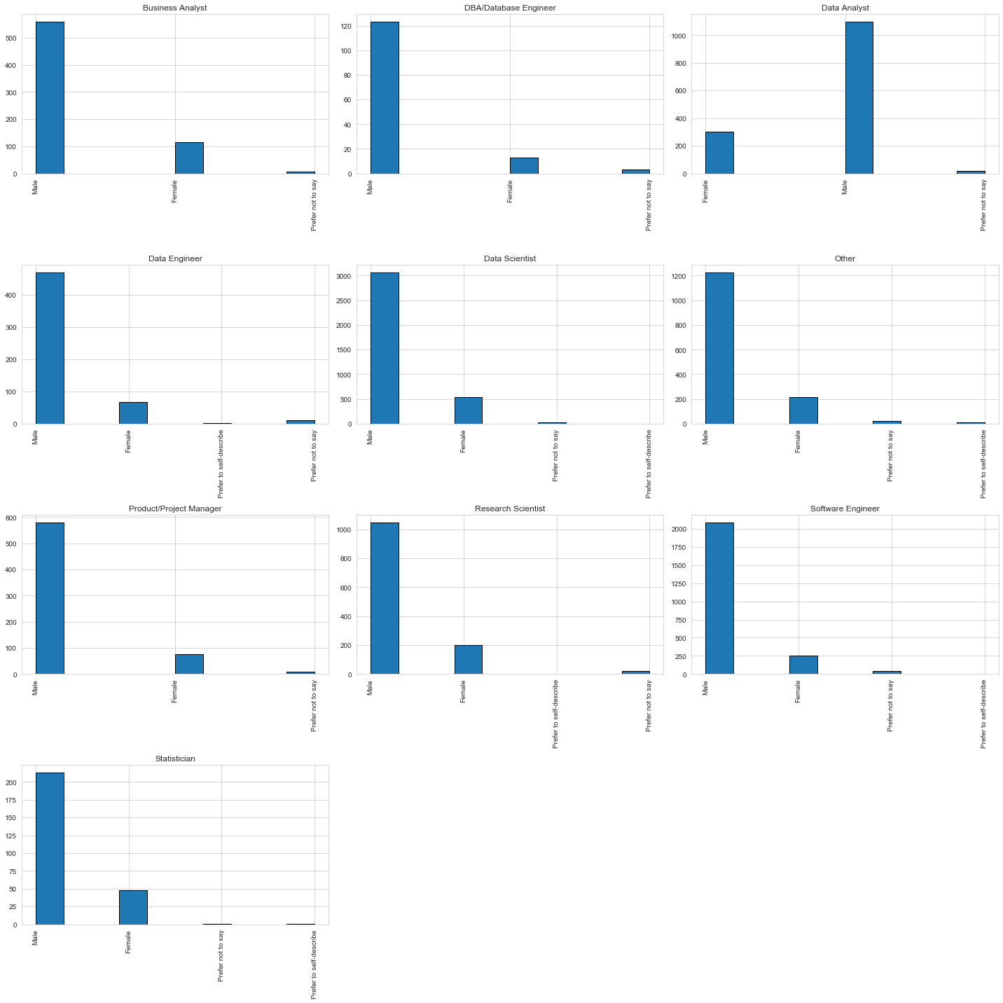
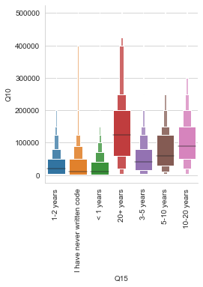
Trends in Data
Experience Vs Salary Gender wise positions

Slide 4
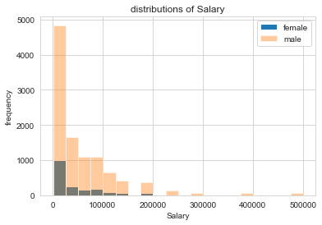
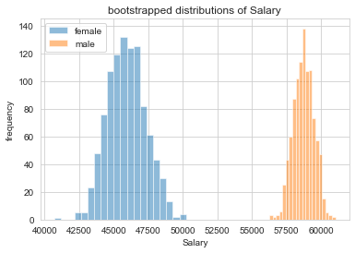
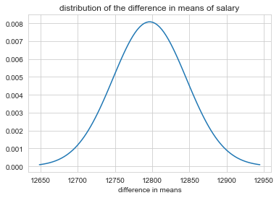
Question - 2
The data is right skewed or positive skewed
After bootstrapping, the data is normally distributed.
We get a p value of 0.0 on performing T-Test hypothesis.
We reject null hypothesis and consider alternate hypothesis
which says that the salaries of males and females are
statistically different.

Slide 5
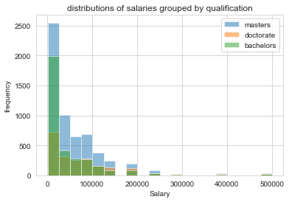
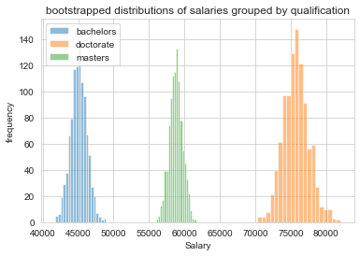
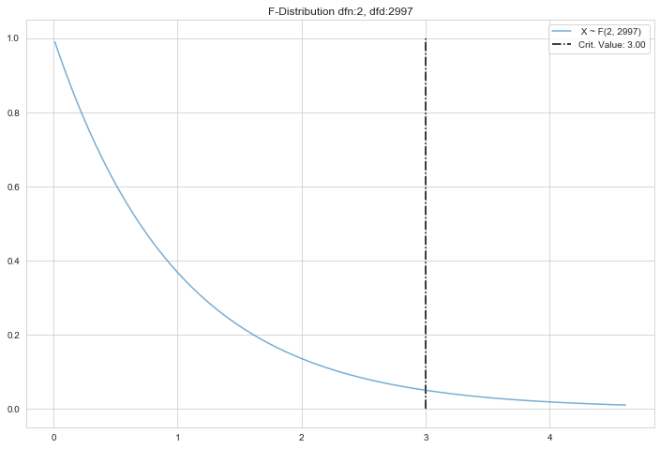
Question - 3
The data is right skewed or positive skewed
After bootstrapping, the data is normally distributed.
We get a p value of 0.0 on performing ANOVA analysis.
Since the P-value is less than threshold (0.05), we can conclude that there is a statistical difference between mean salaries of people with different educational qualification.

