Slide 1

SMART INDIA HACKATHON 2026
TITLE PAGE
Problem Statement ID –SIH26182
Problem Statement Title-Automated Attribution of Unknown Cryptocurrency Wallets to Nearest Virtual Asset Service Providers (VASPs) through Blockchain Intelligence APIs
Theme-Blockchain & Cybersecurity
PS Category- Software
Team ID-: [SIH - T224]
Team Name-[gridx]

Slide 2
IDEA TITLE
Gridx
Proposed Solution
Suspect Wallet Intake – Accepts a victim-reported cryptocurrency wallet address or transaction hash as the starting point of investigation.
Blockchain Data Collection – Collects transaction history, sender/receiver addresses, amounts, timestamps, assets and connected wallets through blockchain APIs/nodes.
Transaction Normalization & Graph Creation – Converts blockchain data into a common format and represents wallets as nodes and transactions as edges for investigation.
Real-Time Multi-Hop Tracing – Automatically follows the movement of fraud-linked funds across multiple wallet hops to identify the observable fund-flow path.
Unknown Wallet Detection – Detects unlabeled or unidentified wallets encountered during tracing and forwards them for deeper entity analysis.
VASP Attribution – SIH26182 – Analyzes unknown wallets using wallet behavior, transaction relationships, clustering and VASP fingerprints to identify likely service providers.
Graph-Based AI Analysis – Uses GraphSAGE / graph analysis to study the wallet and its surrounding transaction network and rank possible VASP associations.
Risk & Confidence Scoring – Produces a fraud-risk score and a confidence-ranked VASP result, clearly distinguishing probable attribution from confirmed identification.
Evidence-Based LEA Reporting – Combines transaction paths, wallet relationships, attribution signals, timestamps, risk and confidence into a visual investigation graph and LEA-ready report.

Slide 3
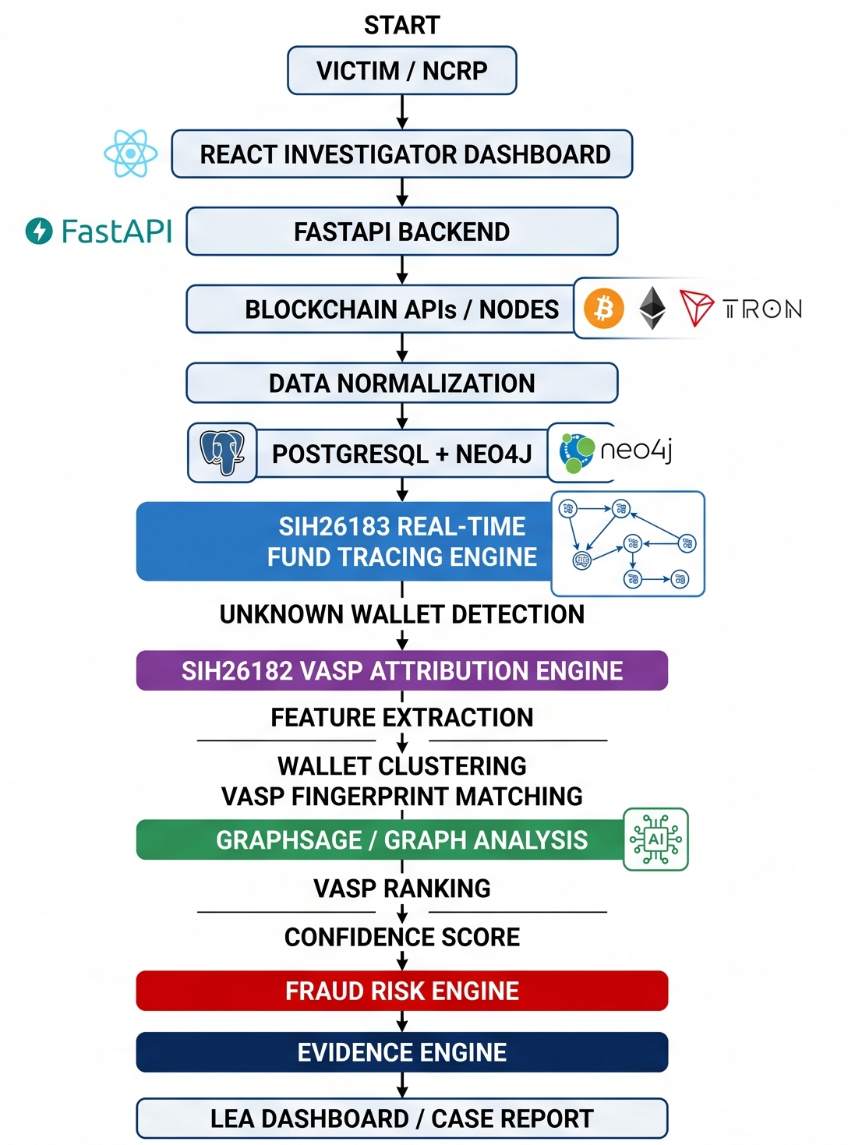
TECHNICAL APPROACH
Gridx
Frontend: React – investigator dashboard and visualization
Backend: FastAPI – asynchronous API and investigation services
Programming/Analytics: Python – blockchain analytics, feature processing and AI
Blockchain Data: Bitcoin Core, Etherscan, TronGrid – BTC, ETH and USDT-TRC20 data
Graph Database: Neo4j – wallets as nodes and transactions as edges
Case Database: PostgreSQL – case metadata, evidence and investigation records
AI/Graph ML: GraphSAGE – wallet/VASP attribution and graph-based scoring
Visualization: Interactive transaction and fund-flow graphs for investigators
Methodology and process for implementation:
1. Input & Validation – Receive suspect wallet address/transaction hash and validate the blockchain/network.
2. Data Ingestion – Collect transaction, address, asset, amount, timestamp and block information from blockchain APIs/nodes.
3. Data Normalization – Convert multi-chain data into a common structured transaction format.
4. Graph Construction – Store wallets as nodes and transactions as directed edges in Neo4j.
5. SIH26183 – Fund Tracing – Perform multi-hop tracing to follow suspicious fund movement from the reported wallet.
6. SIH26182 – VASP Attribution – For an unknown wallet, extract behavioral features, identify clusters and compare VASP fingerprints.
7. Graph AI & Scoring – Apply GraphSAGE/graph analysis to rank likely VASPs and generate an attribution confidence score.
8. Risk, Evidence & Report – Generate fraud-risk indicators, preserve transaction evidence, visualize the fund flow and produce the LEA case report.

Slide 4
FEASIBILITY AND VIABILITY
gridx
Analysis of the feasibility of the idea
Uses public blockchain data, APIs and open-source technologies.
Software-based solution with no special hardware requirement.
Initial implementation supports Bitcoin, Ethereum and USDT-TRC20.
Uses scalable graph and database architecture for blockchain investigation.
Modular design allows future support for additional blockchains and VASPs.
Potential challenges and risks
Bridges and privacy-focused systems may interrupt fund tracing.
New/offshore VASPs may have limited public information.
High transaction volume can increase processing time.
VASP wallet addresses and behavioral patterns can change.
AI-based attribution may produce false or uncertain matches.
Strategies for overcoming these challenges
Return the strongest observable path when tracing is incomplete.
Use confidence-ranked VASP attribution instead of absolute identification.
Apply hop limits, targeted traversal and caching for large transaction volumes.
Maintain a living VASP fingerprint database with updated information.
Treat AI results as decision support, not legal proof.

Slide 5
IMPACT AND BENEFITS
gridx
IMPACT AND BENEFITS
Enables cybercrime investigators and LEAs to analyze cryptocurrency fraud cases faster.
Reduces manual wallet-to-wallet tracing and repetitive blockchain analysis.
Helps identify suspicious fund-flow paths and likely VASP destinations.
Supports faster preparation of investigation evidence and case reports.
Provides a standardized and scalable workflow for digital-financial investigations.
Benefits of the solution
Social: Supports faster response to cryptocurrency fraud and strengthens digital- forensics capabilities.
Economic: Reduces investigation effort and can improve the opportunity for timely intervention before funds move further.
Operational: Combines tracing, VASP attribution, risk scoring and evidence in one platform.
Technical: Provides multi-hop transaction visualization and confidence-ranked VASP attribution.
Scalable: Can be extended to additional blockchains, VASPs and investigation cases.

Slide 6
RESEARCH AND REFERENCES
gridx
Meiklejohn et al. (2013) – A Fistful of Bitcoins
(https://www.usenix.org/system/files/login/articles/03_meiklejohn-online.pdf)
We take wallet/address clustering concepts and transaction-based entity identification for grouping related Bitcoin
addresses.
Möser, Böhme & Breuker (2013) – An Inquiry into Money Laundering Tools in the Bitcoin Ecosystem
(https://www.usenix.org/system/files/login/articles/03_meiklejohn-online.pdf)
We take transaction-graph analysis and awareness of mixing/anonymization behavior for tracing and risk analysis.
Weber et al. (2019) – Anti-Money Laundering in Bitcoin
(https://sensorsportal.com/BAC_journal/Vol_03/Blockchain_and_Cryptocurrency_Vol_3.pdf)
We take graph-based machine-learning concepts for detecting suspicious and illicit cryptocurrency transaction patterns.
Akcoraetal. (2020) – BitcoinHeist
(https://www.ijcai.org/proceedings/2020/0612.pdf)
We take graph/topological analysis techniques for identifying abnormal and malicious patterns in blockchain
transactions.
Hamilton, Ying & Leskovec (2017) – GraphSAGE
(https://cs.stanford.edu/~jure/pubs/graphsage-nips17.pdf)
We take the GraphSAGE graph-learning approach to analyze a wallet together with its neighboring transaction network for VASP attribution.
Elmougy & Liu (2023) – Demystifying Fraudulent Transactions and Illicit Nodes in the Bitcoin Network
(https://arxiv.org/abs/2306.06108)
We take graph-based methods for identifying suspicious transactions and illicit wallet nodes for financial-forensics analysis.

