Slide 1
Docker

Slide 2
Docker
docker create creates a container but does not start it.
docker rename allows the container to be renamed.
docker run creates and starts a container in one operation.
docker rm deletes a container.
docker rmi deletes an image
docker update updates a container's resource limits.
Few Docker run Options:
Normally if you run a container without options it will start and stop immediately, if you want keep it running you can use the command, docker run -td container_id this will use the option -t that will allocate a pseudo-TTY session and -d that will detach automatically the container (run container in background and print container ID).
If you want a transient container, docker run --rm will remove the container after it stops.
If you want to map a directory on the host to a docker container, docker run -v $HOSTDIR:$DOCKERDIR. Also see Volumes.
If you want to remove also the volumes associated with the container, the deletion of the container must include the -vswitch like in docker rm -v.
There's also a logging driver available for individual containers in docker 1.10. To run docker with a custom log driver (i.e., to syslog), use docker run --log-driver=syslog.
Another useful option is docker run --name yourname docker_image because when you specify the --name inside the run command this will allow you to start and stop a container by calling it with the name the you specified when you created it.

Slide 3
Docker - Starting and Stopping Container
docker start starts a container so it is running.
docker stop stops a running container.
docker restart stops and starts a container.
docker pause pauses a running container, "freezing" it in place.
docker unpause will unpause a running container.
docker wait blocks until running container stops.
docker kill sends a SIGKILL to a running container.
docker attach will connect to a running container.

Slide 4
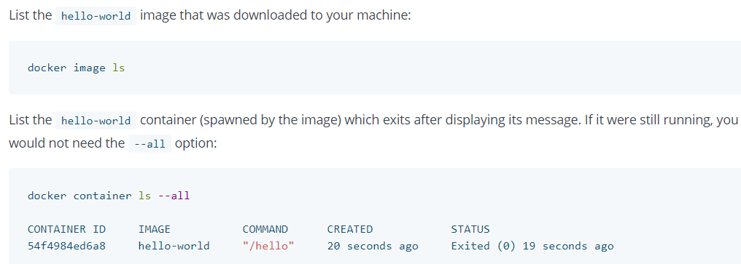
Docker – Import/Export commands
docker cp copies files or folders between a container and the local filesystem.
docker export turns container filesystem into tarball archive stream to STDOUT.
Test that your installation works by running the simple Docker image, hello-world:
docker run hello-world

Slide 5
Docker – more Container commands
docker ps shows running containers.
docker logs gets logs from container.
docker inspect looks at all the info on a container (including IP address).
docker info – displays number of Containers, Images, etc…
docker container ls -a : show all container even which is not running
docker container ls: show only running COntainers
docker events gets events from container.
docker port shows public facing port of container.
docker top shows running processes in container.
docker stats shows containers' resource usage statistics.
docker diff shows changed files in the container's FS.
docker ps -a shows running and stopped containers.
docker stats --all shows a running list of containers.

Slide 6
Docker – Import/Export commands
docker cp copies files or folders between a container and the local filesystem.
docker export turns container filesystem into tarball archive stream to STDOUT.
-d : run container in background
docker run --name=abcdname -p 8080:8080 -t fridayimage
To explciitly give container name

Slide 7
Docker – Registry & Repository
A repository is a hosted collection of tagged images that together create the file system for a container.
A registry is a host -- a server that stores repositories and provides an HTTP API for managing the uploading and downloading of repositories.
Docker.com hosts its own index to a central registry which contains a large number of repositories. Having said that, the central docker registry does not do a good job of verifying images and should be avoided if you're worried about security.
docker login to login to a registry.
docker logout to logout from a registry.
docker search searches registry for image.
docker pull pulls an image from registry to local machine.
docker push pushes an image to the registry from local machine.

Slide 8
Docker – Container Commands
Kill running containers
docker kill $(docker ps -q)
Delete all containers (force!! running or stopped containers)
docker rm -f $(docker ps -qa)
Delete stopped containers
docker rm -v $(docker ps -a -q -f status=exited)
Delete containers after stopping
docker stop $(docker ps -aq) && docker rm -v $(docker ps -aq)

Slide 9
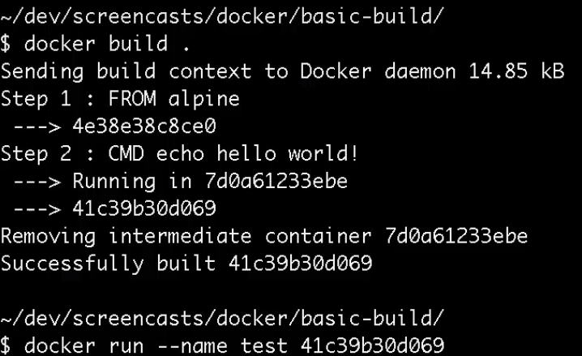
Docker – How to create an Image
One you create Dockerfile use “docker build .” command to create an image.
Now run the Image
docker run - -name test <image_id>
Assuming Dockerfile is in current folder
test is name, using which it can be referred later

Slide 10
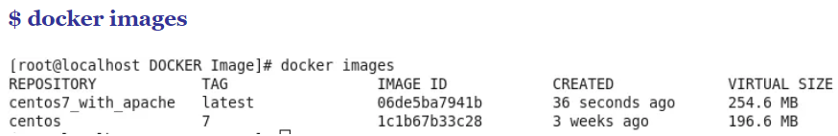
Docker – How to create an Image
After creation of image you can verify it, with below command
docker images

Slide 11
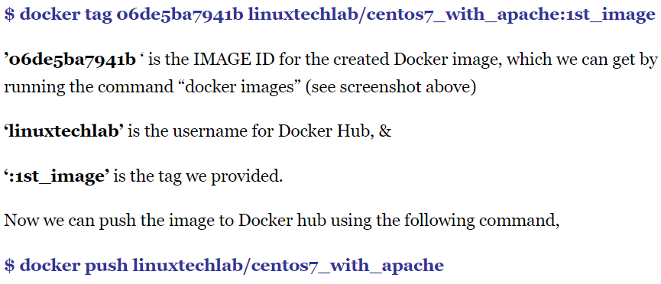
Docker – Upload Image to Docker Hub
Image you created can be kept local and be used. However incase you want to share it with others, you can upload Image to Docker Hub
$ docker login
You will be prompted for Docker Hub username and password.

Slide 12
Docker – Misc commands
docker-machine ip default
Above command to get IP address of docker machine. you can access Docker machine from Host machine, using IP address shown by above command.
docker port a6e93aefde4d
Above command to get port on which the container is running

Slide 13
Q & A
Difference between Image & Container
Using an object-oriented programming analogy, thedifference between a Docker image and a Docker container is the same as that of the difference between a class and an object. An object is the runtime instance of a class. Similarly, a container is the runtime instance of an image.

Slide 14
Q & A
Can there be multiple Containers running, using single Image
Yes, very much. Once you have an image you can run as many Containers as you want, from a single Image.
It is just like Oops single Class can have any number of objects/instances

Slide 15
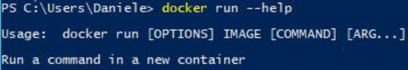
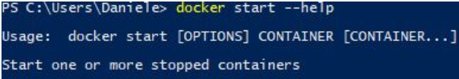
Q & A
Difference between “docker run & docker start”
run runs an image
start starts a container.
Run: create a new container of an image, and execute the container. You can create N clones of the same image. The command is: docker run IMAGE_ID and not docker run CONTAINER_ID
Start: Launch a container previously stopped. For example, if you had stopped a database with the command docker stop CONTAINER_ID, you can relaunch the same container with the command docker start CONTAINER_ID, and the data and settings will be the same.

