Slide 1
Jenkins

Slide 2
Jenkins
Download Jenkins from the URL http://mirrors.jenkins.io/windows/latest

Slide 3
Jenkins
Jenkins url
http://localhost:8080
username: admin
password: admin
E-mail ID: vskreddy652@yahoo.com
Incase Jenkins doesn’t get started, use below command to start it:
C:\Program Files (x86)\Jenkins>java -jar jenkins.war --httpPort=9090
and wait until u see “ Jenkins is fully up and running”

Slide 4
Jenkins
Jenkins is one of the most popular tools for continuous integration and continuous delivery on any platform. A Java application, Jenkins has many plugins for automating almost everything at the infrastructure level. The use of Jenkins has widely increased rapidly due to a rich set of functionalities, which it provides in the form of plugins.
Step by Step Installation: Below is URL to download Jenkins from
http://mirrors.jenkins.io/windows/latest

Slide 5
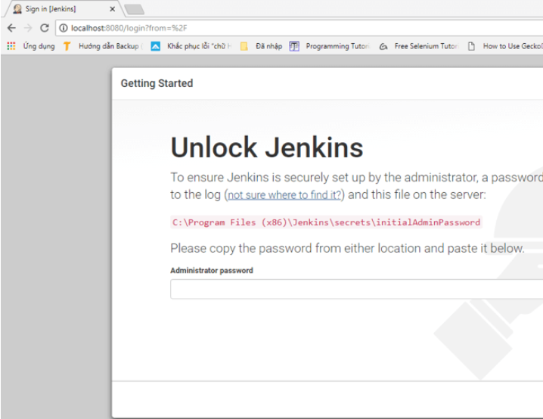
Jenkins
Follow onscreen Instructions to complete installation.
Open URL http://localhost:8080

Slide 6
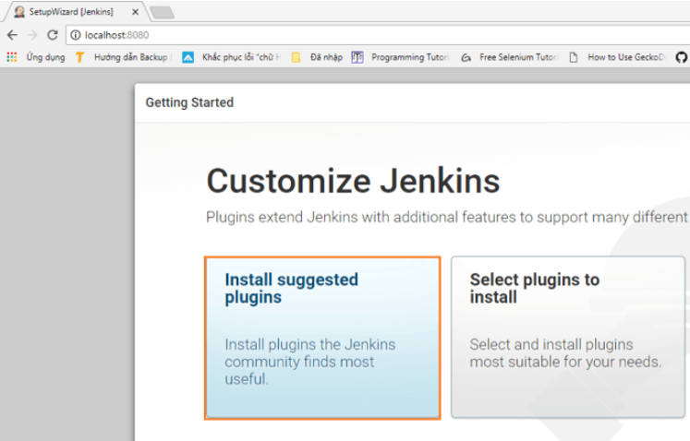
Jenkins
To unlock Jenkins, copy the password from the file at C:\Program Files (x86)\Jenkins\secrets\initialAdminPassword and paste it in the Administratorpassword field. Then, click the "Continue" button.

Slide 7
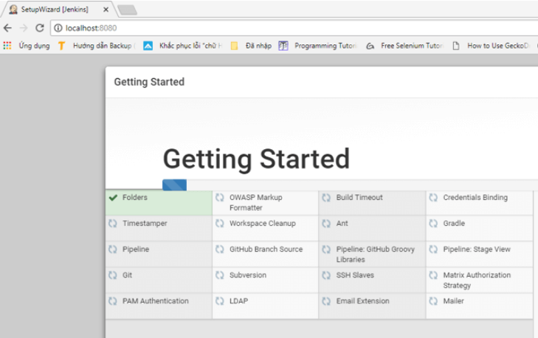
Jenkins
In Next Screen, wait until all plugins are installed

Slide 8
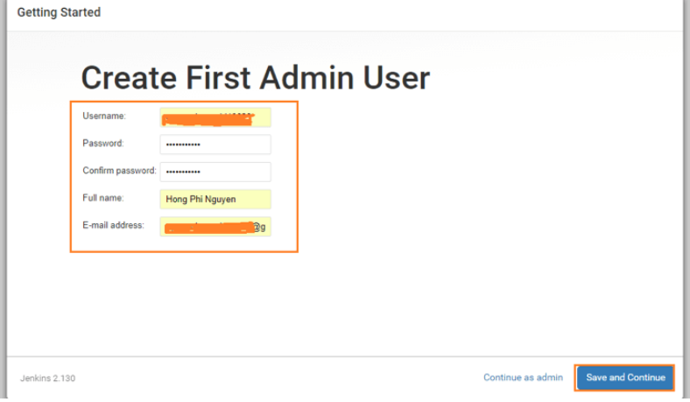
Jenkins
Provide username and password of Admin. From now on use this admin username/password to login to Jenkins

Slide 9
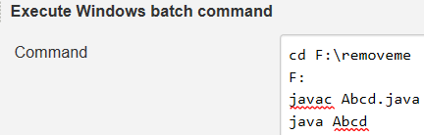
Jenkins – Create First Job – Non GIT
After Login to Jenkins, click New Item
Provide a Name for the New Job, select “Freestyle”
Click Ok.
Under Build, Select “Execute Windows batch” Command. And provide below commands in window
Click Save, to Complete creation of Job Item.
Now Select Build Now from left side menu, observe that build gets done, after that, you can observe Console output

Slide 10
Jenkins – Get GIT Project ready
Now create a folder, and in that create a Java file.
Create Github repo, commit & Push above Project, to GitHub
Follow instructions from next slide to Build above project using Jenkins

Slide 11
Jenkins – Create Job – GIT Based
Create Item just like above, now select Configure from left side.
Now on the next web page, under “Source Code management” select “Git”
This option gets expanded, and asks for GIT repo URL
In Build Trigger, select Poll SCM, specify * * * * *
Above indicates that SCM need to be polled for every one minute, for changes. Once Jenkins Job finds changes, build is initiated.

Slide 12
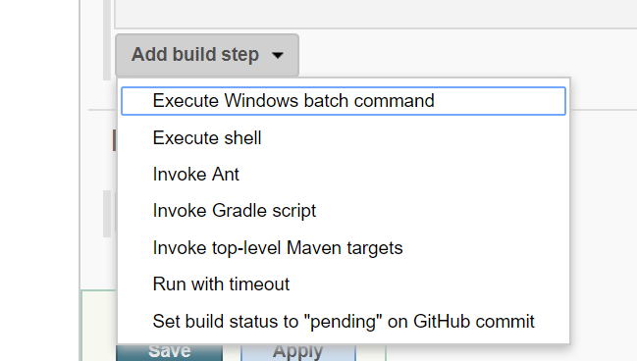
Jenkins – Maven Project
1. Create New Item -> Give name as Maven example
2. Provide some description
3. Under Build Section, select “Invoke top-level Maven targets”

Slide 13
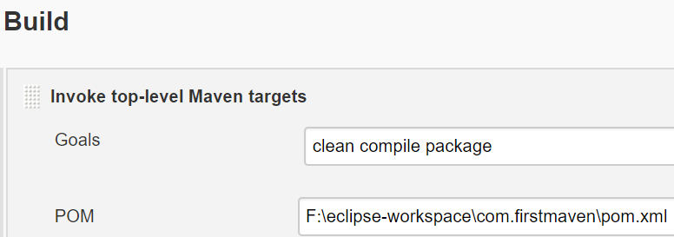
Jenkins – Maven Project
4. Specify Goals appropriately “clean package”
5. Select Advanced Button at bottom, and for POM, specify POM file name full path.
6. Now select Apply and Save

Slide 14
Jenkins – Maven Project
4. Specify Goals appropriately “clean package”
5. Select Advanced Button at bottom, and for POM, specify POM file name full path.
6. Now select Apply and Save

Slide 15
Jenkins – Maven Project
From left hand menu, select “Build Now”, it may take a min or so to complete Build, once done you can click on the icon to view console logs

Slide 16
Jenkins – Git - Maven Project
Build a freestyle software project, by providing New Item name, provide Project name, and Free Style Project, click OK.
Now Project Configuration gets displayed.
Under Source code Management Section, select Git, and specify Repository URL.
Under Build Triggers section, select Poll SCM and for Schedule specify H * * * *
To run a simple Maven build. Scroll down to the Build section and click on the "Add build step" and choose "Invoke top-level Maven targets". Then enter "clean package" in the Goals field.

Slide 17
Jenkins – JUnit Test Report
Project configuration - Post Build
Go to the Post-build Actions section and check "Publish JUnit test result report" checkbox.
When Maven runs unit tests in a project, it automatically generates the XML test reports in a directory called surefire-reports in the target directory.
So enter "**/target/surefire-reports/*.xml" in the "Test report XMLs" field. The two asterisks at the start of the path ("**") are a best practice to make the configuration a bit more robust: they allow Jenkins to find the target directory no matter how we have configured Jenkins to check out the source code.

Slide 18
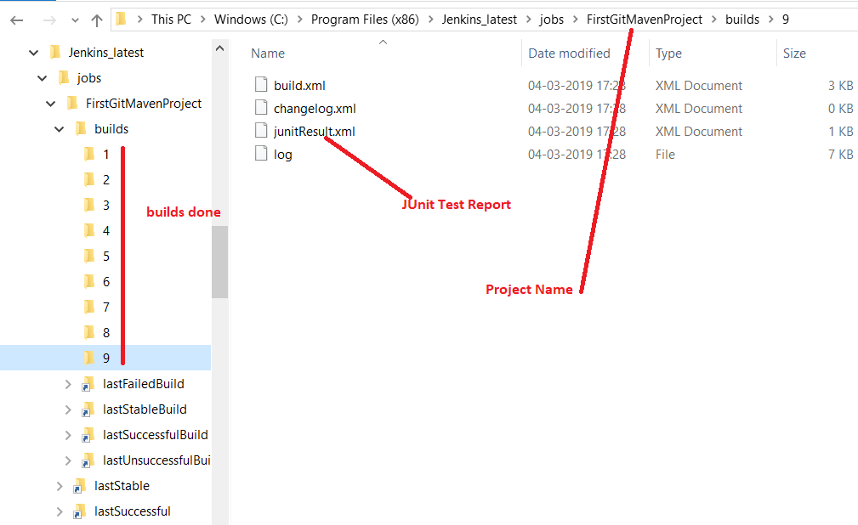
Jenkins – JUnit Test Report

Slide 19
Emma Code Coverage Integration
https://devsoap.com/test-coverage-analysis-with-emma/
https://wiki.jenkins.io/display/JENKINS/Emma+Plugin

Slide 20
Misc
How to restart Jenkins
http://localhost:8080/restart
Other ways: From command line use below(below runs only when installed using .msi, and is running as Service)
net stop jenkins
net start jenkins
How to change default port?
Go to the directory where you installed the Jenkins (In default, it is under Program Files/Jenkins)
Open the Jenkins.xml.
Search --httpPort=8080 and replace the 8080 with the new port number that you wish.

