Slide 1
Jenkins Pipeline

Slide 2
Steps to Manually create Jenkins Pipeline
Create Individual multiple Jobs, by following the steps in earlier ppt. For example you create three individual Jobs with the names Job1, Job2 and Job3.
In Job1, under Post Build Action section, in drop down select Build other Projects, and specify name of next job which is Job2. Apply & click Save.
In Job2, under Post Build Action section, in drop down select Build other Projects, and specify name of next job which is Job3. Apply & click Save.

Slide 3
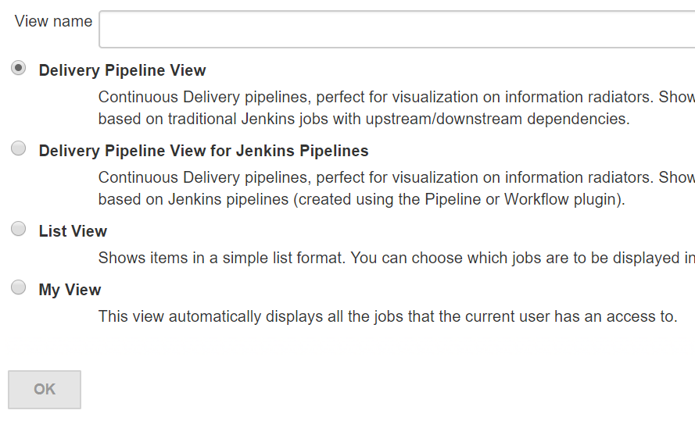
Steps to Manually create Jenkins Pipeline
Now we need to Visually show the JObs as a Pipeline. FOr that click on + symbol tab, beside list of all the jobs. Specify Name Click Ok

Slide 4
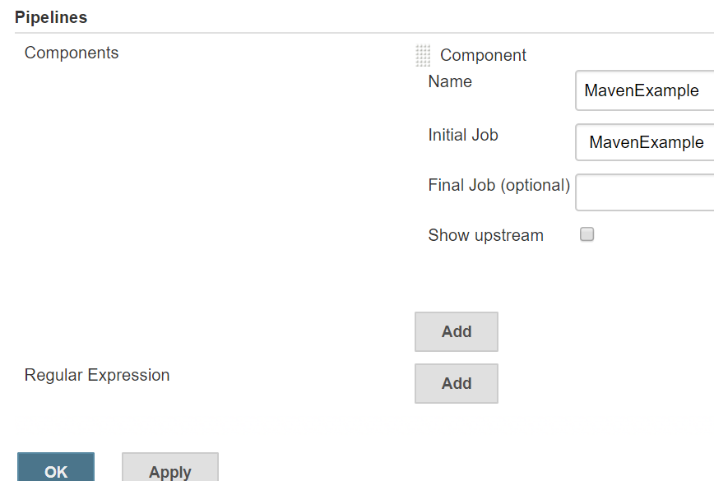
Steps to Manually create Jenkins Pipeline
Now select Initial Job, from list of existing Jobs, as shown below. Click Apply & Ok, to complete creation of PIpeline.

Slide 5
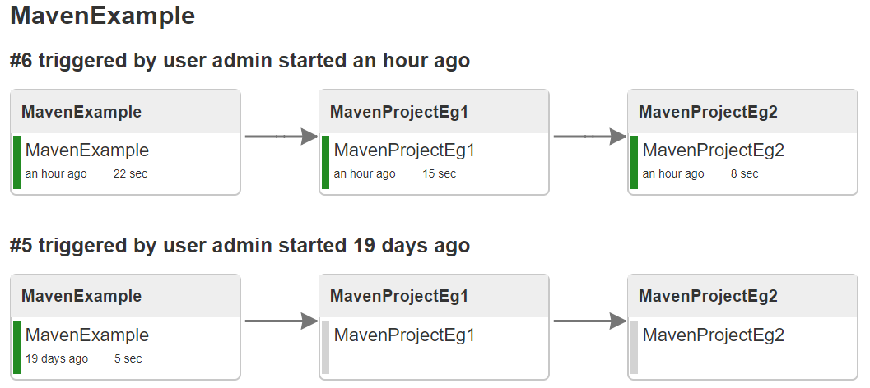
Steps to Manually create Jenkins Pipeline
Now, goto First JOb which is Job1(in our case) and Click ‘Build Now’, and then Select appropriate Pipeline you created from Tabs on top, to get below View

Slide 6
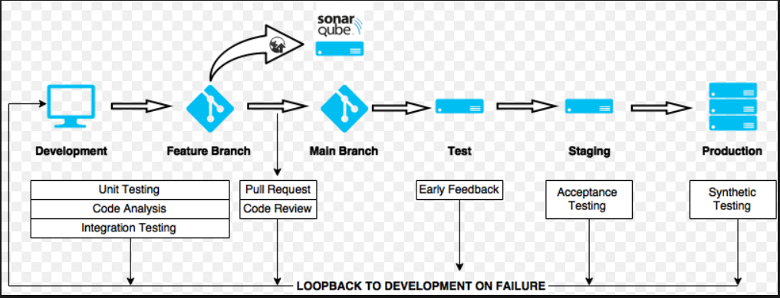
Jenkins Pipeline

Slide 7
Jenkins Pipeline
Jenkins 2 comes with a great feature called Pipelines, which is very extensible when we need to define a continuous integration environment for a project.
A Pipeline is another way of defining some Jenkins steps using code, and automate the process of deploying software.
It’s using a Domain Specific Language(DSL) with two different syntaxes:
Declarative Pipeline
Scripted Pipeline
In our examples, we’re going to use the Scripted Pipeline which is following a more imperative programming model built with Groovy.
Let’s go through some characteristics of the Pipeline plugin:
pipelines are written into a text file and treated as code; this means they can be added to version control and modified later on
they will remain after restarts of the Jenkins server
we can optionally pause pipelines
they support complex requirements such as performing work in parallel
the Pipeline plugin can also be extended or integrated with other plugins

Slide 8
Jenkins Pipeline
In other words, setting up a Pipeline project means writing a script that will sequentially apply some steps of the process we want to accomplish.
To start using pipelines we have to install the Pipeline plugin that allows composing simple and complex automation.
We can optionally have the Pipeline Stage View one too so that when we run a build, we’ll see all the stages we’ve configured.

Slide 9
Jenkins Pipeline - Example
we’ll use a small Spring Boot application. We’ll then create a pipeline which clones the project, builds it and runs several tests, then runs the application.
Let’s install the Checkstyle, Static Analysis Collector and JUnit plugins, which are respectively useful to collect Checkstyle results, build a combined analysis graph of the test reports and illustrate successfully executed and failed tests.
First, let’s understand the reason of Checkstyle here: it’s a development tool that helps programmers write better Java code following accepted and well-known standards.
Static Analysis Collector is an add-on which collects different analysis outputs and prints the results in a combined trend graph. Additionally, the plug-in provides health reporting and build stability based on these grouped results.
Finally, the JUnit plugin provides a publisher that consumes XML test reports generated during the builds and outputs detailed and meaningful information relative to a project’s tests.

Slide 10
Jenkins Pipeline - Example
First, we’re cloning the repository from GitHub, then changing the directory to our project, which is called spring-jenkins-pipeline.
Next, we compiled the project and apply Checkstyle analysis in a parallel way.
The following step represents a parallel execution of unit tests and integration tests, then deployment of the app.
Parallelism is used to optimize the pipeline, and have the job runs faster. It’s a best practice in Jenkins to simultaneously run some independent actions that can take a lot of time.
For example, in a real-world project, we usually have a lot of unit and integration tests that can take longer.
Note that if any test failed the BUILD will be marked as FAILED too and the deployment will not occur.
Also, we’re using JENKINS_NODE_COOKIE to prevent immediate shut down of our application when the pipeline reaches the end.

Slide 11
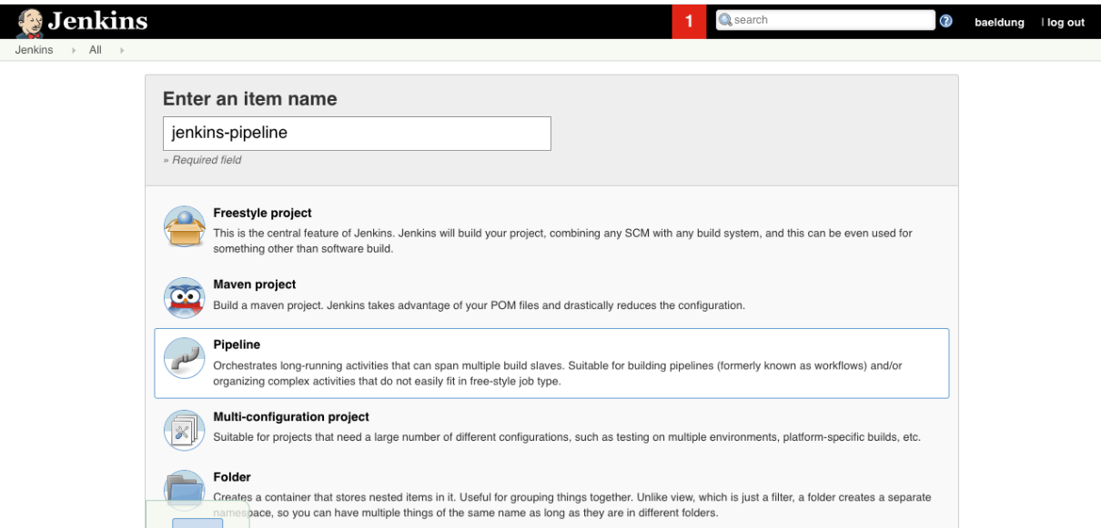
Jenkins Pipeline - Steps
We need to create a new Jenkins job. Let’s be sure to select Pipeline as the type before hitting the OK button as described in this screenshot:

Slide 12
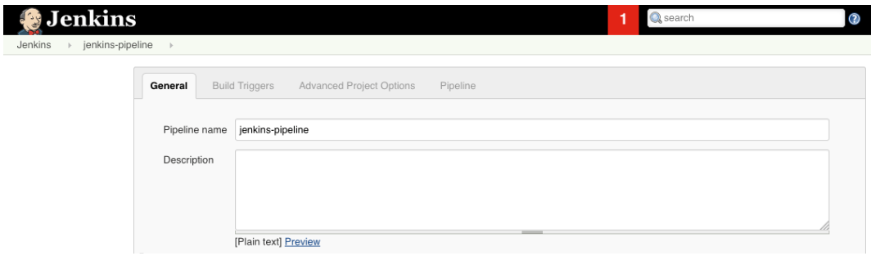
Jenkins Pipeline - Steps
The next screen allows us to fill in more details of the different steps of our Jenkins job, such as the description, triggers, some advanced project options:

Slide 13
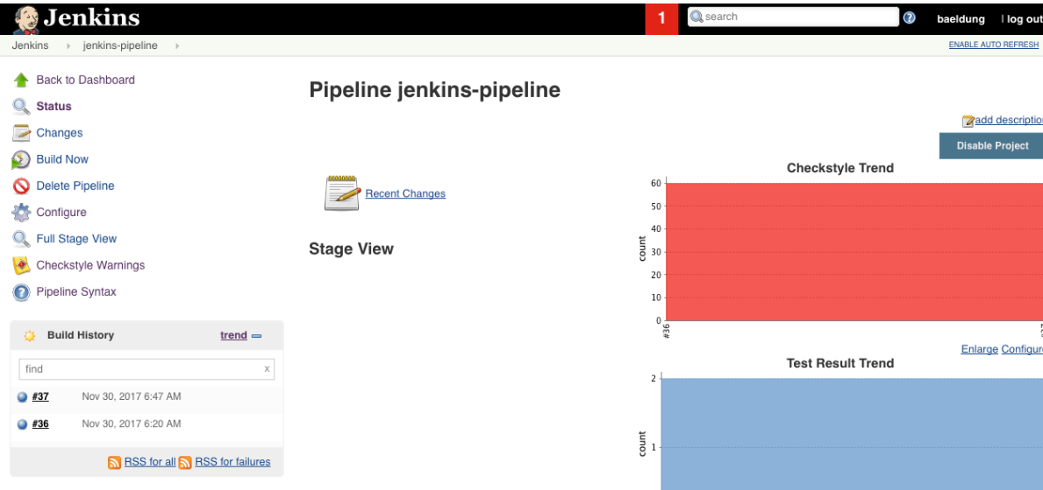
Jenkins Pipeline - Steps
After creating the job, we’ll save our script and hit Build Now on the project home of our Jenkins dashboard.
Here’s an overview of the builds:

Slide 14
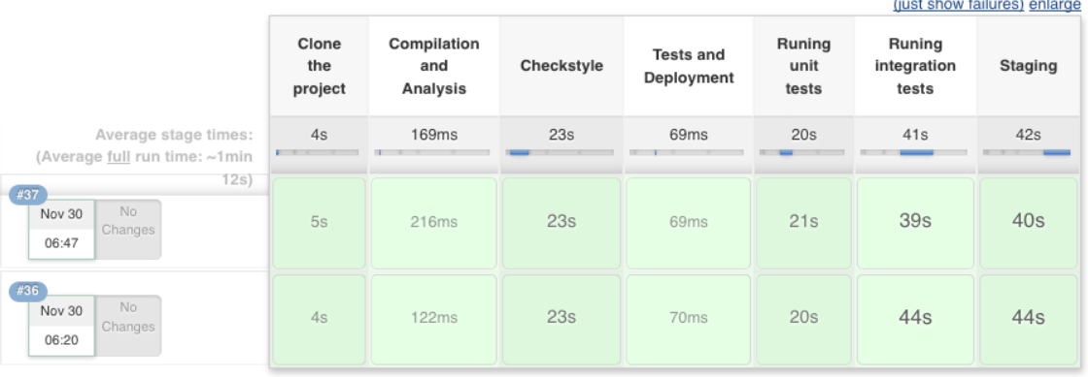
Jenkins Pipeline - Steps
the stage view of the pipeline, with the result of each stage:
Each output is accessible when hovering over a stage cell and clicking the Logs button to see the log messages printed in that step.
We can also find more details of the code analysis. Let’s click on the desired build from the Build History on the right menu and hit Checkstyle Warnings.

Slide 15
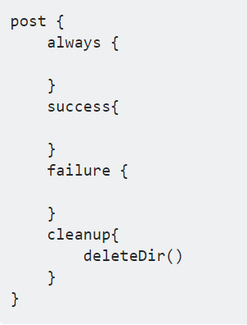
Jenkinsfile Syntax - Misc
https://jenkins.io/doc/book/pipeline/syntax/

