Slide 1
CSE713 Paper Review
Saib Ahmed
ID: 22166032
Moh. Shohanur Rahman
ID: 22166040
Shah Sufian Noor Mahady
ID:21266030

Slide 2
Paper Title:
Automatic Music Genre Classification and Its Relation with Music Education

Slide 3
The process of identifying music genres has now grown to be too complicated for humans to handle given the global music industry's quick advancement and the enormous growth of data.
The goal is to create a deep learning system that can categorize 10 various musical genres, taking into account the achievements of deep neural networks in this area.
GTZAN dataset is used for this research

Slide 4
Mel Frequency Cepstral Coefficients are used in the dataset to represent musical parts (MFCC).
The Mel Frequency Cepstral Coefficients (MFCCs) of a signal are a small set of features (usually about 10-20) which concisely describe the overall shape of a spectral envelope.

Slide 5
Method
Fig1.General Classification Scheme

Slide 6
As can be understood from Figure 1, in this study, first the data were preprocessed and transformed each datum into structures represented by MFCCs. Later, the authors carried out the training of CNN, which was decided as a result of the experiments, using these structures. They decided the parameters of the model as a result of the experiments. While determining the parameters, They took into account the goal of realizing the most successful classification. Then, they determined the classification success of the model with the testing data.

Slide 7
Preprocessing
The music segments are structures represented as sound signals. These signals, which have direction and intensity, have constantly changing values depending on time. To make the audio signals understandable by the computer, these analog signals should be converted into digital signals by sampling with the specified sampling rate.
Figure 2.Signal Representation of Blues-0

Slide 8
Figure 3. Signal Representation of Metal-0

Slide 9
Figure 4.Fast Fourier Transform (FFT)of Blues-0

Slide 10
Figure 5. FFT of Metal-0

Slide 11
Mel Frequency Cepstral Coefficients (MFCC)
Figure 6. Mel Filters

Slide 12
MFCCs are features that enable distinction similar to the human voice perception system. In this way, MFCCshavea structure that can achieve high performance in applications such as music classification and voice recognition. Cepstrum is defined as the inverse Fourier transform of the logarithmic Fourier transform of a signal. Before taking the logarithm of the Cepstrum, if it is arranged according to the mel filters in Figure 6, which shows similar responses to human hearing nerves.

Slide 13
Proposed CNN Model
MFCCs resized to 26x65 as input to CNN. The CNN with the most successful results in experiments consists of the following layers:
•Convolution Layer with filters:256, kernel size:3x3, activation function: relu, padding: valid,
•Convolution Layer with filters:256, kernel size:3x3, activation function: relu, padding: valid,
•Average Pooling with pool size:3x3, strides:2x2, padding: same,
•Convolution Layer with filters:256, kernel size:3x3, activation function: relu, padding: valid,
•Average Pooling with pool size:3x3, strides:2x2, padding: same,
•Convolution Layer with filters:512, kernel size:4x4, activation function: relu, padding: valid,
•Global Average Pooling,
•Fully Connected Layer,
•Dense Layer with units:256, activation function: relu,
•Dense Layer with units:128, activation function: relu,
•Dense Layer with units:10, activation function: softmax.

Slide 14
Figure 7. Convolutional Neural Network Architecture

Slide 15
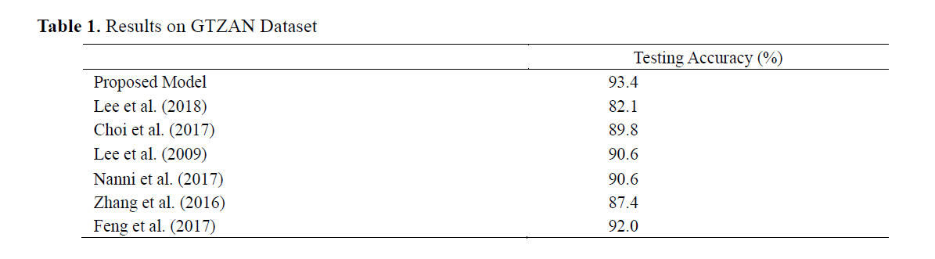
Results:

Slide 16
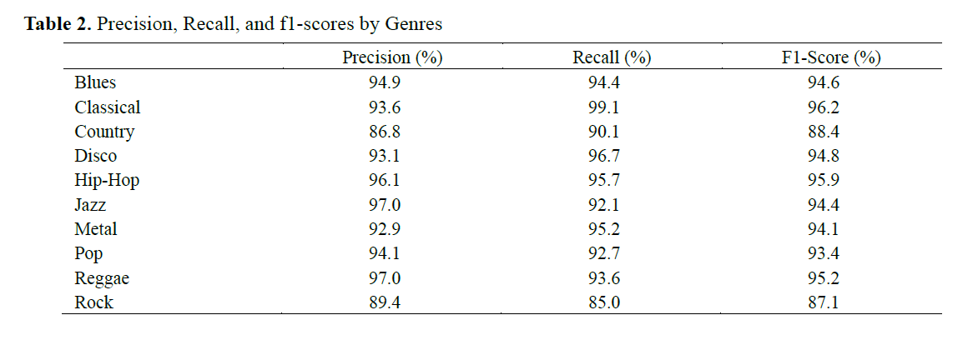

Slide 17
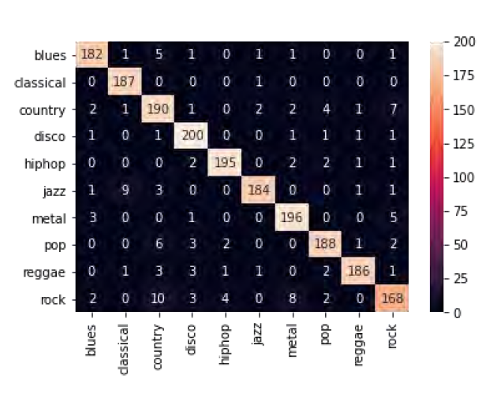
Figure 8. Confusion Matrix of 93.8%Accurate Fold

Slide 18
Conclusion
The idea that deep learning can perform this classification process faster and with more successful results than humans has been the main starting point of this study. Therefore, considering the results of the models used in previous studies and the experiments on the subject, The authors carried out the classification process using CNN and 26x65 MFCCs. As a result of the study, we achieved a level of success that can be compared with studies in which many features or more complex and combined deep learning models were used. Also, the use of smaller data resulted in less training time and lower memory usage.

Slide 19
Thanks

