Slide 1
SIC–USING GEN AI
(Smart Interview Coach)
Enhancing Resume Analysis and Interview Preparation with AI
BY S.SAIBABU-21BCE9232
D.JAYANTH VARMA -21BCE9786 CH.NAGA CHANDANA PRIYA-21BCE9235

Slide 2

Introduction
GEN AI-Powered Smart Interview Coach System: An advanced digital tool that combines AI and machine learning techniques to provide in-depth analysis of candidate profiles and interviews.
Enhancing Resume Analysis, Interview Preparation, and Mock Interviews with AI Utilizes AI-driven insights to optimize resume evaluations, tailor interview preparations, and simulate realistic mock interviews for better candidate readiness.
Our project, Smart Interview Coach using Gen AI, is an intelligent and accessible platform designed to enhance interview preparation using Generative AI and Machine Learning. It analyzes resumes to generate customized, domain-specific interview questions and conducts AI-powered mock interviews via speech or text. With real-time feedback on response quality and personalized improvement tips, the system helps candidates build confidence, identify skill gaps, and track progress .

Slide 3
Problem Statement
Job seekers often struggle with interview preparation due to lack of personalized coaching.
Professional interview coaching services are expensive and inaccessible to many.
Generic question sets and mock interviews fail to address individual candidate needs.
There's no real-time, adaptive feedback mechanism in traditional preparation methods.
Candidates lack a realistic, risk-free environment to practice and improve.

Slide 4
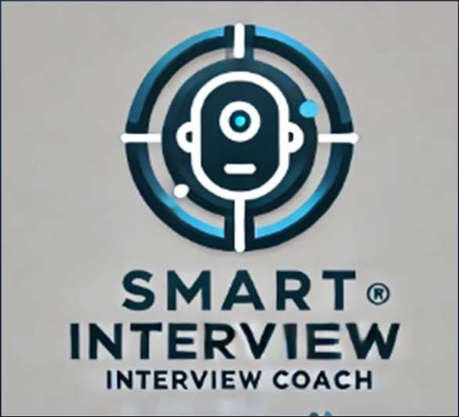
GEN AI POWERED SMART INTERVIEW COACH
RESUME ANALYSIS AND OPTIMIZER
INTERVIEW PREPARATION GUIDE
MOCK INTERVIEW ASSESSMENT

Slide 5

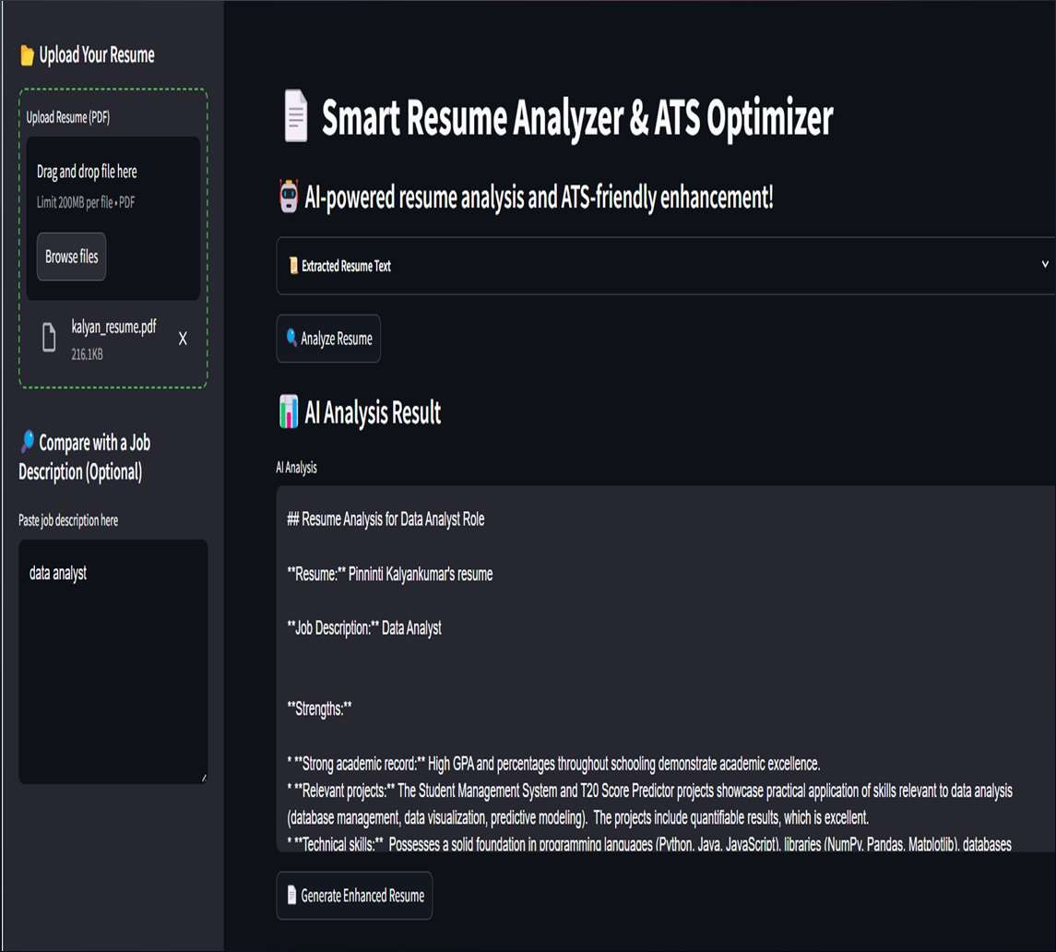
Resume Analysis
01
RESUME UPLOAD
TEXT EXTRACTION
AI ANALYSIS : IDENTIFY STRENGTHS AND WEAKNESSES SKILLS TO IMPORVE , SUGGESTING KEY WORDS TO ENCHANCE THE RESUME
RESUME SCORING ( ATS SCORE )
ENHANCED RESUME

Slide 6

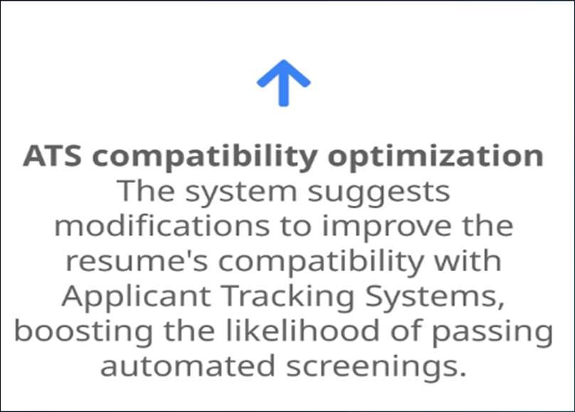
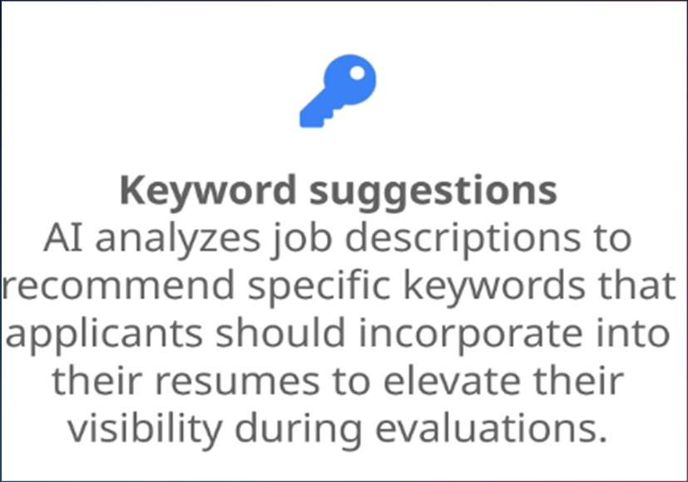
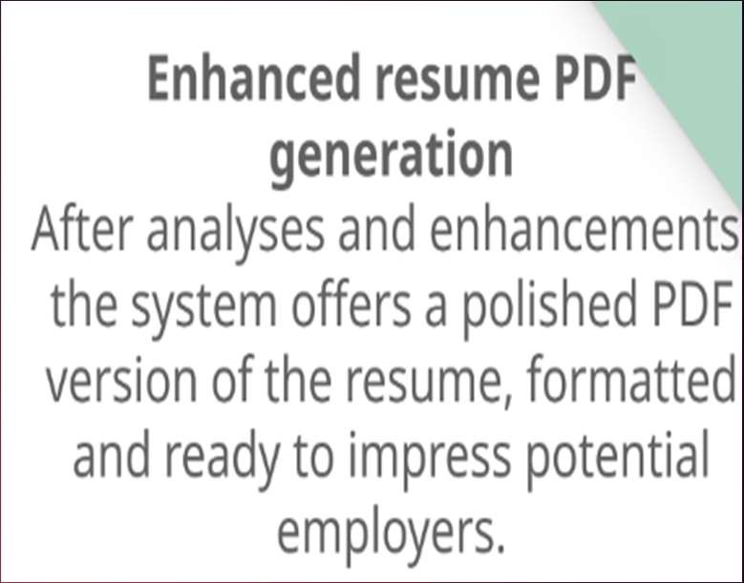
NLP and AI models for extraction
SIC utilizes advanced Natural Language Processing (NLP) and AI models, such as Google Gemini AI, to automate the extraction of crucial details from resumes. This ensures a comprehensive analysis that identifies key qualifications and experiences relevant to job positions.

Slide 7
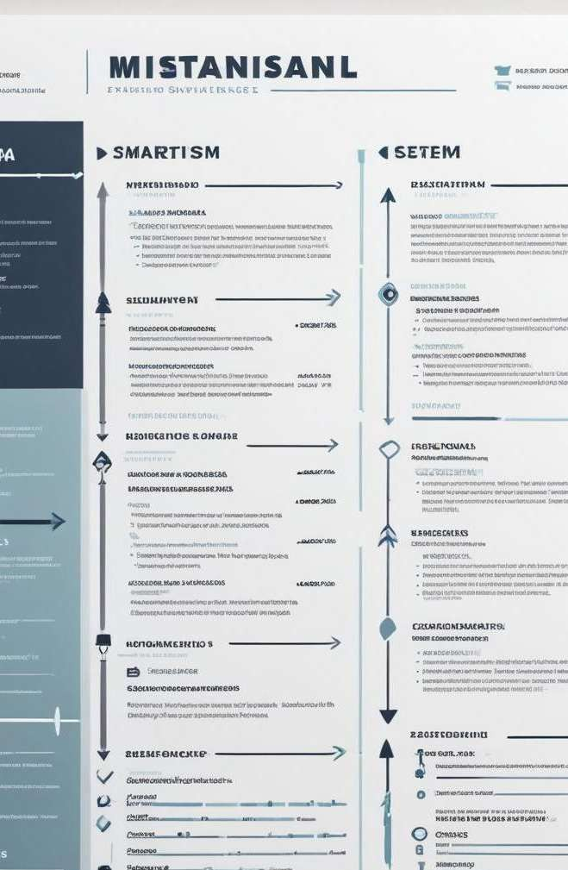
Key Details Evaluation
The system evaluates resumes by identifying and scoring essential components like skills, education, and past job experiences. It highlights strengths and weaknesses and performs gap analysis to suggest areas for improvement.
ATS compatibility assessment
The ATS (Applicant Tracking System) compatibility assessment checks how well a resume can pass through automated screening processes used by employers, providing recommendations to enhance the resume's visibility and effectiveness.

Slide 8
02
Interview Prep Guide
PERSONALIZED INTERVIEW QUESTION GENERATION BASED ON RESUME
SUGGESTING BEST WAY OF APPROACH TO ANSWER
COMPANY SPECIFIC ROLE BASED PREVIOUS YEARS QUESTION AND BEST ANSWERS GENERATION
SUGGEST STUDY MATERIALS ACCORDING TO THE SPECIFIC JOB ROLE AND
PREPARATION WEBSITES SUGGESTION . i.e Prepinsta, Javatpoint, Interviewbit

Slide 9

Personalized question generation
SIC generates personalized interview questions tailored to the candidate's resume details, incorporating both technical and behavioral aspects to cover the specific requirements of the role.
Role-specific questions
The system fetches common industry-specific interview questions relevant to particular job titles such as Software Engineer or Data Scientist, ensuring that candidates are well-prepared for the types of questions they may encounter.
Company-specific interview preparation
SIC pulls real-world interview questions from leading companies like TCS, Infosys, Amazon, and Google, along with AI-generated ideal answers to help candidates form their own well-structured responses.

Slide 10
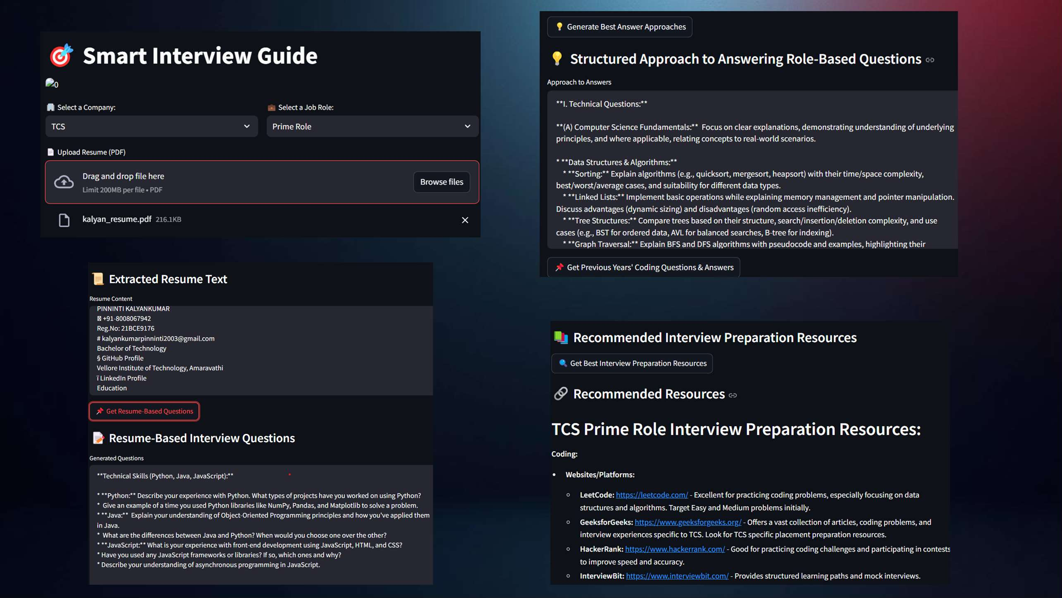

Slide 11
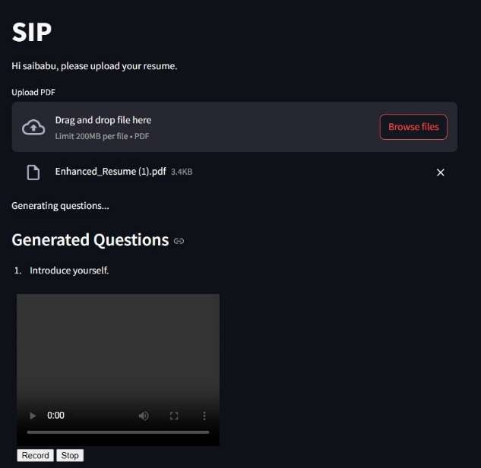
GEN AI Powered Mock Interviews System
03
Simulated real-time interviews
SIC simulates real-time interviews to provide candidates with a realistic interview environment. Candidates engage in mock interviews, allowing them to practice and refine their responses while building confidence before facing actual interviews.
AI feedback on performance
After each mock interview, the system generates instant feedback, evaluating aspects such as clarity, engagement, and the quality of responses. This feedback helps candidates understand their performance and identify areas for improvement.

Slide 12
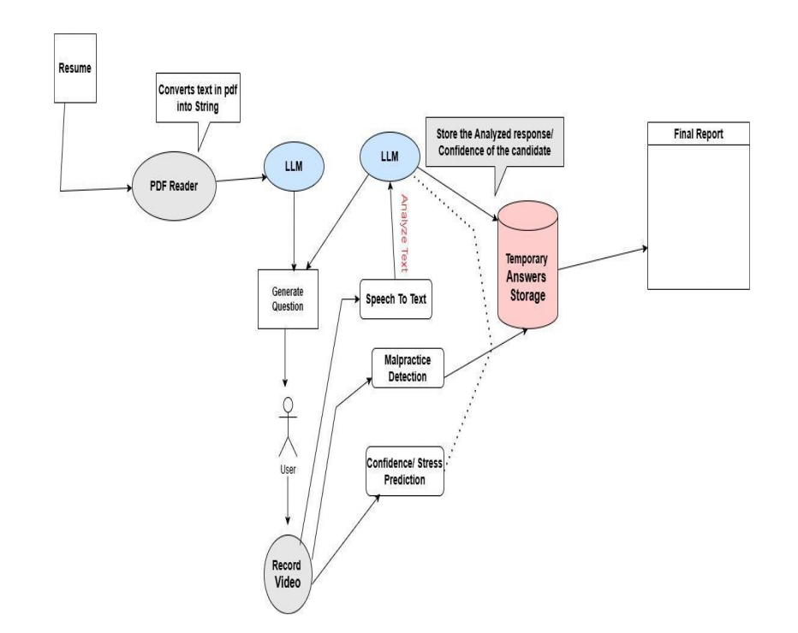

Slide 13

Video and speech analysis
Candidates can record their responses during mock interviews. AI analyzes the videos for speech clarity, emotional expression, and confidence levels, providing insights that help candidates improve their verbal communication and body language.
Technical correctness assessment:
AI algorithms assess the accuracy and relevance of candidates' answers to technical questions, ensuring a factual basis for evaluations.

Slide 14
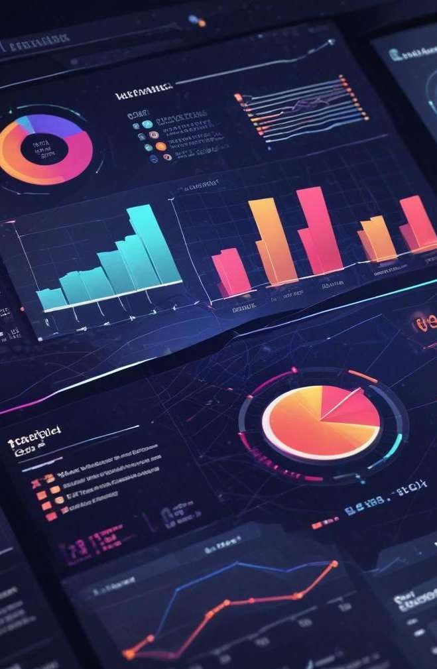
Feedback Reports
Automated report generation
Following the mock interview, an automated report is generated summarizing the candidate's performance. This report provides a structured overview, highlighting key metrics and personalized feedback.
Strengths and weaknesses summary
The report details the candidate's strengths, such as high performance in specific question types, as well as weaknesses that require attention, enabling targeted improvement strategies.
Performance scoring
Candidates receive a score based on their overall performance in the mock interview. This scoring system helps quantify their readiness for actual interviews and track improvements over time.

Slide 15
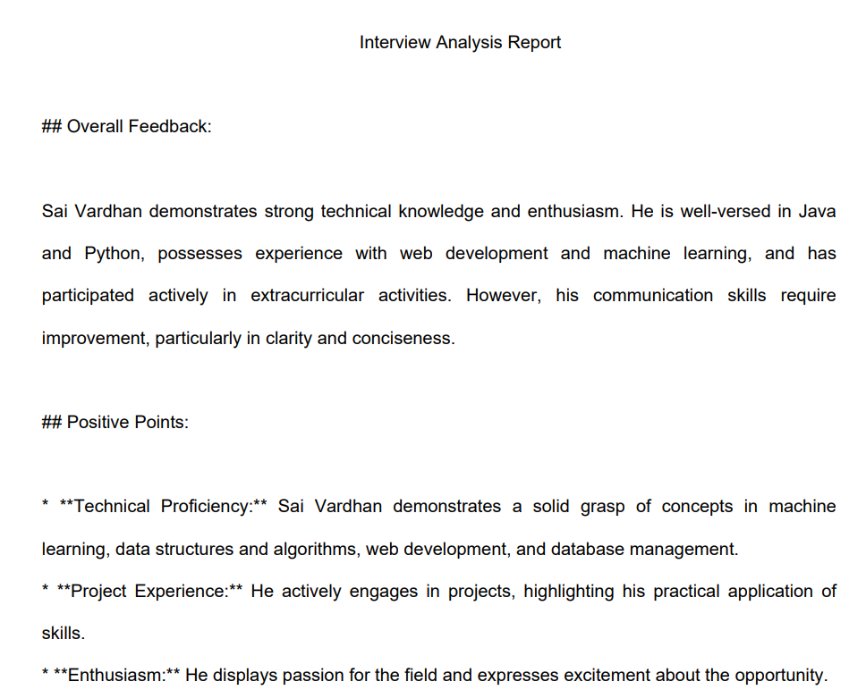

Slide 16
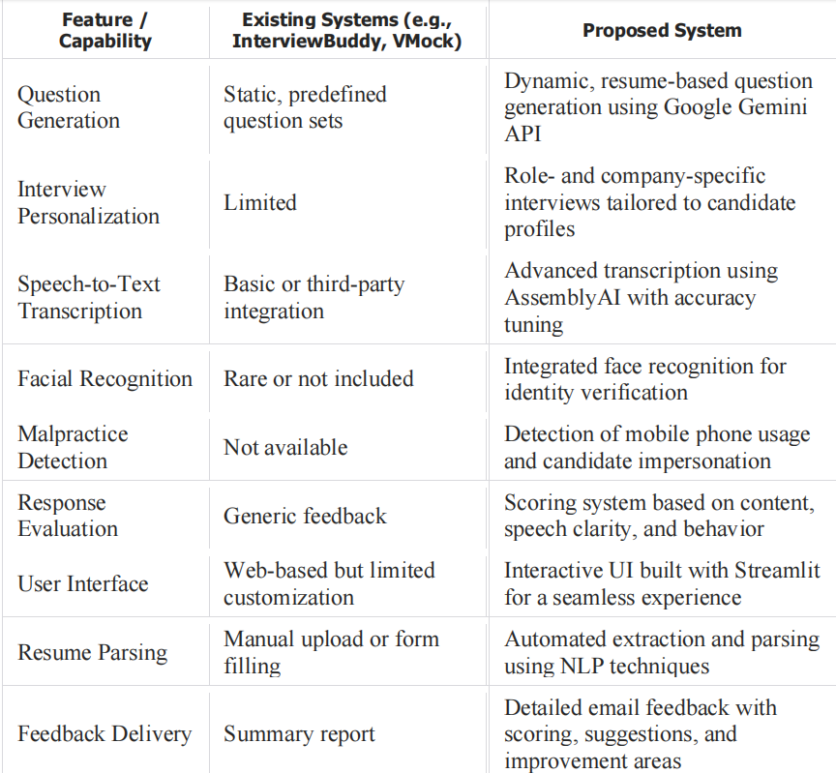

Slide 17
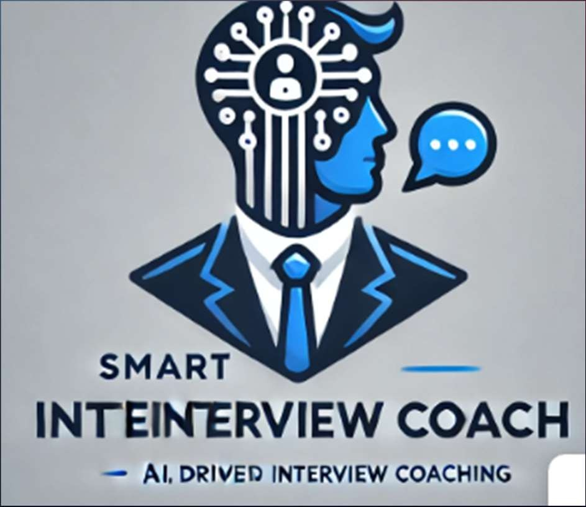
Conclusions
In summary, SIC offers a comprehensive suite of AI-driven tools for resume analysis, interview preparation, and mock interviews, significantly enhancing the hiring process for both job seekers and recruiters.
Future enhancements for SIC include real-time interview coaching, multi-language support for global candidates, and the integration of virtual reality for immersive interview simulations, broadening the tool's capabilities.
Thank you!

