Slide 1

ACADEMIC DBMS PROJECT SUBMISSION
DOCTRACK
Healthcare Management Database
A Relational Database System Architecture Implemented in MySQL
Submission Date
October 2026
Notes:
Welcome evaluators and viva committee. This presentation introduces MediTrack, a structured relational database project designed to streamline clinical healthcare records using MySQL.

Slide 2



SYSTEM ARCHITECTURE OVERVIEW
One relational database for healthcare records
MediTrack replaces disconnected files with a normalized relational schema, connecting clinical workflows with referential consistency.
Project Type
Domain Scope
Relational Database Management System (RDBMS), designed for ANSI SQL compliance.
Healthcare management: consultations, care and settlement.
Records organized: Patients, doctors, appointments, prescriptions and billing.
MediTrack DBMS Viva Defense · Domain: Hospital Information Systems
Notes:
MediTrack is centered on five core operational entities. Rather than treating patient visits, treatments, and accounting as separate paperwork, the system structures them as interconnected records in a single database.

Slide 3

PROBLEM STATEMENT & MOTIVATION
Why organize these records?
Healthcare facilities handle high volumes of concurrent operational data. Without a normalized relational model, facilities encounter critical workflow friction.
Scattered & Duplicated Demographics
Patient and physician particulars replicated across clinic notebooks lead to update anomalies and conflicting contact entries.
Fragmented Consultation Histories
Searching through non-relational logs makes retrieving past visits or doctor-patient appointment trails slow and error-prone.
Disconnected Invoicing & Prescriptions
Financial settlements frequently decouple from clinical visit encounters, risking untracked balances and unlinked prescriptions.
Note: Presenting core project motivations and structural challenges, not post-deployment metrics.
Notes:
These operational vulnerabilities highlight the explicit need for MediTrack. We emphasize these as design motivations rather than production claims.

Slide 4




DESIGN TARGETS
Objectives of MediTrack
The primary aim is to establish a rigorous relational foundation supporting healthcare record accuracy and retrieval.
Structured Entities
Referential Integrity
Redundancy Reduction
SQL Retrieval
Facilitate targeted data queries via standard SQL joins, filters, and aggregations.
Organize distinct medical domains into logically segregated, normalized tables.
Enforce strict primary key (PK) and foreign key (FK) constraints across all dependencies.
Eliminate repetitive attribute duplication while preserving atomic data integrity.
MediTrack Relational Database Engineering · Project Milestones
Notes:
Our objectives focus directly on database design standards: schema normalization, relational keys, elimination of anomalies, and flexible queryability.

Slide 5




ENGINEERING STACK
Technology and design tools
MediTrack is focused purely on relational database modeling and engine-level schema execution.
MySQL DBMS
MySQL Workbench
ER Modeling
Relational database engine executing ANSI DDL/DML scripts, constraint validations, and indexed relation queries.
Conceptual entity-relationship mapping defining entity sets, attributes, key constraints, and relational cardinalities.
Visual database design environment utilized for forward-engineering scripts, SQL debugging, and interactive execution.
Scope Boundary Note: This academic project implements the relational database schema and SQL queries exclusively. No web/mobile frontend application or backend application server was built.
Notes:
To ensure academic transparency during viva questioning: this work is strictly an RDBMS implementation using MySQL and Workbench, without unverified full-stack applications.

Slide 6
RELATIONAL SCHEMA SPECIFICATION
Five tables form the schema
The MediTrack architecture standardizes healthcare data across five modular relations.
PATIENTS
DOCTORS
APPOINTMENTS
Patient_ID [PK]
Name
Age
Gender
Contact
Email
Address
Doctor_ID [PK]
Name
Specialization
Fee
Experience_Years
Appointment_ID [PK]
Patient_ID [FK]
Doctor_ID [FK]
Appointment_Date
Status
Clinical Specialist Profile
PRESCRIPTIONS
BILLING
Prescription_ID [PK] · Appointment_ID [FK] · Medicine · Dosage · Duration_Days
Bill_ID [PK] · Appointment_ID [FK, UNIQUE] · Amount · Payment_Method · Payment_Status
Supports multiple prescribed medicines linked to a single clinical appointment encounter.
Enforces at most one billing record per appointment encounter via UNIQUE constraint.
Notes:
Review the exact attribute catalog across our five tables. Notice that APPOINTMENTS serves as the core associative hub connecting patients and doctors.

Slide 7
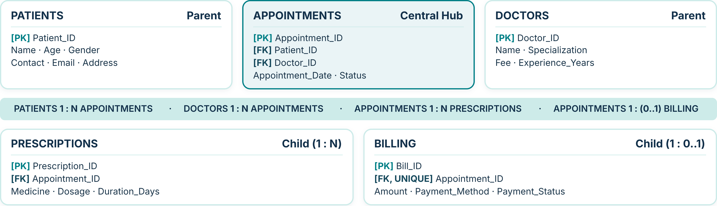
ENTITY RELATIONSHIP DIAGRAM
Entity relationships connect the tables
Logical cardinality and key mappings across the MediTrack database model.
Integrity Rule: UNIQUE on BILLING.Appointment_ID prevents duplicate bills for the same visit while permitting completed or scheduled appointments without an immediate bill.
Notes:
Explain the cardinality: a patient or doctor participates in multiple appointments (1:N). Prescriptions can have multiple medications per visit (1:N). Billing is 1:0..1 through the UNIQUE constraint.

Slide 8
DATABASE POPULATION · FICTIONAL DEMONSTRATION DATA
Fictional sample data: patients and doctors
PATIENTS Table (5 Records)
Patient_ID | Name | Age | Gender | Contact
101 | Aarav Sen | 29 | Male | 9000000101
102 | Mira Das | 34 | Female | 9000000102
103 | Rohan Roy | 45 | Male | 9000000103
104 | Sana Ali | 22 | Female | 9000000104
105 | Priya Ghosh | 38 | Female | 9000000105
DOCTORS Table (5 Records)
Doctor_ID | Name | Specialization | Fee | Experience_Years
201 | Dr. N. Bose | Cardiology | 800.00 | 12
202 | Dr. P. Ghosh | Dermatology | 600.00 | 8
203 | Dr. R. Sen | Pediatrics | 500.00 | 6
204 | Dr. A. Mukherjee | Neurology | 1000.00 | 15
205 | Dr. S. Chatterjee | Orthopedics | 700.00 | 10
Notes:
Point out the key domains: Patient_IDs run 101 to 105; Doctor_IDs run 201 to 205. These exact keys will be referenced in our transaction tables.

Slide 9
TRANSACTION LINKAGE
Fictional appointments link patients and doctors
APPOINTMENTS resolves the many-to-many relationship between patients and healthcare providers.
Appointment_ID [PK] | Patient_ID [FK] | Doctor_ID [FK] | Appointment_Date | Status
1001 | 101 (Aarav Sen) | 201 (Dr. N. Bose) | 2026-10-20 | Completed
1002 | 102 (Mira Das) | 202 (Dr. P. Ghosh) | 2026-10-21 | Completed
1003 | 103 (Rohan Roy) | 201 (Dr. N. Bose) | 2026-10-22 | Scheduled
1004 | 104 (Sana Ali) | 203 (Dr. R. Sen) | 2026-10-23 | Completed
1005 | 105 (Priya Ghosh) | 204 (Dr. A. Mukherjee) | 2026-10-24 | Scheduled
Referential integrity: Patient_IDs exist in PATIENTS (101–105) and Doctor_IDs in DOCTORS (201–204); no orphaned visits.
Fictional demonstration data · Appointment encounters are the foreign key target for prescription items and billing statements.
Notes:
Every row in APPOINTMENTS enforces foreign key checks. Notice Appointment_IDs 1001 to 1005; these exact IDs are the target references for our next slide.

Slide 10
DOWNSTREAM CLINICAL & FINANCIAL LOGS
Prescriptions and bills reference appointments
Demonstrating referential integrity: every record references valid Appointment_IDs (1001–1005).
PRESCRIPTIONS Table (1 : N)
BILLING Table (1 : 0..1 UNIQUE)
Rx_ID | Appt_ID | Medicine | Dosage | Days
501 | 1001 | Atorvastatin | 10 mg | 30
502 | 1001 | Aspirin | 75 mg | 30
503 | 1002 | Cetirizine | 10 mg | 7
504 | 1004 | Amoxicillin | 250 mg | 5
Bill_ID | Appt_ID | Amount | Method | Status
801 | 1001 | 800.00 | UPI | Paid
802 | 1002 | 600.00 | Card | Paid
803 | 1004 | 500.00 | Cash | Paid
No duplicate Appointment_IDs exist. Appointments 1003 & 1005 are scheduled and carry zero bills.
Appointment 1001 demonstrates multiple medication items (1 : N relation).
MediTrack DBMS Academic Viva Presentation · All sample data fictional · Pure SQL and Relational Modeling
Notes:
Conclude the presentation by noting how referential integrity is sustained: Prescription items link directly to completed appointments, and billing respects the 1:0..1 constraint.

