Slide 1

Project #2 CO2 & Temperature
Michael High
Saibal Chakrabarti
Chris Obonaga

Slide 2
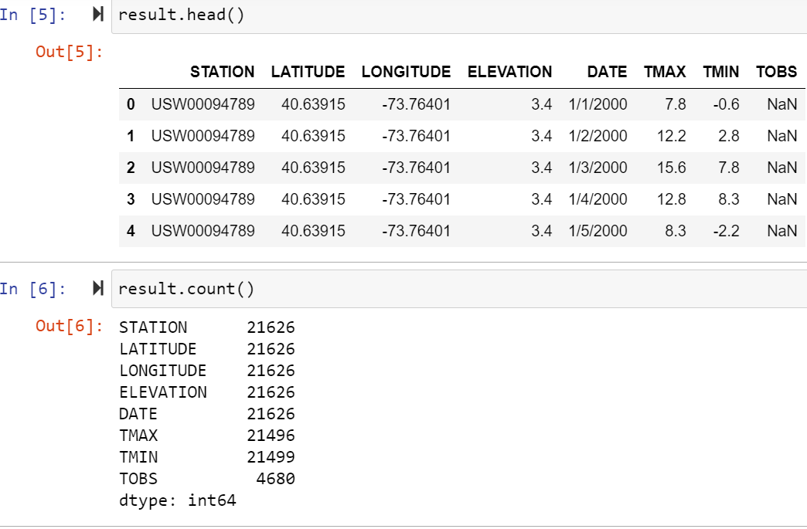
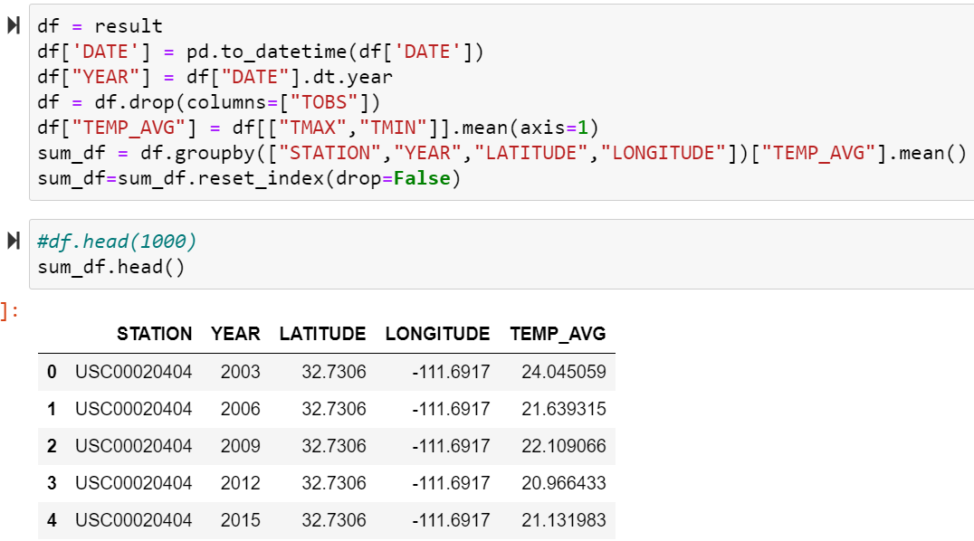
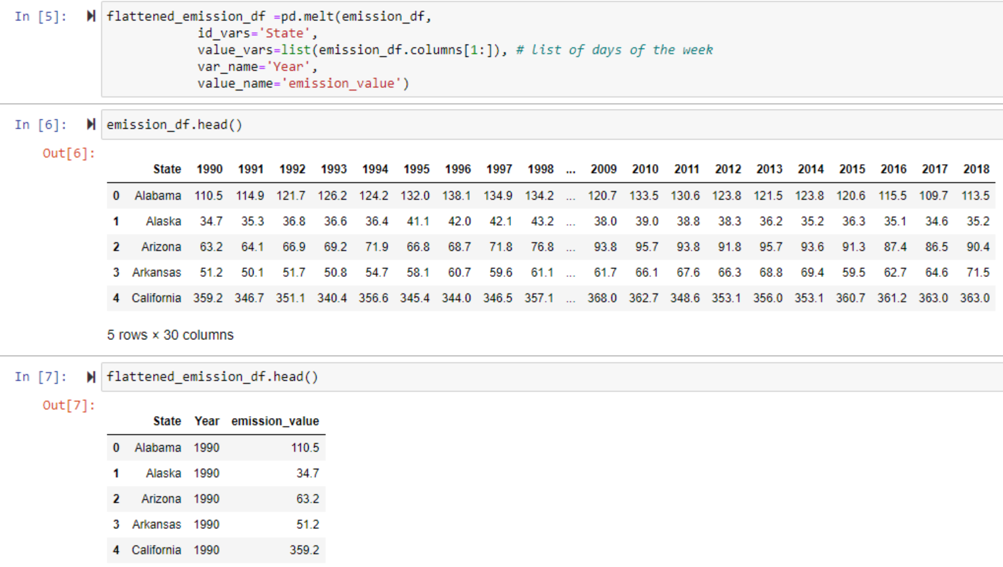
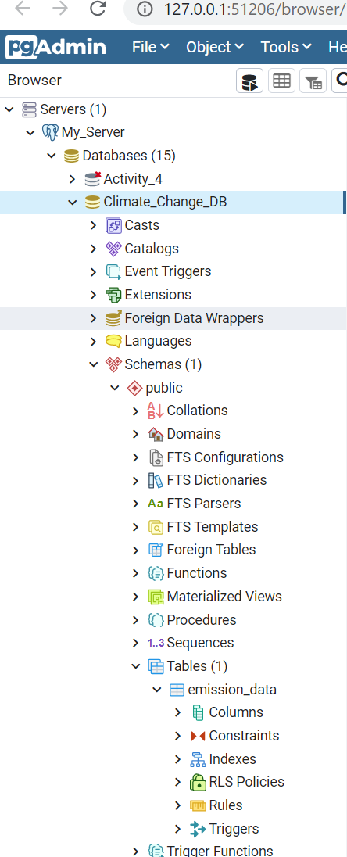
Getting Started
Data Sources
NOAA.gov
Used API to retrieve multiple CSVs (21,626 rows
Used Pandas to clean (append, groupby, drops, and convert pd to csv)
Result = average temp per year per station
https://mesonet.agron.iastate.edu/sites/networks.php?station
Used this to translate STATION data into cities and States to narrow down search in NOAA
https://www.eia.gov/environment/emissions/state/
Downloaded CSV
Used panda.melt to flatten the table
Result = Emission data per year per State
Database
PostgreSQL

Slide 3
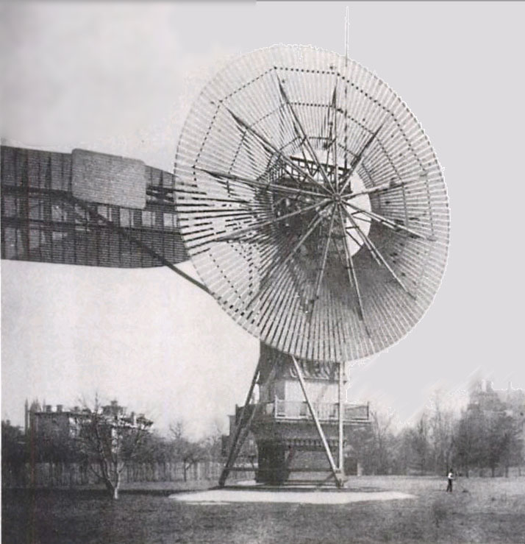
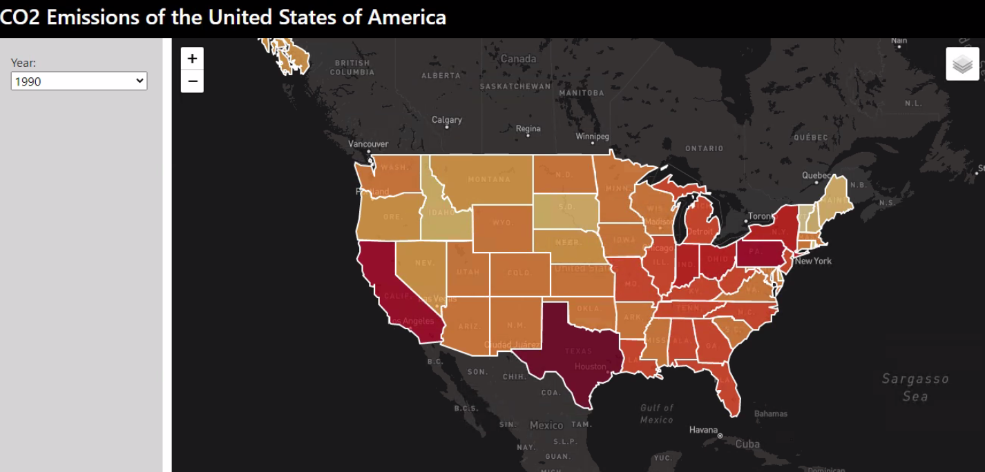
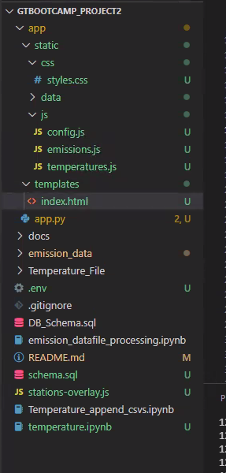
Let's take you for a spin

Slide 4

Thank you Questions?

