Slide 1
A Deep Learning Ensemble With Data Resampling for Credit Card Fraud Detection

Slide 2
ABSTRACT
In today's digital economy, credit cards play a crucial role, and their utilization has increased dramatically in combination with a rise in credit card fraud. We discusses the issue of credit card fraud and how machine learning algorithms have been utilized to detect it. The dynamic purchasing habits of credit card holders and the class imbalance problem have made it challenging for ML classifiers to achieve optimal performance. To address this issue, we proposes a robust deep-learning approach consisting of long short-term memory (LSTM) and gated recurrent unit (GRU) neural networks as base learners in a stacking ensemble framework, with a multilayer perceptron (MLP) a meta-learner. To balance the class distribution in the dataset, the hybrid synthetic minority oversampling technique and edited nearest neighbor (SMOTE-ENN) methods are employed. Combining the proposed deep learning ensemble with the SMOTE-ENN method obtained a good sensitivity and specificity respectively, which is better than other widely used ML classifiers and methods in the literature.

Slide 3
INTRODUCTION
Information technology advancements have significantly impacted the financial sector, leading to the broad adoption of electronic commerce (e-commerce) platforms. Also, the recent outbreak of the novel coronavirus (COVID-19) pandemic has further shown the need for a more digital world and further expanded the e-commerce industry. One of the major issues associated with modern e-commerce is the high cases of credit card fraud. Also, in the last decade, there has been an increase in credit card fraud, which is a huge burden on financial institutions. The increased credit card fraud rate is associated with the expansion of e-commerce and increased online transactions. Therefore, credit card fraud detection (CCFD) is crucial for financial companies to avoid losses. Artificial intelligence (AI) and machine learning applications in the financial sector can produce excellent results for companies, such as improved efficiency, reduced operational cost, and enhanced customer satisfaction. Several ML-based systems have been developed to detect credit card fraud.

Slide 4
OBJECTIVE
Our objective is to combat the escalating credit card fraud issue in the digital economy. We propose a robust deep-learning ensemble approach using LSTM and GRU neural networks as base learners, with an MLP as a meta-learner. Addressing class imbalance with SMOTE-ENN, we aim to achieve superior sensitivity and specificity in credit card fraud detection, surpassing existing ML methods.

Slide 5
PROBLEM STATEMENT
The increasing prevalence of credit card fraud in the digital economy poses a significant challenge. Traditional machine learning algorithms struggle due to dynamic spending patterns and class imbalance. To address this, we propose a robust deep learning approach, using LSTM and GRU networks in an ensemble with an MLP meta-learner. We also employ SMOTE-ENN to balance the dataset, achieving superior sensitivity and specificity compared to existing methods.

Slide 6
LITERATURE SURVEY
Credit card fraud detection in the era of disruptive technologies: A systematic review:
Credit card fraud detection in the era of disruptive technologies: A systematic review - ScienceDirect
ABSTRACT: Credit card fraud is becoming a serious and growing problem as a result of the emergence of innovative technologies and communication methods, such as contactless payment. In this article, we present an in-depth review of cutting-edge research on detecting and predicting fraudulent credit card transactions conducted from 2015 to 2021 inclusive. The selection of 40 relevant articles is reviewed and categorized according to the topics covered (class imbalance problem, feature engineering, etc.) and the machine learning technology used (modelling traditional and deep learning). Our study shows a limited investigation to date into deep learning, revealing that more research is required to address the challenges associated with detecting credit card fraud through the use of new technologies such as big data analytics, large-scale machine learning and cloud computing. Raising current research issues and highlighting future research directions, our study provides a useful source to guide academic and industrial researchers in evaluating financial fraud detection systems and designing robust solutions.

Slide 7
LITERATURE SURVEY
eFraudCom: An E-commerce Fraud Detection System via Competitive Graph Neural Networks:
(PDF) eFraudCom: An E-commerce Fraud Detection System via Competitive Graph Neural Networks (researchgate.net)
ABSTRACT: With the development of e-commerce, fraud behaviors have been becoming one of the biggest threats to the e-commerce business. Fraud behaviors seriously damage the ranking system of e-commerce platforms and adversely influence the shopping experience of users. It is of great practical value to detect fraud behaviors on e-commerce platforms. However, the task is non-trivial, since the adversarial action taken by fraudsters. Existing fraud detection systems used in the e-commerce industry easily suffer from performance decay and can not adapt to the upgrade of fraud patterns, as they take already known fraud behaviors as supervision information to detect other suspicious behaviors. In this article, we propose a competitive graph neural networks (CGNN)-based fraud detection system (eFraudCom) to detect fraud behaviors at one of the largest e-commerce platforms, “Taobao” ¹ . In the eFraudCom system, (1) the competitive graph neural networks (CGNN) as the core part of eFraudCom can classify behaviors of users directly by modeling the distributions of normal and fraud behaviors separately; (2) some normal behaviors will be utilized as weak supervision information to guide the CGNN to build the profile for normal behaviors that are more stable than fraud behaviors.

Slide 8
LITERATURE SURVEY
On the Black-Box Challenge for Fraud Detection Using Machine Learning (II): Nonlinear Analysis through Interpretable Autoencoders:
[PDF] On the Black-Box Challenge for Fraud Detection Using Machine Learning (II): Nonlinear Analysis through Interpretable Autoencoders | Semantic Scholar
ABSTRACT: Artificial intelligence (AI) has recently intensified in the global economy due to the great competence that it has demonstrated for analysis and modeling in many disciplines. This situation is accelerating the shift towards a more automated society, where these new techniques can be consolidated as a valid tool to face the difficult challenge of credit fraud detection (CFD). However, tight regulations do not make it easy for financial entities to comply with them while using modern techniques. From a methodological perspective, autoencoders have demonstrated their effectiveness in discovering nonlinear features across several problem domains. However, autoencoders are opaque and often seen as black boxes. In this work, we propose an interpretable and agnostic methodology for CFD. This type of approach allows a double advantage: on the one hand, it can be applied together with any machine learning (ML) technique, and on the other hand, it offers the necessary traceability between inputs and outputs, hence escaping from the black-box model.

Slide 9
LITERATURE SURVEY
Credit Card Fraud Detection Using a New Hybrid Machine Learning Architecture:
(PDF) Credit Card Fraud Detection Using a New Hybrid Machine Learning Architecture (researchgate.net)
ABSTRACT: The negative effect of financial crimes on financial institutions has grown dramatically over the years. To detect crimes such as credit card fraud, several single and hybrid machine learning approaches have been used. However, these approaches have significant limitations as no further investigation on different hybrid algorithms for a given dataset were studied. This research proposes and investigates seven hybrid machine learning models to detect fraudulent activities with a real word dataset. The developed hybrid models consisted of two phases, state-of-the-art machine learning algorithms were used first to detect credit card fraud, then, hybrid methods were constructed based on the best single algorithm from the first phase. Our findings indicated that the hybrid model Adaboost + LGBM is the champion model as it displayed the highest performance. Future studies should focus on studying different types of hybridization and algorithms in the credit card domain.

Slide 10
LITERATURE SURVEY
Enhanced Credit Card Fraud Detection Model Using Machine Learning:
Enhanced Credit Card Fraud Detection Model Using Machine Learning | Semantic Scholar
ABSTRACT: The COVID-19 pandemic has limited people’s mobility to a certain extent, making it difficult to purchase goods and services offline, which has led the creation of a culture of increased dependence on online services. One of the crucial issues with using credit cards is fraud, which is a serious challenge in the realm of online transactions. Consequently, there is a huge need to develop the best approach possible to using machine learning in order to prevent almost all fraudulent credit card transactions. This paper studies a total of 66 machine learning models based on two stages of evaluation. A real-world credit card fraud detection dataset of European cardholders is used in each model along with stratified K-fold cross-validation. In the first stage, nine machine learning algorithms are tested to detect fraudulent transactions. The best three algorithms are nominated to be used again in the second stage, with 19 resampling techniques used with each one of the best three algorithms.

Slide 11
EXISTING SYSTEM
In literature they conducted a performance evaluation of ML classifiers and data resampling techniques for detecting credit card fraud. The classifiers used in the study include LGBM, XGBoost, random forest, categorical boosting (CatBoost), logistic regression, and Naïve Bayes. The results indicated that the CatBoost classifier integrated with a k-nearest neighbor-based undersampling technique performed better than the other methods. Another researcher noted that algorithms that utilize sequential modelling, such as RNNs, usually perform better than conventional ML models. One of the researcher introduces a novel model by improving long short-term memory with a time-aware gate that can capture the behavioral changes caused by consecutive transactions of users. A current-historical attention module is designed to build up connections between current and historical transactional behaviors, which enables the model to capture behavioral periodicity. An interaction module is designed to learn comprehensive and rational behavioral representations.

Slide 12
DISADVANTAGES FOR EXISTING SYSTEM
Building robust machine learning-based CCFD models has remained a challenge for some reasons.
Firstly, conventional classifiers make predictions based on the transaction details only, such as amount, transaction country, and transaction type, ignoring the sequence of transactions that defines the clients’ shopping behaviour, which is useful in identifying appropriate fraud patterns.
Imbalance classification is a challenge because most ML algorithms were designed with the assumption of an even class distribution.Using imbalanced data results in models with poor classification performance, especially for the minority class, i.e., fraudulent transactions.
Meanwhile, simple RNN-based models are prone to the vanishing gradient problem.
SMOTE obtains synthetic samples via linear interpolation between majority class samples in the neighbourhood and often generates noisy samples.
Random undersampling deletes samples from the majority class and sometimes it may leads to losing information which is valuable to a model.

Slide 13
PROPOSED SYSTEM
We proposes to solve the problem of credit card fraud detection using a robust deep-learning approach. The approach consists of long short-term memory (LSTM) and gated recurrent unit (GRU) neural networks as base learners in a stacking ensemble framework, with a multilayer perceptron (MLP) as the meta-learner. The hybrid synthetic minority oversampling technique and edited nearest neighbor (SMOTE-ENN) method is employed to balance the class distribution in the dataset.

Slide 14
ADVANTAGES FOR PROPOSED SYSTEM
However, LSTM and GRU-based RNNs were proposed to solve the vanishing gradient problem and have shown good performances in different sequence classification tasks.
Furthermore, this study uses the SMOTE-ENN method for solving the imbalance class problem. Hybrid resampling techniques such as SMOTE-ENN have shown enhanced effectiveness in dealing with imbalanced data compared to oversampling and under sampling techniques.
Improving the credit card fraud detection rate by combining the robustness of ensemble learning and deep learning.
In the hybrid SMOTE-ENN, the ENN removes noisy samples that often generated by SMOTE.

Slide 15
REQUIREMENTS
SOFTWARE
HARDWARE
Software : Anaconda
Primary Language : Python
Frontend Framework : Flask
Back-end Framework : Jupyter Notebook
Database : Sqlite3
Front-End Technologies : HTML,CSS,JavaScript and Bootstrap4
1) Operating System : Windows Only
2) Processor : i5 and above
3) Ram : 8gb and above
4) Hard Disk : 25 GB in local drive

Slide 16
MODULES
Data exploration: using this module we will load data into system
Processing: Using the module we will read data for processing
Splitting data into train & test: using this module data will be divided into train & test
Model generation: Model building - Without SMOTEENN, With SMOTEENN {AdaBoost, Random Forest, MLP, LSTM, GRU, LSTM + GRU with NN, Stacking Classifier, Voting Classifier}
User signup & login: Using this module will get registration and login
User input: Using this module will give input for prediction
Prediction: final predicted displayed
Note: As an extension we applied an ensemble method combining the predictions of multiple individual models to produce a more robust and accurate final prediction.
However, we can further enhance the performance by exploring other ensemble techniques such as Stacking Classifier with RF + MLP With LightGBM and Voting Classifier which got 100% accuracy.

Slide 17
ALGORITHMS
AdaBoost: AdaBoost (Adaptive Boosting) is a machine learning ensemble technique that improves classification accuracy by combining multiple weak learners into a strong one. It assigns different weights to data points and iteratively focuses on misclassified samples, adjusting their importance, leading to a robust predictive model.
LSTM + GRU with NN: LSTM (Long Short-Term Memory) and GRU (Gated Recurrent Unit) are specialized recurrent neural network (RNN) architectures. They enhance traditional RNNs by mitigating the vanishing gradient problem. LSTMs employ memory cells and gates, while GRUs use reset and update gates, making them adept at capturing long-range dependencies in sequential data.
LSTM: LSTM (Long Short-Term Memory) is a type of recurrent neural network (RNN) architecture designed to address the vanishing gradient problem. It uses memory cells and three gates (input, output, and forget) to efficiently capture and retain information over extended sequences, making it suitable for tasks involving sequential data, like natural language processing and time series forecasting.
GRU: GRU (Gated Recurrent Unit) is a type of recurrent neural network (RNN) architecture, similar to LSTM but with a simpler structure. It uses two gates (reset and update) to control the flow of information through the network, allowing it to capture and retain relevant information over sequential data, making it computationally efficient for various tasks, including natural language processing and time series analysis.

Slide 18
Stacking Classifier: Stacking is a way of ensembling classification or regression models it consists of two-layer estimators. The first layer consists of all the baseline models that are used to predict the outputs on the test datasets. The second layer consists of Meta-Classifier or Regressor which takes all the predictions of baseline models as an input and generate new predictions.
Voting Classifier: A voting classifier is a machine learning estimator that trains various base models or estimators and predicts on the basis of aggregating the findings of each base estimator. The aggregating criteria can be combined decision of voting for each estimator output.
Random Forest: Random forest is a commonly-used machine learning algorithm trademarked by Leo Breiman and Adele Cutler, which combines the output of multiple decision trees to reach a single result. Its ease of use and flexibility have fueled its adoption, as it handles both classification and regression problems.
MLP: A fully connected multi-layer neural network is called a Multilayer Perceptron (MLP). It has 3 layers including one hidden layer. If it has more than 1 hidden layer, it is called a deep ANN. An MLP is a typical example of a feed forward artificial neural network.

Slide 19
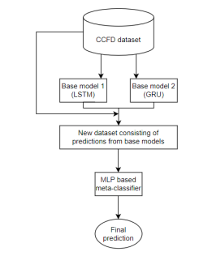
SYSTEM ARCHIRECTURE

Slide 20
UML DIAGRAMS

Slide 21
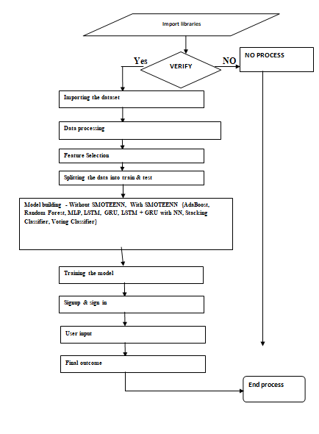
DATAFLOW DIAGRAM

Slide 22
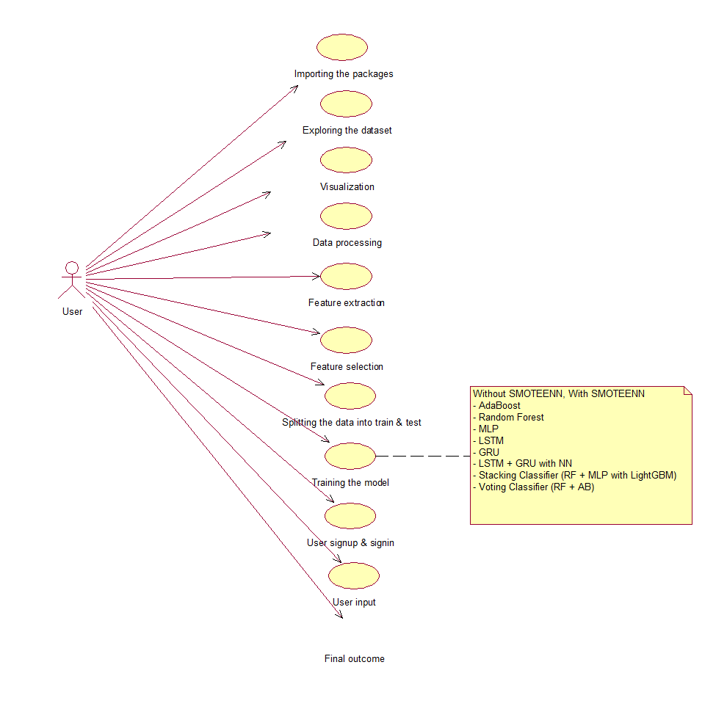
USECASE DIAGRAM

Slide 23
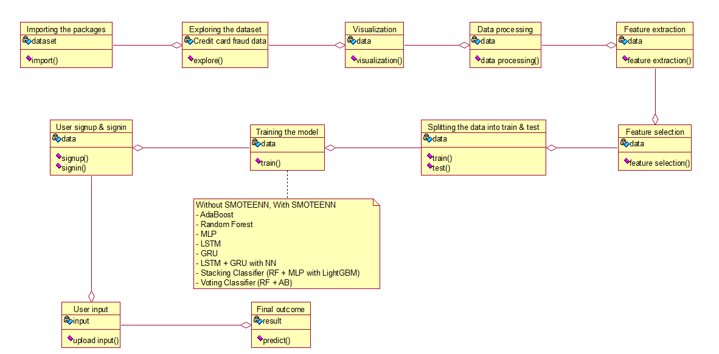
CLASS DIAGRAM

Slide 24
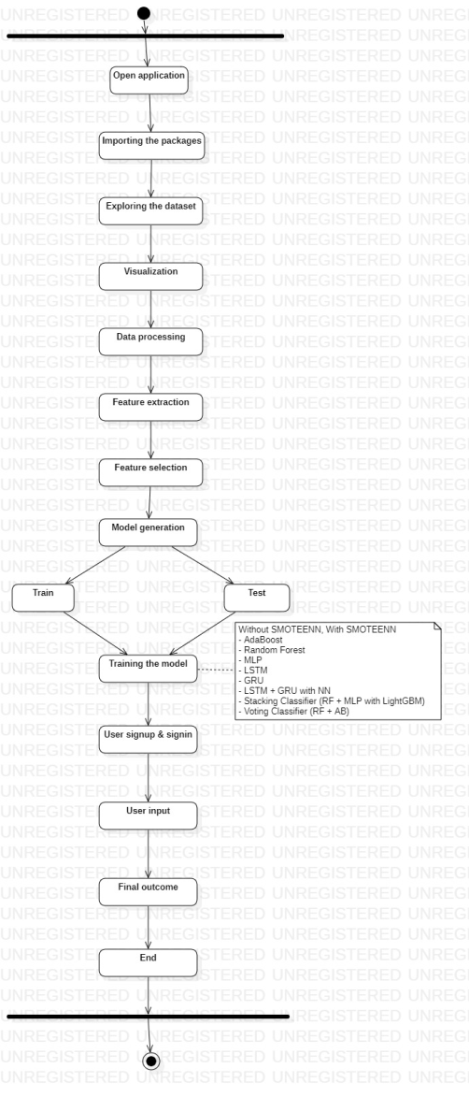
ACTIVITY DIAGRAM

Slide 25
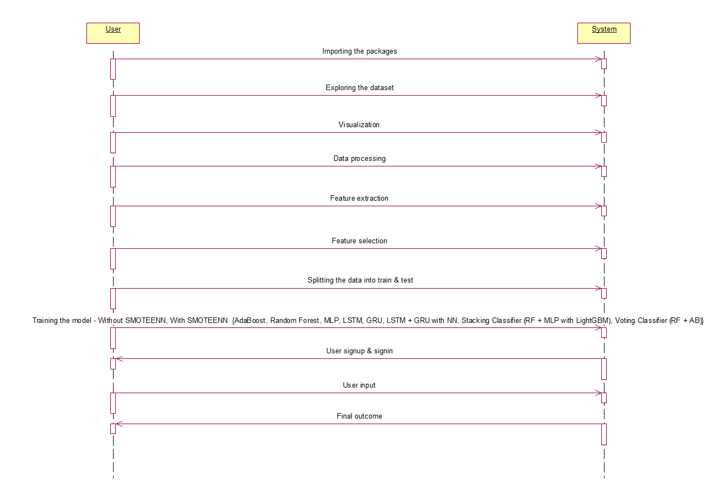
SEQUENCE DIAGRAM

Slide 26
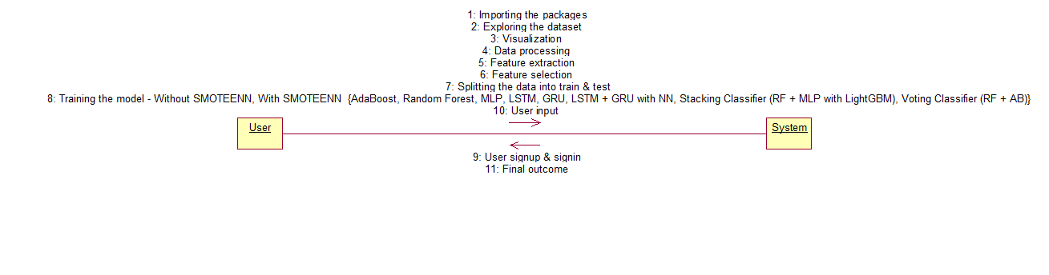
COLLABORATION DIAGRAM

Slide 27
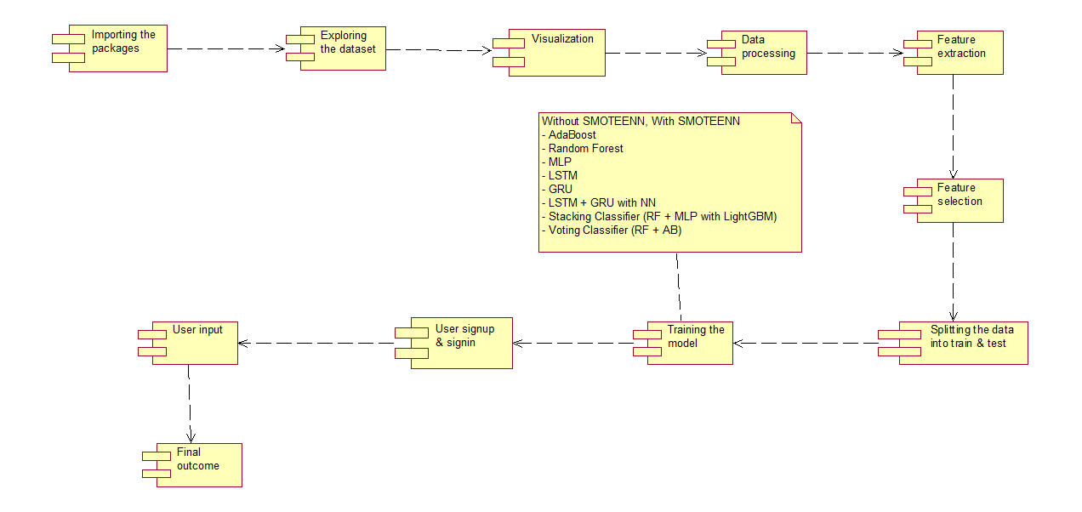
COMPONENT DIAGRAM

Slide 28
DEPLOYMENT DIAGRAM

Slide 29
screenshots

Slide 30
CONCLUSION
The conclusion of the work is that credit card fraud detection is an essential and challenging task, and the proposed deep learning-based stacking ensemble with data resampling approach is effective in detecting credit card fraud. The approach uses LSTM and GRU neural networks as base learners and an MLP as the meta-learner, and the data resampling is achieved using the hybrid SMOTE-ENN method. We achieved a high sensitivity and specificity respectively, which is superior to other widely used ML classifiers and methods in the literature. the proposed method presents an excellent performance. Future works would aim to introduce diversity in the base models using classifiers with different training methods, such as combining LSTM with random forest, logistic regression, or SVM. Also, future research works could consider feature importance and risk factor analysis.

Slide 31
REFERENCES
[1] M. Habibpour, H. Gharoun, M. Mehdipour, A. Tajally, H. Asgharnezhad, A. Shamsi, A. Khosravi, M. Shafie-Khah, S. Nahavandi, and J. P. S. Catalao, ‘‘Uncertainty-aware credit card fraud detection using deep learning,’’ 2021, arXiv:2107.13508.
[2] A. Cherif, A. Badhib, H. Ammar, S. Alshehri, M. Kalkatawi, and A. Imine, ‘‘Credit card fraud detection in the era of disruptive technologies: A systematic review,’’ J. King Saud Univ. Comput. Inf. Sci., vol. 35, no. 1, pp. 145–174, Jan. 2023, doi: 10.1016/j.jksuci.2022.11.008.
[3] G. Zhang, Z. Li, J. Huang, J. Wu, C. Zhou, and J. Yang, ‘‘eFraudCom: An e-commerce fraud detection system via competitive graph neural networks,’’ ACM Trans. Inf. Syst., vol. 40, no. 3, pp. 1–27, Mar. 2022, doi: 10.1145/3474379.
[4] T. K. Dang, T. C. Tran, L. M. Tuan, and M. V. Tiep, ‘‘Machine learning based on resampling approaches and deep reinforcement learning for credit card fraud detection systems,’’ Appl. Sci., vol. 11, no. 21, p. 10004, Oct. 2021, doi: 10.3390/app112110004.
[5] J. Chaquet-Ulldemolins, F.-J. Gimeno-Blanes, S. Moral-Rubio, S. MuñozRomero, and J.-L. Rojo-Álvarez, ‘‘On the black-box challenge for fraud detection using machine learning (I): Linear models and informative feature selection,’’ Appl. Sci., vol. 12, no. 7, p. 3328, Mar. 2022, doi: 10.3390/app12073328.

