Slide 1


TITLE:OTP BASED LOCKING SYSTEM
USING IOT
THEME: PUBLIC SAFETY
By,
SoC T-01
KONAKATI SINDHU VTU 23137
A TEJA SREE. VTU 21751
JUNUTHULA AKSHAYA VTU 21897
DASARI CHANDU VTU 24198
CH SAI BHARGAV VTU 22497
SHAIK RAHIL BASHA VTU 21948
Guided by,
Mr.K Subramani
ASSISTSNT PROFESSOR & MECHANICAL
Mrs.Suma Nair Designation & dept.
Vel Tech Rangarajan Dr.Sagunthala R & D Institute of Science & Technology

Slide 2
INTRODUCTION :
An Advance digital locking system is meant to make a microcontroller based mostly Digital number Code Lock that serves the goal of security. want of safety may be achieved by creating locks which might be electrical or mechanical with one or some keys, except for lockup a giant space several locks area unit needed. As everybody is aware of quaint locks area unit significant weight and fragile additionally counting on the tools thus electronic locks area unit given additional price than those of mechanical locks. These lockup systems area unit wont to management the movement of door and area unit useful while not requiring a key to lock or unlock the door. These lockup systems area unit controlled by a keyboard. The microcontroller based mostly Digital Code Lock is associate degree access system that permits solely approved persons to access are stricted space. Security may be a prime concern in our day-today life. Everybody needs to be the maximum amount secure as potential. associate degree access management for doors forms a significant link in an exceedingly security chain.. The system contains of a electrical switch keyboard connected to the Arduino microcontroller. The lock can open if and as long as the entered countersign matches the countersign sent to mobile. Thus, what we wish is digital technology to construct associate degree integrated and well custom-built safety system at a worth that is cheap.

Slide 3
LIST OF THEMES:
AGRICULTURE
PUBLIC SAFETY
WASTE TO WEALTH
ENERGY CONSERVATION
ENVIRONMENTAL CONSERVATION
ROBOTICS
INFRASTRUCTURE
TRANSPORTATION
BIO ENGINEERING
RENEWABLE ENERGY

Slide 4

SELECTED THEME : PUBLIC SAFETY
The simple circuit can be used at residential places to ensure better safety . It can be used at organisations to ensure authorized access to highly secured places with aslight modification this project can be used to control the switching of loads through password .this {OTP} based lock system helps the simple way for security of no risk only the user is always involved to unlock it.

Slide 5
PROBLEM IDENTIFICATION 1:
The basic problem with this type of locking system is that like in key based locking device every time we need to carry a key to unlock the door and there is a higher risk of losing a key if he is lost then we have to break the locking system which also result in wastage of money for old age people it is difficult to carry.
SOLUTION:
This is smart lock can easily be opened by the OTP for its unlocking no
key and the physical strength is required, senior citizen or disabled do
not have to struggle with keys or go near the door to open it which is
biggest advantage to use this locking system.

Slide 6
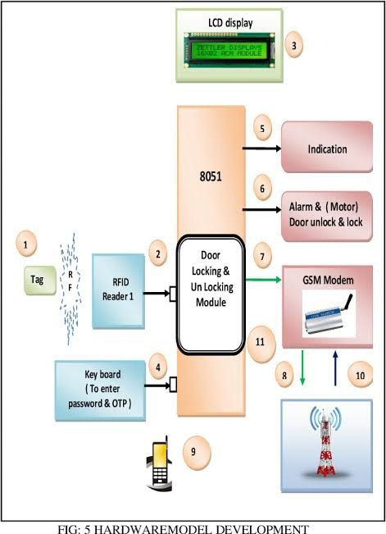
WORKING PRINCIPLE :
BLOCK DIAGRAM / DESIGN:

Slide 7
COMPONENTS REQUIRED
COMPONENTS REQUIRED
•Arduino Uno
•Bluetooth HC05
• LED
• Some wires/jumper wires
• Servo motor
• 5V Battery/Power Bank
•USB Type B for Programming Arduino
• LCD Display
• Key board Indication
•Indication
•GSM Modem

Slide 8
EXPLANATION OF BLOCK DIAGRAM:
In this project first we connect the Arduino UNO controller to HC-05 Bluetooth module in this we connect the transmitter and receiver pin of Arduino to the HC-05 receiver and transmitter then we connect to VCC and ground pin of HC-05 to servo motor positive and negative pin signal pin of servomotor connect to the Arduino pin number 09 then we create app using MIT app inventor for random OTP generation then we include the code portion of working to the Arduino microcontroller using Arduino IDE then we give the power supply to Arduino board through power bank or battery.

Slide 9
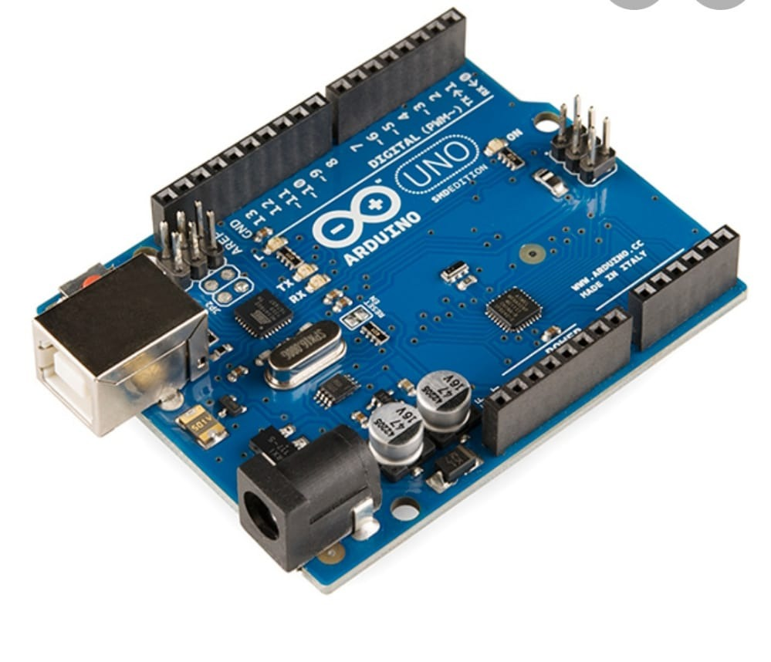
COMPONENTS:
1. ARDUINO UNO:
The Arduino Uno is an open-source microcontroller board based on the Microchip ATmega328P microcontroller and developed by Arduino.cc and initially released in 2010. The board is equipped with sets of digital and analog input/output pins that may be interfaced to various expansion boards and other circuits.

Slide 10
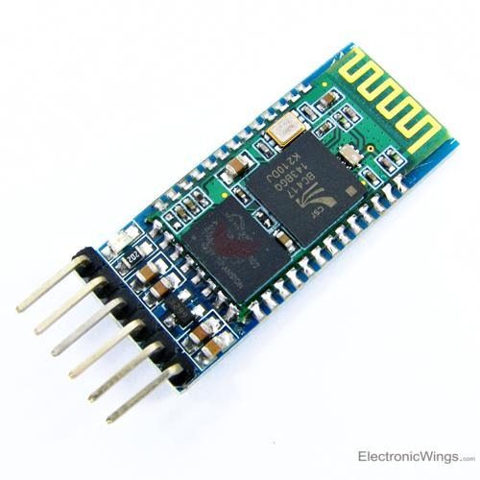
2.HC-05 BLUETOOTH MODULE :
It is used for many applications like wireless headset, game controllers, wireless mouse, wireless keyboard and many more consumer applications. It has range up to <100m which depends upon transmitter and receiver, atmosphere, geographic & urban conditions. It is IEEE 802.15.1 standardized protocol, through which one can build wireless Personal Area Network (PAN). It uses frequency-hopping spread spectrum (FHSS) radio technology to send data over air. It uses serial communication to communicate with devices. It communicates with microcontroller using serial port (USART).

Slide 11
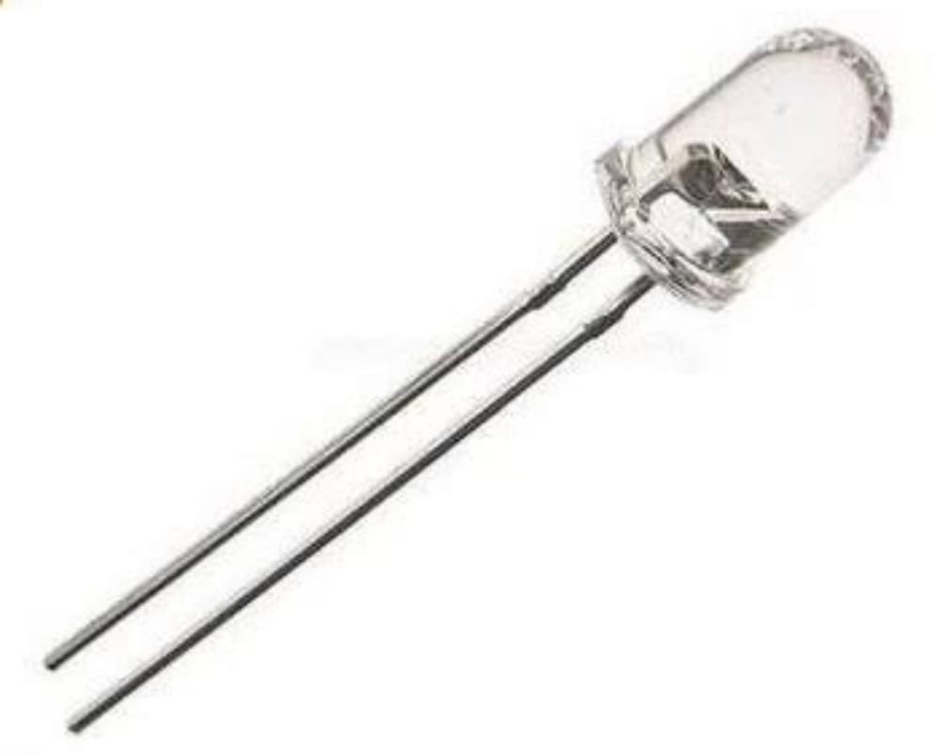
3. LED:
A light-emitting diode (LED) is a semiconductor device that emits light when current flows through it. Electrons in the semiconductor recombine with electron holes, releasing energy in the form of photons. The color of the light (corresponding to the energy of the photons) is determined by the energy required for electrons to cross the band gap of the semiconductor. White light is obtained by using multiple semiconductors or a layer of light-emitting phosphor on the semiconductor device.

Slide 12
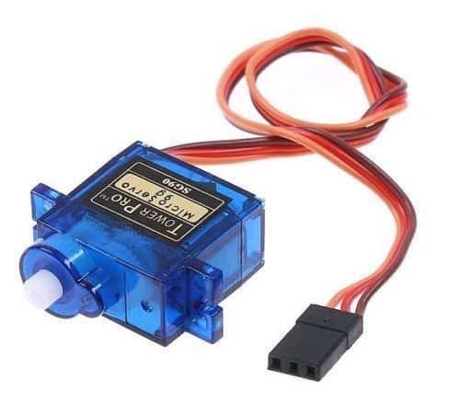
4. SERVO MOTOR:
A servomotor (or servo motor) is a rotary actuator or linear actuator that allows for precise control of angular or linear position, velocity and acceleration. It consists of a suitable motor coupled to a sensor for position feedback. It also requires a relatively sophisticated controller, often a dedicated module designed specifically for use with servomotors.

Slide 13
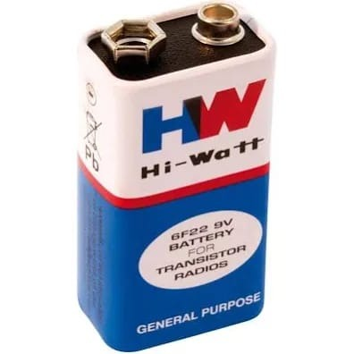
5. 5V BATTERY:
This type is commonly used in pocket radios, smoke detectors, carbon monoxide detectors, guitar effect units, electro-acoustic guitars and radio-controlled vehicle controllers. They are also used as backup power to keep the time in certain electronic clocks.

Slide 14
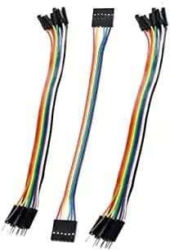
6. JUMPER WIRES:
A jump wire (also known as jumper, jumper wire, DuPont wire) is an electrical wire, or group of them in a cable, with a connector or pin at each end (or sometimes without them – simply "tinned"), which is normally used to interconnect the components of a breadboard or other prototype or test circuit, internally or with other equipment or components, without soldering. Individual jump wires are fitted by inserting their "end connectors" into the slots provided in a breadboard, the header connector of a circuit board, or a piece of test equipment.

Slide 15
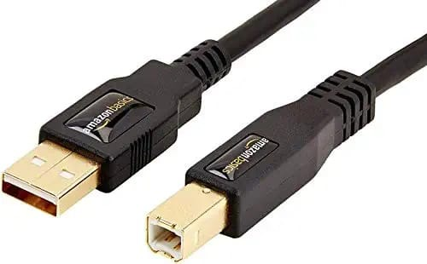
7. USB TYPE B:
USB Type B Also known as USB standard B connector, the B style connector is designed for USB peripherals, such as printer, upstream port on hub, or other larger peripheral devices.

Slide 16
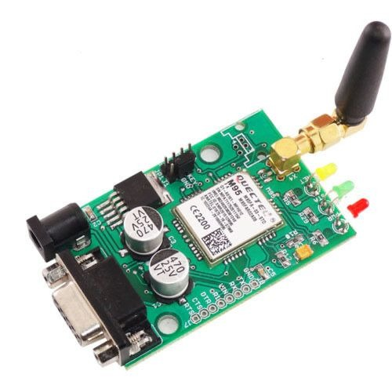
8.GSM MODULE:
A GSM modem or GSM module is a device that uses GSM mobile telephone technology to provide a wireless data link to a network. GSM modems are used in mobile telephones and other equipment that communicates with mobile telephone networks. They use SIMs to identify their device to the network.

Slide 17
FUTURE WORK :
This smart lock can be easily used , it is highy safer because every time you unlock it a new OTP will be generated .
This smart lock is not very costly so it can be availed by every common person.
This smart lock can easily replace the electronic lock system in future because it is highly secured.

Slide 18
REFERENCE:
Elins International Journal of Science Engineering and Management ”Secure Electronic Lock Based on Bluetooth Based OTP System” vol.2, Issue1,January 2017.
Pooja K M, Chandrakala K G , Nikhitha M A, Anushree P N “ Finger Print Based Bank Locker Security System”, International Journal of Engineering Research &Technology (IJERT),Issue -2018
Md. Maksudur Rahman1, Dr. Mohammed Sowket Ali & Md. ShoaibAkther “Password Protected Electronic Lock System for Smart Home Security” International Journal of Engineering Research & Technology (IJERT) Vol. 7 Issue 04, April-2018.
Prajwal D, NaagaSoujanya N, Shruthi N, “Secure Bank Lockers Using RFID and Password Based Technology (Embedded System)”, International Journal of Scientific Development and Research, May 2018 IJSDR | Volume 3, Issue.

Slide 19
LIST OF MODELS:
Carpentry :
  Wooden window
  Sliding door
  Wheel chair
  Crank and slotted link
Electronics :
  Power supply board
  Emergency light
  Relay Board
Machine Shop :
  Machine Vice
  Bolt and nut assembly
  Simple and compound Gear train
  Sheet metal tray

Slide 20
CARPENTRY : WOODEN WINDOW
ELECTRONICS : RELAY BOARD
MACHINE SHOP : SHEET METAL TRAY
SELECTED MODELS:

Slide 21
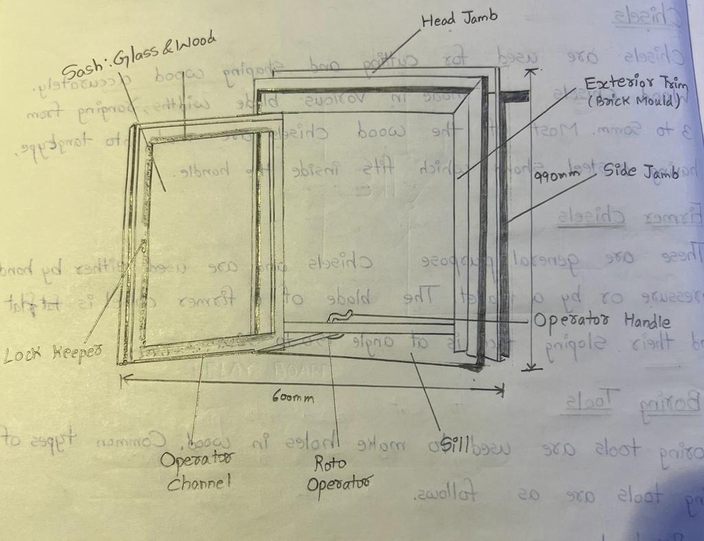
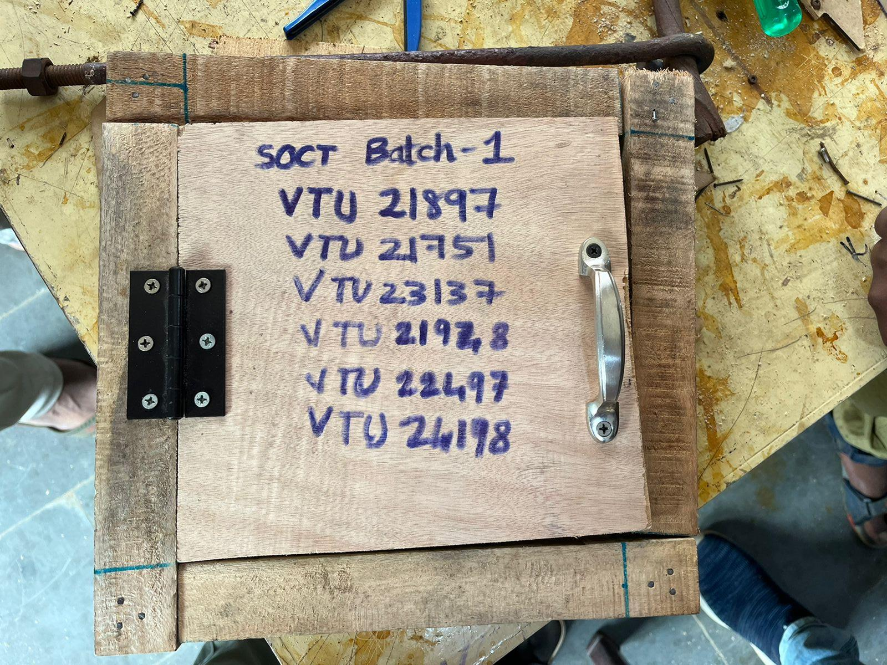
MODEL 1:
CARPENTRY WORK – WOODEN WINDOW
Design:

Slide 22
3.Tools used:
i. Jack plane
ii. Carpentry vice
iii. Try square
iv. Marking gauge
v. Steel rule
vi. Tenon saw
vii. Rip saw
viii. Firner chisel
xi. Mallet
2.Scope:
Wood cutting
Screwing
Using required tools
Marking
sawing
chiseling

Slide 23
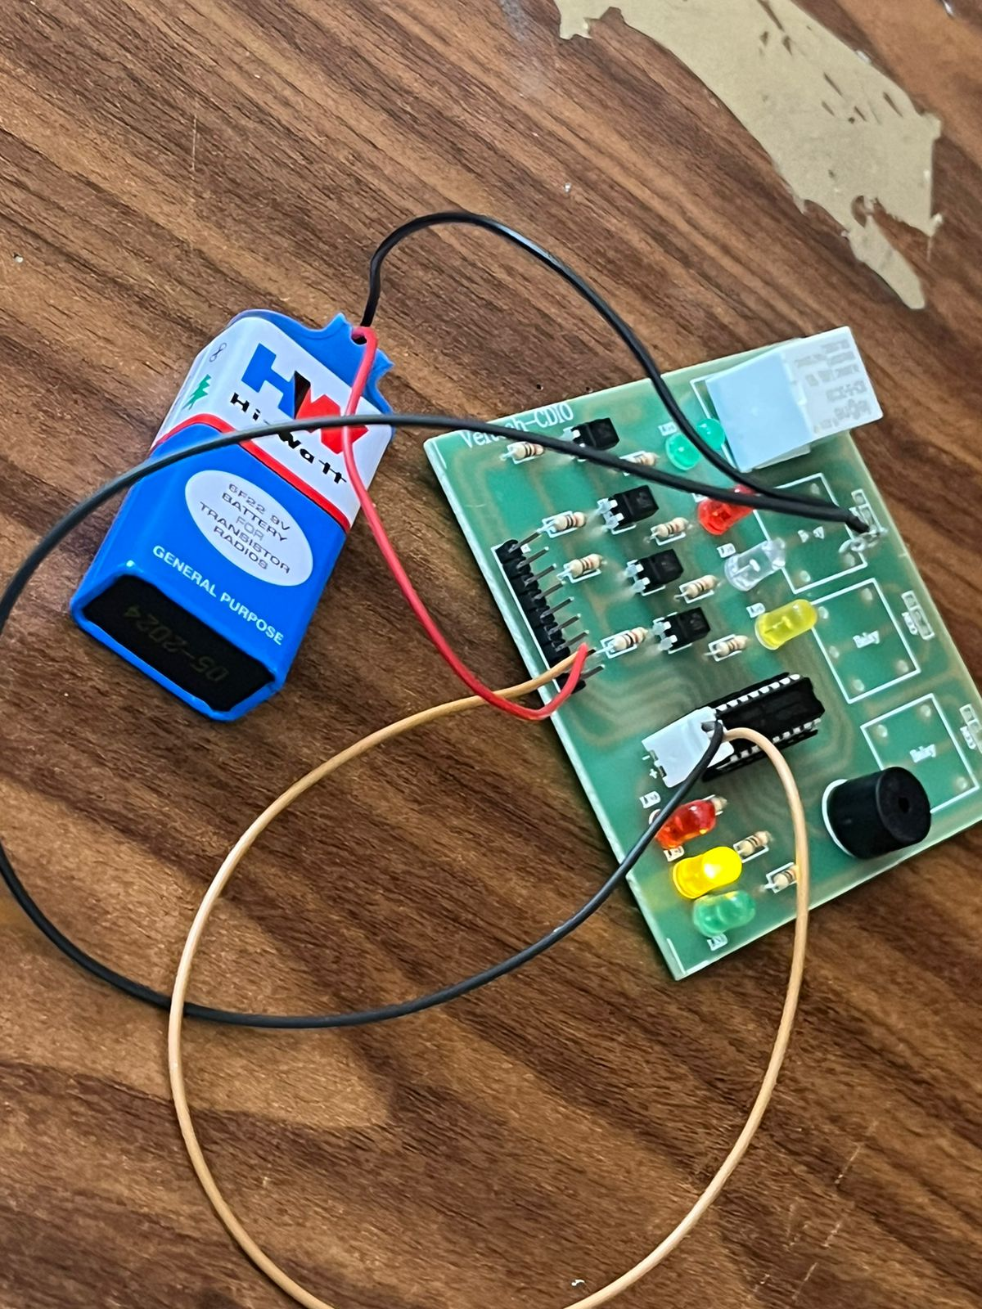
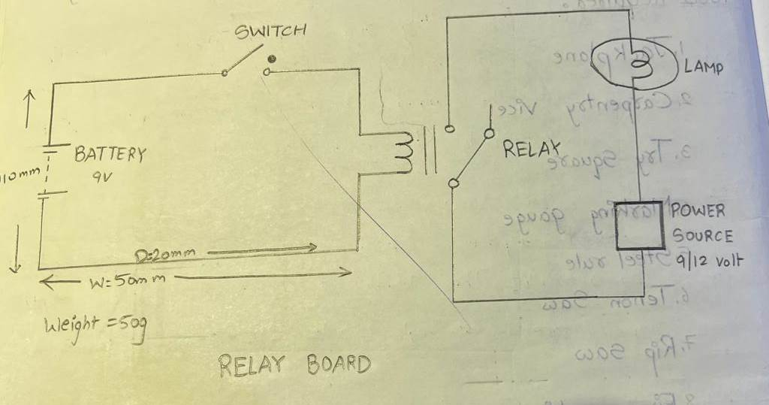
MODEL 2:
ELECTRONICS – RELAY BOARD
Design:

Slide 24
2.Scope:
3.Tools:
Metal cutting
Soldering
Using multi meter
Dot board
Digital multi meter
Soldering lead
Soldering iron
Relay
Switch
Battery
Wires
Lamp

Slide 25
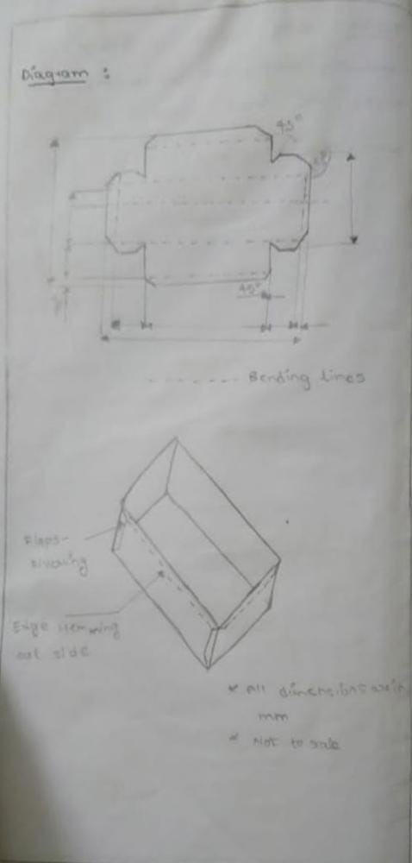
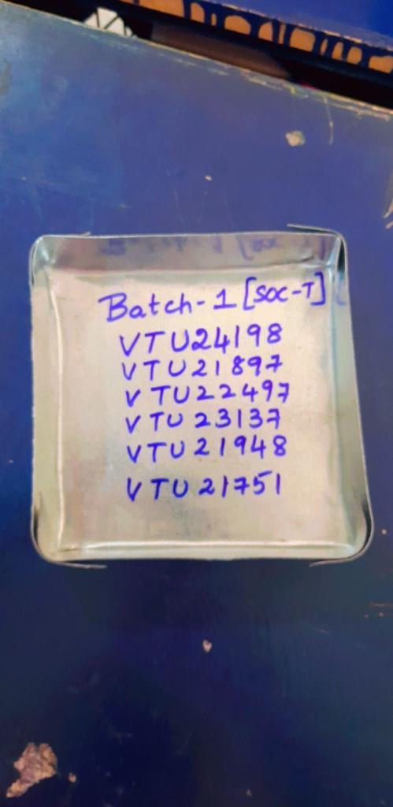
MODEL 3:
MACHINE SHOP – SHEET METAL TRAY
Design:

Slide 26
2. Scope:
Metal cutting
Measuring length of the metal sheet
3.Tools used:
i. Steel rule
ii. Scriber
iii. Divider
iv. Mallet
v. Stakes
vi. Try square
vii. Snip straight

Slide 27
THANK YOU

