Slide 1

Notes:
Hello everyone, welcome to `The talk on ONNX`.

Slide 2
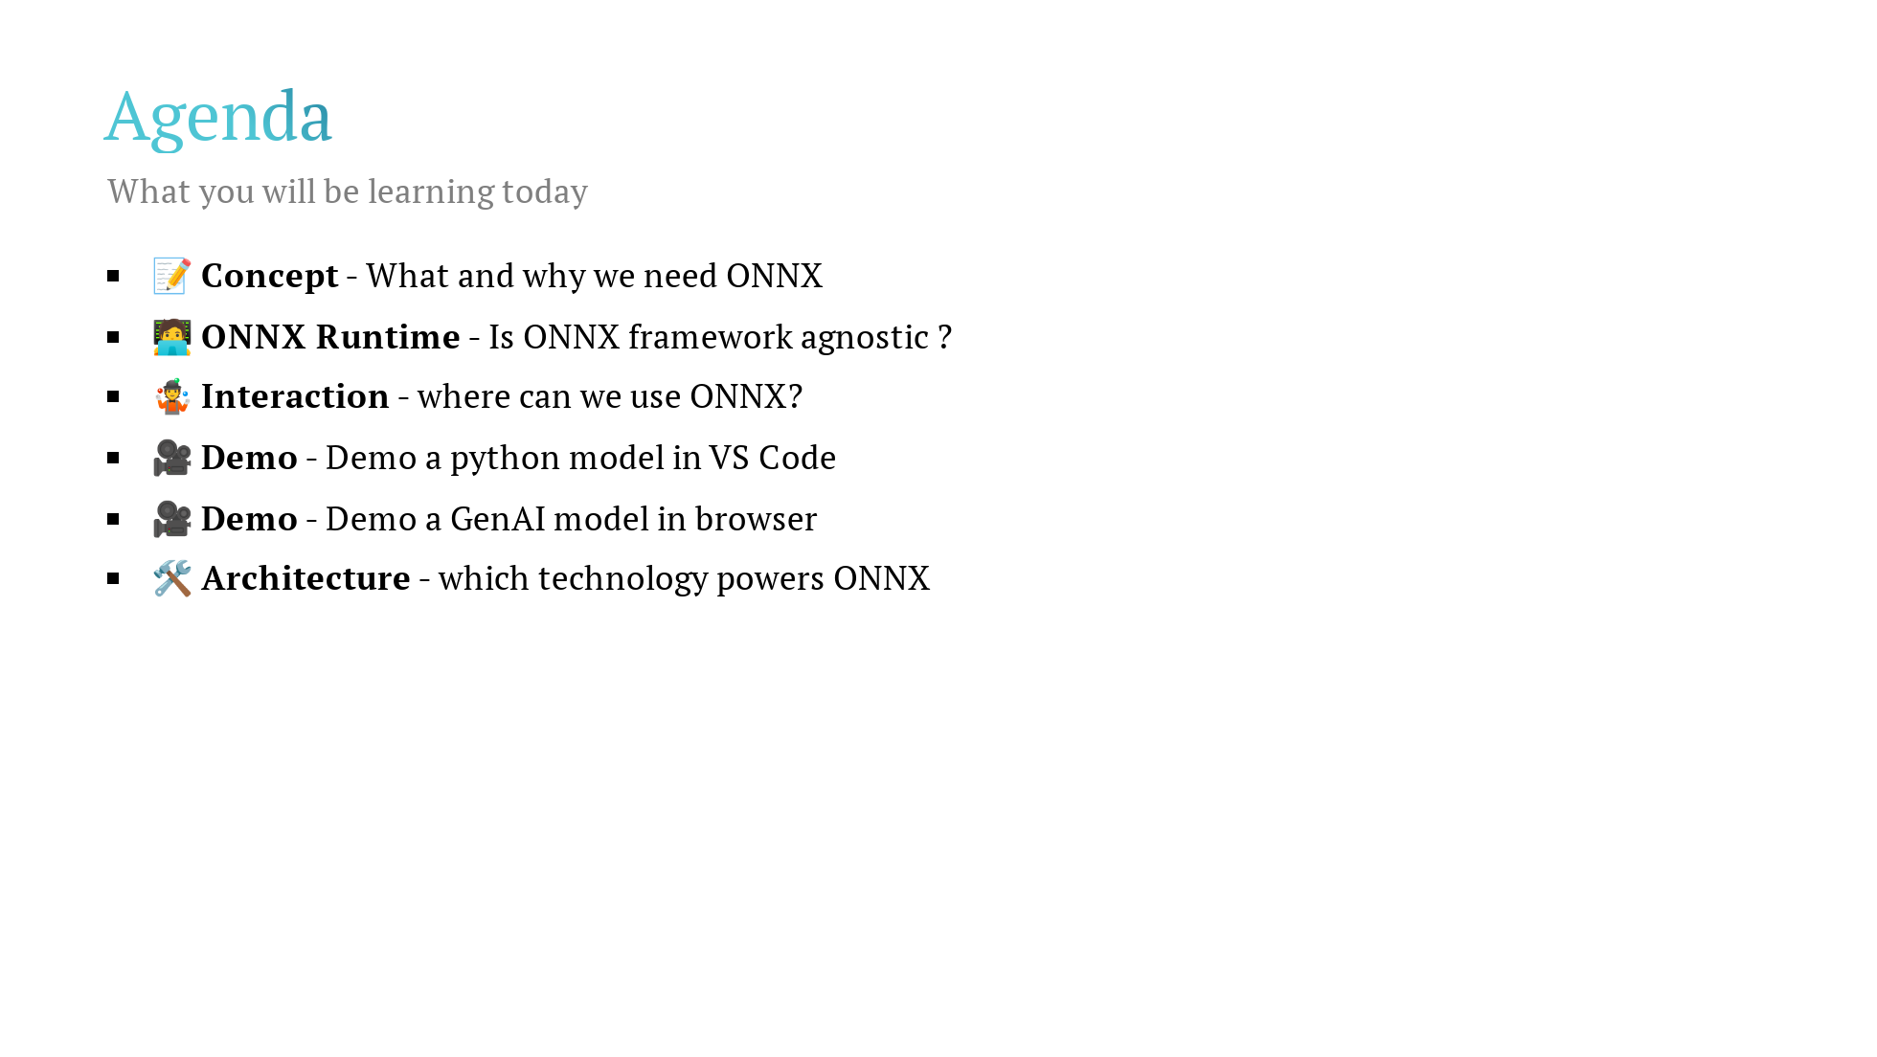
Notes:
By the end of this presentation you will be learning these concepts not necessarily in order but the important fundamental questions will get answered to help you get started with ONNX in your projects.

Slide 3
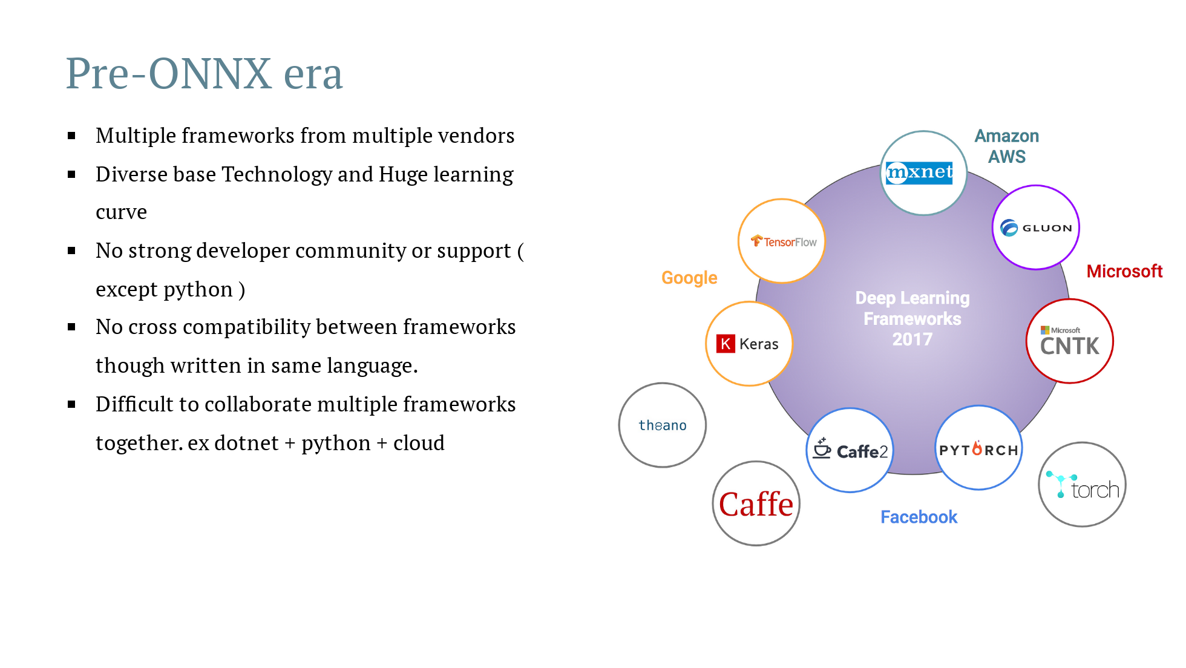
Notes:
Pre-onnx era , we had or we still have many frmaeworks from multiple vendors. Microsoft had ML.NET obviously designed for dotnet developers, Google has tensorflow for python developers and so on. lets focus on dotnet, lets say you want to start a ML project in dotnet, before choosing any framework besides understanding the framework , what do you look for? you look for support packages, developer community , range of projects it is capable to built and most importantly execution speed. second, lets say someone wrote a package or model in pytorch and you are working on tensorflow. now, both are in python but in order to not re-invent the wheel, you wanted to consume the pytorch model in tensorflow but due to framework or syntax restrictions , you couldn't re-use and were forced to re-write. third, a dept like ours, we had to force ourself to learn python and related frameworks to complete the project. This was a pain for a developer switching contexts and mastering various frameworks to get the job done. Lets take a look at what happened after ONNX came into market.

Slide 4
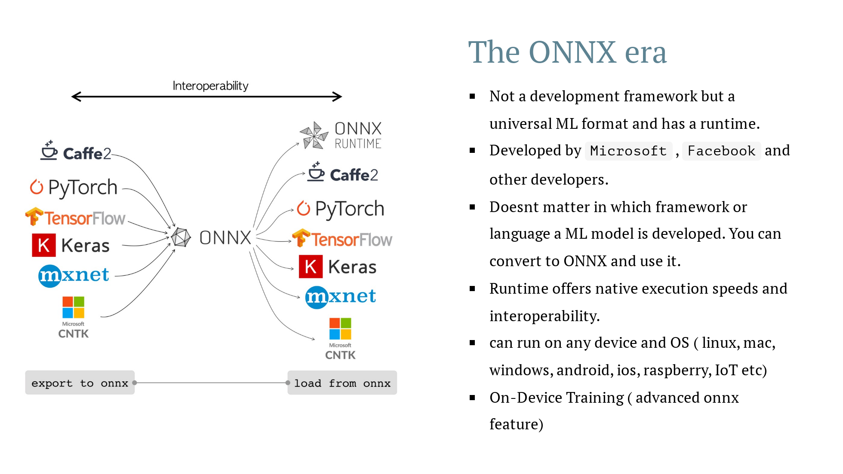
Notes:
Welcome to onnx-era , firstly, ONNX is NOT a ML development framework, its a open format and has a runtime. if you use ONNX runtime, you can use a model that is developed in tensorflow in python and consume it in dotnet at native execution speed. lets take the same example we talked earlier. our dept is developing a ML soluton and we would like to stick to dotnet for designing and development. In order to achieve the final product, you realised that part 1 and part 4 of a 6-part development is already developed in python by industry experts and open-sourced. if not for ONNX, we probably would be switching to python whereever needed and might come up ways to integrate with dotnet and azure. This is a pain during development, deployment and debugging. We faced this in this dept before merger and i was one of the developer. with ONNX runtime, you can convert the industry desinged open-source python model or any language models to ONNX format and consume directly in our dotnet code eliminating the need for other frameworks learning curve, re-using state-of-the-art models and not re-inventing the wheel and focusing on our core development process. we will understand this with a demo soon.

Slide 5
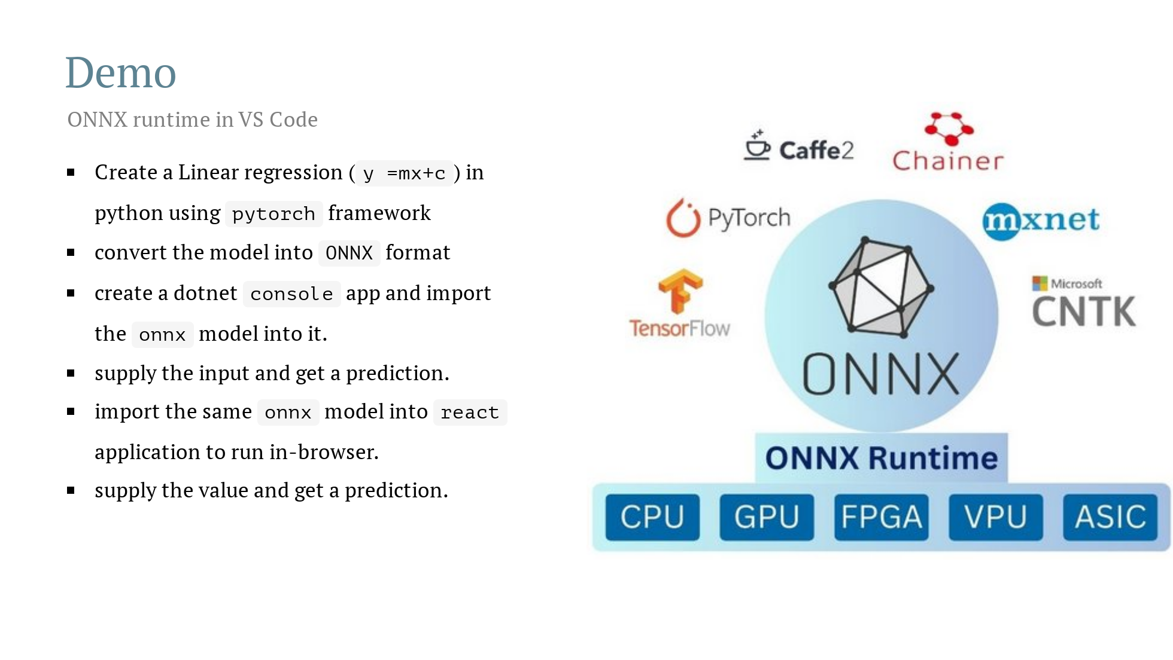
Notes:
https://github.com/onnx/models https://huggingface.co/spaces/MaziyarPanahi/Phi-3.5-Vision https://github.com/microsoft/onnxruntime-inference-examples/tree/main/js/chat

Slide 6
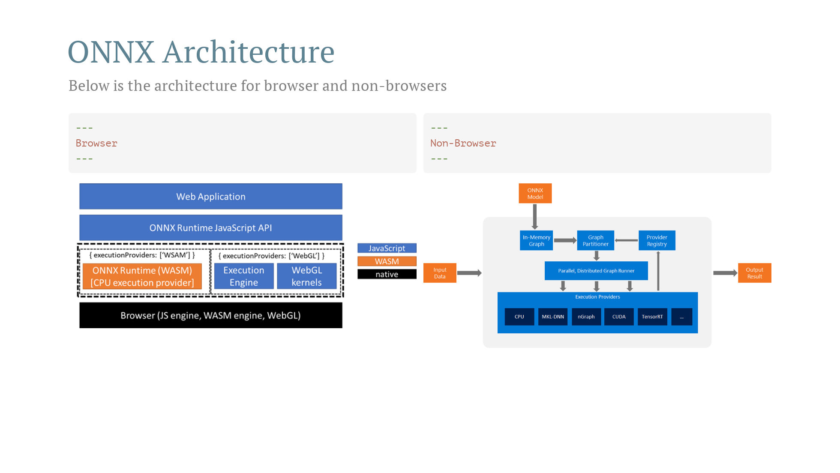
Notes:
Before you think too much , allow me to make you happy by saying you need not know this for development. this is just for the sake of getting a feel of internal working. since browsers understand JS only, onnx models are converted using `wasm`. the webassembly module runs in the browsers JS engine allowing the ML model to be executed in client-side without any support. For non-browser, it uses the providers ( CPU, GPU etc).

Slide 7
