Slide 1
{{project_name}}
PRODUCT POTENTIAL REPORT
Produced by Innovate Design for {{client_name}}, founder

Slide 2
Research team notes:
A summary explaining the basis of the product has been identified.
Product summary based on your idea submission
{{product_summary}}

Slide 3
Product Potential Report
Understand the commercial potential of your idea

Slide 4
PRODUCT POTENTIAL REPORT EXPLAINED
Thank you for choosing Innovate Design to create your Product Potential Report. We have suggested this report because you are developing a product innovation and this report has been created to help you take an early look at its future potential.
The report can give valuable insights to all types of products whether physical, digital, or a new kind of service. When we refer to “product”, we are talking about anything you can develop which creates value for customers that you can sell.
The report focuses on three pillars of Innovation – desirability, viability and feasibility. This “Innovation Trinity” as it is known was developed by product strategist Ideo, and we believe successful innovations need all three. The aim is to help you create –
A desirable product, which could provide a viable business that it is feasible to develop and produce. The Product Potential Report gives you tools to uncover potential challenges in your plan and easily adjust it in response. The report lays the foundations for these factors to be explored and verified in higher resolution during further development.
If you are happy with the results of the report, we hope that this is the first step on a path that allows us to help you to transform your idea into a product and a business.
INTRODUCTION
VIABILITY
INNOVATION
DESIRABILITY
FEASIBILITY

Slide 5
INNOVATION TRINITY STRESS TESTS
Customer Segments
Customers are the heart of any product. So, it’s natural that identifying your potential customers is the starting point for the report.
Early Adopters
If customers are the heart, then early adopters are those first heartbeats that bring a project to life. We take a look at who they might be.
Existing Alternatives
In this analysis, we research at least three competitor products to better understand the existing market.
What is the Problem?
We list the main problems that we feel your potential customers may be unable to address with existing solutions.
Unique Value Proposition (UVP)
A summary of the solutions your product offers which are not currently available.
Minimum Success Criteria
Your Minimum Success Criteria (MSC) is the revenue you hope to achieve in year three of your business.
Market Size
Relevant market information has been researched to learn more about the Total Addressable Market (TAM) and assess the viability of reaching the number of customers needed either locally or globally to achieve your MSC.
Product Cost Structure
In this analysis, we help you review the targets your product might need to hit for cost of goods, customer acquisition and other elements.
The Proposed Solution In 7 Words
We consider whether the proposed solution can be clearly described in 7 words or fewer.
Feasibility Summary
We talk you through how you can assess whether it is feasible to produce your innovation.
Traction Roadmap
Starting from the launch of your product, this allows us to consider how you can gauge whether it has traction in the market.
Development Roadmap
This roadmap is designed to provide you with a feasible development process to prepare your Innovation for launch.
DESIRABLE
VIABLE
FEASIBLE

Slide 6

Desirability
Does the product create a strong enough desire to be bought by a group of customers?

Slide 7



Research team notes:
Add notes
Customer segment
CUSTOMER SEGMENT
{{customer_1}}
{{customer_2}}
{{customer_3}}
CUSTOMERS
EARLY ADOPTERS
Customer segments explained
Here we list the general customer groups who might buy the product. These are usually large groups e.g. coffee drinkers. This is also known as your Total Addressable Market (TAM).

Slide 8
Research team notes:
Add notes
Early adopters
EARLY ADOPTERS
{{early_adopter_1}}
{{early_adopter_2}}
{{early_adopter_3}}
CUSTOMERS
EARLY ADOPTERS
Early adopters explained
Early adopters are the people who might be most likely to buy the product when marketed to. We recommend you orient your product to these people initially.
We try to identify these people by thinking about the so-called “switching triggers” which cause them to look for a better solution.

Slide 9
Research team notes:
Add sidenote.
Existing alternatives
{{
{{alt_product_name_1}}
{{alt_img_1}}
BRAND
{{alt_brand_1}}
PRICE
{{alt_price_1}}
HOW IT DOES THE JOB
{{alt_doesjob1_1}}
{{alt_doesjob1_2}}
{{alt_doesjob1_3}}
PROBLEMS
{{alt_prob1_1}}
{{alt_prob1_2}}
{{alt_prob1_3}}
{{alt_url_1}}

Slide 10
Research team notes:
Add sidenote.
Existing alternatives
{{alt_product_name_2}}
{{alt_img_2}}
BRAND
{{alt_brand_2}}
PRICE
{{alt_price_2}}
HOW IT DOES THE JOB
{{alt_doesjob2_1}}
{{alt_doesjob2_2}}
{{alt_doesjob2_3}}
PROBLEMS
{{alt_prob2_1}}
{{alt_prob2_2}}
{{alt_prob2_3}}
{{alt_url_2}}

Slide 11
Research team notes:
Add sidenote.
Existing alternatives
{{alt_product_name_3}}
{{alt_img_3}}
BRAND
{{alt_brand_3}}
PRICE
{{alt_price_3}}
HOW IT DOES THE JOB
{{alt_doesjob3_1}}
{{alt_doesjob3_2}}
{{alt_doesjob3_3}}
PROBLEMS
{{alt_prob3_1}}
{{alt_prob3_2}}
{{alt_prob3_3}}
{{alt_url_3}}

Slide 12
Research team notes:
Problems have been considered.
Problems
{{prob_summary_1}}
{{prob_summary_2}}
{{prob_summary_3}}
Problems explained
We look at the specific problems that we feel the existing alternatives identified don’t solve.

Slide 13
Research team notes:
A UVP has been considered.
Unique value proposition
{{uvp}}
Unique Value Proposition (UVP)
UVP describes the features your product could include to solve problems better than the existing alternatives. Your UVPs could be used to promote brand awareness, maintain customer relationships, and increase sales.

Slide 14
£
Viability
Can you create a viable business from your innovation?

Slide 15

Research team notes:
Minimum Success Criteria has been reviewed.
This is an opportunity for you to review whether the MSC listed here is a suitable goal for your product business.
Minimum success criteria
Minimum Success Criteria:
£1,000,000 ARR.
This is based on a net profit of £100,000 and profitability of 10%
Minimum Success Criteria (MSC) explained
What is your financial goal? Your MSC is the minimum Annual Recurring Revenue (ARR) you could earn in year 3 of trading which you feel would make the business worthwhile. You can adjust this figure to suit your needs.

Slide 16
Research team notes:
Total Addressable Market has been considered.
Market size
{{mkt_data}}
{{mkt_source_url}}
Market size explained
We identify a potential Total Addressable Market (TAM) for your product to help assess whether there may be enough customers to meet the MSC of your product locally or globally.

Slide 17
Research team notes:
Target revenue per customer has been established.
Examples of add-on value could include:
{{ex_av_item}}
Target revenue per customer
Example recommended retail price (RRP) for your main product
{{ex_rrp}}
Example product sales in year 3
{{ex_yr3_units}}
+
+
Example add on value
{{ex_add_value}}
=
Example Target Revenue per Customer
{{ex_tgt_rev}}
Target Revenue per Customer explained
What will each customer be worth on average? You can increase your revenue per customer by selling add-ons like complimentary products, accessories, and replaceable parts.
These numbers are for example. You can adjust this value in your spreadsheet.

Slide 18
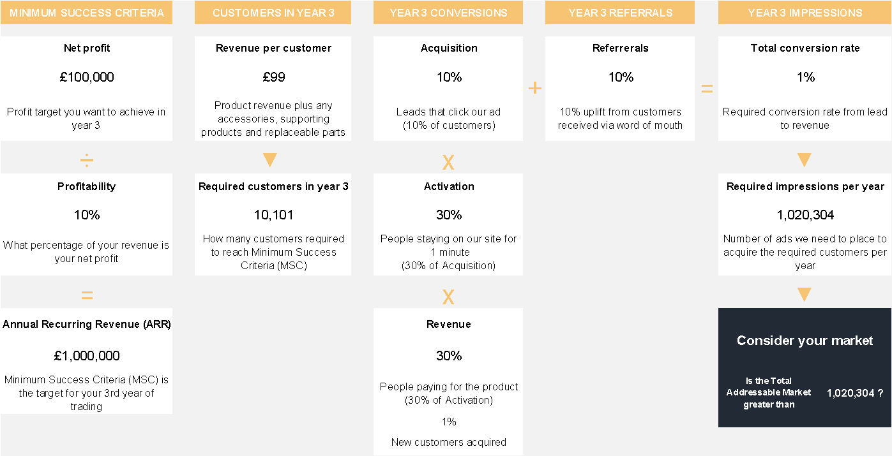
Research team notes:
This viability model provides a simplified view of how your business can reach a sustainable revenue target by Year 3. It assumes a direct-to-consumer sales funnel and uses standard benchmarks for digital acquisition and conversion rates. The key question is whether your Total Addressable Market (TAM) is large enough to support the required volume of impressions and conversions.
Viability estimate
Based on nominal values for a direct-to-consumer sales model. You can adjust these numbers in the provided spreadsheet.

Slide 19

Feasibility
Is it feasible to produce your innovation?

Slide 20
Research team notes:
An example traction roadmap has been considered.
Example traction roadmap
Y
{{cust_yr1}}
Y
{{cust_yr2}}
Y
{{cust_yr3}}
TOTAL OVER 3 YEARS
{{tot_cust}}
YEAR 1 CUSTOMERS
YEAR 2 CUSTOMERS
YEAR 3 CUSTOMERS
Based on nominal values including a 10x growth multiplier suggested in the playbook Running Lean.
You can adjust these numbers in the provided spreadsheet.

Slide 21
Research team notes:
These calculations use highly speculative data and are not financial advice.
Example net profit targets
Y
£1,000
Y
£10,000
Y
£100,000
TOTAL OVER 3 YEARS
£111,000
YEAR 1 TARGET
YEAR 2 TARGET
YEAR 3 TARGET
Based on nominal values. You can adjust these numbers in the provided spreadsheet.

Slide 22
Your one page Innovate Business Plan
An Innovation Business Plan is a one-page business plan which succinctly helps you describe every aspect of the plan to commercialise the product.

Slide 23
This Lean Business Plan is adapted by Innovate Product Design Ltd from the Lean Canvas. Lean Canvas was created by Ash Maurya and is adapted from the Business Model Canvas. It is licensed under the Creative Commons Attribution Share Alike 3.0 Un-ported License.
Lean business plan
PROBLEM {{lbp_problems}} Existing solutions {{lbp_exst_sol}} | SOLUTION {{lbp_sol}} | UNIQUE VALUE PROPOSITION {{lbp_uvp}} HIGH-LEVEL CONCEPT {{lbp_hlc}} |  | UNFAIR ADVANTAGE Intellectual Property – Seeking legal protection. Customer Connection – Fostering personal engagement with customers. First-mover advantage - Being the first to offer a dedicated solution. | CUSTOMER SEGMENTS Target Customers {{lbp_cust}} Early adopters {{lbp_ea}}
 | KEY METRICS {{lbp_keymet}} |  |  | CHANNELS {{lbp_chan}}
COST STRUCTURE {{lbp_cost_struc}} Target retail price: {{lbp_rrp}} |  |  | REVENUE STREAMS {{lbp_rev_stream}} Preferred route: {{lbp_pref_route}}

Slide 24
Appendix

Slide 25
Product potential report context
This report is speculative and provides a very general overview of the potential of your product. For a product such as this, how the product is developed and marketed will hugely affect the outcome. Therefore, these numbers should not be relied on for any financial or other decisions.
This document is representative of the research team's considered opinion but is not the final or definitive answers to these questions or issues, which can be yours alone as 'expert in the field’. Therefore, you must consider all content as a launchpad but not tactical, legal or commercial advice.
Should a business based around this product be of interest to you, further development will be required to prepare the product for sale. This may incur significant additional costs which have not been estimated in this report.

Slide 26
References and further reading
The Product Potential Report format has been developed by the team at Innovate Design. It includes methodologies and playbooks which have been developed by cutting-edge innovators in the industry. You can learn more about the concepts we have been inspired by in the books below.
Running Lean (3rd Edition) by Ash Maurya
Lean Startup by Eric Ries
The Art of Innovation by Tom Kelley (Ideo)
Business Model Generation by Alexander Osterwalder and Yves Pigneur (Strategyzer)
Value Proposition Design by Alexander Osterwalder and the team at Strategyzer

