Slide 1
AI-Powered Insurance Claims Assistant
Evidence-led investigation over 100 million claims, with Synapt knowledge and a human review gate
100 million
2,000
8 stages
claims queried in place
tickets in Synapt
and one human gate
Capstone panel | 10 minutes
Notes:
(0:30) Claims teams review historical claims by hand. This assistant finds comparable claims among 100 million, brings in Synapt's procedures, estimates three things, and writes a cited brief that a person reviews. It never approves, denies or pays a claim. Everything I show today ran live on the real dataset and the real Synapt provider.

Slide 2
Three questions every handler asks
1
2
3
Has a similar claim been processed, and how did it end?
What makes claims larger, or slower to resolve?
Does it resemble claims flagged as fraud?
Filters, keyword, numeric and Synapt semantic ranks are fused over 100 million claims. Outcomes shown, with the rule that only already-settled claims count.
Amount and resolution models explain themselves: the direction of each effect, and what moved this claim from a typical one.
A fraud-flag model, the flag rate among the closest historical claims, and an audited priority score. A signal to investigate, never a verdict.
Hybrid retrieval
Explainable models
Risk and priority
Nothing here approves, denies or pays a claim. The handler decides.
Notes:
(1:00) These are the three questions in the brief. Each maps to a capability, and I will show all three working. The sentence at the bottom is a design rule enforced in code: a validator blocks any recommendation that approves, denies, pays, or calls something proven fraud.

Slide 3
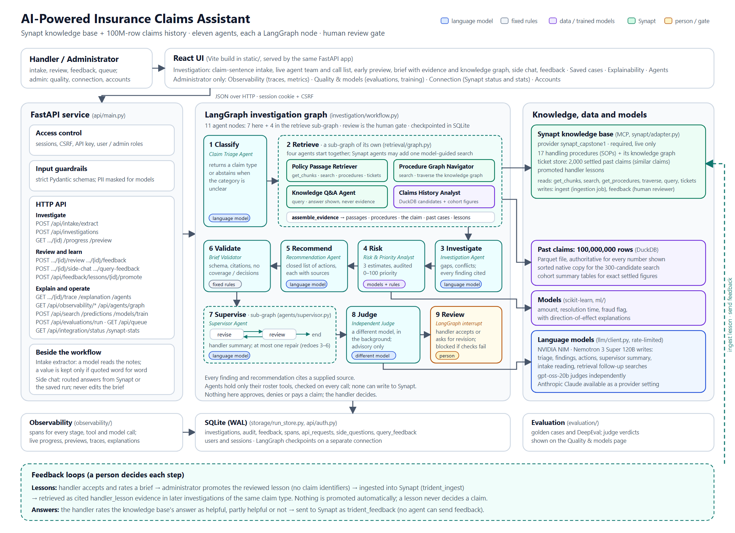
One service, three stores, one human gate
1
Parquet, 100M rows
Authoritative for filters, similar claims, every number shown, and model training.
2
Synapt, over MCP
Procedures as documents (the knowledge graph), past claims in its ticket store, reviewed lessons.
3
Human gate
LangGraph pauses; the handler accepts or revises. Acceptance is blocked on failed validation.
Notes:
(1:15) A handler uses the React UI served by one FastAPI service. A LangGraph workflow runs eight stages and pauses for a person. Three stores each do what they can: the Parquet file is the authority for the 100 million claims, Synapt holds knowledge, SQLite holds runs and audit. Synapt holds procedures as documents, from which it builds the knowledge graph, and a sample of settled claims in its ticket store; the 100 million claims stay in Parquet. Models write the brief; a second, different model judges it.

Slide 4
Hybrid search over 100 million claims in 3 to 5 seconds
1
SQL filters and candidates
100,000,000
Type, state, status, amount, history. Only claims settled before this one was filed qualify.
claims, queried in place by DuckDB
2
Synapt semantic ranking
Past claims in Synapt's ticket store closest to this one; looked up under the same filters, so nothing bypasses them.
3 to 5 s
3
Reciprocal-rank fusion
per filtered, fused search
Keyword 1, numeric similarity 1, Synapt 0.5. The five closest come first.
2.52 GB
4
Related by meaning
Up to three more that Synapt ranks similar, labelled with their Synapt rank.
one Parquet file, SHA256-verified
Measured, not assumed. Keyword IDF ranked a $3,393 New Jersey claim above exact $8,500 Texas matches. Removed, with a regression test.
Notes:
(1:30) Search never loads the file into memory. DuckDB scans it and only a few hundred candidates reach Python. Two rules matter: a comparable claim must have been settled before the new claim was filed, and the pending rows store their duration as NaN, not null, which the SQL handles. During live testing I found the keyword leg ranked Synapt's odd outliers above exact matches, because IDF rewards rare terms. I removed IDF and added a regression test that fails on the old behaviour.

Slide 5
Synapt: the right data in the right store
Documents
99.6%
17 handling procedures. Synapt builds the knowledge graph from them: 21 procedures, 93 ordered steps. Cited as evidence.
of the provider's chunks were claim cards
55 vs 135
Was wrong
Claim rows were stored as text cards beside the procedures. Review feedback said the split was wrong, and the graph agreed.
graph links: 10,020 card chunks vs 17 procedures
13 Oct
Tickets
2,000 settled past claims in the ticket store. The claim is sent as one ticket; the closest past claims come back.
cards deleted; claims moved to the ticket store
Ticket labels never beat the majority class on this data, so they are not shown; the past claims are used only to rank.
Notes:
(1:15) Synapt has two stores for two kinds of content. Documents are for knowledge: the seventeen procedures, from which Synapt builds the graph of procedures and ordered steps that every brief cites. Settled claims are cases with outcomes, which is what the ticket store is for. I first put ten thousand claim rows into the documents as text cards. The review said that split was wrong, and the graph shows why: the cards were 99.6 percent of the chunks but gave 55 graph links, against 135 from seventeen procedures. So I uploaded two thousand settled claims through the Ticketing source, checked that the procedures and graph were untouched, and deleted the cards. Now the passage retriever sends the claim as one ticket, ticket-only mode, no model call, and the closest past claims are looked up in Parquet under the handler's filters. I measured the ticket labels against the majority class and they add nothing, so the app does not show them.

Slide 6
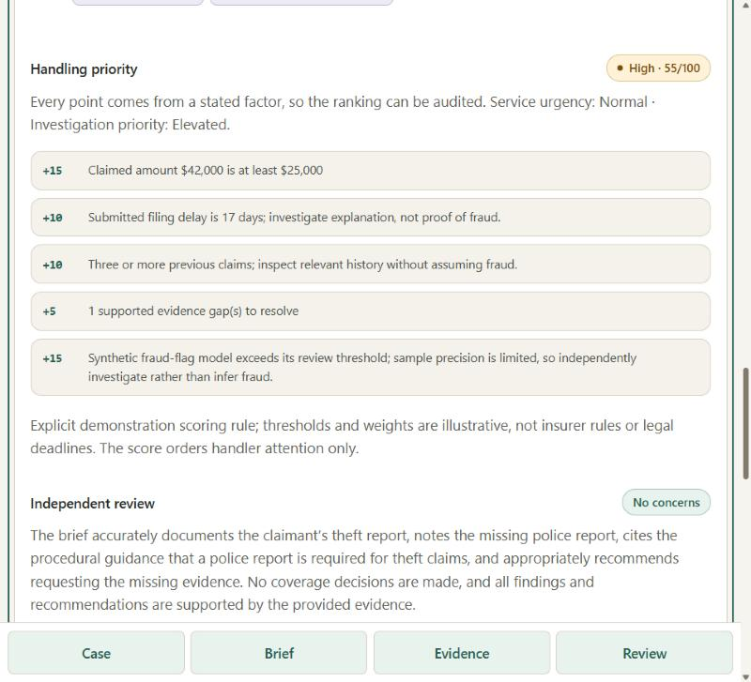
Live: an auto-theft claim, from intake to a reviewed lesson
1
Intake
Pick the example, or type a claim. Invalid input is refused with a clear reason.
2
Brief in about 15 s
Cited gap: a police report, from a Synapt procedure. Documents are only ever 'reported available'.
3
Priority 55 of 100, High
Each point attributed: amount, 17-day delay, 3 prior claims, a gap, the fraud signal.
4
Independent review
A second model judges the brief in the background and appears when ready.
5
Review, feedback, promote
Accepted lessons become cited evidence next time, and are ingested into Synapt.
Notes:
(1:45) Switch to the running app. Submit the Auto theft example. It returns in about fifteen seconds. Point at: the police-report gap cited to a Synapt procedure; the priority score where every point is attributed; and the independent review, which arrives afterwards because it runs in the background. Then accept the brief, rate it, promote the lesson as the administrator, and run the claim again to show the lesson cited as evidence.

Slide 7
Predictions a handler can interrogate
Amount
Resolution time
Fraud flag
28% lower error
9% lower error
4x the baseline
MAE $16,072 vs $22,364 baseline. The 90% interval covers 90.1%.
MAE 6.58 vs 7.22 days. Interval covers 89.8%.
PR-AUC 0.32 vs 0.08; precision 56%, recall 31%.
Why this estimate: what the models learned, and what moved this claim
Fraud score falls with tenure (0.23 at six months to 0.05 at eleven years) and rises with claim size, the pattern the dataset describes.
Resolution time tracks filing delay: about 13 days after a one-day delay, about 25 after thirteen.
Amount: business claims average about $107,000 against $17,000 for renters.
Per claim: each feature is swapped for a typical value to show how far it moved this estimate. Associations, not causes.
Notes:
(1:00) Models are trained on a repeatable 200,000-row sample of the 100 million, split by filing date so the test period is strictly later. The 3,000-row slice I started with made the fraud model weak; the larger sample made it useful. The explanations are the part to emphasise: global direction of effect, in plain language, and for each claim what moved its estimate. All associations, none causal.

Slide 8
Evaluated, guarded and learning
1
Evaluated
2
Guarded
3
Learning
Golden cases: 4 of 4 on the live system
DeepEval: 12 of 12 metrics ran, 8 pass
Independent LLM judge on every live brief
905 backend and 171 UI tests
7 of 7 invalid inputs refused
Every finding must cite a supplied source
A brief claiming a document was 'provided' is held for review
Decision language is blocked
Rate an accepted brief
Administrator promotes the lesson
Cited as evidence next time, and ingested into Synapt
Answer ratings sent to Synapt as feedback
Evaluation, the guardrail catch and the feedback loop were exercised on the live system, not only in unit tests.
Notes:
(1:15) Three kinds of assurance. Evaluated: golden cases and DeepEval, plus a second model judging every live brief. Guarded: strict input checks, mandatory citations, and a validator that caught the model writing that a document had been provided when only its name was received; the brief was held for manual review, and a prompt fix cut that from one in four to none in four. Learning: handler feedback becomes cited evidence, and a handler's rating of Synapt's answer goes back to Synapt as feedback.

Slide 9
Honest limits, and what comes next
Limits
Next
Synthetic data: no claim of real-world accuracy
Synapt's ticket store holds 2,000 of 100 million claims: a mild ranking signal
Fraud recall is 31%: a screening aid, not a detector
The judge is advisory and probabilistic
Episode mining over the ticket store (not yet run)
A larger ticket store, with its ranking re-measured
DeepEval over real handler runs, not only golden cases
Single sign-on, MFA and multi-tenant isolation
Evidence informs. A person decides.
Notes:
(0:30) The limits are real and documented. The data is synthetic. Synapt's ticket store holds two thousand claims, not a hundred million, so its ranking leg is a mild signal, and episode mining over those tickets has not run yet. The fraud model is a screening aid. Next steps are about scale and about evaluating on real handler runs. Close on the design principle: evidence informs, a person decides. Questions.

